Slide 1

Building a National Open Access Repository
The MAREN Experience
Jones Kumwenda | Systems Engineer, MAREN | April 2, 2026 | AfricaArXiv Open Science Webinar Series

Slide 2
Session
Overview
Context & Motivation
Stakeholders Landscape
Technical Architecture and Stack
Governance & Policy
Implementation Journey
Challenges & Lessons
Scaling and Onboarding
Future Roadmap
Advice for others

Slide 3


The Problem
Limited Infrastructure hinders research dissemination in Malawi
Valuable academic outputs remain trapped in isolated institution silos
Lack of integration with global persistent identifiers (DOIs).

Slide 4
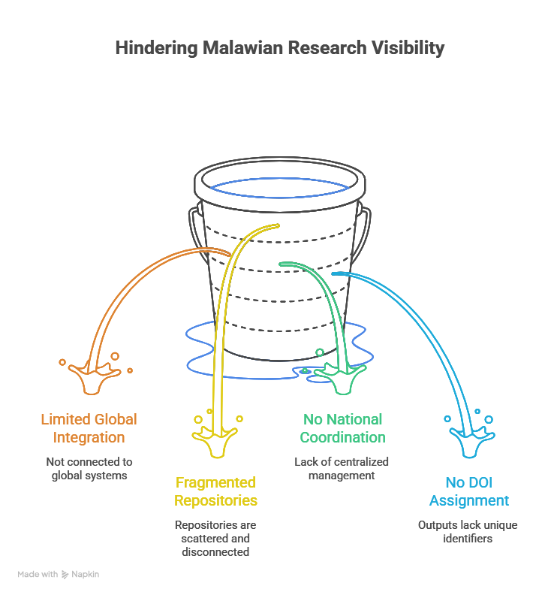
The Problem

Slide 5

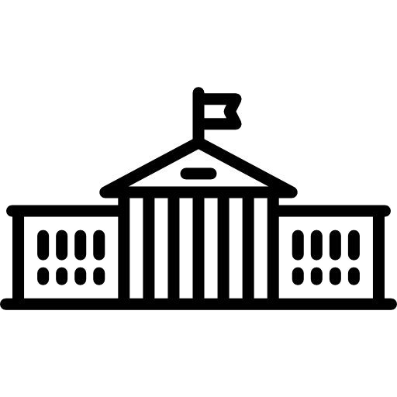
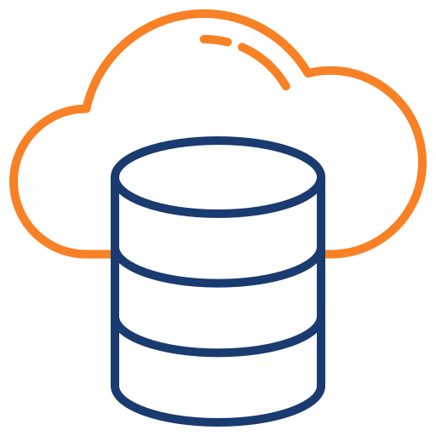
Vision
DataCite
National Repository

Slide 6
Motivation
Increase global visibility: Expose research to global indexing platforms. Work appears in search engines and academic databases. Which leads to more reads and citations.
DOI-based citation: Assign persistent identifiers to research outputs. Researchers cite work accurately and track impact.
Support Open Science: Make research openly accessible. Anyone reads and reuses outputs without barriers. Improves transparency and accelerates knowledge sharing
Build shared infrastructure: One national platform used by many institutions. Reduce duplication of systems and cost. It also standardizes how research is managed.
Strengthen collaboration : Connect universities, researchers, and policymakers on one platform. Having a shared access to data and outputs improves joint research and partnerships.

Slide 7
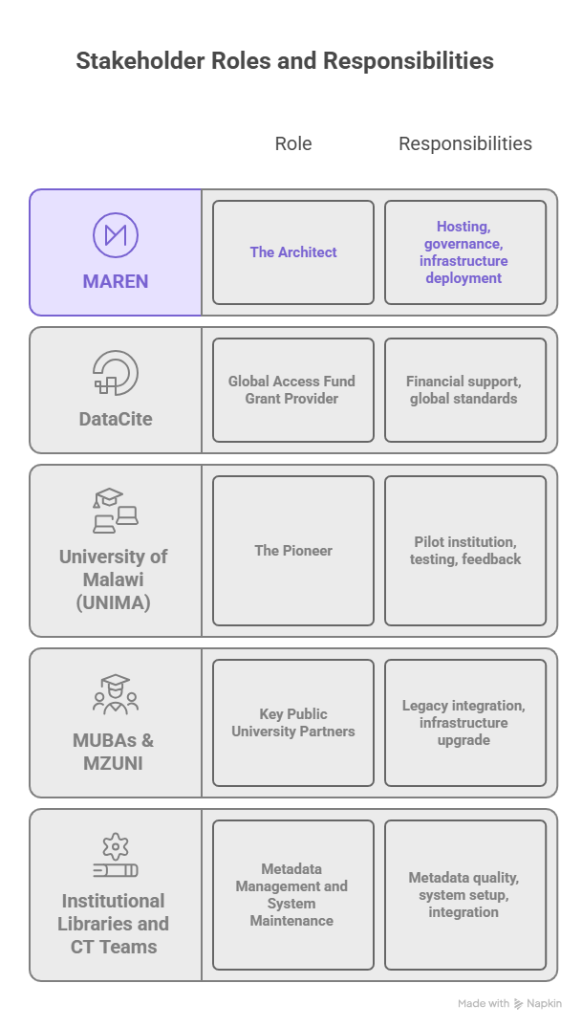

Slide 8
Technical Architecture - Approach
Use existing institutional repositories
  Build on systems already in place. This reduced cost and avoided disruption at institutions.
Institutions define harvest collections and DOI-eligible outputs
  Institutions control what enters the national repository system.
Aggregate metadata centrally
  Collect metadata into one national platform. Users search once and find research from all institutions.
Avoid duplicating content
  Keep full content at the source institution. The national system links back, which reduces storage and sync issues.
Align with global standards
  We Followed standards like OAI-PMH, Dublin Core, and DataCite. This ensures interoperability and global discoverability.
Notes:
Key decision. Do not replace institutional systems.
Build a federation model.

Slide 9
Technical Stack and Design Decisions
Infrastructure: Hybrid cloud-on-premise model hosted on MAREN’s OpenStack.
Core Software: DSpace version 8.2 (Angular frontend, PostgreSQL database, Apache Solr indexing).
Integration: OAI-PMH for metadata harvesting, DataCite API for DOI minting.
Design Decision: Metadata-only harvesting to preserve institutional ownership.

Slide 10
Hybrid Cloud-On-Premise Architecture
Institutional
Repositories
OAI-PMH
Harvesting
National
Repository
DataCite
API
UNIMA, MUBAS, MZUNI
DSpace 7/8 OAI-PMH
Metadata harvesting
Dublin Core & DataCite
MAREN DSpace 8.2
Angular Frontend
DOI Minting
Metadata Sync
TECH STACK
DSpace 8.2
PostgreSQL
Apache Solr
OpenStack
TLS/HTTPS
Repository Platform
Primary Database
Search & Index
Private Cloud (MAREN)
Security Layer

Slide 11
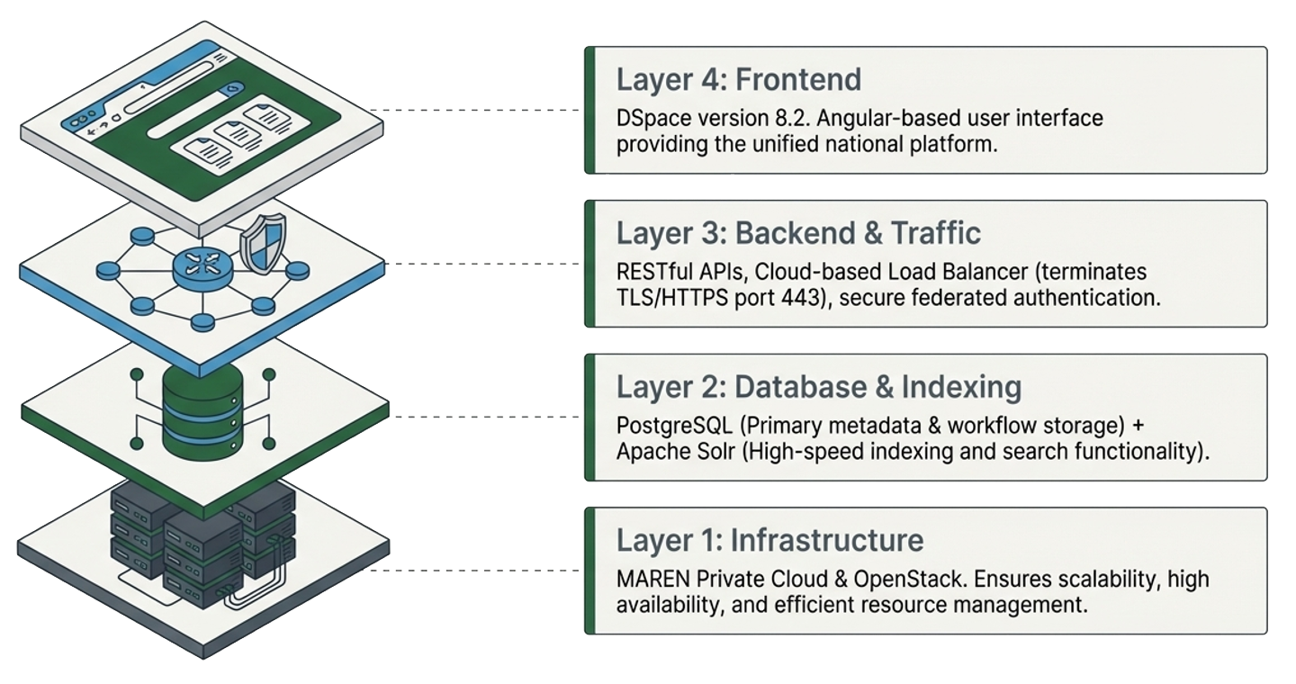
The Technical Stack – MAREN Cloud Architecture
TECH STACK
DSpace 8.2
PostgreSQL
Apache Solr
OpenStack
TLS/HTTPS
Repository Platform
Primary Database
Search & Index
Private Cloud (MAREN)
Security Layer

Slide 12
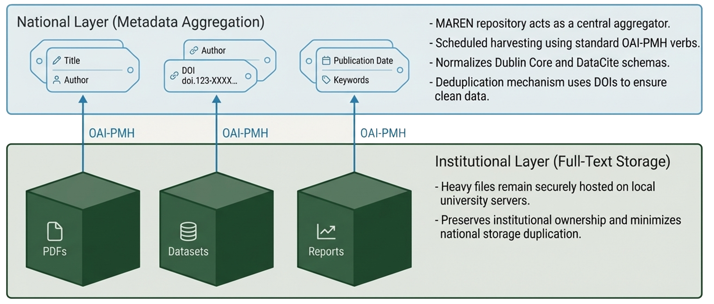
Visibility and Access Model - Metadata Only Harvesting

Slide 13
Metadata & DOI Integration – How a research item gets a global DOI
1
Research Deposited
Author deposits output to institutional DSpace repository (UNIMA, MUBAS, MZUNI)
2
OAI-PMH Harvest
MAREN National Repo harvests metadata via OAI-PMH protocol on scheduled intervals from the institution eligible collections
3
Validate & Normalize
From the DOI-eligible outputs, Metadata is validated against FAIR & DataCite schema; deduplication using Handles & DOIs
4
DOI Reservation
National repo reserves a DOI during curation process before final approval
5
DataCite Registration
DOI registered with DataCite upon curator approval; resolves to persistent landing page

Slide 14
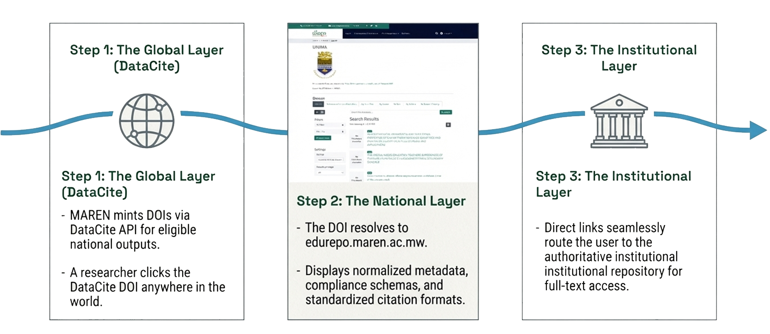
DOI Resolution and Persistence Governance

Slide 15
Key Design Decisions
Metadata only Harvesting
    Minimizes storage, institutions retain content ownership
Hybrid Cloud Model
    MAREN OpenStack private cloud + institutional servers
DSpace 8.2 + Angular
    Modern, actively maintained, API-first platform
Fair Compliance first
    Every record validated before DOI registration
MAREN Federation auth
    Federated identity via MAREN’s existing AAI framework
Service Level Agreements
    Formal SLAs with each institution defines obligation

Slide 16
GOVERNANCE & POLICY FRAMEWORK
DOI Governance
Data Protection & Access
▸ MAREN manages DOI reservation & minting
▸ Role-based access control (RBAC)
▸ Existing institutional DOIs remain unaffected
▸ TLS/SSL encryption across all services
▸ Landing pages hosted nationally for persistence
▸ Regular vulnerability assessments
▸ DataCite metadata schema enforced
▸ MAREN AAI federation for secure authentication
Open Access Policy
▸ 75% target: research outputs openly accessible
▸ Aligns with national development priorities
▸ Institutional buy-in through leadership engagement
▸ Open science culture building

Slide 17
Results & Achievements
Operational National Repository Platform hosted by MAREN on OpenStack private cloud
  Live at edurepo.maren.ac.mw
UNIMA institutional repository fully integrated with DataCite API — DOI minting active
  MZUNI repository successfully update and integrated with National Repository – Pending DOI minting
Metadata validation system ensuring FAIR principles & DataCite schema compliance
OAI-PMH harvesting pipeline with scheduled sync and deduplication
Impact metrics & monitoring system tracking repository usage and DOI assignments
MAREN Federation AAI authentication integrated for secure federated access
Training manual & documentation on repository management published

Slide 18
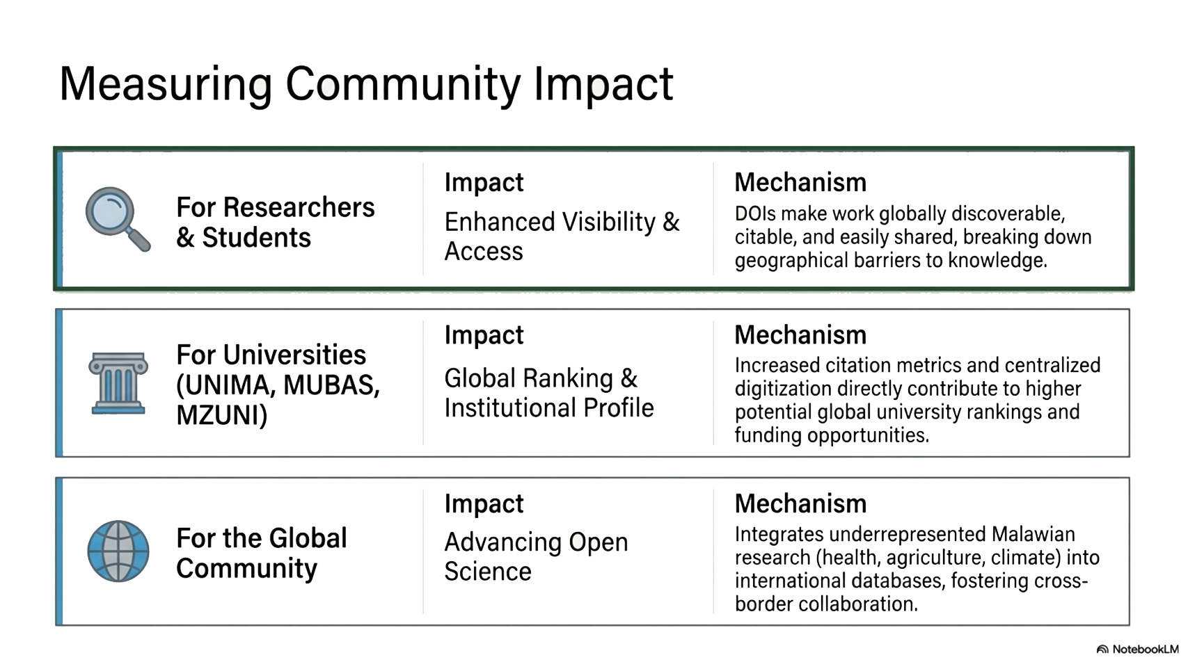

Slide 19
Challenges
Outdated DSpace versions
Administrative buy-in delays
MUBAS & MZUNI running old versions lacking APIs needed for DOI integration & metadata harvesting
Institutional management approval processes for upgrades and policies caused timeline slippage
Limited local technical capacity
Data quality & metadata gaps
Not enough repository & open science knowledge at some institutions; FAIR principles unfamiliar
Inconsistent metadata structures required significant cleanup before FAIR compliance
Infrastructure constraints
Policy & data protection
Some institutions lacked servers and dedicated infrastructure for running repositories
No institutional open access or data governance policies in place at project start

Slide 20
Reasons Learned
Early technical assessment is critical
Hands-on support accelerates adoption
Assess DSpace version compatibility before project start to prevent delays
Direct MAREN-institution collaboration beats documentation-only approach
Pilot one institution first
Build flexibility into planning
Administrative & technical delays are inevitable — plan for them from day 1
UNIMA pilot created a tested blueprint for scaling — a proven template for others
Continuous leadership engagement
Open science culture must be built
Regular updates to institutional leadership ensured administrative ownership
Training on FAIR & benefits of open access is as important as the technology

Slide 21
What Worked vs. What Didn’t
What Worked:
Starting with a single-institution pilot (UNIMA).
OpenStack cloud deployment — scalability, resilience & control
Joint technical sessions to resolve granular issues (e.g., metadata gaps, thumbnail errors).
Direct technical interventions from MAREN.
OAI-PMH metadata-only harvesting — institutions retained content ownership
MAREN AAI federation for secure institutional authentication
What Didn’t Work:
Assuming uniform technical readiness across all institutions.
Assuming all institutions had compatible DSpace versions
Reliance on local IT teams for complex upgrades without prior hands-on support
Expecting institutional upgrades to be administratively straightforward
Underestimating metadata quality issues — significant cleanup needed
Expecting open science awareness without targeted training
Full content harvesting considered initially — switched to metadata-only

Slide 22
Future Roadmap –
Where MAREN is heading next
🐳
Dockerize the Solution: Dontainerize the entire MAREN repository stack using Docker & Kubernetes. Goal: any NREN can deploy a national repository in hours, not months.
DSpace as a Service: Managed DSpace hosting for institutions that lack server infrastructure. Institutions subscribe to MAREN-hosted repositories — no hardware needed
Open APIs on the National Repository: Build a REST API layer on top of the national repository to power Data Commons — enabling third-party apps, analytics dashboards, and federated queries.
Plagiarism Detection System: Leverage the national research corpus to build a Malawian plagiarism checker for higher education institutions — reducing reliance on expensive external tools.
DOI Minting Consortium: Establish a national DataCite consortium under MAREN for shared DOI minting, reducing per-institution costs and simplifying governance across Malawi.
NREN Replication Across Africa: Package the MAREN model (Docker + docs + governance templates) for other African NRENs — Zambia, Zimbabwe, Mozambique and beyond.
☁
🔌
🔍
🤝
🌍

Slide 23
Onboarding Institutions and Researchers
1
2
3
4
5
Technical Assessment
Upgrade & Migration
Integration & Testing
Training & Capacity
Go-Live & Support
› Audit existing DSpace version & configuration
› Guided DSpace upgrade (if required)
› Configure harvesting into national repo
› IT staff: DSpace & DOI management
› Sign SLA with MAREN
› Identify metadata quality gaps
› Metadata cleanup & schema alignment
› Test DataCite API DOI minting workflow
› Librarians: metadata standards & FAIR
› Deploy to production & monitor
› Map collections to be harvested
› FAIR compliance validation
› Deduplication & metadata normalization
› Repository managers: governance & SLAs
› Ongoing technical support via helpdesk

Slide 24
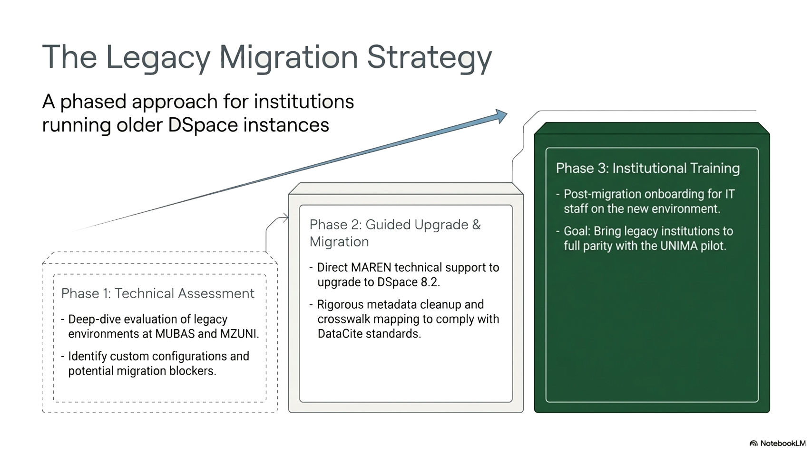

Slide 25
ADVICE FOR OTHER NRENs & COUNTRIES
01
Start with a technical audit of all institutional repositories before writing a single line of code or signing agreements
05
Design for metadata sovereignty: institutions own their content, the national repo is a discovery layer
02
Pick one institution as your pilot — choose the most technically ready. Don't try to integrate all institutions simultaneously
06
Build in training from the start — open science culture change is harder than the technology
03
Secure institutional leadership commitment upfront. Without management buy-in, technical progress stalls
07
Plan for the upgrade problem: many institutions run outdated repository versions incompatible with modern integrations
04
Use open-source where possible: DSpace + PostgreSQL + Solr = a proven, maintainable, cost-effective stack
08
Join DataCite as a consortium — shared membership reduces costs and simplifies DOI governance nationally

Slide 26
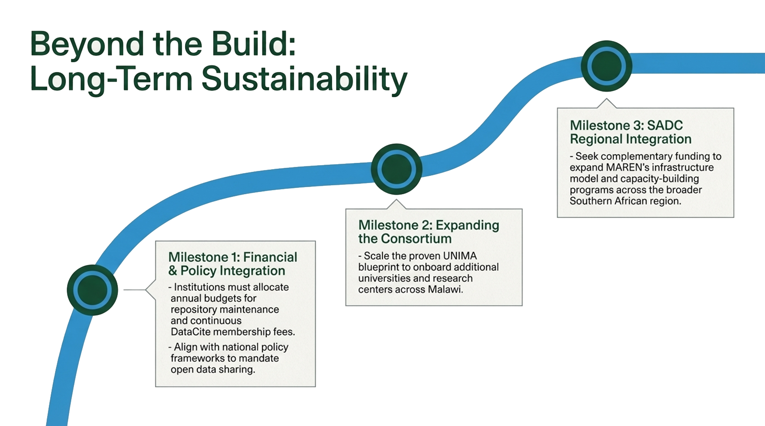

Slide 27
Q&A Session
"Malawi's research has always mattered —
now the world can find it."
— MAREN National Repository Project, 2025

Slide 28
Thank you
Jones Kumwenda
Systems Engineer, MAREN
+265 999 952 315
j.kumwenda@maren.ac.mw
www.maren.ac.mw
RESOURCES & LINKS
AfricArXiv Webinar Series:
info-africarxiv.ubuntunet.net/open-science-webinar-series
DataCite Global Access Fund:
datacite.org/blog
National Repository:
edurepo.maren.ac.mw
MAREN Website:
maren.ac.mw

