Slide 1
The Future of eduroam with a Cross-Border eSIM Solution for Seamless Scholarly Connectivity
By
Micheal Nasasira
mnasasira@renu.ac.ug
1st November, 2024

Slide 2
Overview
Outline
What is eduroam?
eduroam Flavors
Challenges
Proposed Solution
Deployment Framework
Possible Benefits

Slide 3
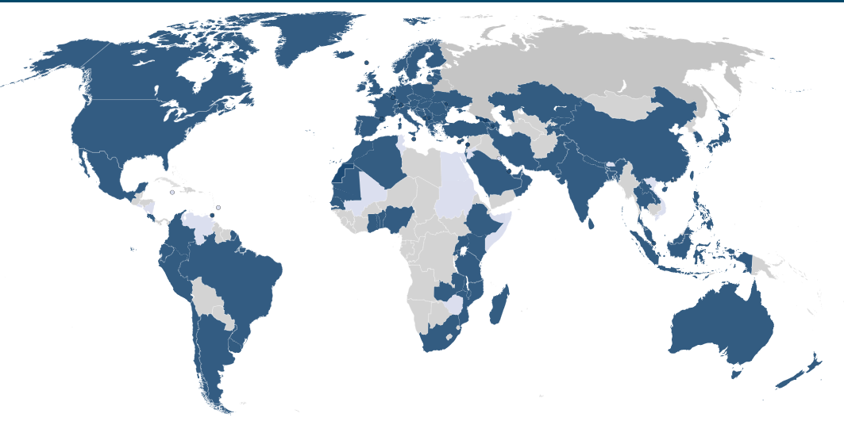
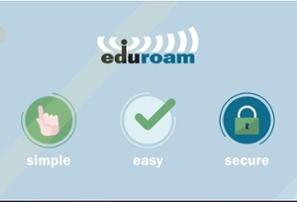
What is eduroam?
eduroam (education roaming) is a secure global Wi-Fi service for the research and education community
Over 100 member NRENS
7.5 billion successful logins recorded in 2023 across the world

Slide 4

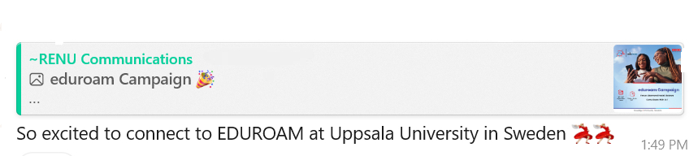
eduroam Flavors
Fixed
On Campus
Homelinks
Metro eduroam

Slide 5


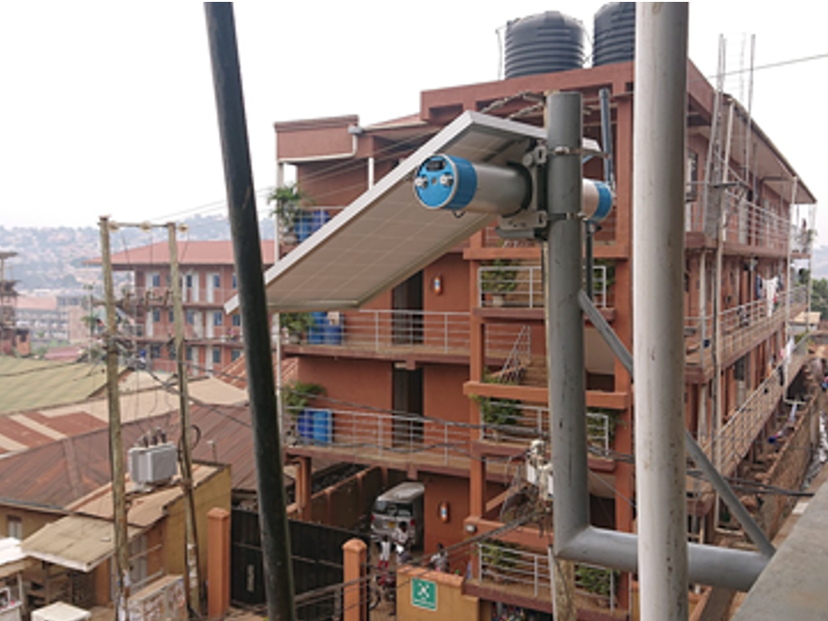
eduroam Flavors

Slide 6
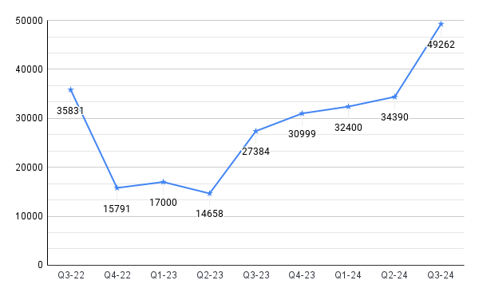
Metro-eduroam
Unique Users – From Q3 2022 to Q3 2024
Notes:
MNO – Mobile Network Operator

Slide 7

eduroam Flavors
On the move
  RENU – eduroam on the Go device
  Jisc - edubox

Slide 8
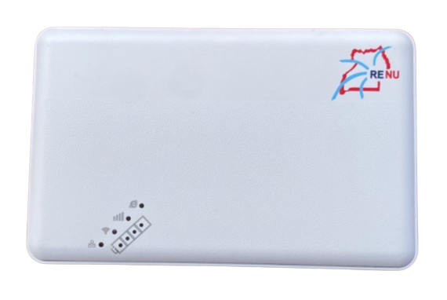
eduroam on the Go
Pocket-sized routing device
Implemented over MNO infrastructure
Rechargeable battery
Access to the Internet anytime, anywhere –Uganda boundaries
Capable of WPA2 enterprise authentication
Broadcasts eduroam
Notes:
MNO – Mobile Network Operator

Slide 9
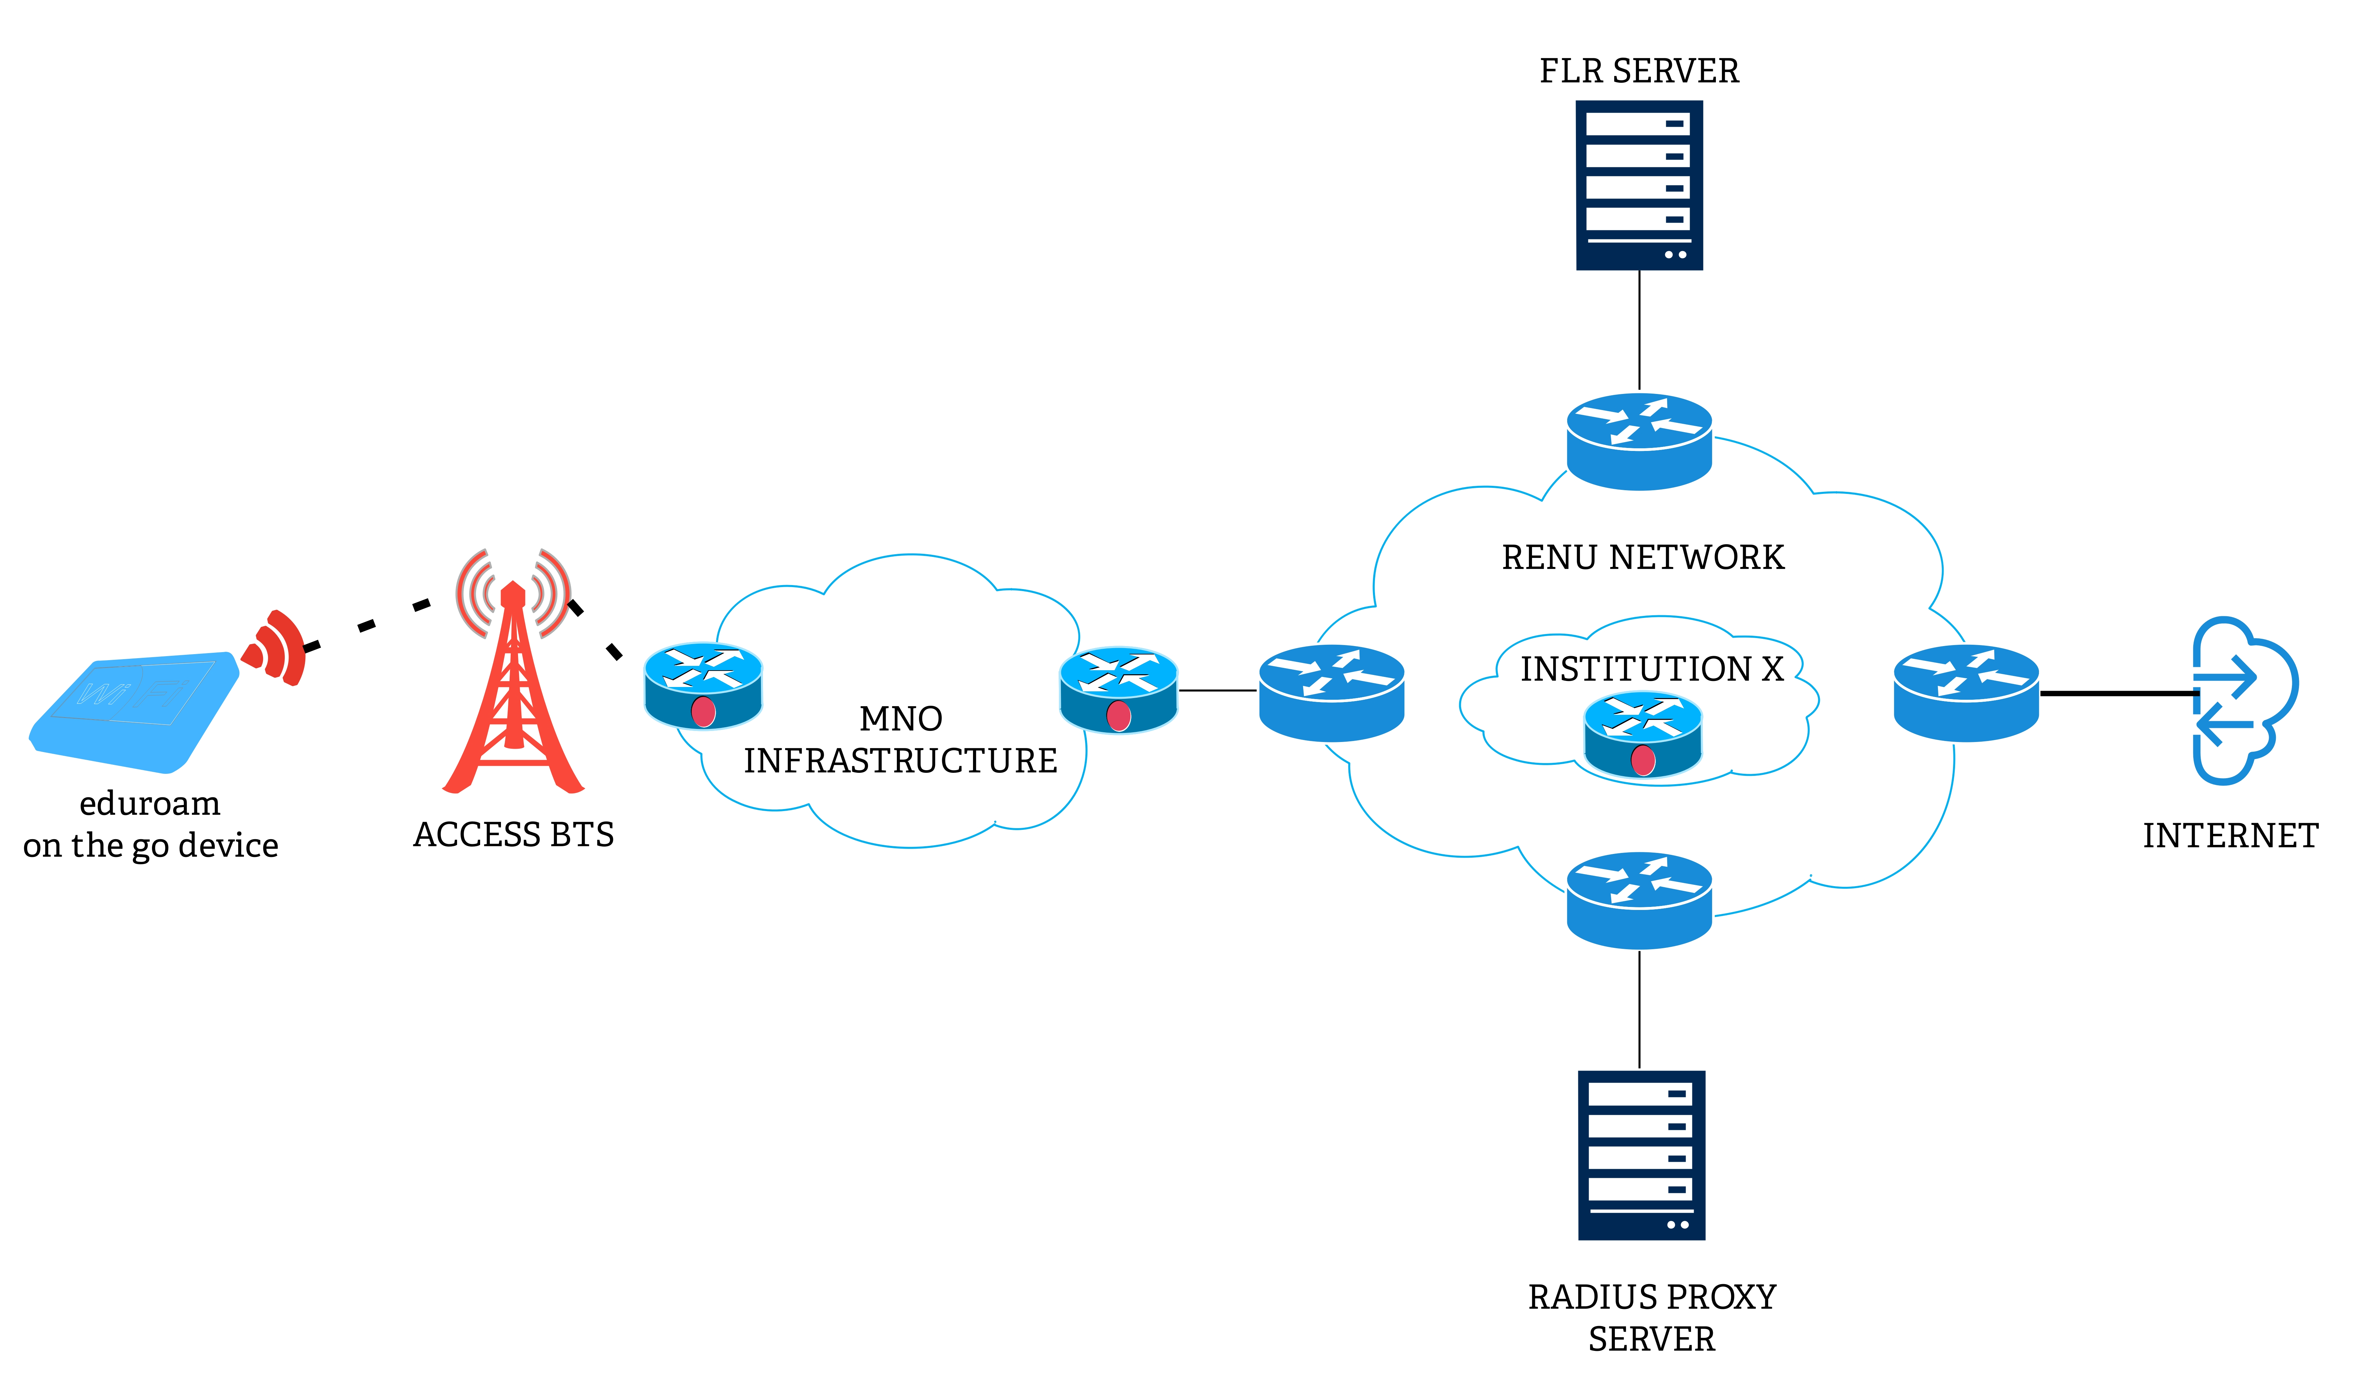
How it works – set up
Notes:
MNO – Mobile Network Operator

Slide 10
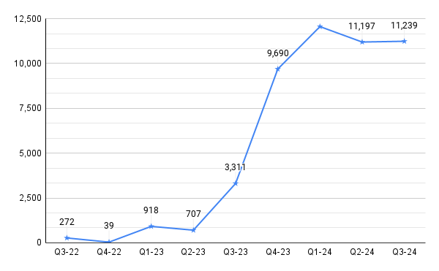
eduroam on the Go
Unique Users – From Q3 2022 to Q3 2024
Notes:
MNO – Mobile Network Operator

Slide 11
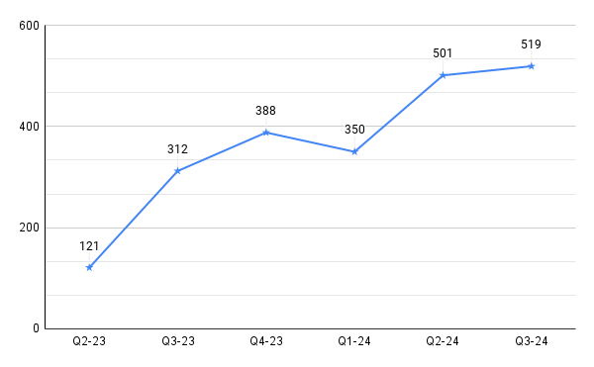
eduroam- Outside Uganda
Unique Users – From Q2 2023 to Q3 2024
Notes:
MNO – Mobile Network Operator

Slide 12

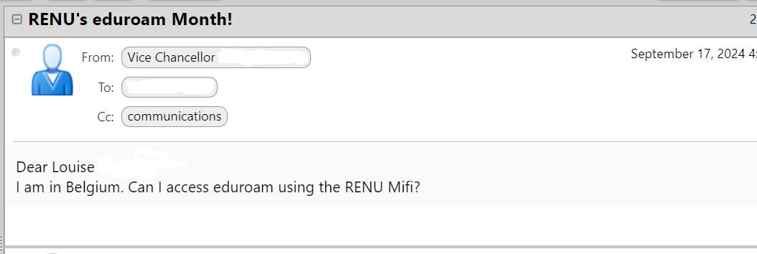
Challenges
Cross-border roaming

Slide 13
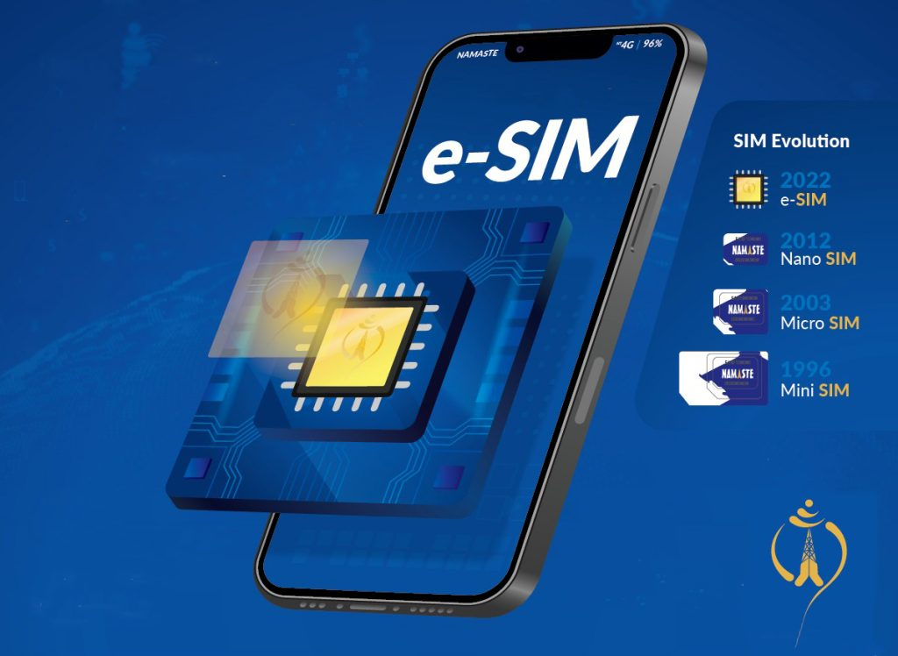
Proposed Solution
+
eduroam on the Go – eSIM

Slide 14
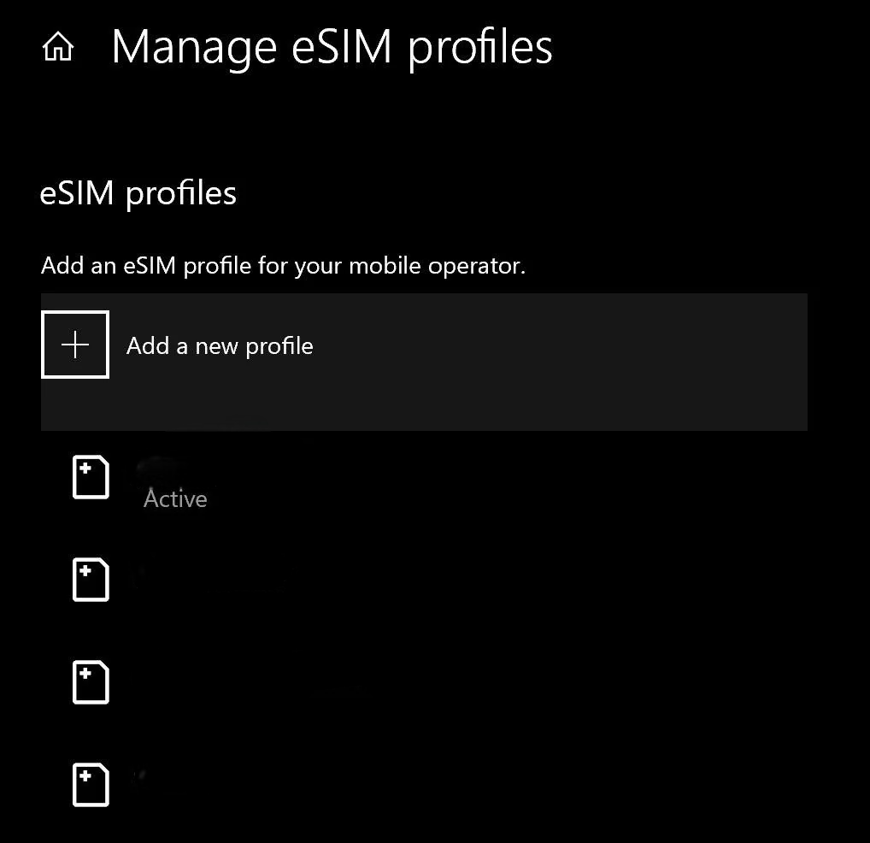
Proposed Solution
eSIM profiles - NRENs
Common repository for eSIM profiles
Download & upload the profile on eduroam on the Go device

Slide 15
Proposed Deployment Framework

Slide 16
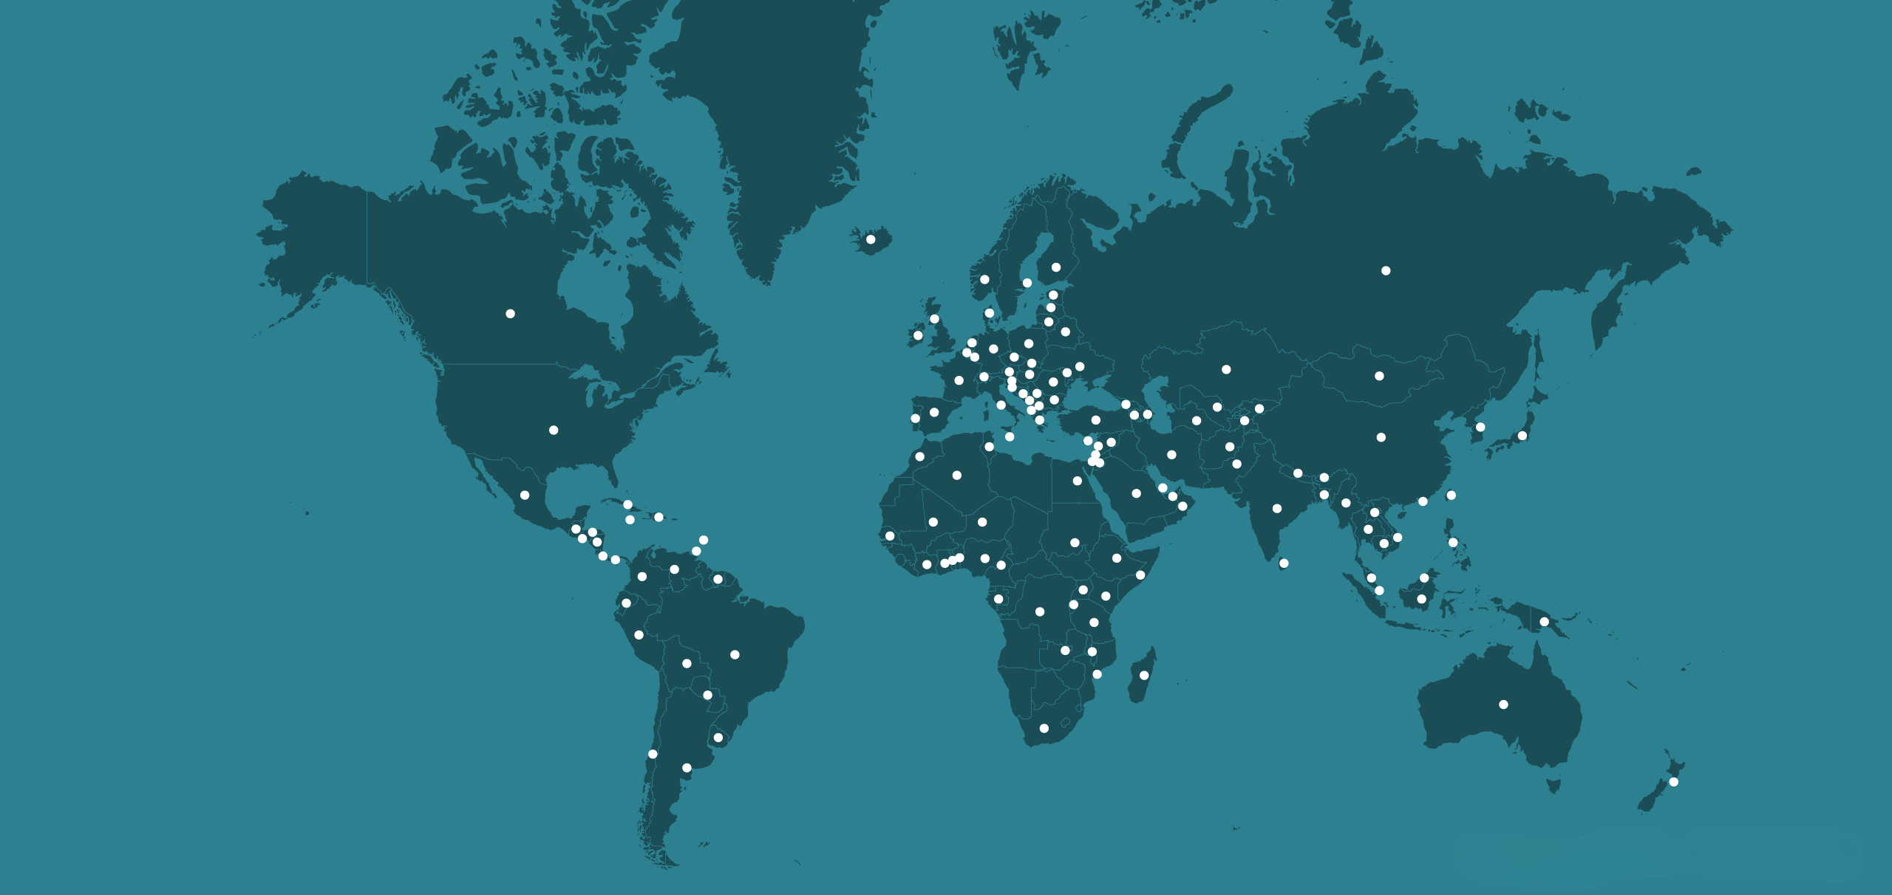
Possible benefits
Enhanced R&E globally
More collaboration between NRENs and MNOs
Seamless international roaming
More collaboration between different NRENs and RRENs

