Slide 1
TENET’s TVET Connectivity Project

Slide 2


Slide 3


Slide 4


Slide 5


Slide 6


Slide 7
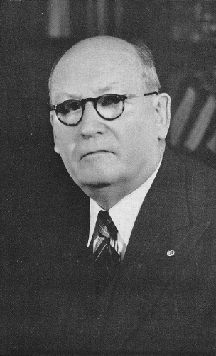

Slide 8
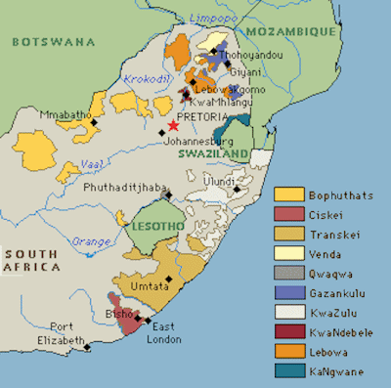

Slide 9
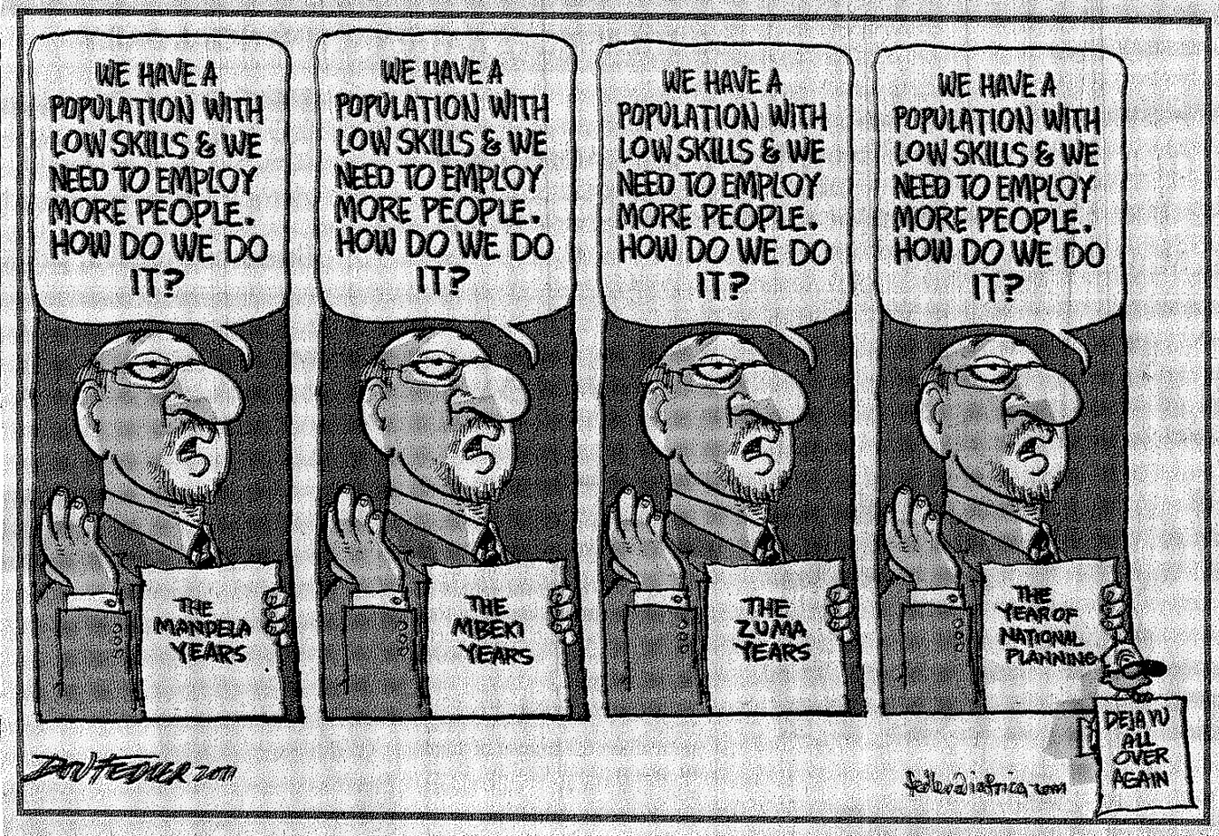

Slide 10
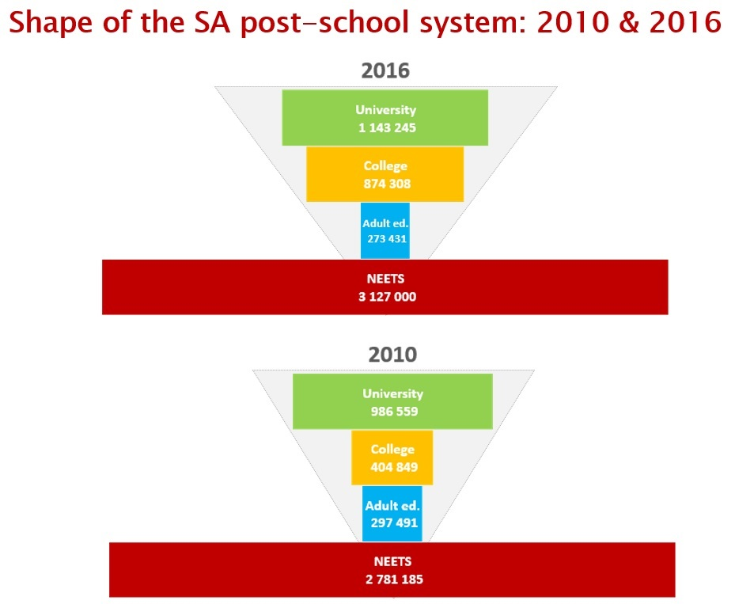
(Acknowledgement: Centre for Higher Education Transformation)

Slide 11
New emphasis on TVET colleges
50 public TVET colleges, > 300 campuses
Key role identified in National Development Plan
Public policy expectation that they will become the cornerstone of South Africa’s skills development system
2.5 million students expected by 2030
Capacity of public TVET colleges will need to be substantially improved

Slide 12
TENET NPC
Tertiary Education and Research Network of South Africa
Non-profit company created by the public universities of South Africa in 2000
Board of Directors appointed by Member institutions
Current members: all 26 public universities and six research councils
Mandate to provide interconnectivity and related services to the public higher education and research sector

Slide 13
SABEN NPC
South African Broadband Education Networks – a non-profit company created and controlled by TENET
Mandate to provide Internet and related services to TVET colleges and related entities
Recipient of grant funding from the National Skills Fund
(ZAR 250 million, about USD 17 million)

Slide 14
SANReN
South African National Research Network
Initiative of the Department of Science and Innovation, deployed through the Council for Scientific and Industrial Research
Close collaboration relationship with TENET
Designs and deploys SANReN national backbone, among other things
TVETs will be connected to SANReN, which will be augmented where necessary

Slide 15
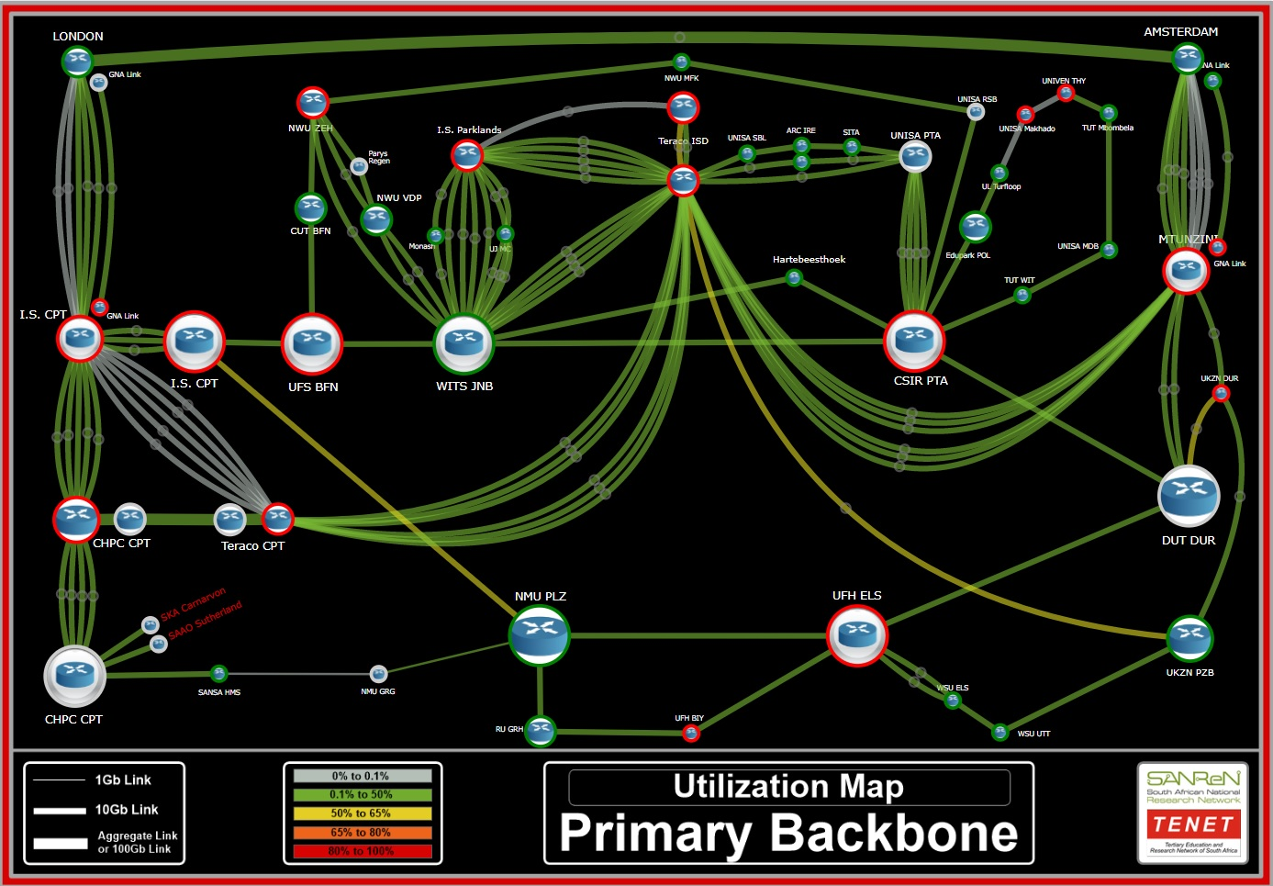

Slide 16
Work in Progress
12 Requests for Proposals have been issued and evaluated
Negotiations with TVET colleges in progress
Connection process will begin before the end of 2019

