Slide 1



UbuntuNet-Connect2024 -
October 31-November 1, Dar es Salaam, Tanzania​
Mapping the Future of Artificial Intelligence-Large Language Models in Light of Academic Integrity at Chinhoyi University of Technology: Addressing Concerns and Safeguarding Educational Ethics.
Presenter : Dr Chinofunga S
Co Authors : Chikazhe Lovemore, Kiwa Fungai Jacqueline, Masamha Tavengwa , Shangwa Mary, Chabvutagondo T

Slide 2

Introduction & Background
The rapid advancement of Artificial Intelligence (AI) technologies as a supporting pillar of the 4th Industrial Revolution, particularly Large Language Models (LLMs), has transformed various sectors, including education.
Artificial intelligence (AI) stands as a transformative technology designed to replicate and simulate human cognitive and behavioral functions within machines, showcasing a remarkable ability to process information, learn from data, and make decisions akin to human thought processes, as elucidated in the research conducted by Berşe et al. (2024).
Advancements in artificial intelligence (AI) are exemplified by the emergence of large language models (LLMs) such as Gemini, ChatGPT, and Copilot, along with the progression of these multi-modal models, as indicated in the research by Wu et al. (2024).
Recently, there has been a surge in popularity and utilization of large language models (LLMs), with ChatGPT standing out prominently, especially within the realm of education (Upadhyay et al., 2024).
In the realm of academia, advancements in educational technology utilizing large language models (LLMs) have demonstrated the capacity to streamline the arduous tasks associated with creating and evaluating textual material (Yan et al., 2024).
Zimbabwe’s Higher and Tertiary education is guided by the Education 5.0 philosophy (Teaching , Research, Community Service, Innovation and Industrialisation).
At Chinhoyi University of Technology (CUT), the integration of AI-LLMs into academic practices presents both significant opportunities and notable challenges. These powerful tools, exemplified by platforms like ChatGPT and Gemini, offer innovative ways to support learning, enhance creativity, and streamline academic tasks. However, their widespread adoption raises crucial questions regarding academic integrity and the ethical implications of their use.

Slide 3
Introduction & Background
This paper aims to map the future of AI-LLMs within the context of educational ethics at CUT, addressing concerns that emerge from their application in academic settings.
The research seeks to identify potential challenges and propose strategies to ensure ethical use of AI tools while upholding educational standards and integrity within the university environment.
The interconnected relationship between student-staff research-learning and Large Language Models (LLMs) lies at the forefront of modern educational paradigms. As students and staff engage in research and learning processes, the integration of LLMs offers unprecedented opportunities and challenges.
LLMs such as ChatGPT, Gemini and Copilot demonstrates diverse potential uses within the educational domain, including the provision of personalized learning plans and materials, the development of clinical practice simulation scenarios, and aiding in the composition of written content (Xu, Chen, & Miao, 2024).
Enhanced Research Capabilities
Personalized Learning Experiences
Ethical Considerations
Skill Development
Innovation and Collaboration
Harnessing the vast potential of big data, sophisticated large-scale models, and robust computing capabilities, artificial intelligence (AI) technology has been swiftly progressing on a trajectory of innovation and evolution, as highlighted by the research conducted by Wu et al. (2024)

Slide 4

The Problem
The integration of Artificial Intelligence-Large Language Models (AI-LLMs) at Chinhoyi University of Technology (CUT) poses significant challenges to academic integrity and educational ethics due to the lack of explicit guidelines governing their use. While AI-LLMs offer opportunities to enhance learning and streamline tasks, their application raises concerns about unethical practices such as plagiarism, reliance on inaccurate information, and diminished critical thinking skills among students. Concerns have been raised regarding the feasibility and ethical implications associated with the utilization of these AI-driven large language models (AI-LLMs) (Yan et al., 2024). This research seeks to identify the risks associated with AI-LLM usage in academic contexts at CUT, assess the current frameworks for academic integrity, and propose strategies to safeguard ethical standards in the evolving landscape of AI technology.

Slide 5

Scope of the Research
The research scope encompasses an examination of the integration of Large Language Models (LLMs) in academic practices (by students and staff across all university academic desciplines) at Chinhoyi University of Technology, Zimbabwe.
It aims to assess the impact of AI-LLM technologies on academic integrity, identify challenges, and propose strategies to maintain ethical standards and uphold educational ethics within the university environment.

Slide 6
Literature Review
Artificial Intelligence and Large Language Models in Education (ChatGPT, Gemini, Copilot) (DOI by Rodgers)
According to Yan et al. (2024), large language models have the capability to effectively analyze an unparalleled volume of textual content and accomplish intricate natural language processing and generation tasks.
Artificial Intelligence (AI) and Large Language Models (LLMs) are revolutionizing the educational landscape in diverse and profound ways
(Upadhyay et al., 2024; Wang et al., 2024))
Personalized Learning | LLMs enable the creation of adaptive educational materials that cater to diverse learning preferences (Berşe et al., 2024 )
Enhanced Teaching | Assist educators in designing interactive and engaging learning content, automating administrative tasks, providing real-time feedback to students
Data-Driven Decision Making | Collect and analyze vast amounts of data to improve operations, predict student performance, optimize resource allocation
Accessibility and Inclusivity | HCI- speech recognition and natural language processing powered by LLMs, can make education more accessible to students with disabilities.
Lifelong Learning | facilitate continuous learning by offering personalized recommendations for upskilling and reskilling based on individual career goals and industry trends
Research and Innovation | LLMs support research endeavors by automating literature reviews, data analysis, and hypothesis generation. These technologies enable researchers to process vast amounts of information quickly and discover new insights in various academic fields.
Global Collaboration | AI-powered language translation tools facilitate communication and collaboration among students and educators from diverse linguistic backgrounds, breaking down language barriers and fostering global academic partnerships.
Ethical Considerations | With the increasing use of AI and LLMs in education, it is crucial to address ethical concerns related to data privacy, bias in algorithms, and transparency in decision-making processes to ensure fair and equitable educational outcomes for all learners.

Slide 7
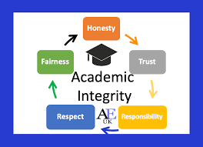
Literature Review cont’
Academic Integrity in Higher Education
Academic integrity embodies the ethical principles and values that underpin scholarly work, emphasizing honesty, fairness, trust, and respect for intellectual property. It involves upholding a high standard of ethics in all academic pursuits, including research, writing, exams, and collaboration, while acknowledging and crediting the ideas and work of others.
(Yan et al., 2024)
Significance in Maintaining Educational Standards
Promoting Learning (Upholding academic integrity fosters a culture of genuine learning and intellectual growth)
Preserving Credibility (Academic institutions rely on the integrity of their students and faculty to maintain their reputation for excellence )
Ensuring Fairness (discouraging cheating, plagiarism, and other dishonest practices, universities can ensure that all students have an equal opportunity to demonstrate their knowledge and skills )
Developing Ethical Conduct (It instills a sense of responsibility and integrity in students that extends beyond the academic setting)
Preserving Educational Quality | Nurturing Ethical Professionals | Protecting Intellectual Property | Enhancing Reputation | Preparing Students for Success

Slide 8
Literature Review cont’
Concerns Surrounding AI-LLMs in Education (Ferdaus et al., 2023; González-Santamarta et al., 2024; Groza & Marginean, 2023 ; McAuley, 2024; Tayan et al., 2023; Upadhyay et al., 2024)
Ethical Concerns:
Bias: LLMs can perpetuate biases present in the training data, potentially leading to discriminatory outcomes.
Plagiarism: Students may misuse AI-generated content, leading to plagiarism issues if not properly cited.
Data Privacy: Storing and processing student data using AI raises concerns about data privacy and security.
Quality and Reliability:
Accuracy: LLMs may generate inaccurate or misleading information, impacting the quality of research and learning materials.
Overreliance: There is a risk of overreliance on AI tools, potentially diminishing critical thinking and research skills among students and educators.
Lack of Transparency:
The complex algorithms used in AI and LLMs can lack transparency, making it challenging to understand how decisions are made or content is generated.
Intellectual Property:
Issues may arise regarding the ownership and attribution of AI-generated content, particularly in collaborative research projects or when using pre-trained models.
Accessibility and Inclusivity:
AI tools may inadvertently exclude individuals with disabilities if not designed with accessibility features in mind.
Unequal access to AI technologies may widen the digital divide among students and institutions.
Training and Expertise:
Faculty and students may require training to effectively use AI and LLMs, raising concerns about the availability of resources and support for skill development.
Impact on Academic Integrity:
The ease of content generation with LLMs raises concerns about maintaining academic integrity, ensuring proper citation practices, and preventing plagiarism.
Regulatory Compliance (DPA 5 of 2021 in Zimbabwe)
Long-term Effects:
The long-term implications of integrating AI and LLMs into academic environments, including changes in teaching methodologies and research practices, need to be carefully considered.
plagiarism, cheating, and the potential erosion of academic integrity due to AI-generated content

Slide 9
Literature Review cont’
Safeguarding Educational Ethics (Dong et al., 2024; Sajib et al., 2024)
Ethical Guidelines and Policies
Transparency and Explainability - transparency in the use of AI-LLMs by providing explanations of how these tools are utilized in academic work.
Training and Education
Promoting Critical Thinking
Verification and Validation - verify AI-generated content through cross-referencing with reliable sources and conducting thorough validation checks
Data Privacy and Security – data handling strategy review , Implement robust data privacy and security measures to protect student data and ensure compliance with relevant regulations.
Collaboration and Oversight - collaboration between faculty, students, and AI experts to address concerns and continuously improve AI-LLM usage in educational settings
Accessibility and Inclusivity
Continuous Evaluation and Improvement
(Upadhyay et al., 2024)
the role of policies, training programs, and technology solutions in safeguarding educational ethics.

Slide 10
Literature Review cont’
Literature Review: Diffusion of Innovations in Higher Education with AI-LLMsThe adoption of Artificial Intelligence (AI) and Large Language Models (LLMs) in higher education is a manifestation of the diffusion of innovations within academic settings. The framework of Diffusion of Innovations theory, proposed by Everett Rogers in 1962, provides a lens through which to understand the process by which new technologies, like AI-LLMs, are adopted and integrated into educational practices.
Innovation Characteristics:The adoption of AI-LLMs in higher education hinges on factors like their relative advantage over existing methods, compatibility with educational practices, complexity, trialability, and observability, all of which influence how educators perceive and incorporate these technologies into their teaching.
Adoption Process: Educators and institutions go through stages of knowledge acquisition, persuasion, decision-making, implementation, and confirmation when integrating AI-LLMs into educational settings, with each phase contributing to the successful adoption and utilization of these innovative tools.
Communication Channels:Effective dissemination of information about AI-LLMs in higher education relies on peer networks, professional organizations, academic conferences, research publications, and online platforms, which serve as vital channels for sharing knowledge and influencing stakeholders' perspectives on these technologies.
Social Systems:The adoption of AI-LLMs in higher education is embedded within complex social systems that encompass various stakeholders, including faculty, administrators, students, and policymakers. These social dynamics, institutional structures, and cultural norms collectively shape how AI-LLMs are perceived and integrated within the academic ecosystem.
Innovation-Decision Process: Educators engage in a systematic innovation-decision process when considering the integration of AI-LLMs into their teaching practices, involving stages of knowledge acquisition, persuasion, decision-making, implementation, and confirmation.

Slide 11
Research Objective/s
To understand the usage patterns of LLMs among Chinhoyi University of Technology (CUT) users.
To identify factors influencing the utilization of LLMs in academic activities.
To assess user confidence levels in use of LLMs.
To evaluate the needs of users regarding LLM usage.

Slide 12
Research Question/s
What are the specific usage patterns of large language models (LLMs) among students and faculty at CUT in terms of frequency and academic tasks?
What key factors influence the decision to utilize LLMs in academic activities among students and faculty at CUT?
How confident do students and faculty feel in their ability to effectively use LLMs
What challenges do they encounter during their usage?
What measures are necessary to enhance the effective use of LLMs among students and faculty at CUT?

Slide 13
Research Methodology
1 Public University - CUT
Quantitative inquiry utilizing a cross-sectional survey design to collect quantitative data from diverse stakeholders at Chinhoyi University of Technology (CUT),
114 lecturers,
147 students, and
14 administrators
Google Form based Online questionnaire was developed, comprising closed-ended questions to assess the frequency and nature of AI-Large Language Models (LLMs) usage, perceptions of academic integrity risks, awareness of existing policies, and open ended question on suggestions for ethical improvements.

Slide 14
Data Analysis
Using SPSS version 27 and Amos 22
SPSS version 27 was employed for data management, analysis, and the generation of descriptive statistics, offering a comprehensive platform for statistical analysis. Descriptive statistics were utilized to summarize key variables within the dataset. These statistics provided a snapshot of the central tendencies, dispersion, and shape of the data distribution for each variable under consideration.
Amos 22, a software tool for structural equation modeling, was utilized to explore the relationships between variables in a more intricate manner, allowing for the examination of complex interdependencies and pathways within the dataset. Relationships between variables were examined to understand how they interacted and influenced one another within the context of the study.

Slide 15
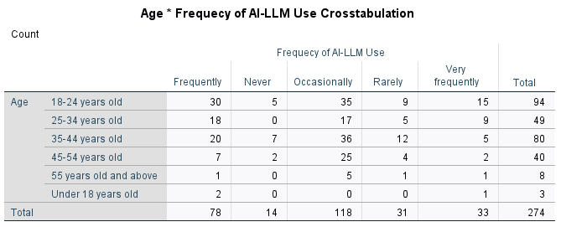
Findings
Frequency of use
The majority of respondents are aged 18-24 and predominantly male.
Most participants are students, followed by lecturers with a few administrators.
The highest qualification among respondents ranges from high school certificates to doctorates, indicating diverse educational backgrounds.

Slide 16
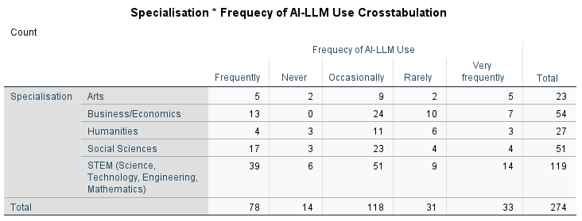
Findings cont’
  Several respondents identified specific subjects where LLMs were particularly valuable, such as programming, business topics, and STEM fields.
  There is a notable emphasis on practical applications in programming and data analysis.
Demographic Variability: Usage patterns vary by demographics such as age, gender, and academic discipline, with younger students in STEM fields more likely to utilize LLMs frequently compared to other groups. This highlights a potential generational trend in technology adoption.

Slide 17
Findings cont’
Academic Tasks
Primary Tasks Utilized:
  Writing Research Papers: 40%
  Generating Ideas or Brainstorming: 20%
  Seeking Information: 30%
  Writing Assignments: 5%
  Checking Grammar and Language Usage and
  Generating Course Content: 5%

Slide 18
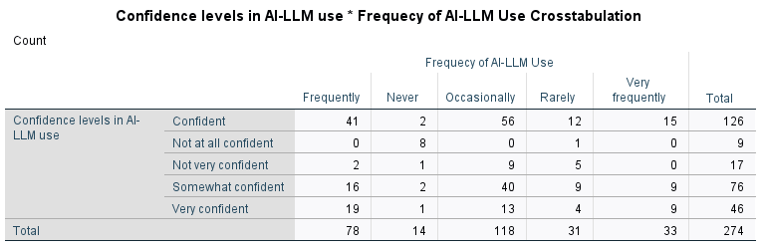
Findings cont’
Users who intermittently and regularly utilize large language models (LLMs) demonstrate confidence in their usage.
While many users expressed confidence in their ability to use LLMs effectively, there were notable segments that reported low confidence levels, particularly among those who use LLMs less frequently. This indicates a need for further support and training.

Slide 19
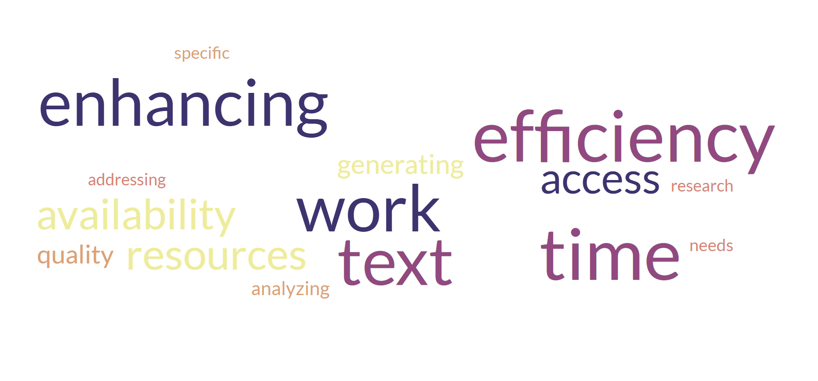
Findings cont’
Key Factors Influencing LLM Utilization
Availability and Access to LLM Resources: 60%
Time Efficiency in Generating Content: 50%
Enhancing the Quality of Work: 40%
Addressing Specific Research or Writing Needs: 30%
Time Efficiency in Analyzing Text: 20%
The primary reason for utilizing LLMs is the availability of resources, followed closely by the efficiency they provide in generating and improving academic work.

Slide 20
Findings cont’
Confidence in Using LLMs and Challenges Encountered
Confidence Levels
Very Confident: 30%
Confident: 40%
Somewhat Confident: 20%
Not Very Confident: 5%
Not at All Confident: 5%
A majority of respondents feel confident in using LLMs, with 70% expressing at least some level of confidence.
Challenges Faced
Inaccurate/ Misleading Information: 35%
Lack of Human Reasoning: 25%
Network Connectivity Issues: 20%
Content Not Covering Specific Needs: 15%
Deep Vocabulary Challenges: 5%
The most significant challenge is the accuracy of information provided by LLMs, indicating a need for improved reliability in outputs.
Implicit bias (Warr , Oster & Isaac , 2024)

Slide 21
Findings cont’
Communication and Policy
University Communication
  Many respondents feel that the university have not clearly communicated policies regarding academic integrity and the use of LLMs.
  There is a call for clearer guidelines on what constitutes academic dishonesty in the context of using AI.
Training Requirements: A significant number of respondents indicated a lack of formal training or guidance on using LLMs, suggesting a critical gap in support that could be addressed through targeted training programs.
Policy Clarity: Many users expressed uncertainty regarding policies on academic integrity related to LLM usage. This indicates an urgent need for the university to develop clear policies and communication strategies to guide students and faculty in the ethical use of these tools.

Slide 22
Recommendations
Researchers ought to harness the advantages, glean insights from the constraints, and explore prospective research avenues facilitated by AI-LLMs ( Yan et al., 2024).
Develop Training Programs (Advance AI Literacy) (Wu et al.,2024):
  Workshops and Seminars: Organize regular workshops and seminars to train students and faculty on how to effectively use LLMs for academic tasks, including writing, research, and problem-solving (Xu, Chen, and Miao (2024)..
  Online Tutorials: Create accessible online tutorials and resources that cover best practices for using LLMs, including examples and case studies.
Enhance Communication of Policies
  Clear Guidelines: Develop and disseminate clear policies regarding the use of LLMs in academic work, including what constitutes acceptable use and academic integrity (Xu, Chen, and Miao (2024).
  Regular Updates: Keep the academic community informed about any updates to policies or best practices related to LLM usage.
Provide Access to LLM Resources
  Institutional Licenses: Consider establishing institutional licenses for popular LLM tools to ensure all students and faculty have access to these resources.
  Technical Support: Set up a support system to help users troubleshoot issues with LLM access or usage.
  Encourage Collaboration and Sharing of Best Practices
  Peer Learning: Foster a culture of peer learning where students and faculty can share their experiences and strategies for using LLMs effectively.
  Case Studies: Highlight successful use cases of LLMs in various disciplines to inspire broader adoption and innovative applications

Slide 23

Recommendations
Xu, Chen, and Miao (2024) emphasized the difficulties linked to academic integrity, data precision, and possible adverse effects on learning when employing LLMs.
On challenges
Information Accuracy –encourage critical thinking and verification of information generated by LLMs. Promote resources that help users assess the reliability of AI-generated content.
Connectivity Solutions - Work on improving internet connectivity and access to technology on campus to mitigate challenges faced by users.
Feedback Mechanism
  Collect User Feedback - Regularly gather feedback from users regarding their experiences with LLMs to identify areas for improvement and adapt training and resources accordingly.
  Continuous Improvement - Use feedback to continuously refine training programs and policies related to LLM usage.
Promote Ethical Use
  Ethics Education - Incorporate discussions about the ethical implications of using LLMs into the curriculum, emphasizing responsible use and the consequences of academic dishonesty.
  Transparency in Use -Encourage students and faculty to disclose their use of LLMs in academic work, fostering an environment of transparency.
Collaboration with AI Experts and Developers - Collaborate with developers of LLMs to address specific educational needs and improve the relevance of AI outputs.
(Yan et al., 2024)

Slide 24
Conclusion
Overall Adoption: LLMs are widely adopted among students and faculty for various academic tasks, particularly in STEM and business disciplines.
Need for Training: There is a significant gap in training and guidance on using LLMs effectively, which could enhance confidence and improve outcomes.
Policy Development: Universities should consider developing clear policies and training programs to address the challenges and ethical implications of using LLMs in academic work.

Slide 25



One Key output of this research
AI POLICY DRAFT FOR CHINHOYI UNIVERSITY OF TECHNOLOGY
Policy Background
Policy Statement
Core Principles of the AI Policy
University core actions in AI applications
AI’s For Students
AI’s For Lecturers
Citing AI Responsibly
Acknowledgement of the use AI
Penalties

Slide 26
Resources used for Policy Formulation
Australian Government – Tertiary Education Quality Standards
  https://www.teqsa.gov.au/students/artificial-intelligence-advice-students
  https://www.teqsa.gov.au/students/understanding-academic-integrity
  https://www.teqsa.gov.au/students/understanding-academic-integrity/what- academic-integrity
AU HIGH-LEVEL PANEL ON EMERGING TECHNOLOGIES (APET), 2023, AUDA-NEPAD White paper:
Regulation and Responsible Adoption of AI in Africa Towards Achievement of AU Agenda 2063.
Using AI Tools at UWA: A Guide for Students, The University of Western Australia
Artificial Intelligence in Higher Education Policy, The University of Law, 2021
University of NorthWestern St Paul Library, Citing AI-Generated Content: https://guide.unwsp.edu/ChatGPT
Generative AI at Duke : https://learninginnovation.duke.edu/ai-and-teaching-at-duke-2/
How to cite ChatGPT: https://apastyle.apa.org/blog/how-to-cite-chatgpt
Generative AI Policy for Students: https://honorcode.nd.edu/generative-ai-policy-for-students- august-2023/
Class Policies for AI Tools, https://www.niu.edu/citl/index.shtml
Temple University, ACCEPTABLE AND UNACCEPTABLE USE OF AI
Johns Hopkins University, Self-supervised Models AI Policy
Harvard Business School , Academic Standards of Conduct, Using ChatGPT & Artificial Intelligence (AI) Tools (https://www.hbs.edu/mba/handbook/standards-of-conduct/academic/Pages/default.aspx )
Arizona State University, Generative AI: FAQs ( https://provost.asu.edu/generative-ai/faqs )
Acknowledging use of AI
https://www.ncl.ac.uk/academic-skills-kit/good-academic-practice/artificial-intelligence/ acknowledging/

Slide 27
References
Berşe, S., Akça, K., Dirgar, E., & Kaplan Serin, E. (2024). The role and potential contributions of the artificial intelligence language model ChatGPT. Annals of Biomedical Engineering, 52(2), 130-133.
Dong, Y., Mu, R., Zhang, Y., Sun, S., Zhang, T., Wu, C., ... & Huang, X. (2024). Safeguarding Large Language Models: A Survey. arXiv preprint arXiv:2406.02622.
Ferdaus, M. M., Abdelguerfi, M., Ioup, E., Niles, K. N., Pathak, K., & Sloan, S. (2024). Towards trustworthy ai: A review of ethical and robust large language models. arXiv preprint arXiv:2407.13934.
González-Santamarta, M. Á., Rodríguez-Lera, F. J., Conde-González, M. Á., Rodríguez-Sedano, F., & Fernández-Llamas, C. (2024, June). Exploring the Use of LLMs for Teaching AI and Robotics Concepts at a Master’s Degree. In Conference of the Spanish Association for Artificial Intelligence (pp. 254-263). Cham: Springer Nature Switzerland.
Groza, A., & Marginean, A. (2023). BRAVE NEW WORLD: AI IN TEACHING AND LEARNING. In ICERI2023 Proceedings (pp. 8706-8713). IATED.
McAuley, D. (2024). AI and LLMs in Cloud Computing: Challenges and Opportunities. Advances in Computer Sciences, 7(1).
Sajib, M. M. H., Hossan, T., Jahin, A., Zaman, S., Hossain, T., Rafi, A. R., ... & Islam, M. I. (2024). Ethical Data Practices for Large Language Model Training.
Tayan, O., Hassan, A., Khankan, K., & Askool, S. (2023). Considerations for adapting higher education technology courses for AI large language models: A critical review of the impact of ChatGPT. Machine Learning with Applications, 100513.
Upadhyay, A., Farahmand, E., Muñoz, I., Akber Khan, M., & Witte, N. (2024). Influence of LLMs on Learning and Teaching in Higher Education. Available at SSRN 4716855.
Wang, S., Xu, T., Li, H., Zhang, C., Liang, J., Tang, J., ... & Wen, Q. (2024). Large language models for education: A survey and outlook. arXiv preprint arXiv:2403.18105.
Warr, M., Oster, N. J., & Isaac, R. (2024). Implicit bias in large language models: Experimental proof and implications for education. Journal of Research on Technology in Education, 1-24.
Wu, D., Chen, M., Chen, X., & Liu, X. (2024). Analyzing K-12 AI education: A large language model study of classroom instruction on learning theories, pedagogy, tools, and AI literacy. Computers and Education: Artificial Intelligence, 7, 100295.
Xu, X., Chen, Y., & Miao, J. (2024). Opportunities, challenges, and future directions of large language models, including ChatGPT in medical education: a systematic scoping review. Journal of Educational Evaluation for Health Professions, 21.
Yan, L., Sha, L., Zhao, L., Li, Y., Martinez‐Maldonado, R., Chen, G., ... & Gašević, D. (2024). Practical and ethical challenges of large language models in education: A systematic scoping review. British Journal of Educational Technology, 55(1), 90-112.

Slide 28

Q & A
Thank You
TANZANIA

