Slide 1

Shaping the Future: Responsible Artificial Intelligence Use by Learners in Higher Education Institutions
TAKUDZWA RUSIKE
trusike@hit.ac.zw
+263772554207
success through innovation

Slide 2
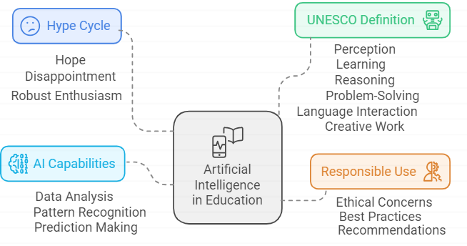
OVERVIEW
Notes:
Numerous technologies experience a cycle of hope and disappointment known as a 'hype cycle' before they are widely adopted, but the present surge of enthusiasm surrounding Artificial Intelligence (AI) is notably robust.
UNESCO(2022) defines artificial intelligence as ‘Computers that imitate some features of human intelligence, such as perception, learning, reasoning, problem-solving, language interaction and creative work’
Artificial Intelligence involves use of algorithms that analyse data, identify patterns, and make predictions, enabling educators and learners to have a paradigm shift in learning and research

Slide 3
INTRODUCTION
Numerous technologies experience a cycle of hope and disappointment known as a 'hype cycle' before they are widely adopted, but the present surge of enthusiasm surrounding Artificial Intelligence (AI) is notably robust.
UNESCO(2022) defines artificial intelligence as ‘Computers that imitate some features of human intelligence, such as perception, learning, reasoning, problem-solving, language interaction and creative work’
Artificial Intelligence involves use of algorithms that analyse data, identify patterns, and make predictions, enabling learners to have a paradigm shift in learning and research
It is pivotal to note that learners are fulfilling tasks with the aid of AI tools and in the process there is need to ensure responsible use of these AI tools
Notes:
Artificial Intelligence involves use of algorithms that analyse data, identify patterns, and make predictions, enabling educators and learners to have a paradigm shift in learning and research

Slide 4
PROBLEM STATEMENT
The academic journey is being navigated smoothly using AI tools by HEI learners in Zimbabwe. However, there is a knowledge dearth on the ethical concerns and the responsible use of AI by learners.
There is also a gap in terms of frameworks that HEIs use to govern and regulate AI responsible use amongst learners in order to promote academic integrity.

Slide 5

AIM OF THE STUDY
To evaluate the utilisation of AI by students, emphasising the potential advantages, ethical dilemmas, and the formulation of a structured framework for cultivating responsible AI practices within Higher Education Institutions.

Slide 6

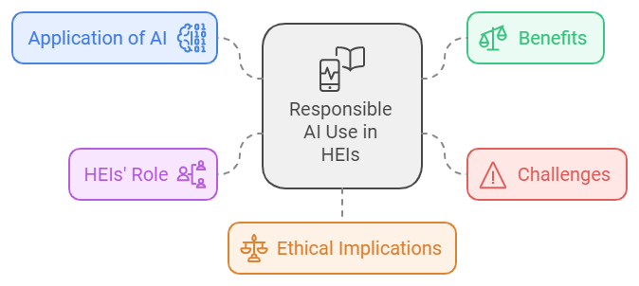
OBJECTIVES
To explore the different AI tools and their potential benefits to learners in HEIs,
To assess the challenges associated with using AI tools in HEI
To investigate the ethical implications associated with the use of AI tools
To assess the role of HEIs in promoting responsible use of AI tools

Slide 7
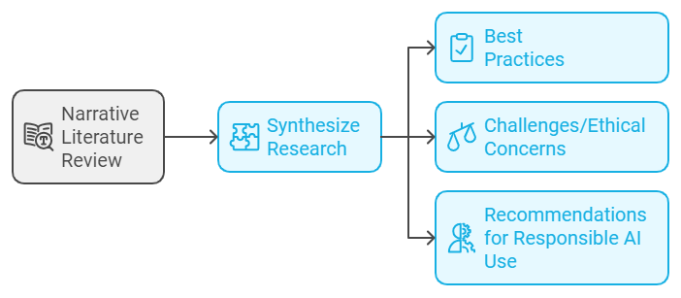
METHODOLOGY

Slide 8
AI TOOLS AND POTENTIAL BENEFITS
Harnessing Literature: Scispace, LitMaps, Elicit papers, Connected papers, inciteful.xyz
Content creation : Gamma, Canva, Napkin
Intelligent Tutoring Systems: Poe, ChatGpt, Gemini
Data analysis for the learners: Julius. Tableau, DataGPT
AI detection: Turnitin, SciSpace AI detector.
Paraphraser: Grammarly, Poe, Ai Paraphraser, Quillbot.
Conversational: Chatpdf, Scispace, Poe, MetaAI
Language translator: Monica, ChatGPT3, Quillbot
Coding: Codium AI, GitHub, CodeRabbit, AskCodi

Slide 9
CONS ASSOCIATED WITH USING AI TOOLS BY LEARNERS
Overreliance on AI destroying critical thinking
Digital divide (the have and have nots access)
AI illiteracy (what, where, how, when and why questions)
Algorithmic bias- perpetuate existing biases present in the data they are trained on, leading to inaccurate information,

Slide 10
ETHICAL CONCERNS OF USING AI TOOLS IN HEIs
AI-giarism (Turnitin version)
Academic integrity (Bangledash tests scores versus exam mark)
Data privacy (personal data of learners)
Authorship- ( no honest disclosure) OpenAI Chat GPT (2023) ChatGPT response to John Smith, 28 March. Available at: https://chat.openai.com/APA.
Deepfakes (misinformation through content generation)

Slide 11
HEIs IN PROMOTING RESPONSIBLE USE OF AI TOOLS
Use of Turnitin in Zimbabwe HEIs
  These tools need not only spot instances of plagiarism but also detect unethical collaboration
Teaching AI literacy to students (Newcastle University)
Establishment of AI labs and Directors for AI
HIT on Education 5.0 (experimental learning)
Developing of AI policies for integration with education
Fact checking AI-generated content.

Slide 12
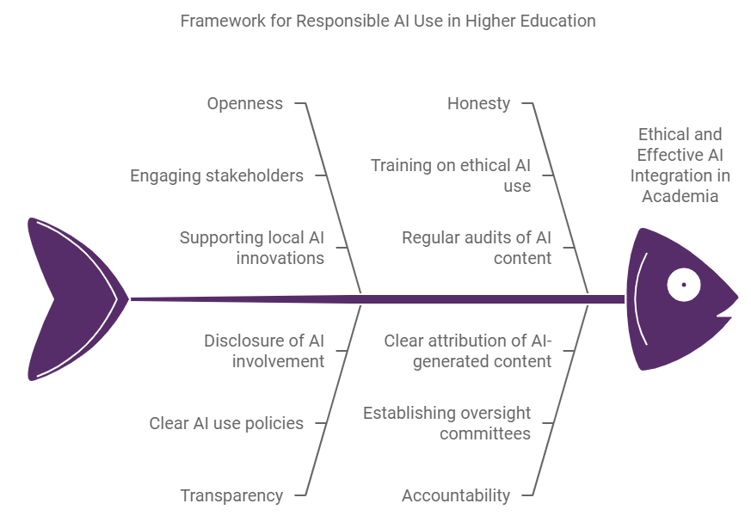
Proposed OTHA framework for responsible AI use in HEIs
.
Notes:
OTHA Framework, based on the principles of Openness, Transparency, Honesty, and Accountability provides a comprehensive model for the ethical and effective integration of AI in higher education.
Collaboration, ensuring transparency, promoting ethical use, and maintaining accountability, institutions can leverage the benefits of AI while mitigating its risks.
This framework not only upholds the academic integrity but enhances educational quality

Slide 13
CONCLUSION
AI has to be embraced for it is not going anywhere, only that learners need to be ethically responsible when using it.
Artificial Intelligence has significant potential for educational enhancement, however ethical concerns have to be addressed.
AI literacy , sophisticated AI detection tools and proactive policy frameworks can eliminate these ethical concerns whilst upholding responsible use of AI.

Slide 14

FUTURE DIRECTIONS
This study guides Zimbabwean HEIs with a framework that may help navigate the potential of AI tools while mitigating ethical risks.
HEIs to focus on experimental learning.
Educators and librarians to be reskilled.
Ministry of Higher and Tertiary Education to do continuous curriculum reviews to embed emerging technologies.
The Ministry of Higher and Tertiary Education to formulate AI policies
Developers to work on more sophisticated AI detectors.

Slide 15
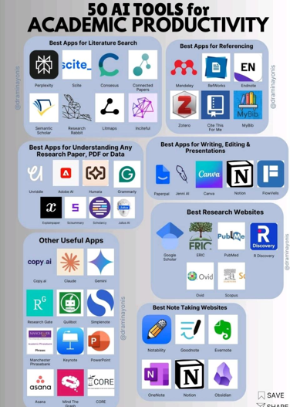
Thank you

