Slide 1


Implementation of the African Union’s AI Strategy:
What Role Can R/NRENs Play
UbuntuNetConnect 2025
October 31, 2025
Prof. Madara Ogot, CEO
For Research and Education Networking

Slide 2

African Union AI Strategy
Overview
Seeks to harness AI for Africa’s development, prosperity and accelerate Agenda 2063 aspirations and the SDGs by improving livelihoods, creating jobs, and driving innovation
Adopted in 2024
Vision is for Africa to become an active participant in the global AI revolution, optimising AI’s benefits while mitigating its harms through appropriate governance, infrastructure, and capacity-building

Slide 3

Raise up your hand if you have a PAID AI account?

Slide 4

Think Big!
Make Yourself Relevant!

Slide 5
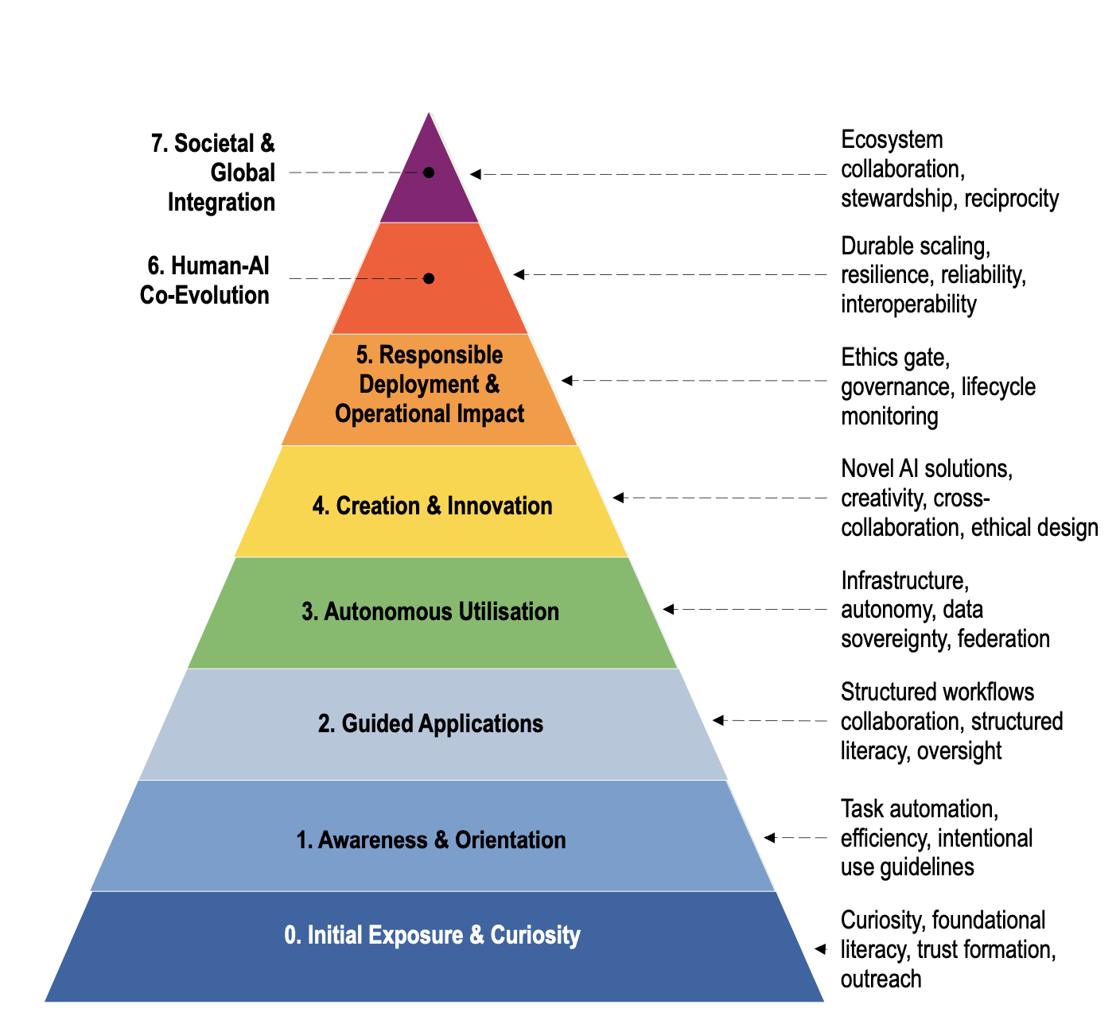
Hierarchy of Engagement with AI Model
https://doi.org/10.48550/arXiv.2509.07032
A diagnostic tool
“where are we today?”
and
A Strategic planning tool
“what happens next?”

Slide 6
Hierarchy of Engagement with AI Model
Turning Strategy to Action
The AU AI Strategy is structured around five focus areas and operationalised through fifteen actions
Policymakers across Africa now face the challenge of moving from the AU's AI Strategy commitments to practical, sequenced implementation
Aligning the fifteen actions with the HE-AI model provides the necessary scaffolding
It gives decision-makers a clear view of what comes first, who should do it, and how to measure progress

Slide 7

AU AI Strategy aligned to HE-AI Model
L0 – Initial Exposure and Curiosity
Relevant AU Strategy Action Lines | Explanation of Fit
7. Strengthen information integrity and promote Media and Information Literacy (MIL). 10. Promote AI skills and talent in schools, workplaces, and across populations (introductory literacy). | Early exposure requires basic AI awareness, MIL campaigns, and introductory skill-building to reach youth, civil servants, and citizens.

Slide 8
AU AI Strategy aligned to HE-AI Model
L0 – Initial Exposure and Curiosity
Potential Role of NRENs | Role of Regional Research and Education Networks
Use NREN platforms to host public webinars, MOOCs, and MIL content on AI ethics, misinformation, and digital literacy Offer free access to AI-literacy materials | Coordinate regional MIL campaigns and curate AI-awareness content. Aggregate usage analytics (e.g., reach, demographics) to inform AU Readiness Index indicators. Partner with RECs and AU Commission to ensure alignment with Agenda 2063 Goal 1 (education and skills revolution)

Slide 9
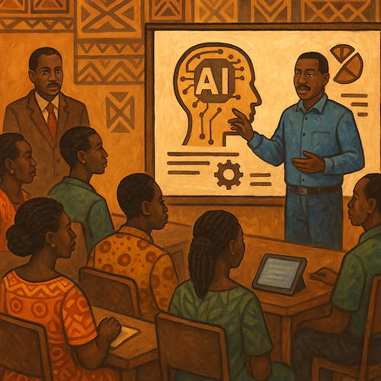
AU AI Strategy aligned to HE-AI Model
L1 – Awareness and Orientation
Relevant AU Strategy Action Lines | Explanation of Fit
2. Promote adoption of AI in the public sector (orientation pilots). 3. Accelerate adoption in priority sectors (education, agriculture, health, climate, etc.) at a pilot level. 7. MIL initiatives (extended). 10. AI literacy at K-12 and vocational levels. | Orientation of ministries, teachers, and early sector pilots with strong human-in-the-loop (HIL) oversight fit at this stage

Slide 10
AU AI Strategy aligned to HE-AI Model
L1 – Awareness and Orientation
Potential Role of NRENs | Role of Regional Research and Education Networks
Support sandbox environments for ministry, university and TVET pilots, ensuring safe experimentation with AI tools Host baseline datasets (education, health, agriculture) developed by universities and ministries to demonstrate responsible data handling | Establish AI orientation resource hubs within regional backbone networks (UbuntuNet Alliance, WACREN, ASREN) Facilitate cross-country peer learning through regional webinars and thematic clusters (e.g., education, health)

Slide 11
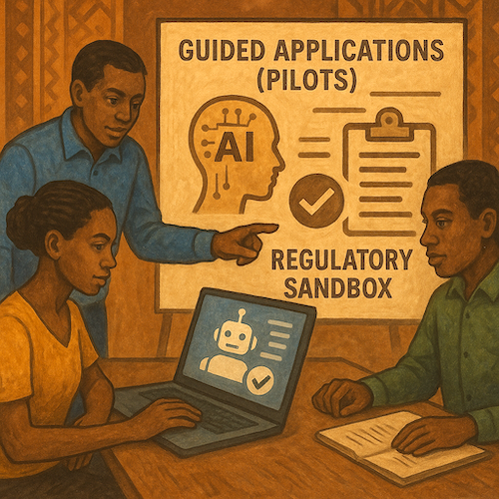
AU AI Strategy aligned to HE-AI Model
L2 – Guided Applications (Pilots)
Relevant AU Strategy Action Lines | Explanation of Fit
2. Public sector adoption (pilot projects). 3. Priority sector pilots. 4. Promote private-sector adoption, including SMEs (early sandboxed use cases). 5. Create enabling environment for start-ups (pilot innovation grants). | Structured pilots under regulatory sandboxes ensure learning by doing.

Slide 12
AU AI Strategy aligned to HE-AI Model
L2 – Guided Applications (Pilots)
Potential Role of NRENs | Role of Regional Research and Education Networks
Operate national regulatory sandboxes for AI pilots, in collaboration with data-protection authorities Provide secure cloud and data-hosting facilities for pilot projects, including compute credits and storage | Offer regional sandbox federation to allow cross-border pilot comparison and replication Supply regional compliance toolkits (audit templates, impact-assessment guides)

Slide 13
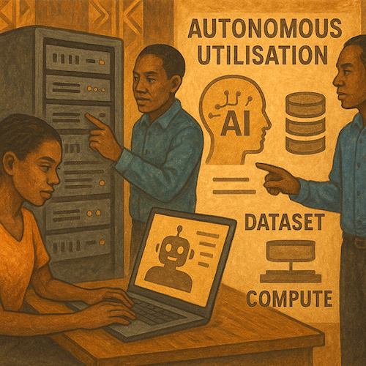
AU AI Strategy aligned to HE-AI Model
L3 – Autonomous Utilisation
Relevant AU Strategy Action Lines | Explanation of Fit
1. Establish AI governance systems (data protection, legal frameworks). 4. SME adoption (when supported by national data/compute). 6. Ensure availability of high-quality datasets and build compute infrastructure (HPC, cloud, data centres). | Level 3 emphasises building sovereign infrastructure and governance needed for sustained AI use, directly aligning with dataset and compute actions.

Slide 14
AU AI Strategy aligned to HE-AI Model
L3 – Autonomous Utilisation
Potential Role of NRENs | Role of Regional Research and Education Networks
Manage national AI Commons comprising HPC clusters, secure data repositories, and federated-identity systems Host national data registries and metadata portals with open-data standards | Coordinate regional AI Commons, interconnecting national data and compute via high-capacity backbones

Slide 15
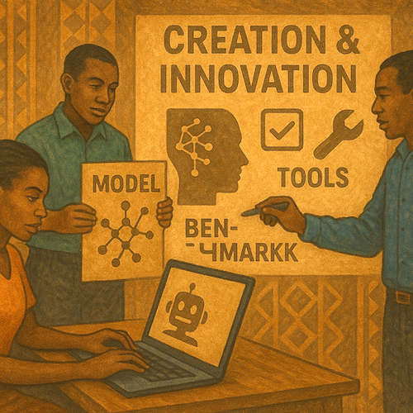
AU AI Strategy aligned to HE-AI Model
L4 – Creation and Innovation
Relevant AU Strategy Action Lines | Explanation of Fit
5. Start-up ecosystem development (innovation hubs, incubation). 11. Foster AI research and innovation through academia-private sector-government partnerships. 12. Advance challenge-driven research in priority areas. | This stage is about creating new models, benchmarks, and tools. It corresponds to innovation ecosystems, R&D programmes, and entrepreneurship support.

Slide 16
AU AI Strategy aligned to HE-AI Model
L4 – Creation and Innovation
Potential Role of NRENs | Role of Regional Research and Education Networks
Run AI hackathons Offer cloud credits and mentorship to student and faculty start-ups building African-language models Support collaborative AI research projects linking universities, ministries, and local industry | Establish regional challenge-driven research platforms on shared HPC and dataset infrastructure Curate and publish regional research outputs and policy briefs feeding AU AI Strategy updates

Slide 17
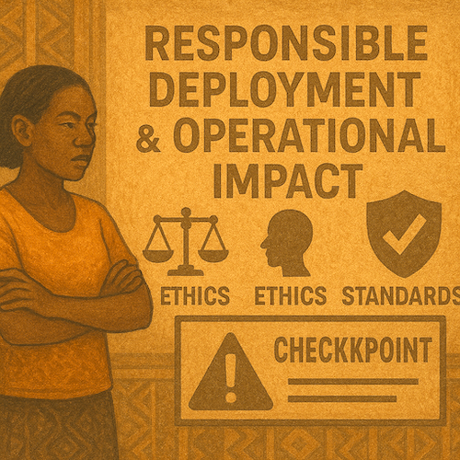
AU AI Strategy aligned to HE-AI Model
L5 – Responsible Deployment & Operational Impact (Ethics Gate)
Relevant AU Strategy Action Lines | Explanation of Fit
1. AI governance systems (operationalisation of laws). 8. Ethical principles respecting human rights, dignity, and inclusion. 9. Technical standards for safety and security. | Level 5 is the compliance checkpoint, where governance, ethics, and standards must be in place before scale.

Slide 18
AU AI Strategy aligned to HE-AI Model
L5 – Responsible Deployment & Operational Impact (Ethics Gate)
Potential Role of NRENs | Role of Regional Research and Education Networks
Host accredited AI audit and red-team laboratories in partnership with national universities Provide testing environments for fairness, bias, and human-rights compliance before national rollout | Operate regional audit exchanges, offering Level-5 “compliance-as-a-service” for Member States

Slide 19
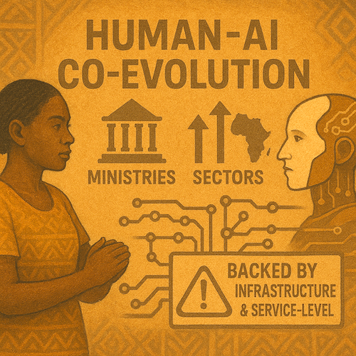
AU AI Strategy aligned to HE-AI Model
L6 – Human-AI Co-Evolution
Relevant AU Strategy Action Lines | Explanation of Fit
2. Public sector adoption (scaled services beyond pilots). 3. Priority sector adoption at production scale. 4. SME adoption at national scale. 6. Compute and datasets (scaled to continental services). 11. Research partnerships (scaling outputs). | Level 6 represents scaling across ministries, sectors, and borders, backed by reliable infrastructure and service-level observability

Slide 20
AU AI Strategy aligned to HE-AI Model
L6 – Human-AI Co-Evolution
Potential Role of NRENs | Role of Regional Research and Education Networks
Support training-of-trainers for ministries to operate scaled AI applications | Enable data-sovereignty compliance via regional federated cloud systems Collaborate with AU MEL platform to produce annual “State of AI in Africa” observability reports

Slide 21
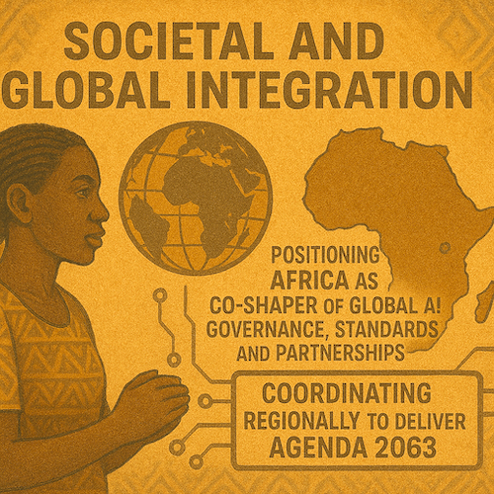
AU AI Strategy aligned to HE-AI Model
L7 – Societal and Global Integration
Relevant AU Strategy Action Lines | Explanation of Fit
13. Promote regional cooperation and stakeholder coordination. 14. Strengthen African participation in global AI governance. 15. Foster partnerships with other regions and global actors. | Level 7 positions Africa as a co-shaper of global AI governance, standards, and partnerships while coordinating regionally to deliver Agenda 2063.

Slide 22
AU AI Strategy aligned to HE-AI Model
L7 – Societal and Global Integration
Potential Role of NRENs | Role of Regional Research and Education Networks
Represent Member States in technical standards bodies (ISO, IEEE, OECD.AI) through academic consortia Publish open datasets, benchmarks, and models under African open-licence frameworks Coordinate with ministries to feed evidence from national AI Commons into AU policy positions | Drive Africa’s unified voice in global AI ethics and governance dialogues (e.g., UN Advisory Body on AI) Support AU Commission in establishing pan-African AI Standards Forum and joint ventures with EU, ASEAN, and OECD

Slide 23
AU AI Strategy aligned to HE-AI Model
Cross-Cutting Benefits of R/NREN
Engagement
Sovereignty & Security: Housing African data and compute in trusted academic networks, NRENs/RRENs protect sovereignty
Inclusivity: Reach to universities and TVETS supports equitable access to AI training and infrastructure
Sustainability: Shared infrastructure reduces duplication and costs, supporting long-term continental resilience
Accountability: R/NREN metrics can feed directly into the AU AI Readiness Index and MEL dashboard

Slide 24
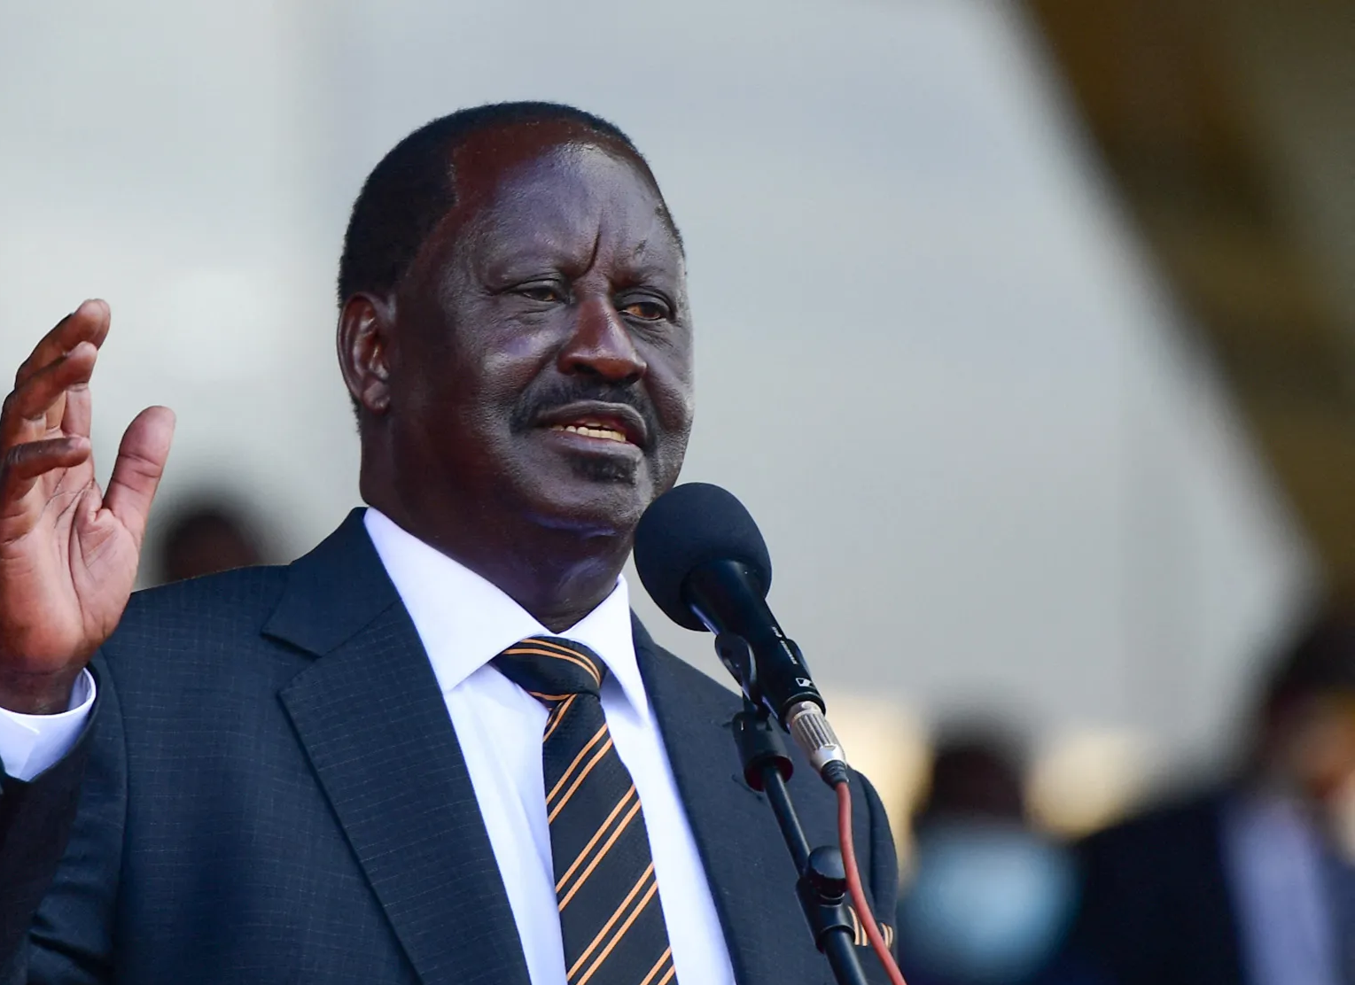
“If this is to be the African century, and we are to usher in a new era of prosperity and peace, then we must harness our vast human and natural resources, and combine the energy of our youth with the vision and wisdom of our leaders.”
- Raila Amolo Odinga
Image: Bloomberg.com

Slide 25

What Role can YOU play in realising Africa’s AI Strategy?
WHAT is holding you BACK?

Slide 26



Thank-You
Prof Madara Ogot
madara.ogot@ubuntunet.net
Twitter: @madaraogot
https://ubuntunet.net
https://doi.org/10.48550/arXiv.2509.07032
https://doi.org/10.60763/africarxiv/10147

