Slide 1

A Smart IoT Honeybee Monitor in Low Resource Settings: Technologies and Design Considerations
UBUNTU-NET alliance Presentation
By
Agatha amara turyagyenda
1st November 2024

Slide 2
CONTENT
Background
Design considerations
Smart IoT Bee Monitoring System
Challenges
Opportunities and Support Technologies

Slide 3
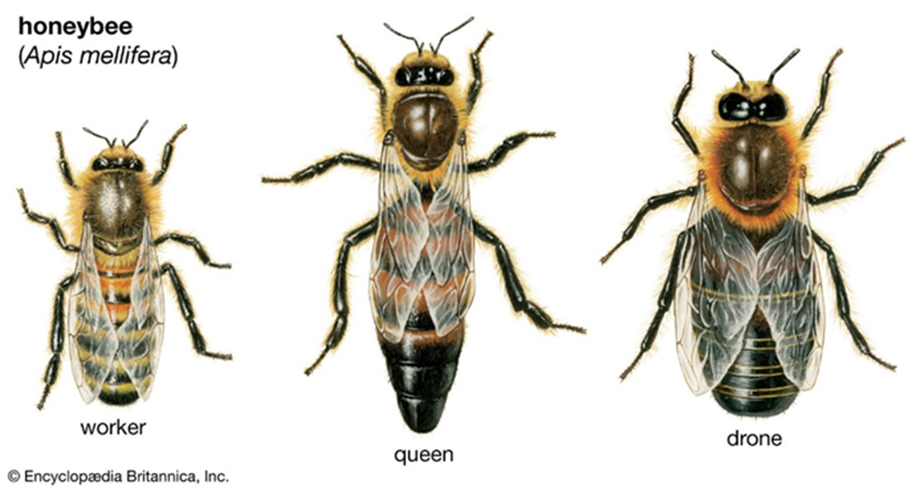
background
75 %
Human consumed crops
85 %
Vegetation exists because of bees
Notes:
Honeybees are vital pollinators in the ecosystem, responsible for 75% of the world’s human consumed crops and pollination of other vegetation that contributes to the ecosystem and allows for diverse species to co-exist.
They are divided into three groups: workers, who build and guard the hive; queens, who lay eggs and the drones whose role is to mate with the queen.

Slide 4
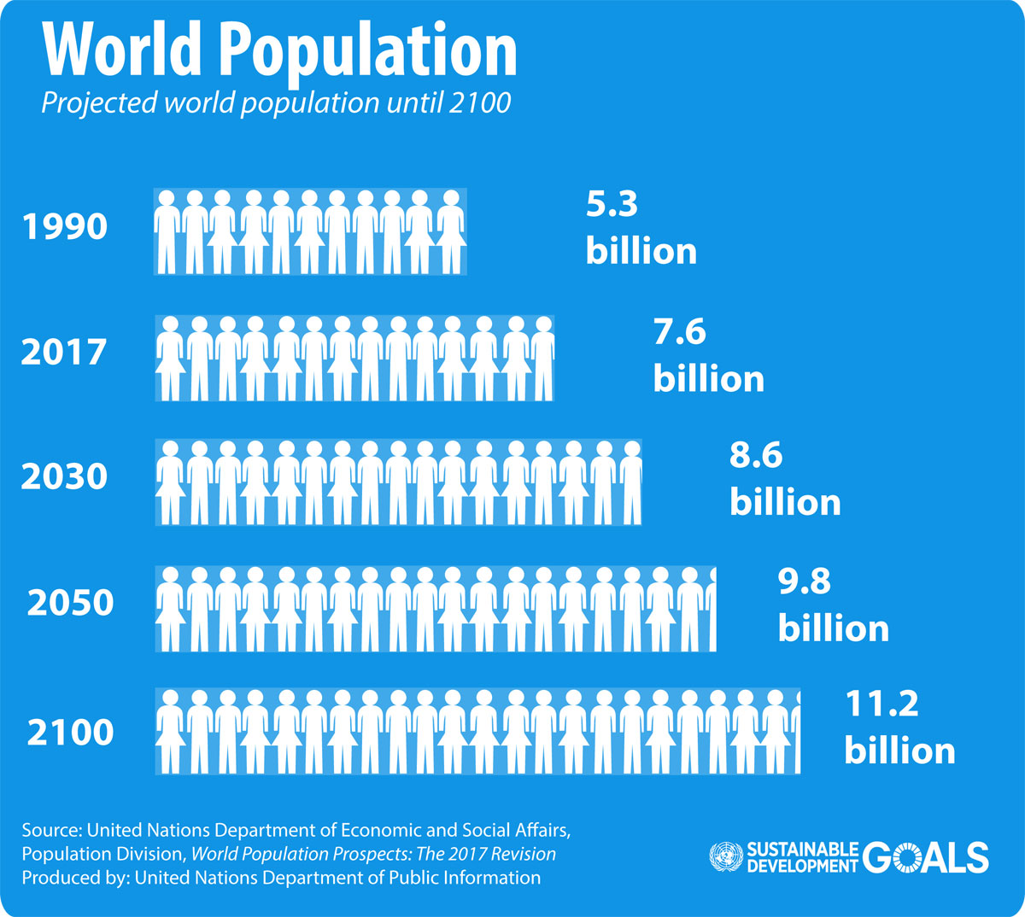

Population growth Vs Food Production
Source: UN Department of Economics and Social affairs
Source: https://www.watchusgrow.org/iffmaterials/

Slide 5
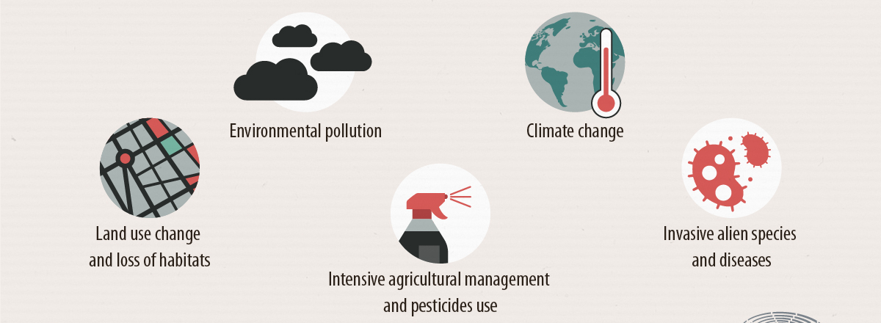
BEE POPULATION DECLINE
Source: European Commission
Notes:
It has been noted globally, 25-50% of bees’ population and bee species are declining.
One of the major causes of decline is the prevalence of pests for example the Varroa mite (Varroa destructor), which has been associated with Colony Collapse Disorder in North America and Europe and the Small Hive beetle in Uganda with a prevalence of about 70% . Pests are a huge threat to honeybees because they feed on their brood, pollen, combs, and the bees, most critically they are disease vectors often carrying viruses that are difficult to identify and treat.

Slide 6
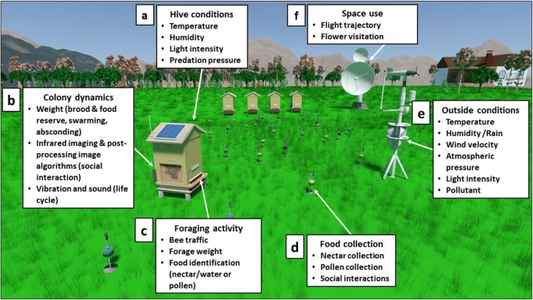
KEY MONITORING PARAMETERS
Source: Automated monitoring of bee behaviour using connected hives
https://link.springer.com/article/10.1007/s13592-019-00714-8

Slide 7
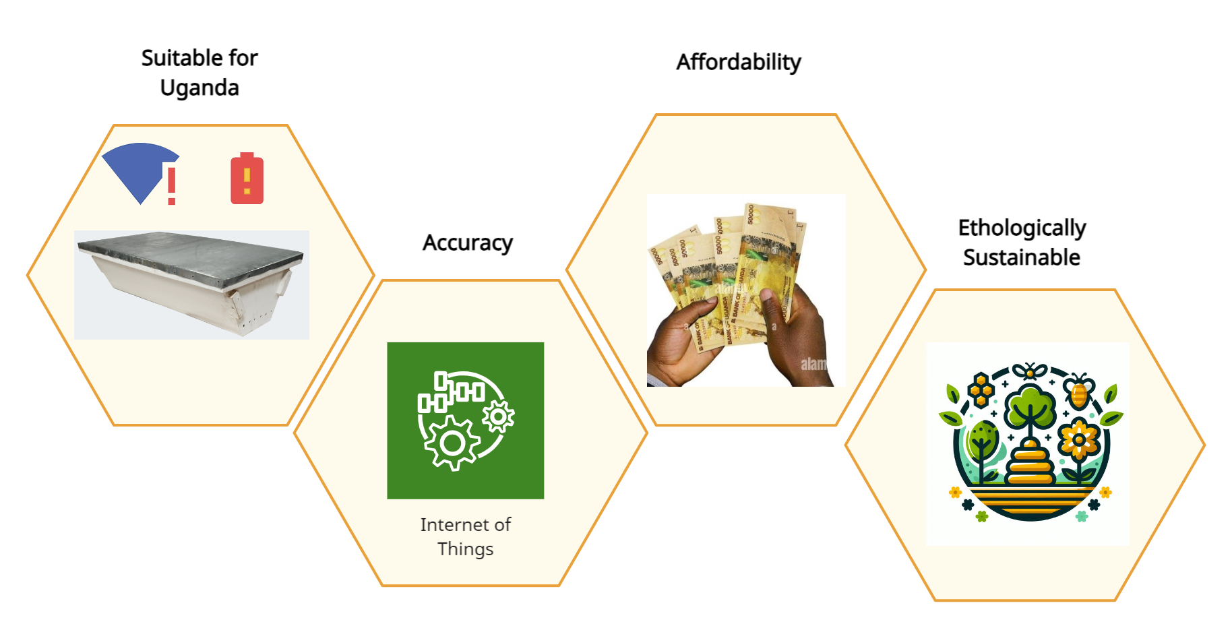
Design considerations

Slide 8
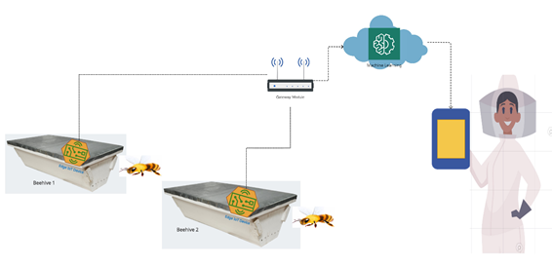
SMART BEE Monitoring SYSTEM
Notes:
the Smart Bee Monitor, a solution that combines technology and sustainability to enhance bee health monitoring. Our goal is to empower local beekeepers with real-time data that can improve hive management and prevent colony collapse.

Slide 9
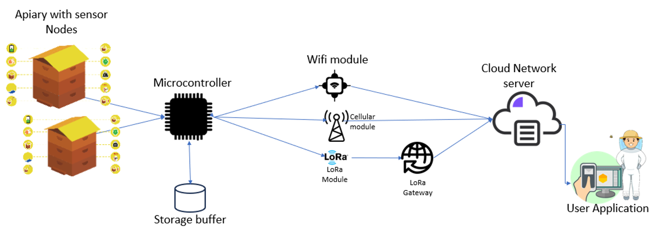
Adaptive Network Design
Notes:
Communication Modules: Combination of LoRa, WiFi, GSM for flexibility.
Minimal Power Consumption: Continuous operation with energy harvesting.
Data Acquisition and Aggregation: Managing both real-time and delay-tolerant data.
Algorithm Integration:
Dynamic Mode Transitioning: Switch between modules based on conditions.
Prioritization Algorithms: Ensure critical data is prioritized for transmission.

Slide 10
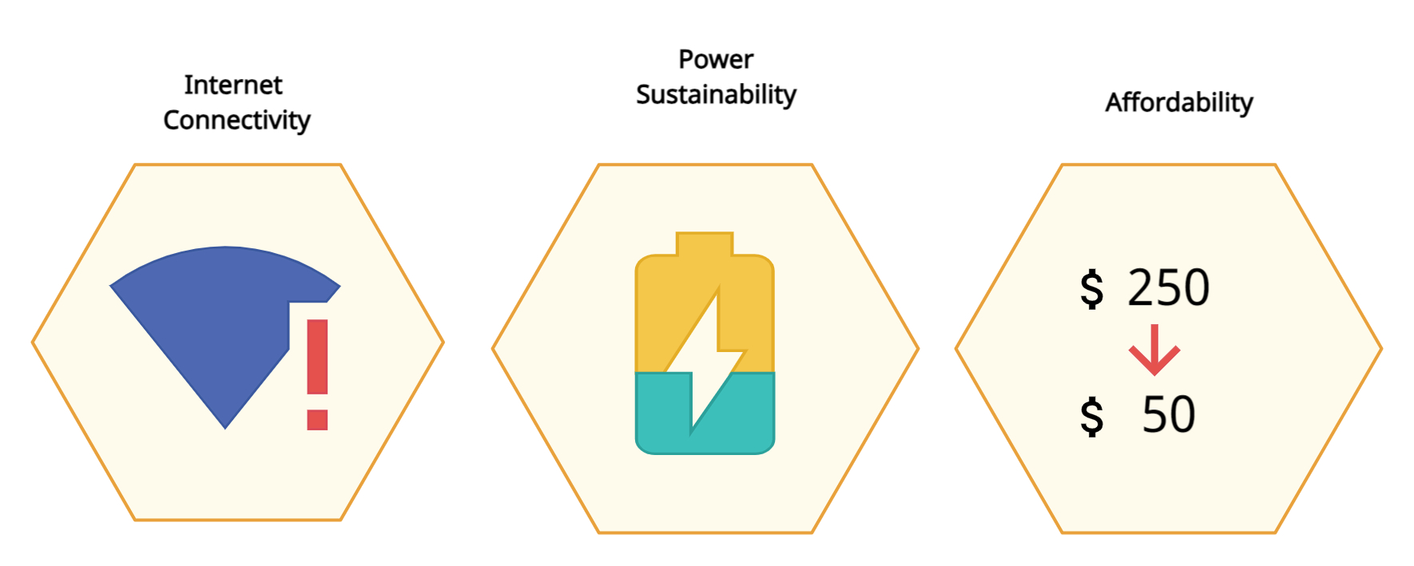
CHALLENGES

Slide 11
Opportunities AND SUPPORT TECHNOLOGIES
Developing affordable IoT hardware that trades off power and computational speed like STM32
Affordable solar energy solutions that integrate communication technologies for remote places or that enable the powering of IoT devices for longevity
Setting up reliable communication networks and integrating low-power wide-area networks (LPWAN)
Singular modules that support different types of communication technology e.g LoRA, GSM, Wifi
Affordable access to AI and machine learning tools that process data e.g Google Cloud AI Platform, Microsoft Azure Machine Learning, Edge Impulse
Open data platforms for sharing hive health data, facilitating collaboration with universities and government agencies

Slide 12

THANK YOU

