Slide 1
Shaping the Future of Education and Research: The Role of ICT Policy Frameworks in Higher Learning Institutions
Mr. Ben Ruhinda , Senior Systems Officer
Inter-University Council of East Africa
1st Nov 2024
UbuntuNet Connect 2024
Dar es Salaam , URT

Slide 2
Outline presentation
IUCEA
History
Why Education and Research
The Role of ICT Policy Frameworks in HLIs
Propose EAC ICT Policy Frameworks
Future trends
Call for action and reflection

Slide 3
IUCEA : Historical Perspective
In 1970 established as Inter-University Committee (IUC) under the East African Community to foster and facilitate collaboration among the newly established National Universities: Uni. of Dar es Salaam (TZ), Uni. of Nairobi (KEN), Makerere Uni. (UG).
In 1980 IUC transformed into IUCEA as an Inter-governmental organization of Kenya, Tanzania, and Uganda facilitating contacts among universities in the 3 countries.
In 1999 when the East African Community was re-established, IUCEA was taken up as an institution of the EAC Community
Notes:
Me, journalist with THES etc. Conversations with Manuel Castells to appear in Korean in 2006.
Me, journalist with THES etc. Conversations with Manuel Castells to appear in Korean in 2006.

Slide 4

Back in History

Slide 5

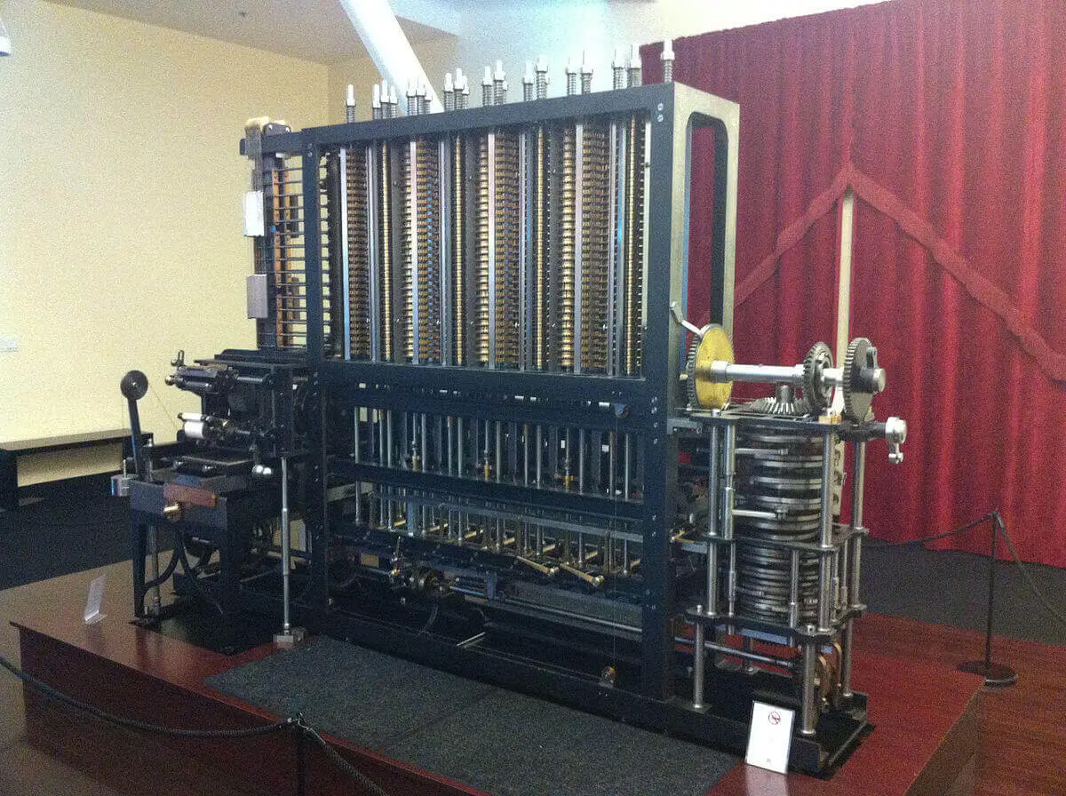
Back in History
1613 Word Computer meant “ a person who perform complex calculations; they were mathematicians and bookkeepers.”
The first computer, that we know about, is the Antikythera mechanism (200 BC -- 70 BC).
A reconstruction of the Antikythera -- the world's first "computer".
Source; Bricsys Blog

Slide 6

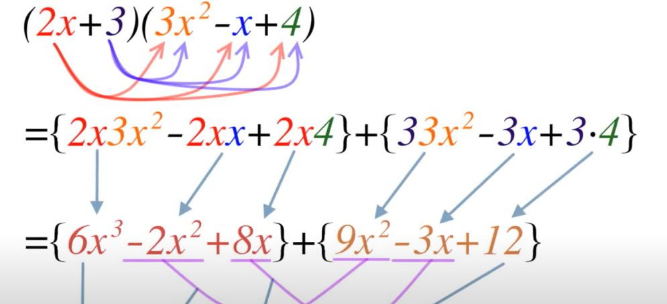
1822 Babbage started working on a Difference Engine its purpose was to compute polynomial functions.
Source; Bricsys Blog

Slide 7
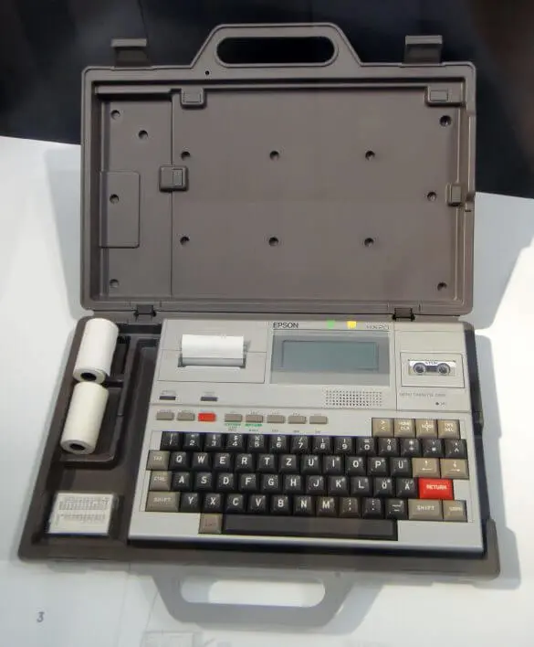
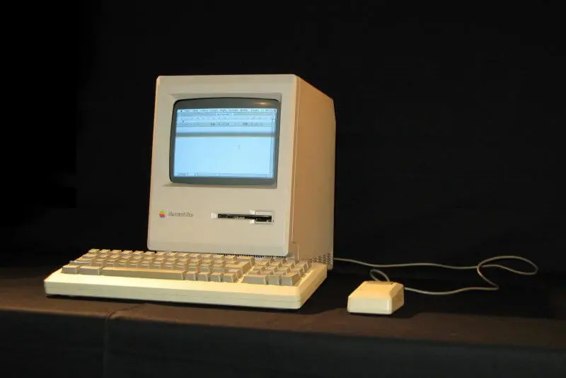
1981 The first laptop was the Epson HX-20 (HC-20/HX-20)
first Macintosh in 1984.
Source; Bricsys Blog

Slide 8
Why Education and Research is necessary.
Education fosters critical thinking, creativity, and skills necessary for personal and professional growth.
Research drives innovation and advances knowledge, addressing societal challenges and informing policy. Together, they empower individuals and communities to adapt, thrive, and contribute to a rapidly changing world.

Slide 9

Education fosters critical thinking, creativity, and skills necessary for personal and professional growth.
Research drives innovation and advances knowledge, addressing societal challenges and informing policy. Together, they empower individuals and communities to adapt, thrive, and contribute to a rapidly changing world.

Slide 10
Why ICT Policy Frameworks in the HLIs
structured guidelines and strategies designed to integrate technology effectively into educational systems.
It outlines the goals, responsibilities, and best practices for integrating ICT into life cycle of Education.
Notes:
ICT policy framework is essential for creating a cohesive strategy that maximizes the benefits of technology in education while addressing challenges and ensuring sustainable practices.

Slide 11
IUCEA
Advisory
Coordination
Awareness
RENS /NRENS
Technology enabling
Capacity building
Universities
ICT leadership
Content
Creator (user)
Content Management (Library)
Policy formulation

Slide 12
W >> W>> W>> >>>W >>>>W
Vision
Mission
Objective
Governance
Performance Measurement

Slide 13
5 W
Vision
Mission
Objective
Governance
Performance Measurement

Slide 14
Objective of the ICT Framework
To promote seamless adoption
To ensure wider access to digital infrastructure
To promote digital skills development
Feedback on the ICT Policy Framework for HLIs
To have an ICT benchmarking tool
To enhance collaboration and partnerships
To facilitate cooperation for skills transfer, experiences’ sharing and best practice

Slide 15
Key components in ICT policy frame- work for EAC HLIs
Infrastructure
Software Assets
Accessibility
Equity
Security
Data Management
Innovation and Continuous Improvement
Compliance and Legal Considerations
Training and Development
Resource Management
Notes:
creating a supportive infrastructure, fostering collaboration, and ensuring ongoing evaluation, effective policies can significantly enhance the role of technology in teaching and research, ultimately improving educational outcomes and advancing knowledge.

Slide 16
Challenges in Implementation
Budget constraints and funding issues.
Resistance to change
The digital divide and disparities in technology access

Slide 17
Governance structures
Regional ICT Policy Steering Committee
National Higher Education ICT Planning Committee
Institutional ICT Steering Committees

Slide 18

KPI
Infrastructure Development
Connectivity and Access
Capacity Building and Professional Development
Content Development and E-Learning
Policy and Governance
Collaboration and Partnerships
Student and Staff Mobility

Slide 19
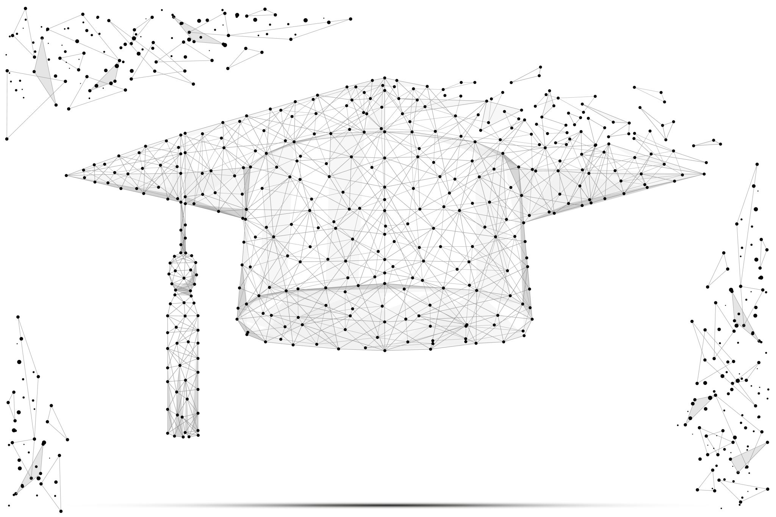
Future trends in education
Artificial Intelligence (AI) and Machine Learning
5G Technology
Augmented Reality (AR) and Virtual Reality (VR)
Biotechnology
Blockchain
Edge Computing
Internet of Things (IoT)
Quantum Computing
Renewable Energy Technologies
Robotics and Automation

Slide 20
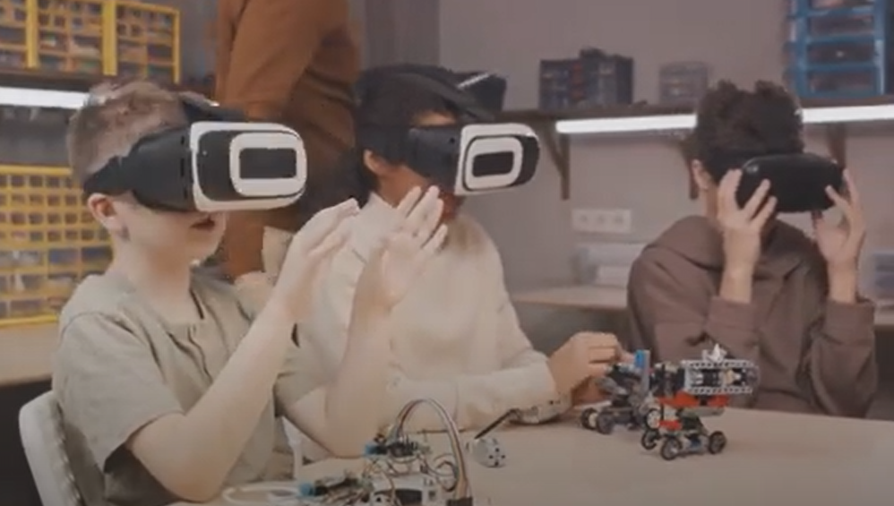


Slide 21

Artificial Intelligence (AI) and Machine Learning
5G Technology
Augmented Reality (AR) and Virtual Reality (VR)
Biotechnology
Blockchain
Edge Computing
Internet of Things (IoT)
Quantum Computing
Renewable Energy Technologies
Robotics and Automation

Slide 22

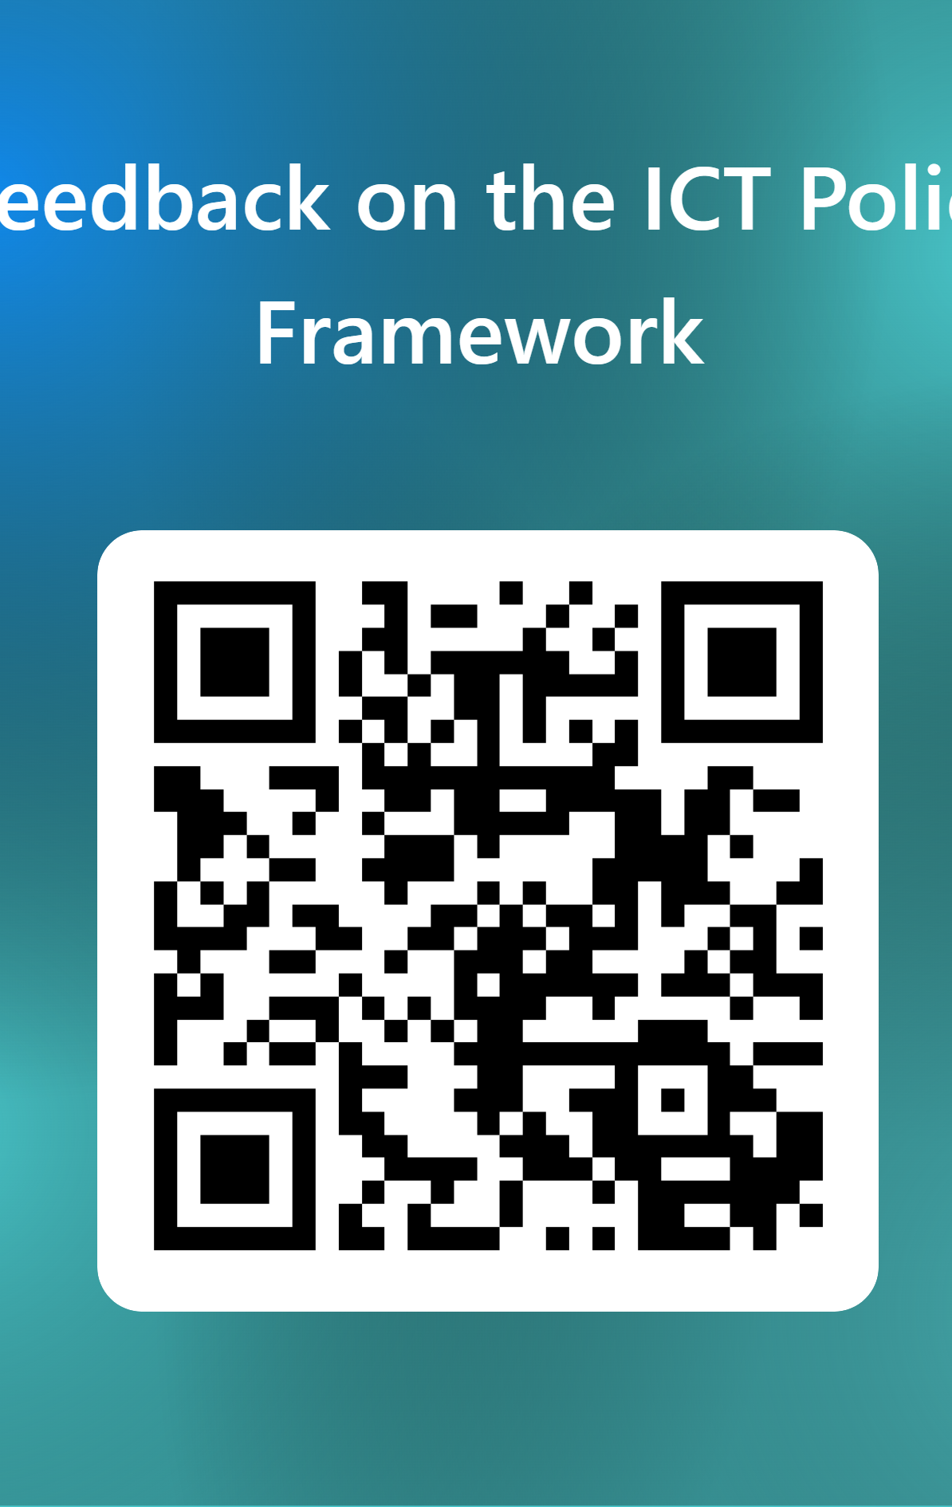
Call for action and reflection
https://www.iucea.org/baj6

Slide 23
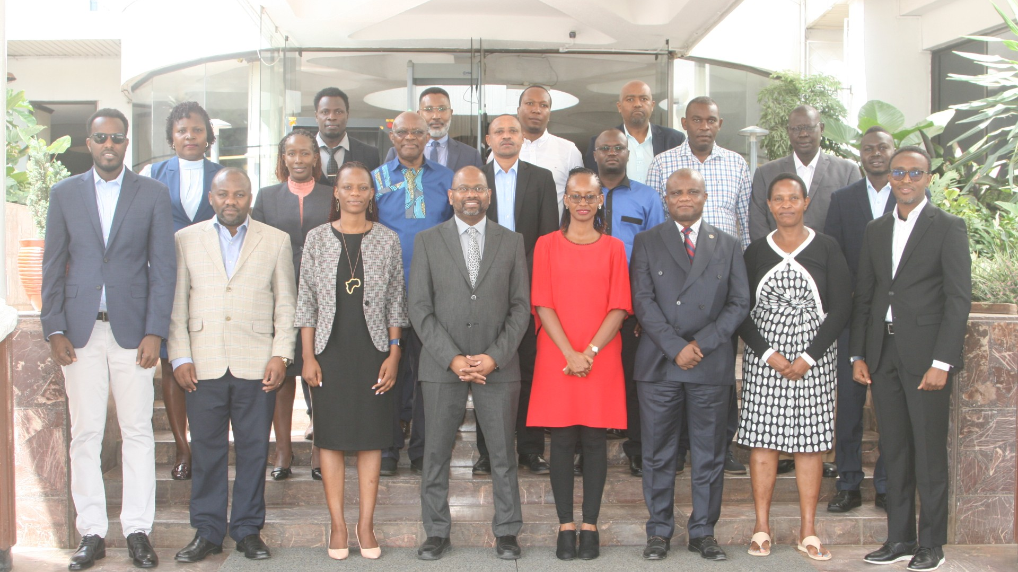

Slide 24
Thank you
Ben G. Ruhinda, Senior System Officer
bruhinda@iucea.org @iucea_info
www.iucea.org

Slide 25


