Slide 1


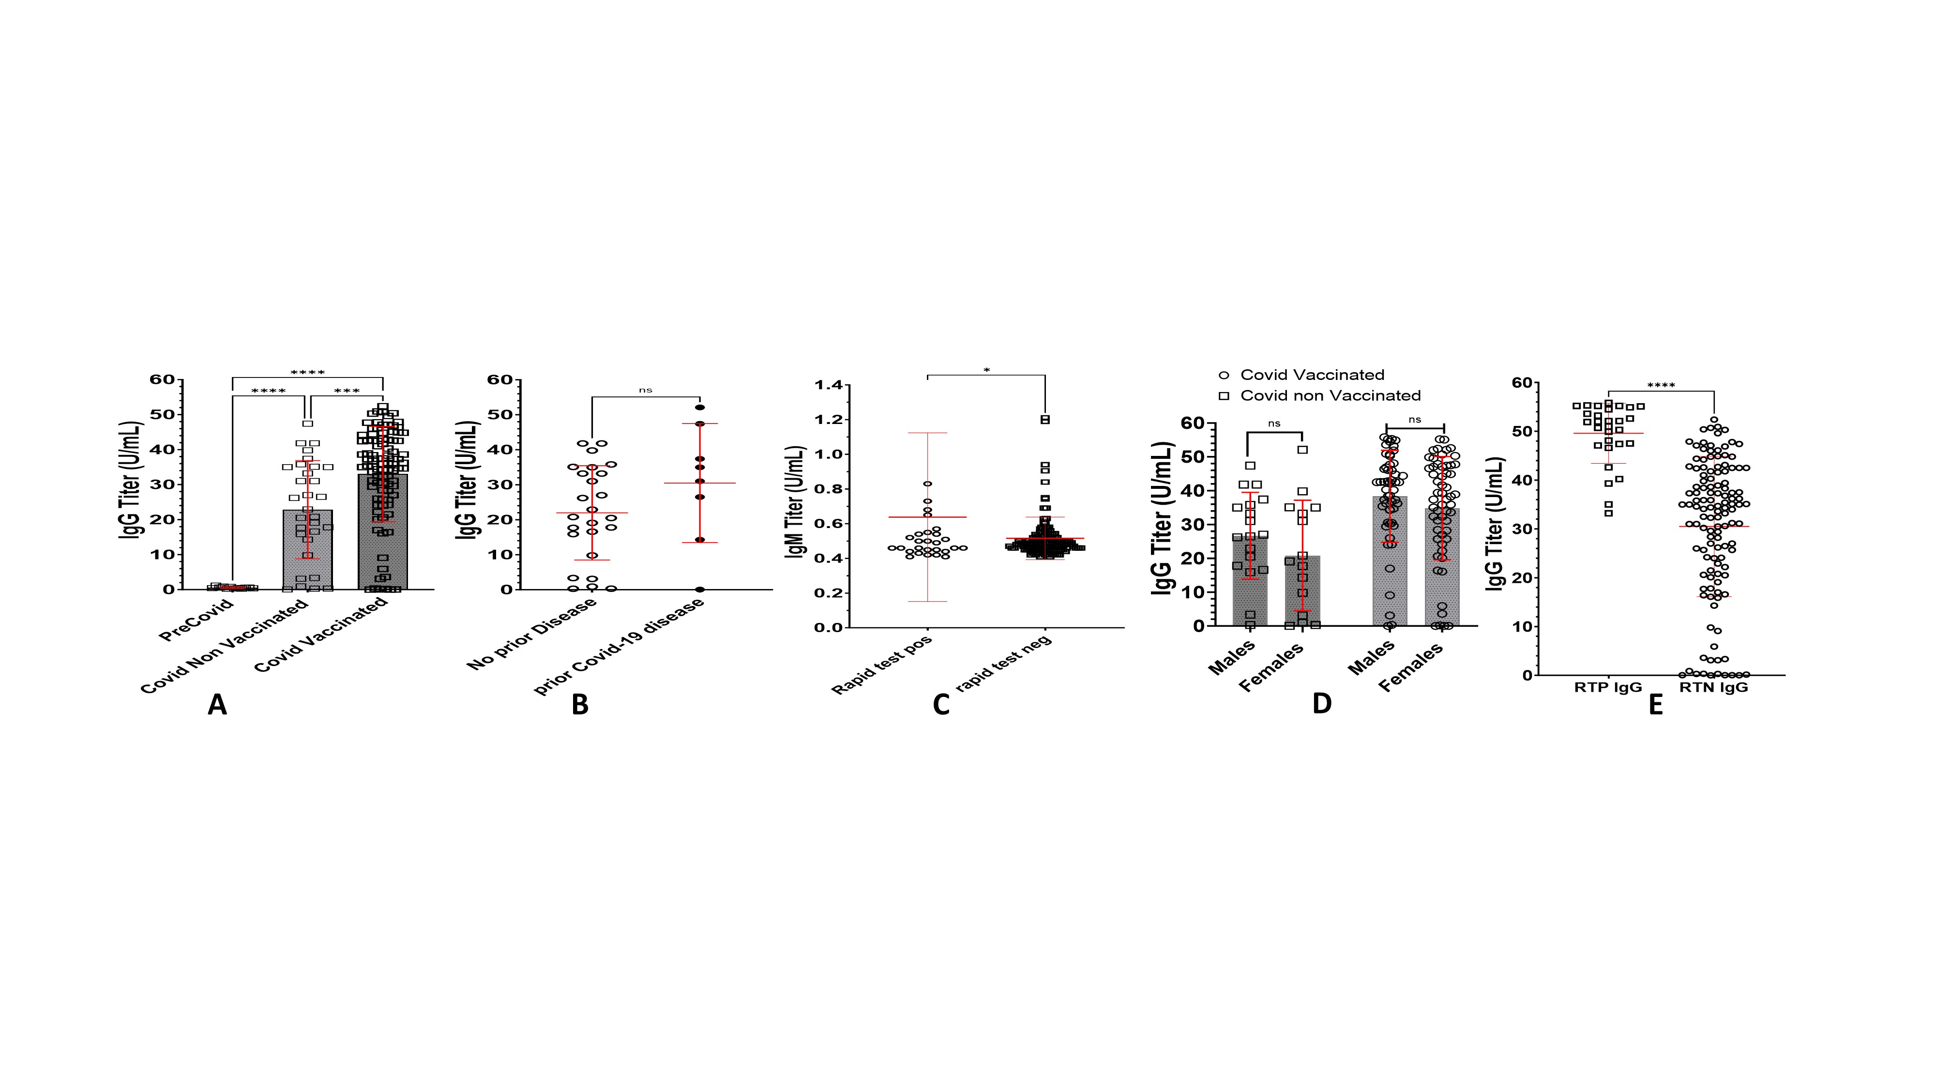
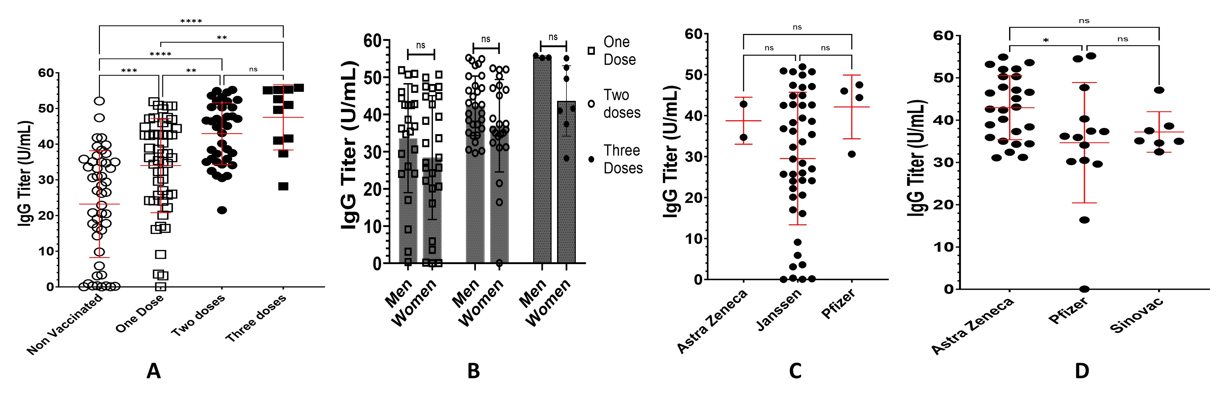
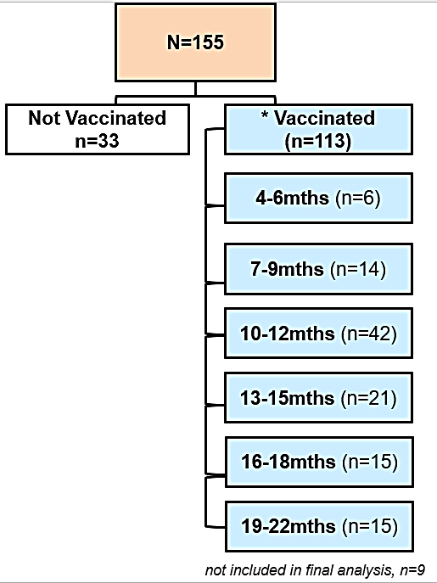
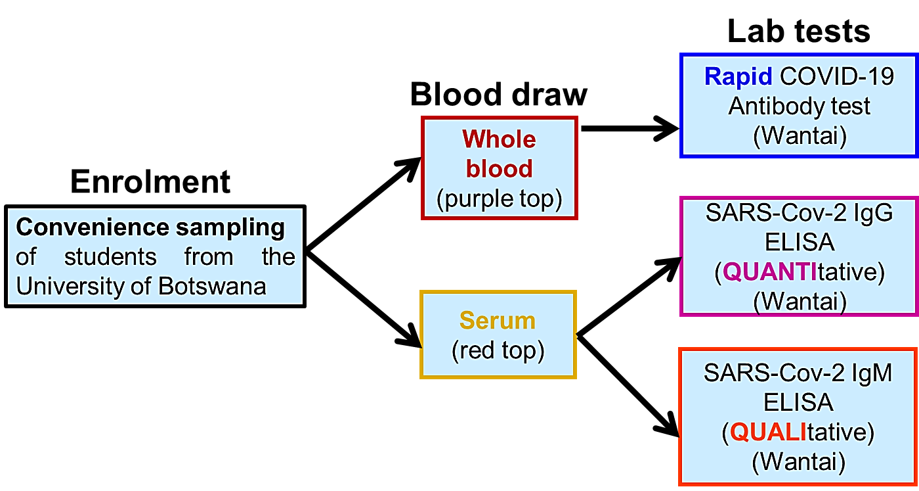
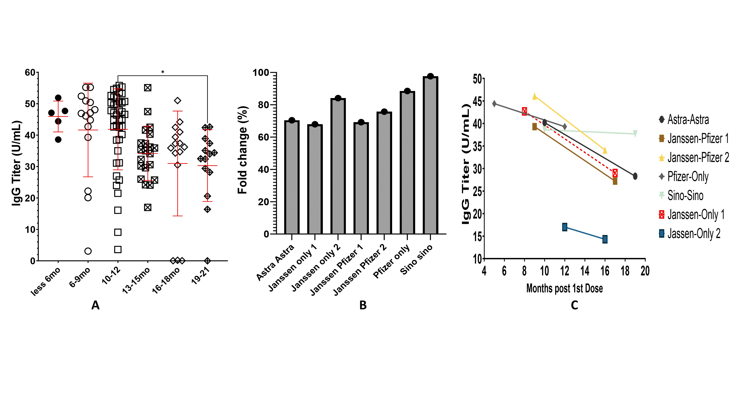
A comparative analysis of the antibody titers to different SARS-COV-2 vaccines in vaccinated tertiary students in Botswana
Naledi Mannathoko PhD¹, Monei Machailo BSc¹, Keagile Bati MSc¹, Tsaone Chalumbila MSc¹, Sajini Souda MD², Thero Modise PhD¹, Keikantse Matlhagela PhD¹, Shathani Nkhwa PhD¹, Enoch Sepako PhD¹, Ludo Badlangana PhD¹, Mighty Kemelo MD PhD^{1 ,} Mosepele Mosepele MD, MSc³, *Bokang Maswabi MD, PhD¹
¹Department of Biomedical Sciences , Faculty of Medicine, University of Botswana, Gaborone, Botswana; ²Department of Pathology, Faculty of Medicine, University of Botswana, Gaborone, Botswana, ³Department of Internal Medicine, Faculty of Medicine, University of Botswana, Gaborone, Botswana
Background
Results cont'd
Rapidly evolving new variants of SARS-CoV-2, e.g., alpha, beta, delta and omicron, were associated with higher transmissibility and pathogenicity causing new waves of infections in most countries. During the Covid-19 pandemic Botswana like most countries in Africa initiated a rigorous vaccine program to protect its population. Due to the dynamics of vaccine availability Botswana engaged in a heterologous mix and match vaccine strategy which relied on using generally available vaccines while. The country prioritised vulnerable citizens. Hence subjects received various vaccines, in varying regimens in both homologous and heterologous combinations. In Botswana, the administered vaccines included inactivated virus-based vaccines Sinovac/CoronaVac, mRNA-based vaccines Pfizer-BioNTech and Moderna and lastly viral vector-based vaccines AstraZeneca and Janssen by Johnson & Johnson. These vaccines stimulate immune responses, including B-cell (humoral/antibody) activation with subsequent production of antibodies (IgM, IgG, IgA) [2,3,4]. Research work was done to analyse and quantify induced antibody titers (IgM and IgG) in vaccinated and non-vaccinated individuals during the Covid-19 pandemic. We also enrolled participants in a longitudinal cohort-based sero-epidemiological survey to quantify the proportion of subjects who were seropositive at various points during Covid-19 pandemic.
Figure 2. IgG titers based on: (A) vaccination status, (B) IgG titers in Non vaccinated individuals, (C) IgM titers (ELISA) at contact, (D) In vaccinated versus non vaccinated individuals and (E) Rapid test status. Antibody titers from pre Covid samples were included for comparison (2A). Initial analysis of subjects with a point of care rapid test showed IgM seroprevalence of 18.7% in all subjects. Subsequent IgM analysis by ELISA qualitative test showed seroprevalence at 2.6%. Analysis of total IgG titers showed 100% seropositivity in both non vaccinated (mean titer levels 22.82U/mL 95% C.I. of 17.67-27.97) and vaccinated (mean titer levels 33.02.U/mL 95% C.I. of 30.23-35.81). In comparison, pre-Covid samples showed mean titer levels of 0.56 U/mL, 95% C.I. of 0.38-0.72). Vaccination conferred significantly higher levels of humoral immunity (2A) though this immunity is similar between the sexes (2D). In both vaccinated and non-vaccinated individuals, there was no significant difference in IgG titers between individuals who had prior Covid-19 disease versus those who reported not having had the disease (2B). RTP=rapid test positive, RTN=rapid test negative.
Aim and objectives
To detect and quantify anti-SARS-COV-2 IgM and IgG antibody titers in the serum of all individuals.
To compare the levels of anti-SARS-COV-2 IgG antibody titers elicited after administration of different types of vaccines
Methods
Figure 3. IgG titers comparison based on: (A) Number of vaccine doses received, (B) Numbers of doses vs gender, (C) Single dose vs vaccine type, (D) two doses of homologous vaccine. Comparison of antibody titers based on number of doses received showed that when compared to a single dose regimen a double dose regimen confers significantly higher antibody titers. A three-dose (booster) regimen is not significantly different from a two-dose regimen (3A). There were no significant differences based on gender in comparison to dose regimen (3B). Regardless of the vaccine type, all single dose regimens elicited similar antibody levels (3C) though in a two-dose homologous regimen the viral vector vaccine Astra Zeneca/Covishield showed significantly higher titers when compared to the mRNA vaccine Pfizer (3D). This advantage was not apparent when AstraZeneca was compared to Sinovac.
Figure 1. Study workflow of the cross sectional study done at the University of Botswana
A 10 ml venous blood was drawn at enrolment. 10 µL was then used in the rapid WANTAI SARS-Cov-2 Ab, an immunochromatographic test for qualitative analysis of total antibodies for SARS-Cov-2 Ab. The test result was read after 15 minutes incubation at room T°C. The remaining blood was centrifuged and stored as serum(4ml) and plasma(4ml) at -80°C and later tested for total IgG antibodies using WANTAI SARS-CoV-2 IgG ELISA(Quantitative) and WANTAI SARS-CoV-2 IgM (Qualitative) ELISA according to manufacturer instructions.
Figure 4. IgG titers based on; (A) Time between when sample was obtained and first doses administered (B) IgG titer fold change analysis, (C) Vaccine specific longitudinal IgG analysis. Analyses of titer levels at different time levels showed that titer levels are significantly different/reduced at time points of over 1 year (4A) and this was irrespective of the vaccine received. The reduction at over 18 months post vaccination still exhibits higher values of titer levels when compared to unvaccinated individuals.
Conclusions
Results
IgG titers were significantly higher in vaccinated individuals compared to non-vaccinated individuals. In both these groups, asymptomatic and symptomatic disease did not show significant differences in titer levels.
There was no statistical differences in IgG titers between the sexes regardless of vaccination status.
IgG titers were significantly higher in vaccinated individuals compared to non-vaccinated regardless of numbers of doses received and individuals who received two doses had significantly increased titers compared to single dose recipients. Booster doses did not confer any significant increase in titers.
Single doses of the vaccines analysed did not elicit any significantly different IgG titers from each other but after 2 doses, AstraZeneca induced significantly higher IgG titers than Pfizer. Double doses of both AstraZeneca and Sinovac elicited similar titers.
Longitudinal sampling shows that IgG titers decreased with time after vaccination irrespective of the vaccine used or dose regimen used.
Variable |  | Number | Vaccinated | Unvaccinated
Age | 18-20 | 65 | 56 | 9
 | 21-40 | 89 | 65 | 24
 | 41-60 | 1 | 1 | 0
 | Total | 155 | 122 | 33
Gender | Male | 78 | 60 | 18
 | Female | 77 | 62 | 15
Covid-19 Rapid test | POS | 29 | 27 | 2
 | NEG | 126 | 95 | 31
Covid-19 before vaccination | No | 104 | 79 | 25
 | Yes | 51 | 51 | 8
Disclosure
Table 1. Summary of demographic data and COVID-19 vaccination status of enrolled participants (n=155).
Authors disclose no possible financial or personal conflicts of interest
Approved by the Ministry of Health research & development committee and the Institutional Review Board of the University of Botswana
The findings and conclusions in this report are those of the authors, who had no conflict of interest with the funding body
33% (51/155) of participants had a prior COVID-19 infection.
22% (27/122) of vaccinated participants tested positive using rapid test, although had no presenting symptoms.
Rapid test results: POS = 18.7%, NEG = 81.3%.
Qualitative IgM test results: POS = 2.6%, NEG = 97.4%.
Acknowledgements
This work was supported by the Africa rapid grant fund via National Research Foundation of South Africa
The project was also supported by the University of Botswana Office of Research and Development
REFERENCES: [1] www.afro.who.int/countries/botswana/news/learning-botswanas-covid-19-vaccine-rollout [accessed 15 October 2023]; [2] Fraussen J. IgM responses following SARS-CoV-2 vaccination: insights into protective and pre-existing immunity. EBioMedicine. 2022 Mar;77:103922. doi: 10.1016/j.ebiom.2022.103922; [3] Montague, B.T., Wipperman, M.F., Chio, E. et al. Elevated serum IgA following vaccination against SARS-CoV-2 in a cohort of high-risk first responders. Sci Rep 12, 14932 (2022). https://doi.org/10.1038/s41598-022-19095-7; [4] Ruggiero A, Piubelli C, Calciano L, et al. SARS-CoV-2 vaccination elicits unconventional IgM specific responses in naïve and previously COVID-19-infected individuals. EBioMedicine. 2022 Mar;77:103888. doi: 10.1016/j.ebiom.2022.103888.
Contact: Bokang Maswabi, MD, PhD, maswabib@ub.ac.bw; +267 75089832

