Slide 1
Empowering African NRENs Using A Cost-Effective Cloud Solution
  Presenters:
  Brenda Namuli bnamuli@renu.ac.ug
  Derrick Ssemanda dssemanda@renu.ac.ug

Slide 2
Overview
Outline
Cloud Computing
Problem Statement
Why the RENU Cloud?
Virtualization Environments
RENU’s Journey to the Cloud
RENU Cloud Solutions
Challenges
Lessons Learned
Recommendations
31st October 2024

Slide 3

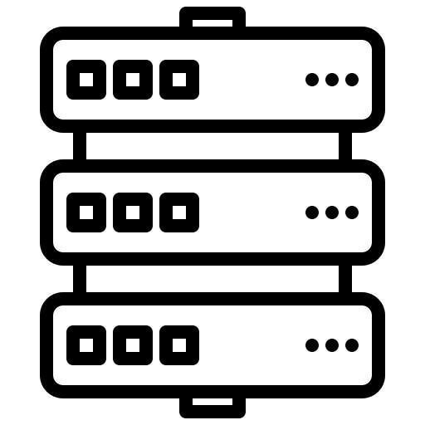



Cloud Computing
The delivery of computing services—including servers, storage, databases, networking, software, analytics, and intelligence—over the internet to offer faster innovation, flexible resources, and economies of scale.
DATABASES
SERVERS
SOFTWARE
STORAGE
NETWORKING
Notes:
Cloud Computing is the delivery of computing services—including servers, storage, databases, networking, software, analytics, and intelligence—over the internet (“the cloud”) to offer faster innovation, flexible resources, and economies of scale. This allows institutions to access IT resources on-demand without owning or maintaining physical infrastructure.
Cloud computing has become critical for scaling institutional operations efficiently.Institutions increasingly rely on cloud resources to manage operations, research, and educational services.
Institutions need to balance the increasing demand for cloud services with financial and regulatory constraints.The challenge is to find affordable, locally controlled cloud solutions that meet these needs
This visually communicates the idea that cloud computing allows users to access and manage different IT resources (servers, storage, etc.) through the internet, all centralized in the "cloud.“
The image effectively conveys that cloud computing provides a flexible, scalable way for institutions to manage their IT needs without owning or maintaining physical infrastructure. By using the cloud, institutions can tap into a broad range of services and resources via the internet.
Flexible & scalable way for institutions to manage their IT needs

Slide 4

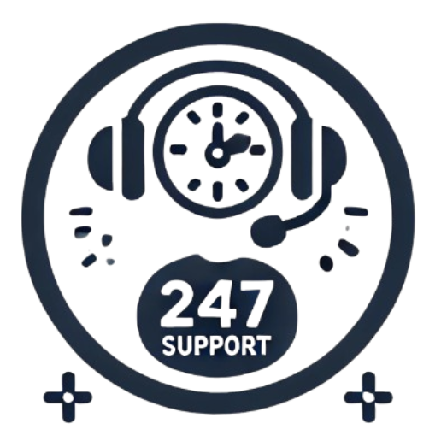




Problem Statement
  Policy Constraints
  24/7 Customer Support
  Security & Privacy Concerns
  Cost Implication
  Technical Capacity
  Bandwidth and Network Limitations
Notes:
Policy Constraints - Many institutions must comply with national or institutional regulations that require sensitive data (e.g., student records, research data) to be hosted within the country or institution. This restricts their ability to use global commercial cloud services, especially if the cloud provider’s data centers are located abroad. For example, some countries enforce laws around data sovereignty, which can limit the options for cloud services.
Cost - Costs include not just storage and processing but also network traffic, backups, and premium support. For institutions with limited budgets, especially in education and research, these expenses can quickly become unaffordable.
Customer support - Institutions often require 24/7 support to ensure continuous operation of critical systems. Commercial cloud providers may offer this, but typically at high costs. Additionally, support may not always be tailored to local contexts or available in the institution's preferred language.
Technical capacity - Many institutions lack the technical expertise to manage and support cloud infrastructure effectively. Engineers and IT staff may not be familiar with the complexities of cloud computing, which involves different approaches to resource management, security, and operations compared to traditional on-premises systems. A lack of technical knowledge can slow cloud adoption, increase the risk of misconfigurations, and leave institutions vulnerable to security issues. Staff may also need significant training, further stretching already limited resources.
Data security and privacy concerns Due to the restrictions on data transfers outside Uganda, institutions are compelled to either use local cloud service providers or ensure that any international cloud provider they use has data centers in Uganda or a country with similar data protection standards. For institutions that rely on global cloud services, this presents a barrier to adoption, as they must either navigate complex compliance regulations or face penalties for non-compliance.
Bandwidth and network limitations - Cloud services depend heavily on reliable and high-speed internet connectivity for efficient performance. Many institutions, especially those in developing countries or remote regions, may struggle with limited bandwidth or unreliable network infrastructure, which can negatively affect their ability to leverage cloud services effectively. These limitations often manifest as slow data transfers, network congestion, or downtime when accessing cloud resources, making it difficult for institutions to rely on cloud services for critical functions like learning management systems (LMS), research, or data analysis.

Slide 5
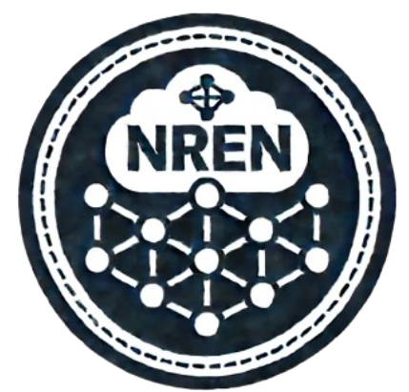






Why the RENU Cloud?
  Low Latency
  Capacity Building
  Cost Savings
  Localized IT Support
  Compliance
  Custom Solutions
Notes:
NRENs (National Research and Education Networks) have long-established relationships with educational and research institutions. They already provide network services, high-speed internet access, and other IT infrastructure. This makes them a trusted partner for institutions seeking cloud solutions.
Low latency - With NRENs hosting local cloud solutions, data stays within the country or region, dramatically reducing the time it takes to access cloud services. Data transfers within the RENU network are not capped.
Compliance - Many institutions must comply with local and national data policies, particularly concerning the storage and processing of sensitive data like student records and research data. NRENs, being local organizations, can easily ensure that all data remains within national boundaries, addressing concerns about data sovereignty. By hosting the cloud locally, NRENs can guarantee compliance with legal frameworks such as data protection laws specific to their country.
Localized Support - Unlike global commercial cloud providers, NRENs understand the specific needs and challenges faced by local institutions. They can provide tailored solutions and support, often at a lower cost, because they have local expertise and an established support network.
NRENs are also more accessible to institutions, offering personalized and faster support that can be crucial for resolving urgent issues.
Custom SOlutions - Unlike commercial cloud providers that cater to a broad market, NRENs are specifically designed to meet the unique needs of educational and research institutions. They understand the specific IT, data, and collaboration requirements of academia.NRENs often facilitate tools for research collaboration, file sharing, and joint academic projects, making them more aligned with the needs of universities and research institutions.
Low costs - Non-Profit Nature: NRENs typically operate as non-profit organizations, focusing on providing services at cost rather than generating profit. By pooling resources and sharing infrastructure among institutions, NRENs can significantly reduce the cost per institution, making cloud services more affordable for even smaller institutions with limited budgets.
Capacity Building - NRENs often engage in capacity-building initiatives to help member institutions improve their IT infrastructure and skillsets. This includes providing training for IT staff, developing best practices for cloud management, and offering ongoing technical support tailored to local institutions’ needs.

Slide 6
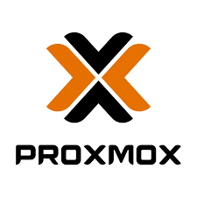
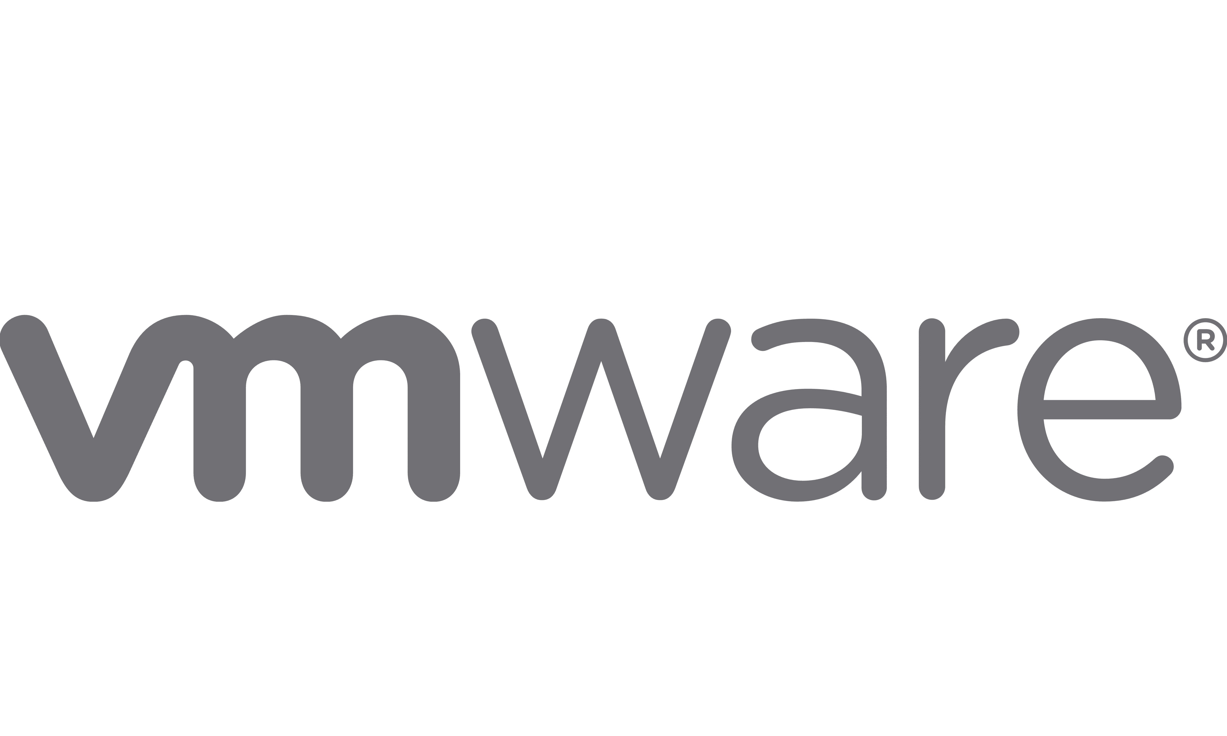
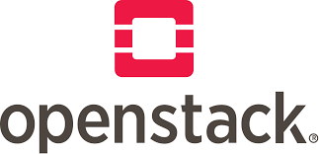

Virtualization Environments
Virtual environments allow multiple operating systems or applications to run on a single server by creating virtual machines (VMs) or containers.
Benefits
Resource Efficiency
Cost Savings
Scalability
Flexibility
Improved Management
  RENU adopted virtual environments to optimize infrastructure and meet the growing demands of our institutions.
Notes:
Building blocks for any cloud environment

Slide 7
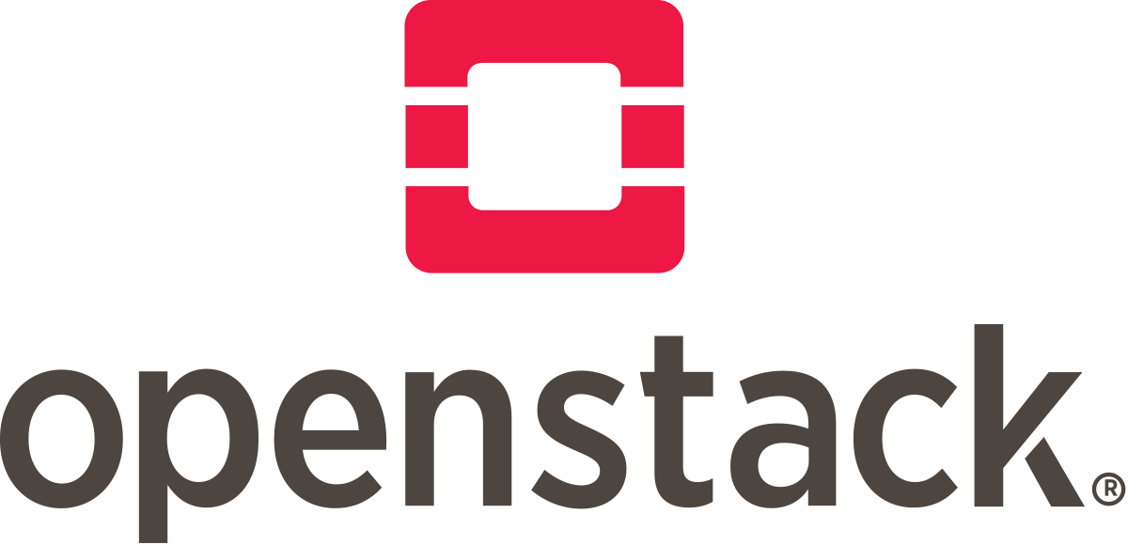
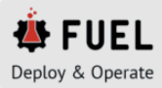

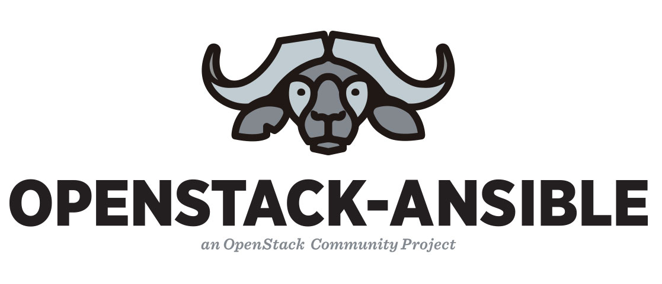
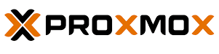
RENU’s Journey to the Cloud
Deployed multiple cloud platforms
Specific use cases
Based on scalability, flexibility, and cost-effectiveness.
Fuel Openstack | Ganeti | Openstack Ansible | ProxmoxVE
Highly scalable | Mid-level solution | Automated with Ansible | Streamlined setup
Robust, flexible | Live migration, failover | Reduced manual work | Cost-effective
Complex setup | Resource-efficient | Ideal for automation | Best for small deployments
Notes:
RENU has deployed various cloud platforms over the years to support the growing needs of our institutions.
Each platform served a different purpose based on scalability, flexibility, and cost-effectiveness.
OpenStack:
As the demand for more robust and scalable cloud services grew, we turned to OpenStack. This platform provided the scalability we needed for large-scale deployments such as research data centers.
While OpenStack allowed us to build highly scalable environments, it came with a significant learning curve and required technical expertise for deployment and management.
Use case: Best suited for larger, complex environments where deep customization and control over networking, storage, and compute services were needed.
Ganeti:
Ganeti is another platform we’ve deployed. It provided us with a mid-level solution between the simplicity of Proxmox and the complexity of OpenStack. Ganeti allowed for live migration, failover, and cluster management, but with a lower resource overhead.
Use case: Ideal for mid-sized deployments, such as managing virtual machines for specific research projects, where reliability and resource efficiency were key."
Proxmox VE:
ProxmoxVE was one of our first deployments. It offered a streamlined setup and allowed us to quickly deploy virtual machines and containers with minimal infrastructure. It became a cost-effective solution for smaller projects where we needed simplicity and ease of management.
Use case: Hosting smaller services such as digital repositories and Learning Management Systems (LMS).
OpenStack Ansible:
To address the complexity of managing OpenStack, we then explored OpenStack Ansible, which helped us automate the deployment and management processes using Ansible playbooks. This significantly reduced manual intervention and made cloud management more efficient.
Use case: Deployed in environments where automation and repeatability were essential, particularly in growing infrastructures that required frequent updates.
Each of these cloud platforms has played a unique role in helping us build a more resilient and scalable cloud infrastructure. By leveraging the strengths of ProxmoxVE, OpenStack, OpenStack Ansible, and Ganeti, we’ve been able to meet the diverse needs of our member institutions while overcoming challenges in cost, technical expertise, and scalability.

Slide 8
RENU Cloud Solutions
Platform | Fuel Openstack | Ganeti | Openstack Ansible | ProxmoxVE
Type | Open-source cloud computing platform for private and public clouds. | Open-source cluster management software for virtual machine clusters. | Open-source virtualization platform for VMs and containers. | Open-source virtualization platform for VMs and containers.
Focus | Large-scale, highly scalable cloud infrastructure. | Cluster management and virtual machine hosting with live migration and failover. | Automated deployment and management of OpenStack. | Simplified virtualization for small- to mid-sized environments.
Scale and complexity of your deployment
Required OpenStack services
Level of automation and customization
Your team's expertise and preferences
  Factors to consider:
Notes:
RENU has deployed various cloud platforms over the years to support the growing needs of our institutions.
Each platform served a different purpose based on scalability, flexibility, and cost-effectiveness.
OpenStack:
As the demand for more robust and scalable cloud services grew, we turned to OpenStack. This platform provided the scalability we needed for large-scale deployments such as research data centers.
While OpenStack allowed us to build highly scalable environments, it came with a significant learning curve and required technical expertise for deployment and management.
Use case: Best suited for larger, complex environments where deep customization and control over networking, storage, and compute services were needed.
Ganeti:
Ganeti is another platform we’ve deployed. It provided us with a mid-level solution between the simplicity of Proxmox and the complexity of OpenStack. Ganeti allowed for live migration, failover, and cluster management, but with a lower resource overhead.
Use case: Ideal for mid-sized deployments, such as managing virtual machines for specific research projects, where reliability and resource efficiency were key."
Proxmox VE:
ProxmoxVE was one of our first deployments. It offered a streamlined setup and allowed us to quickly deploy virtual machines and containers with minimal infrastructure. It became a cost-effective solution for smaller projects where we needed simplicity and ease of management.
Use case: Hosting smaller services such as digital repositories and Learning Management Systems (LMS).
OpenStack Ansible:
To address the complexity of managing OpenStack, we then explored OpenStack Ansible, which helped us automate the deployment and management processes using Ansible playbooks. This significantly reduced manual intervention and made cloud management more efficient.
Use case: Deployed in environments where automation and repeatability were essential, particularly in growing infrastructures that required frequent updates.
Each of these cloud platforms has played a unique role in helping us build a more resilient and scalable cloud infrastructure. By leveraging the strengths of ProxmoxVE, OpenStack, OpenStack Ansible, and Ganeti, we’ve been able to meet the diverse needs of our member institutions while overcoming challenges in cost, technical expertise, and scalability.

Slide 9
Features
Server provision through the command line
Supports clustering
Can use external storage providers
Runs on Ubuntu 14
Supports networking (VLAN support)
60 compute cores
RAM: 600 GB
Storage: 20 TB (On compute node)
1G Network
Use Case: RENU private

Slide 10

RENU Experience
Command-line based
Web manager not installed
Multi-tenancy not available

Slide 11
350 compute cores
RAM: 1.8 TB
Cloud Storage: 140 TB
1G Network
Use case: Member institutions
Features
Fuel Openstack (outdated version)
Clustered Ceph storage
Provides Web UI and CLI
PXE Boot

Slide 12
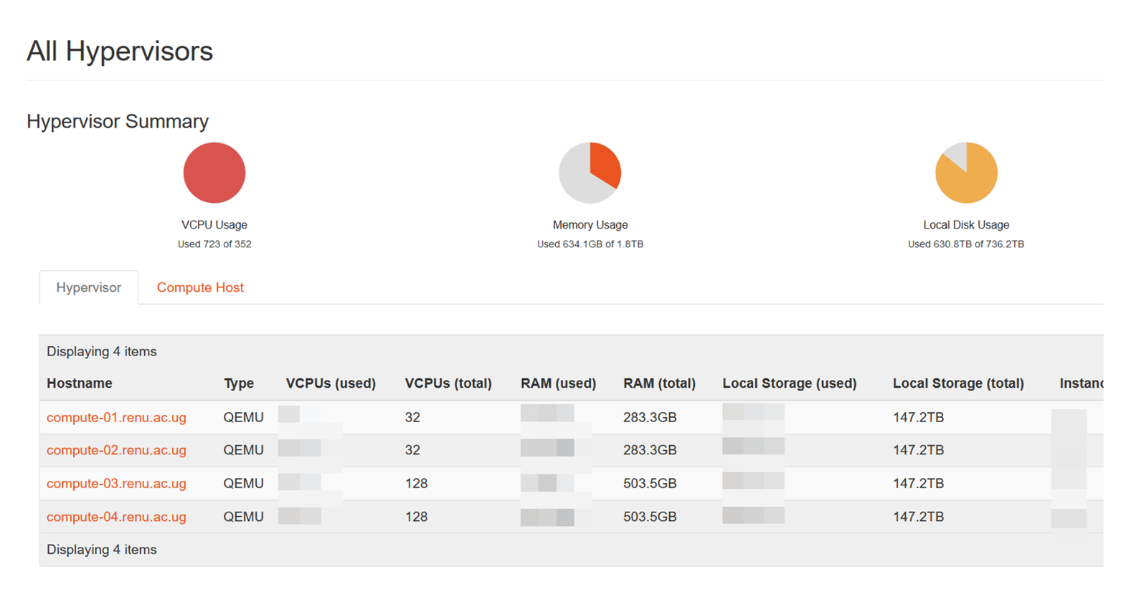

Slide 13
RENU Experience
Slow due to storage network
Very easy to provision new nodes
No longer maintained
Provisions 1 OSD (virtual disk) per Ceph OSD
Aging hardware

Slide 14
480 compute cores
RAM: 2 TB
Cloud Storage: 240 TB
20Gbps Network (40G storage network)
Use case: Member institutions
Features
Ansible used for management, installing, and updating
LXC containers for each Openstack service
Components independently set up and maintained

Slide 15
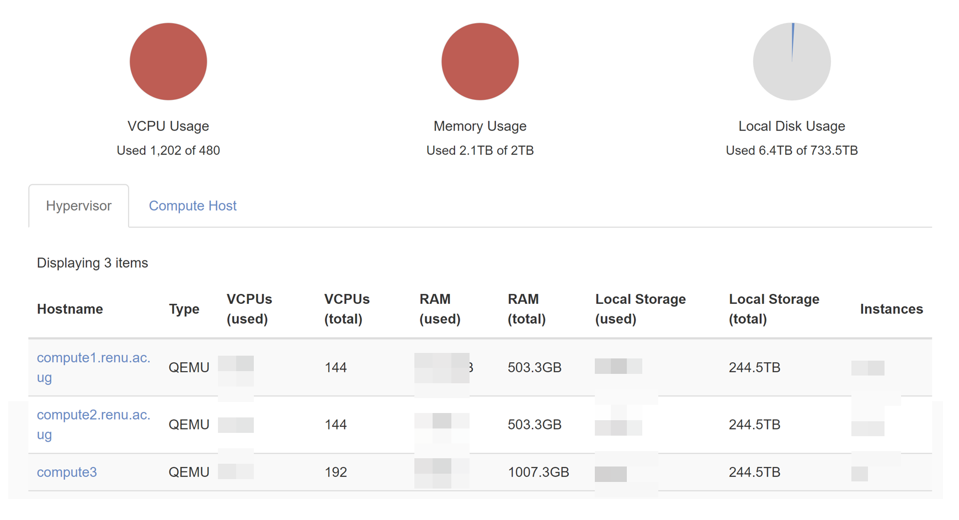

Slide 16

RENU Experience
Faster cloud
A lot of unexplored Openstack features
Easier to update and maintain

Slide 17
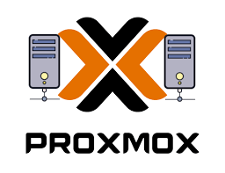




Proxmox Virtual Environment
  Intuitive and Seamless
  Low Setup Costs
  Centralized Management
  Shallow Learning curve
Notes:
ProxmoxVE is an open-source platform designed for enterprise virtualization. It allows institutions to create and manage virtual machines (VMs) and containers cost-effectively, providing the flexibility to run multiple systems on a single physical server.
As an open-source solution, ProxmoxVE offers significant cost savings, avoiding expensive licensing fees associated with proprietary virtualization platforms.
Why Proxmox?
Cost Savings: ProxmoxVE eliminates the need for costly hardware by consolidating multiple virtual machines on fewer physical servers, reducing both capital expenditure (CapEx) and operational expenditure (OpEx).
Complexity: ProxmoxVE simplifies the management of cloud resources. Its user-friendly web interface reduces the complexity associated with setting up and managing virtual environments.
Management: ProxmoxVE provides a centralized, web-based interface, making it easy to manage multiple nodes, virtual machines, containers, storage, and network settings from a single location. This reduces the time and effort required to manage multiple environments.
Ease of Use: With a shallow learning curve, even institutions with limited IT expertise can quickly adopt ProxmoxVE. The platform offers guided installations, clear documentation, and an intuitive dashboard, making it easy to deploy and manage.
Low Setup Costs: ProxmoxVE’s open-source nature and minimal hardware requirements make it highly cost-effective. Institutions can leverage existing infrastructure and deploy ProxmoxVE without significant upfront investments.

Slide 18
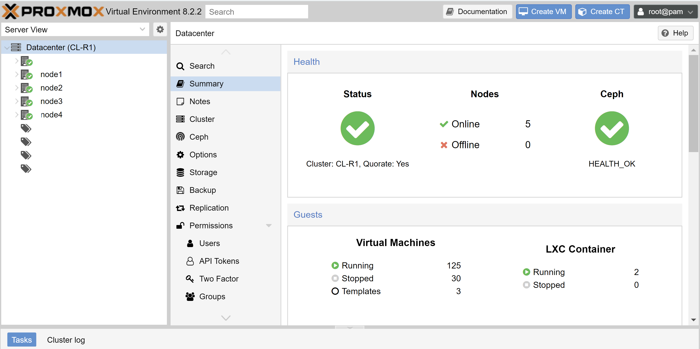
Proxmox VE Dashboard
}
Cluster Nodes
}
Tags

Slide 19
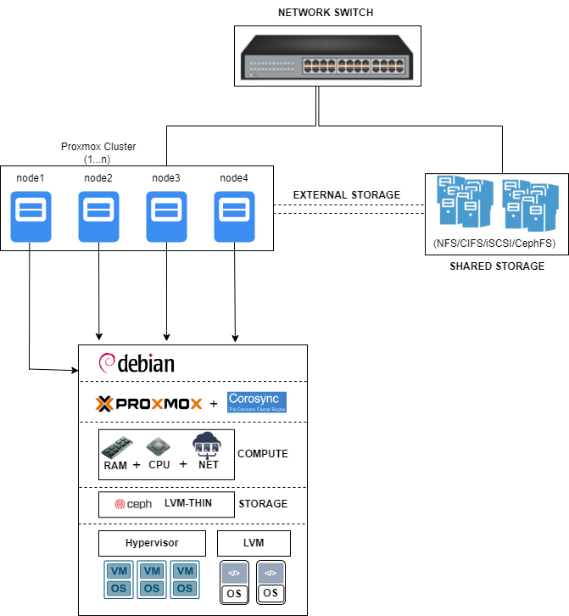
RENU Proxmox Cluster Architecture
Notes:
Architecture:
The architecture of a Proxmox Cluster typically consists of the following components:
Proxmox VE Nodes: Physical servers running Proxmox VE, connected over a network to form the cluster.
Corosync Cluster Engine: Deployed on each node, Corosync manages communication and coordination among the cluster nodes.
Quorum Calculation and Voting: Corosync calculates quorum based on the number of active nodes and facilitates quorum voting during cluster operations.
Shared Storage: Often utilized in Proxmox Clusters to enable live migration and high availability of virtual machines.

Slide 20


RENU Experience
Low setup costs
Easier to update and maintain
User Friendly

Slide 21
Cloud Solutions Comparison
Platform | Pros | Cons
Fuel Openstack | Highly scalable. Supports extensive services (compute, networking, storage). Deep customization. API-driven. | High complexity. Expensive in terms of hardware and management. Requires significant technical expertise.
Ganeti | Simpler than OpenStack. Good for mid-sized environments. Live migration and failover. Low resource overhead. | Limited in terms of network management and scalability compared to OpenStack. Fewer advanced features.
Openstack Ansible | Simplifies OpenStack deployment. Reduces errors with automated playbooks. Great for automation. | Still requires technical knowledge of OpenStack. OpenStack’s complexity remains in terms of management and scaling.
ProxmoxVE | Simple and fast to set up. Low cost. Great for small environments. Supports both VMs and containers. | Not ideal for large-scale or complex environments. Limited advanced features.
Notes:
RENU has deployed various cloud platforms over the years to support the growing needs of our institutions.
Each platform served a different purpose based on scalability, flexibility, and cost-effectiveness.
OpenStack:
As the demand for more robust and scalable cloud services grew, we turned to OpenStack. This platform provided the scalability we needed for large-scale deployments such as research data centers.
While OpenStack allowed us to build highly scalable environments, it came with a significant learning curve and required technical expertise for deployment and management.
Use case: Best suited for larger, complex environments where deep customization and control over networking, storage, and compute services were needed.
Ganeti:
Ganeti is another platform we’ve deployed. It provided us with a mid-level solution between the simplicity of Proxmox and the complexity of OpenStack. Ganeti allowed for live migration, failover, and cluster management, but with a lower resource overhead.
Use case: Ideal for mid-sized deployments, such as managing virtual machines for specific research projects, where reliability and resource efficiency were key."
Proxmox VE:
ProxmoxVE was one of our first deployments. It offered a streamlined setup and allowed us to quickly deploy virtual machines and containers with minimal infrastructure. It became a cost-effective solution for smaller projects where we needed simplicity and ease of management.
Use case: Hosting smaller services such as digital repositories and Learning Management Systems (LMS).
OpenStack Ansible:
To address the complexity of managing OpenStack, we then explored OpenStack Ansible, which helped us automate the deployment and management processes using Ansible playbooks. This significantly reduced manual intervention and made cloud management more efficient.
Use case: Deployed in environments where automation and repeatability were essential, particularly in growing infrastructures that required frequent updates.
Each of these cloud platforms has played a unique role in helping us build a more resilient and scalable cloud infrastructure. By leveraging the strengths of ProxmoxVE, OpenStack, OpenStack Ansible, and Ganeti, we’ve been able to meet the diverse needs of our member institutions while overcoming challenges in cost, technical expertise, and scalability.

Slide 22
Challenges
Complexity of Setup and Configuration
Lack of Technical Expertise
Internal Communication and Service Coordination
Scaling and Resource Management
High Initial Costs and Resource Allocation
Managing Cloud Service Restarts
Ensuring High Availability
Internal Security Configuration
Automation and Orchestration Challenges
Networking Complexities
Resource Management
Notes:
1. Divide and Conquer: Simplifying Complexity
Cloud environments can seem overwhelming at first, but breaking them down into smaller components (e.g., compute, storage, networking) makes the process more manageable.
Understanding each service's role allows for better troubleshooting and optimization.
2. Importance of Automation
Automating deployments and management using tools like Ansible or Terraform reduces errors, saves time, and ensures consistency across environments.
Automation simplifies complex tasks like scaling, configuration, and service management, making operations more efficient.
3. Database Health is Critical
Databases like MySQL are the backbone of cloud operations. Monitoring and maintaining their health is vital for the cloud's stability and performance.
Most cloud-related issues, especially in OpenStack, often arise from internal communication breakdowns between components such as MySQL or RabbitMQ.
4. Understanding Networking is Key
Properly configuring and managing internal communication between cloud services is crucial for cloud functionality.
Misconfigured networks or firewalls can lead to issues with service discovery, instance creation, and load balancing.
5. Initial Knowledge of Virtualization is Beneficial
Familiarity with tools like KVM, VirtualBox, or VMware can significantly ease the learning curve when setting up cloud environments.
Virtualization concepts form the foundation for managing virtual machines (VMs) in the cloud.
6. Cloud Service Restarts Don’t Impact Active Instances
One of the benefits of cloud environments is the non-disruptive nature of service restarts. Services like Proxmox, Ganeti, and OpenStack allow you to restart cloud management services without affecting running VMs.
7. Resource Scheduling is Crucial
Schedule filters (e.g., in OpenStack or Proxmox) determine where new instances are deployed. Misconfigurations here can lead to bottlenecks or failed deployments.
Proper scheduling ensures efficient resource utilization across nodes.
8. Scaling is Easier with Experience
As you become more familiar with the cloud environment, scaling services and adding resources becomes straightforward.
Deploying cloud platforms teaches you how to optimize and fine-tune various components for better performance.
9. Security Should be Prioritized
Configuring firewalls, access controls, and network segmentation is essential to securing cloud environments.
Neglecting security in cloud environments can lead to vulnerabilities that are harder to manage at scale.
10. Cloud is Flexible but Requires Maintenance
Cloud environments provide flexibility in scaling and resource management, but they also require ongoing monitoring and maintenance to ensure optimal performance and availability.

Slide 23
Lessons Learned
Divide and Conquer: Simplifying Complexity
Importance of Automation
Database Health is Critical
Understanding Networking is Key
Initial Knowledge of Virtualization is Beneficial
Cloud Service Restarts Don’t Impact Active Instances
Resource Scheduling is Crucial
Scaling is Easier with Experience
Security Should be Prioritized
Cloud is Flexible but Requires Maintenance
Notes:
1. Divide and Conquer: Simplifying Complexity
Cloud environments can seem overwhelming at first, but breaking them down into smaller components (e.g., compute, storage, networking) makes the process more manageable.
Understanding each service's role allows for better troubleshooting and optimization.
2. Importance of Automation
Automating deployments and management using tools like Ansible or Terraform reduces errors, saves time, and ensures consistency across environments.
Automation simplifies complex tasks like scaling, configuration, and service management, making operations more efficient.
3. Database Health is Critical
Databases like MySQL are the backbone of cloud operations. Monitoring and maintaining their health is vital for the cloud's stability and performance.
Most cloud-related issues, especially in OpenStack, often arise from internal communication breakdowns between components such as MySQL or RabbitMQ.
4. Understanding Networking is Key
Properly configuring and managing internal communication between cloud services is crucial for cloud functionality.
Misconfigured networks or firewalls can lead to issues with service discovery, instance creation, and load balancing.
5. Initial Knowledge of Virtualization is Beneficial
Familiarity with tools like KVM, VirtualBox, or VMware can significantly ease the learning curve when setting up cloud environments.
Virtualization concepts form the foundation for managing virtual machines (VMs) in the cloud.
6. Cloud Service Restarts Don’t Impact Active Instances
One of the benefits of cloud environments is the non-disruptive nature of service restarts. Services like Proxmox, Ganeti, and OpenStack allow you to restart cloud management services without affecting running VMs.
7. Resource Scheduling is Crucial
Schedule filters (e.g., in OpenStack or Proxmox) determine where new instances are deployed. Misconfigurations here can lead to bottlenecks or failed deployments.
Proper scheduling ensures efficient resource utilization across nodes.
8. Scaling is Easier with Experience
As you become more familiar with the cloud environment, scaling services and adding resources becomes straightforward.
Deploying cloud platforms teaches you how to optimize and fine-tune various components for better performance.
9. Security Should be Prioritized
Configuring firewalls, access controls, and network segmentation is essential to securing cloud environments.
Neglecting security in cloud environments can lead to vulnerabilities that are harder to manage at scale.
10. Cloud is Flexible but Requires Maintenance
Cloud environments provide flexibility in scaling and resource management, but they also require ongoing monitoring and maintenance to ensure optimal performance and availability.

Slide 24

Platform Recommendations
Small to medium private deployments: Proxmox
Large clouds: Openstack using Ansible, Juju or Chef
Paid deployments: Mirantis, Redhat, Ubuntu
Only want to use and not manage: Commercial Cloud Providers

Slide 25
In Conclusion….
RENU’s journey to the cloud has been one of growth, learning, and innovation. Through our exploration of various cloud platforms—ProxmoxVE, OpenStack, OpenStack Ansible, and Ganeti—we have gained valuable insights into the diverse needs of our institutions and the solutions that best serve them.

Slide 26
Thank You!
https://renu.ac.ug

