Slide 1
Enhancing eduroam Monitoring in Research and Education Networks with the ELK Stack
Presenter
Lubuulwa Josh Elias
elubuulwa@renu.ac.ug
Notes:
Today, I’ll be discussing how we can enhance eduroam monitoring in Research and Education Networks using the ELK Stack.
With the growing reliance on eduroam for secure, global network access in academic environments, effective monitoring is crucial for optimizing performance of the service.
In this presentation, we'll explore how implementing the ELK Stack can provide deeper insights into eduroam usage patterns, improve network resource management, and enhance the overall user experience.
We’ll look at practical strategies for deploying the stack, the benefits it brings, and how it can transform network monitoring and management.

Slide 2

Outline
What is eduroam?
RENU eduroam deployments
Why monitor eduroam?
ELK Implementation
Use Cases and Insights
Contribution to the REN Community
Conclusion
Overview
1st November, 2024

Slide 3

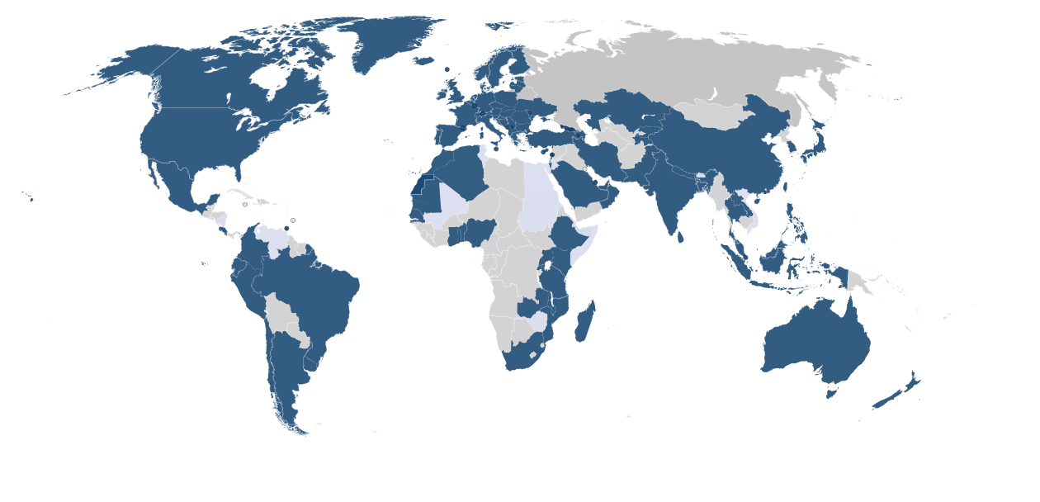
Is the secure, world-wide roaming access service developed for the research and education community.
Notes:
eduroam is an abbreviation of education roaming.
eduroam is a secure, trusted and free WIFI network available around the globe to students, researchers and academicians across research and education networks and their members.
eduroam allows students, researchers and academicians access internet from any location that has an eduroam hotspot.
eduroam can be accessed from any university, school, research centre or academic institution that deployed the service on their campus.

Slide 4
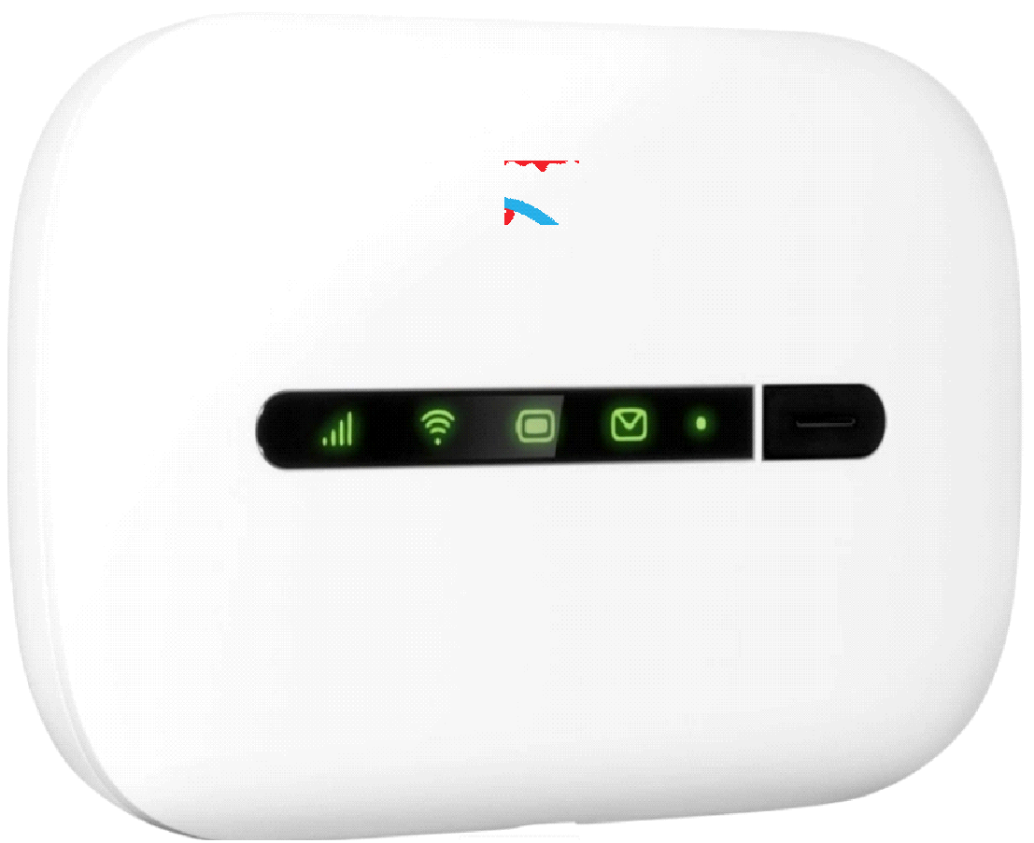


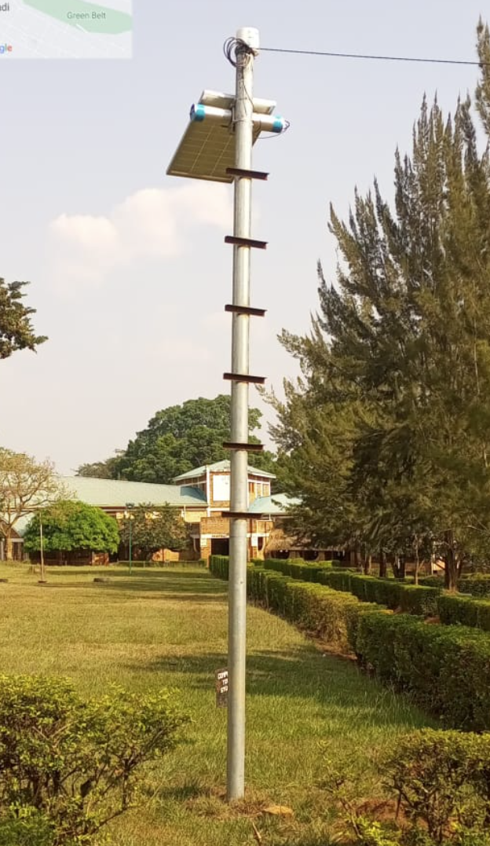


eduroam Deployments
On The Go
Metro eduroam
Homelinks
On Campus
Notes:
With the growing reliance on eduroam for secure, global network access in academic environments, effective monitoring is crucial for optimizing performance of the service.
- eduroam on the Go is a pocket-size routing device specially made to enable researchers and university staff connect to eduroam and the Internet Anytime, Anywhere.
- Metro eduroam simply means eduroam within the city, outside the campuses of institutions.

Slide 5






Why monitor eduroam?
Enhances user experience by resolving performance issues, leading to faster connections and fewer disruptions.
RADIUS Server Availability
Insights in eduroam usage: Understand demand and make informed optimization decisions.
Optimize bandwidth allocation and address resource imbalances

Slide 6
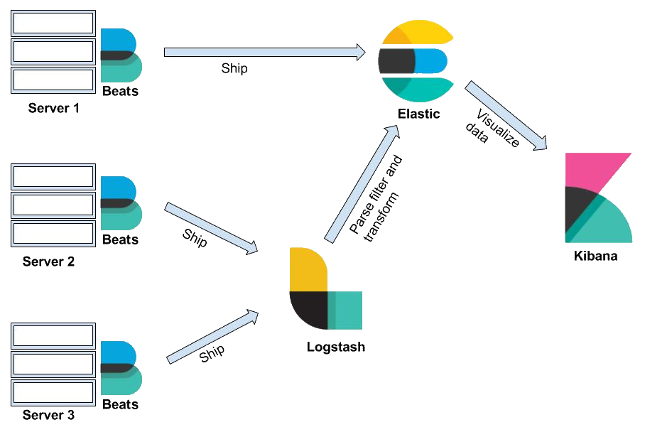
Elasticsearch Logstash Kibana (ELK)
Notes:
Beats are agents that ship the data from different systems.
Logstash collects logs and events data. It parses, filters, and transforms the data.
Elasticsearch stores, searches, and analyzes the data.
Kibana is used to visualize the data.

Slide 7
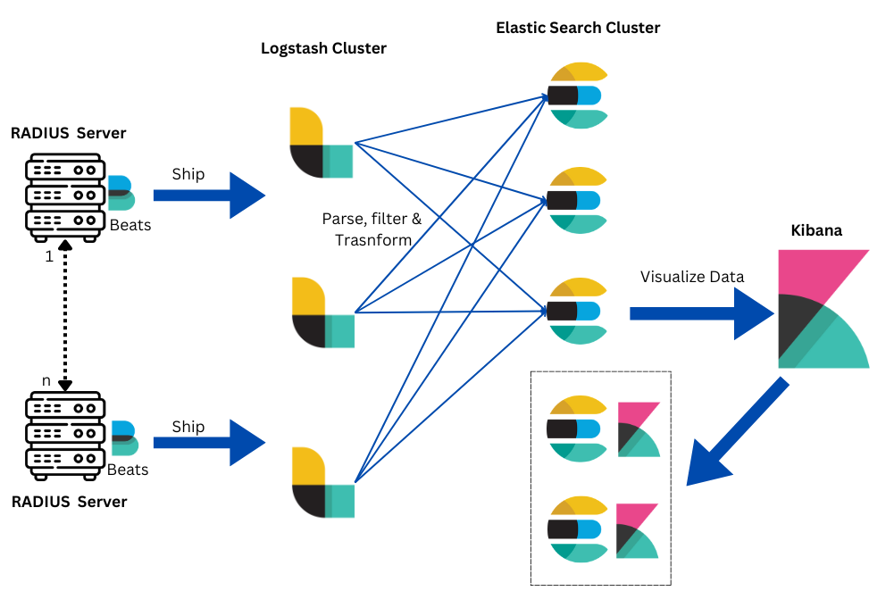
RENU ELK Architecture

Slide 8
FreeRADIUS configuration
linelog eduroam-auth-syslog {
filename = syslog
syslog_facility = daemon
syslog_severity = info
format = "%{Packet-Type} for user %{User-Name} stationid %{Calling-Station-Id} NAS-IP-Address %{NAS-IP-Address}"
reference = "messages.%{%{reply:Packet-Type}:-default}"
messages {
Access-Accept = "%{reply:Packet-Type} for user %{User-Name} stationid %{Calling-Station-Id} NAS-IP-Address %{NAS-IP-Address} proxy %{Packet-Src-IP-Address}"
Access-Reject = "%{reply:Packet-Type} for user %{User-Name} stationid %{Calling-Station-Id} NAS-IP-Address %{NAS-IP-Address} proxy %{Packet-Src-IP-Address}"
}
}
Configuration defines how log messages should be formatted
Notes:
Packet type - access accept / access reject
Access point MAC Address - calling station id
NAS-IP Address - Ip addr for access point
Packet-Src-IP-Address - source radius server
This configuration defines how log messages should be formatted and sent for a component named linelog campus-auth-syslog
filename: Specifies the name of the log file. In this case, syslog indicates that logs will be written to a file named syslog
syslog_severity: Sets the severity level of the logs. Here, info indicates informational messages
format: Defines the format of the log messages. The placeholders %{...} are replaced with actual values from the log entries:
%{Packet-Type}: The type of RADIUS packet (e.g., Access-Request, Access-Accept).
%{User-Name}: The username.
%{Calling-Station-Id}: The ID of the station initiating the request.
%{NAS-IP-Address}: The IP address of the Network Access Server (NAS).
reference: Defines a dynamic reference for log messages based on the packet type.
messages.%{%{reply:Packet-Type}:-default}: This means the log message will reference a specific message format based on the Packet-Type. If the packet type is not defined, it defaults to default
messages: Defines specific formats for different types of RADIUS replies

Slide 9
Logstash Pipeline Configuration
input {
beats { port => "5046" }
}
filter {
grok {
match => { "message" => "%{SYSLOGBASE2} (?<response>(Access-(Accept|Reject))) for user (%{USERNAME:user})(@%{HOSTNAME:realm})? stationid %{MAC:callingstationid} NAS-IP-Address %{IPORHOST:NAS-IP-Address} proxy %{IPORHOST:Packet-Src-IP-Address}"}
}
mutate { lowercase => ["realm"] }
if "_grokparsefailure" in [tags] { drop { } }
}
output {
stdout { codec => rubydebug }
elasticsearch {
hosts => [ "logs-es1.xxxx.ac.ug:9200", "logs-es2.xxxx.ac.ug:9200", "logs-es3.xxxx.ac.ug:9200" ]
index => "eduroam-%{+YYYY.MM}"
}
}
Processes logs from beats, parses and then then outputs the results to the Elasticsearch cluster
Notes:
beats { port => "5046" }: This input plugin configures Logstash to listen for incoming log data from Beats agents
The grok filter is used to parse and structure unstructured log data. -
The match directive uses a pattern to extract fields from the log messages:
%{SYSLOGBASE2}: Matches standard syslog patterns.
(?<response>(Access-(Accept|Reject))): Captures the response type (Accept or Reject) as the response field.
%{USERNAME:user}: Captures the username.
(@%{HOSTNAME:realm})?: Optionally captures the realm (a domain or similar entity).
stationid %{MAC:callingstationid}: Captures the MAC address of the station.
NAS-IP-Address %{IPORHOST:NAS-IP-Address}: Captures the IP address of the NAS.
proxy %{IPORHOST:Packet-Src-IP-Address}: Captures the source IP address of the packet.
- mutate { lowercase => ["realm"] }: Converts the realm field to lowercase
- if "_grokparsefailure" in [tags] { drop { } }: Checks if the grok filter failed to parse the log (tagged as _grokparsefailure). If it did, the log event is dropped and not processed further.
elasticsearch: Sends the processed logs to an Elasticsearch cluster:
hosts: Lists the Elasticsearch nodes where the logs will be sent.
index: Specifies the index name pattern where logs will be stored in Elasticsearch. The pattern eduroam-%{+YYYY.MM} creates monthly indices with names like eduroam-2024.10.

Slide 10
Filebeat Configuration
filebeat.inputs:
- type: log
enabled: true
paths:
- /var/log/syslog
filebeat.config.modules:
path: ${path.config}/modules.d/*.yml
reload.enabled: false
setup.template.settings:
index.number_of_shards: 1
name: <institution-name>-eduroam-radius
tags: ["campus-eduroam", "<Institution Name – Location>"]
output.logstash:
hosts: ["logs-1.xxxx.ac.ug:5046", "logs-2.xxxx.ac.ug:5046", "logs-3.xxxx.ac.ug:5046"]
loadbalance: false
processors:
- add_host_metadata: ~
- add_cloud_metadata: ~
- add_docker_metadata: ~
- add_kubernetes_metadata: ~
/etc/filebeat/filebeat.yml
Notes:
filebeat.inputs: Defines the input sources for Filebeat to collect logs.
type: log: Specifies that Filebeat will collect log files.
enabled: true: Enables this input configuration.
paths: Lists the paths to the log files that Filebeat should monitor. In this case, it’s set to /var/log/syslog, which is a common location for system logs.
<institution-name> with the actual name of your institution. This helps in identifying logs from different Filebeat instances or environments.
name: This sets the name of the Filebeat instance or the identifier for the index in Elasticsearch. In this case, it’s named after the institution and its eduroam (a secure global roaming service for research and education).
tags: These are tags added to each event or log entry. The tags in this configuration include "campus-eduroam" and the institution’s name and location (denoted as <Institution Name – Location>). Tags help with categorization and filtering of logs when viewing them in tools like Kibana.

Slide 11
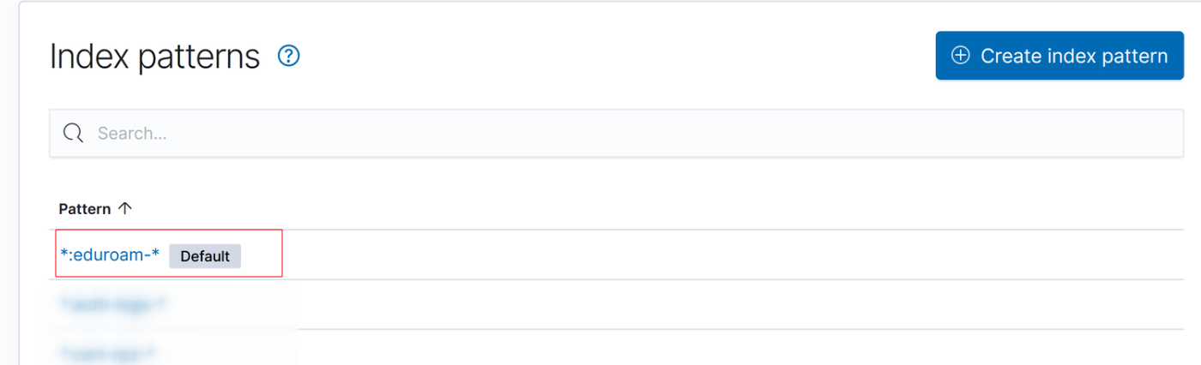
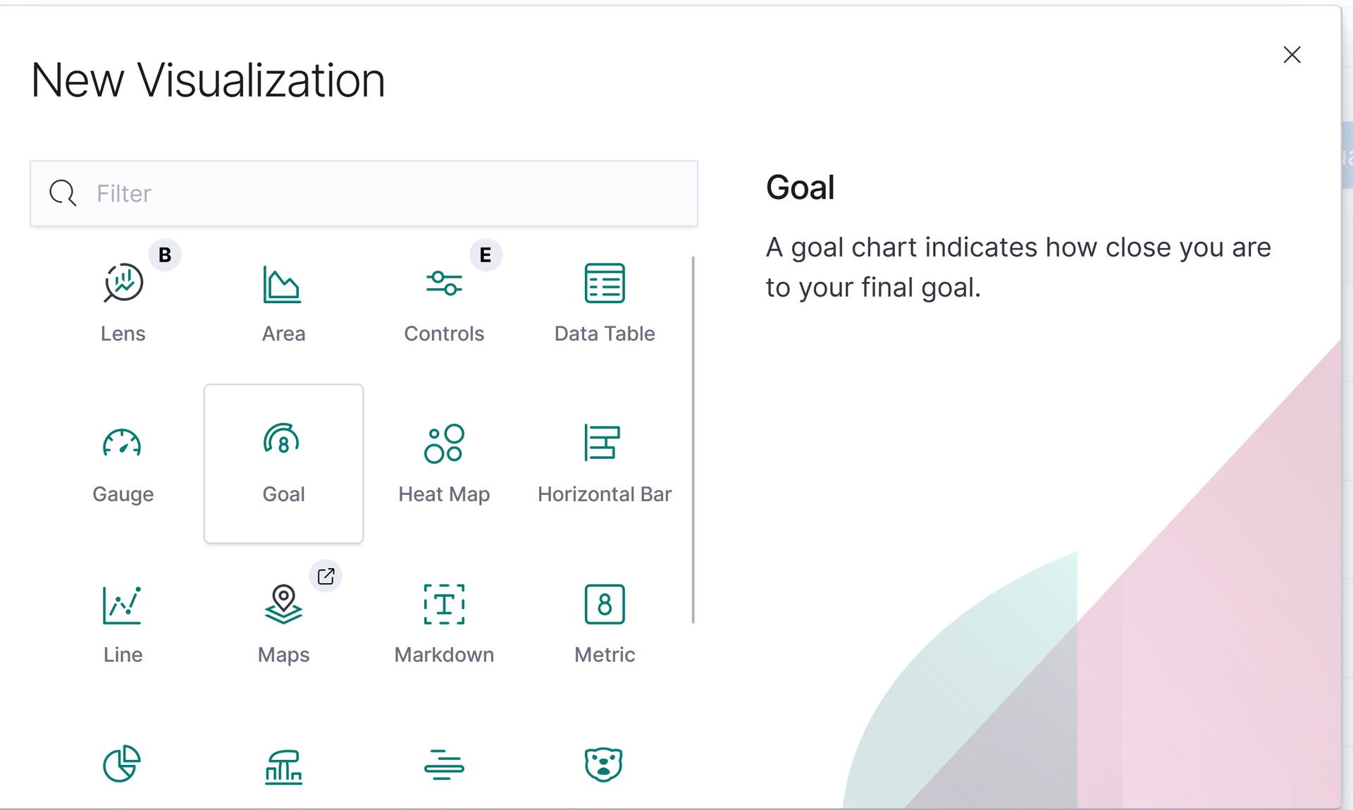
Kibana Configuration
Configure Index Patterns that matches your logs e.g. eduroam-*
Create Visualizations from the index pattern - e.g., bar chart, pie chart, line graph

Slide 12
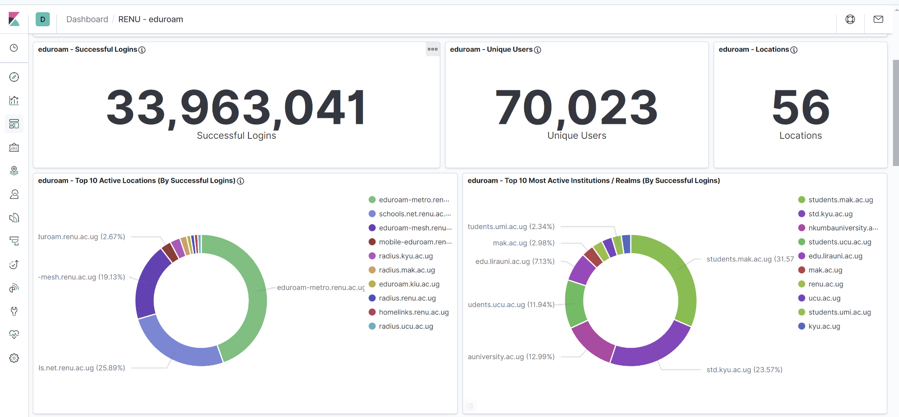
Dashboard Overview
Notes:
Changes that were made to the radius servers

Slide 13

Use Cases and Insights

Slide 14
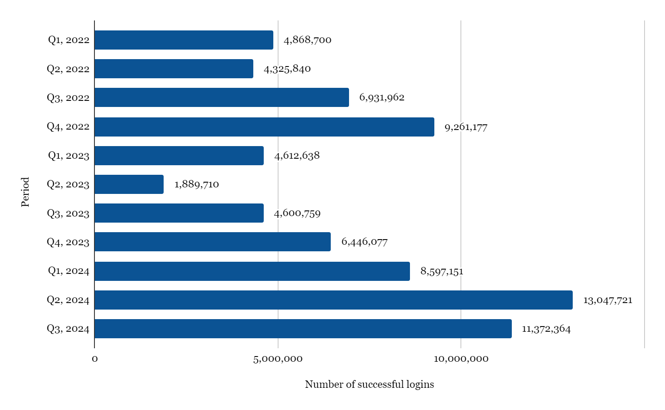
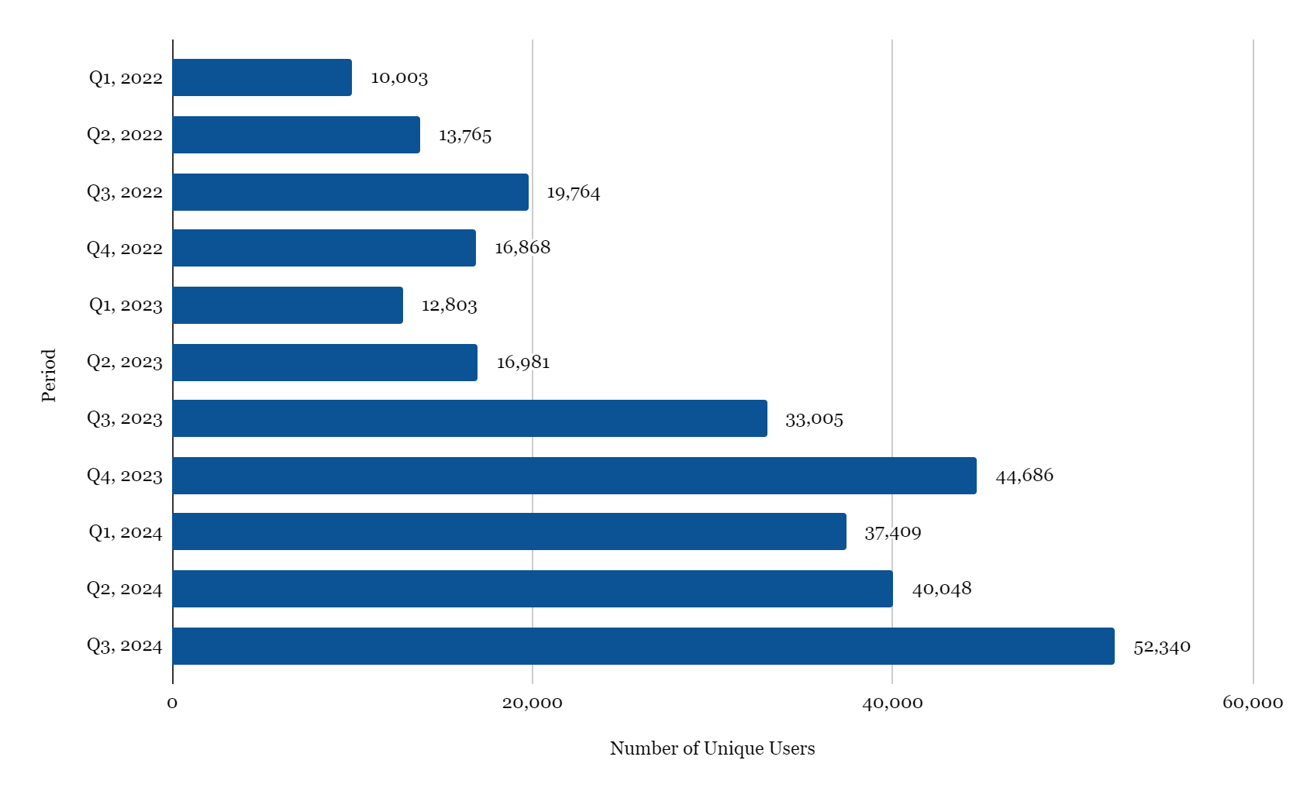
Real Time Visibility into eduroam Usage Patterns
Enables us to analyze how institutions adopt the service and utilized it over time.
Notes:
Real-time visibility into eduroam usage patterns allows us to analyze how institutions adopt the service and utilize it over time. For instance, following the loss of a service provider, we can observe trends in successful logins through graphs. Peaks in logins often correlate with special events or initiatives organized by RENU. In 2024, the introduction of MESH nodes has notably increased the number of successful logins, enhancing service accessibility for users, particularly students. Although the number of unique users hasn’t grown significantly, the MESH nodes have effectively brought eduroam closer to the user base, improving overall access to the service.

Slide 15
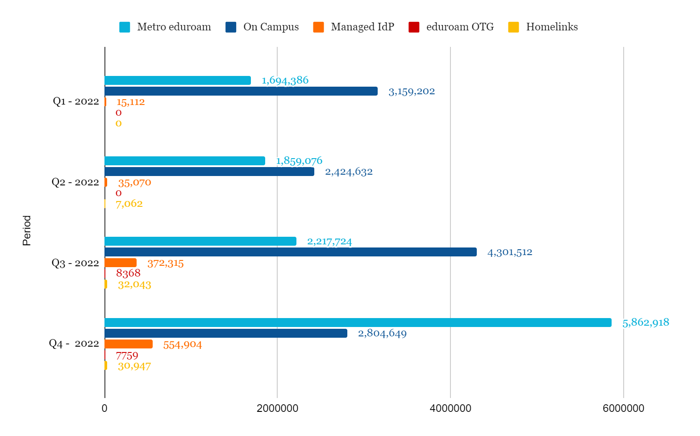
Resource Planning and Optimization
Trend of successful logins across the different deployments overtime (2022 - 2024)

Slide 16
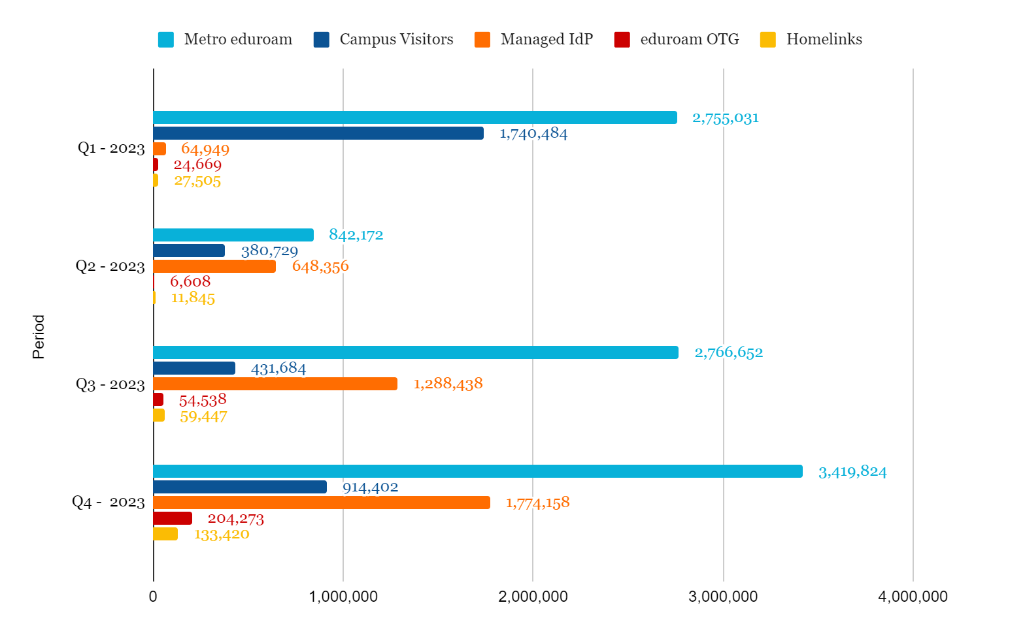
Resource Planning and Optimization

Slide 17
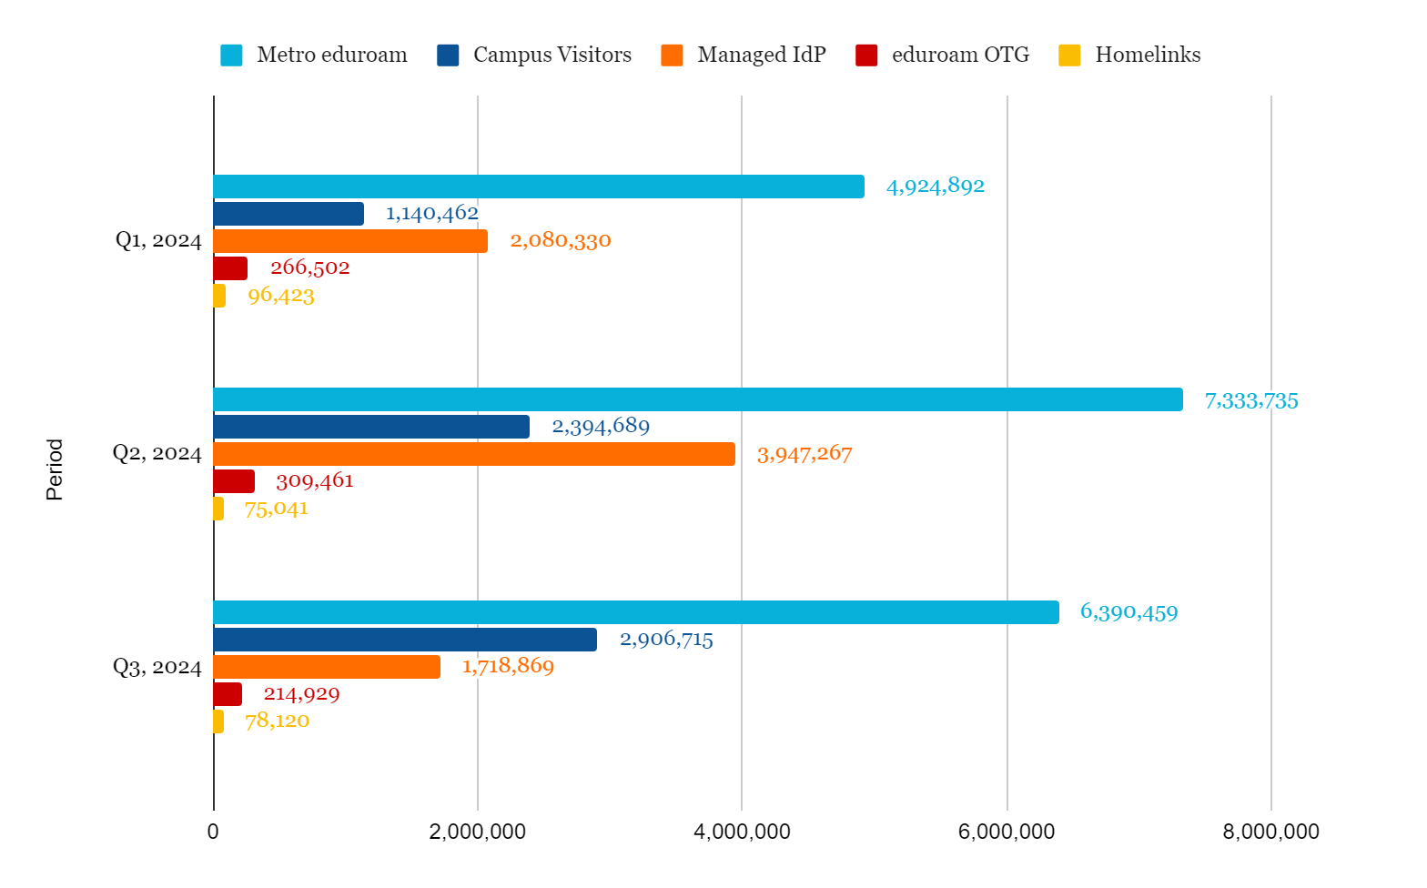
Resource Planning and Optimization
Most user connections are depicted on Metro eduroam overtime, highlighting the need for additional nodes and optimized network resources
Notes:
Metro eduroam has demonstrated a significant increase in successful logins compared to other deployments since 2022. This high utilization indicates that it should be prioritized for network optimization and resource planning. Consequently, there is a need to expand the number of nodes and access points, as well as increase the bandwidth to meet the growing demands of our institutions. Notably, bandwidth allocation for Metro eduroam has risen from 200 Mbps in 2020 to 700 Mbps in 2024, alongside an increase in deployed nodes to support eduroam users.- Identifying peak usage times allows for better distribution of network resources, preventing overload on any single server or node.

Slide 18
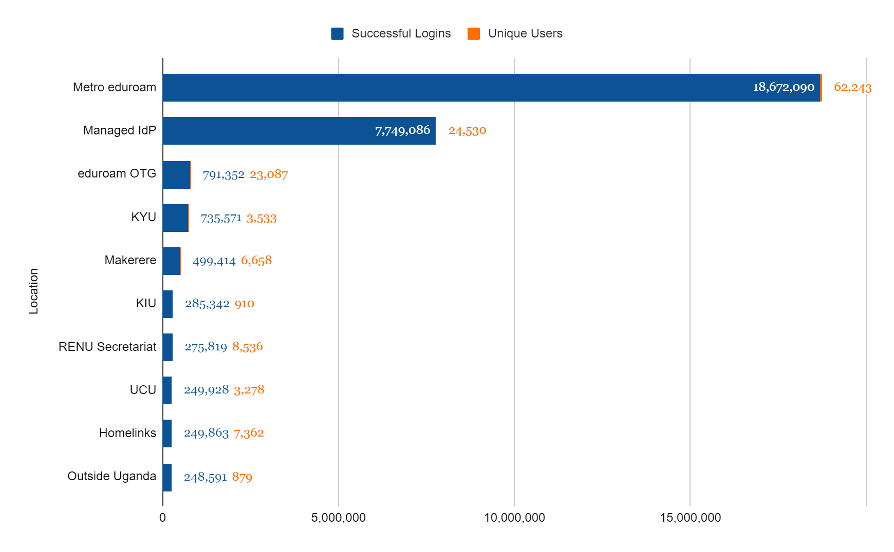
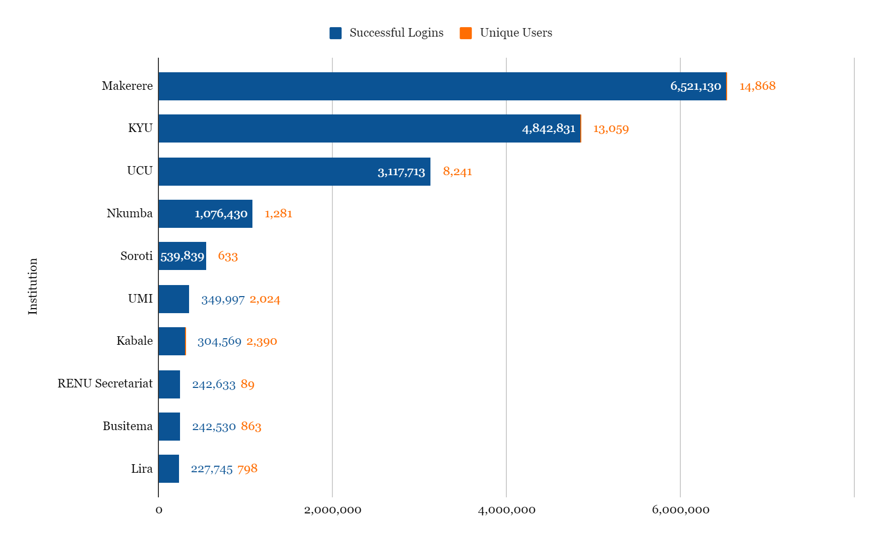
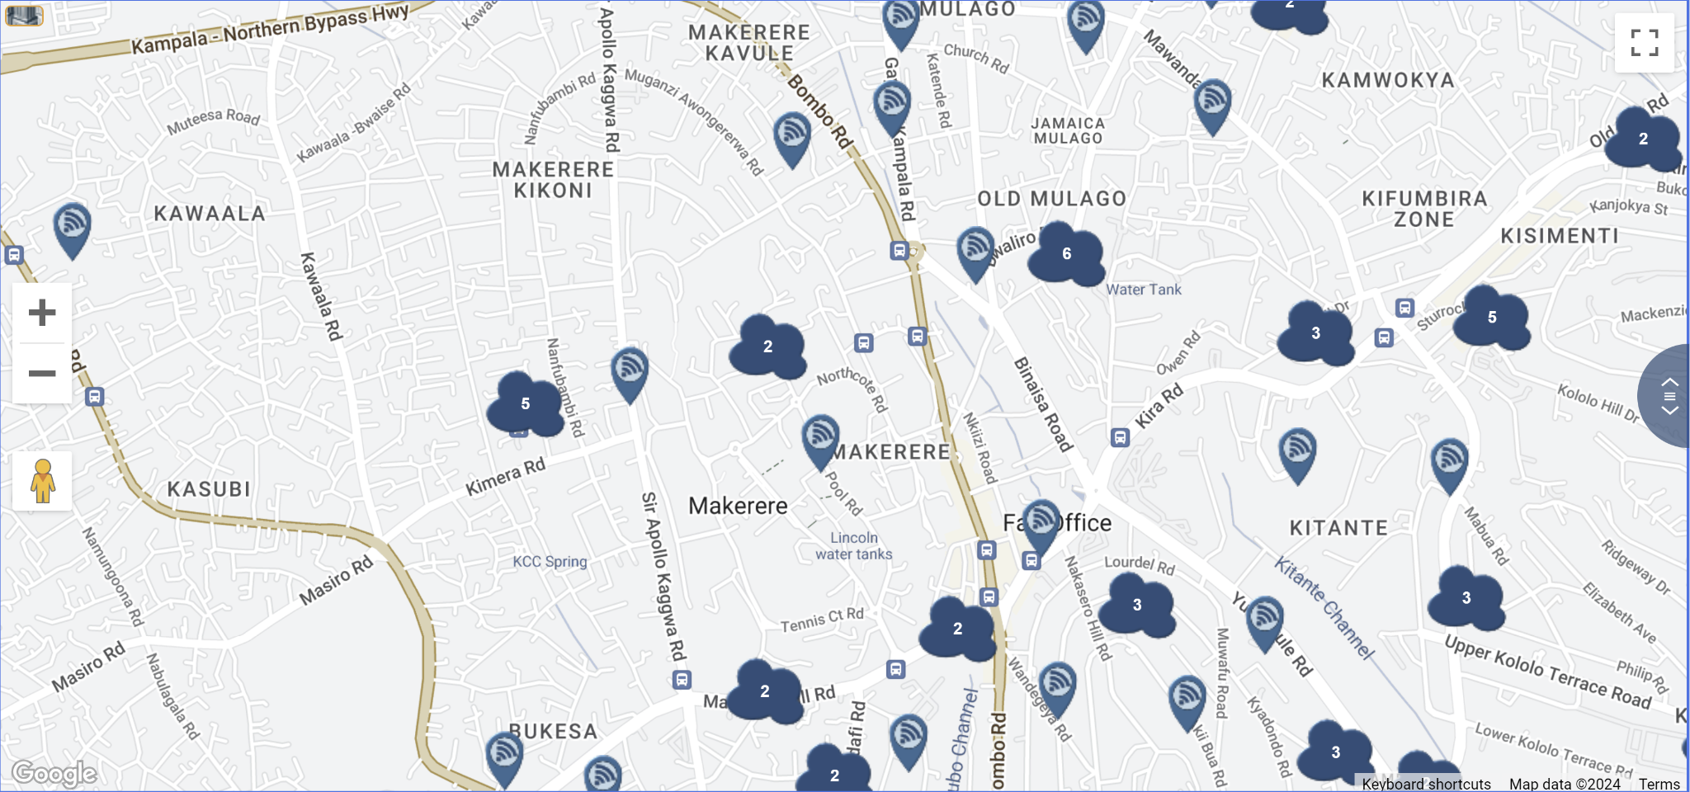
Enhanced User Experience and Connectivity
Collected data allows RENU to make informed decisions on deployments, enhancing user experience.
Notes:
Looking at the number of logins per location can guide the NREN on the decisions about the deployments which will improve the user experience while browsing the internet.

Slide 19

Contribution to the REN Community
Through monitoring we are able to quantify RENU's impact on global eduroam logins.
17,549,184 Successful User Logins Recorded by RENU in 2023
Notes:
Through using such technologies, we are able to quantify RENU`s contribution to the global successful logins.
Through monitoring we are able to quantify values such as this.
Being able to serve the members by us knowing the trends (More connectivity for metro eduraom, more nodes through RENU mesh to have more hotspots deployed).

Slide 20
Thank You!
https://renu.ac.ug

