Slide 1


Immersion cooling for servers in Datacenters
October 31, 2024, Dar es Salaam, Tanzania
PRESENTED BY
Ben Kakeeto
Systems Engineer, Research Data Communication Technologies
NIH-ICER Uganda
bkakeeto@reseachdata.us

Slide 2
What is server immersion cooling?
Servers are submerged into a bath of dielectric, non-conductive liquid for cooling instead of conventional air.
Since liquid absorbs & transfers heat over 20x faster than air, this technique allows for efficient heat dissipation.
Comparable to immersing a bottle filled with a hot drink into a bucket of cold water.

Slide 3
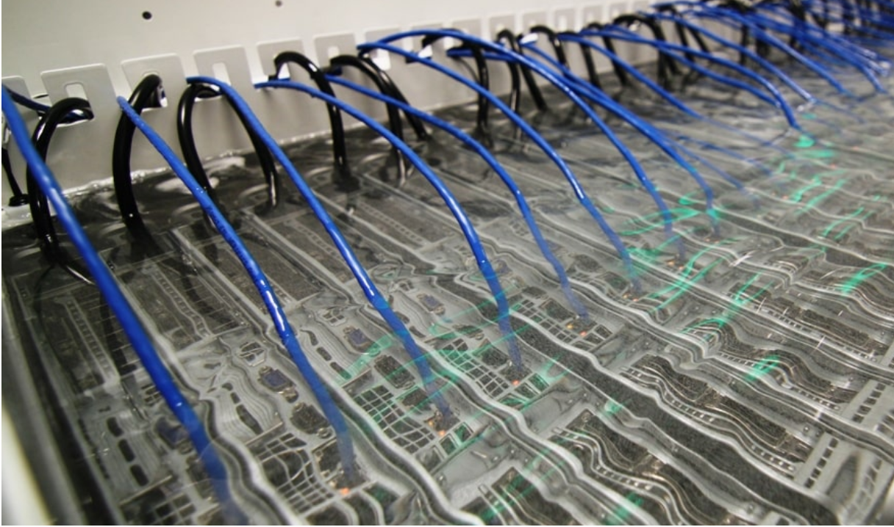
Immersion cooling servers in dielectric fluid

Slide 4

Why server immersion cooling?
Energy efficiency
Space efficiency
Potential for heat reuse
Reduced environmental impact
Hardware longevity
Lower maintenance cost

Slide 5
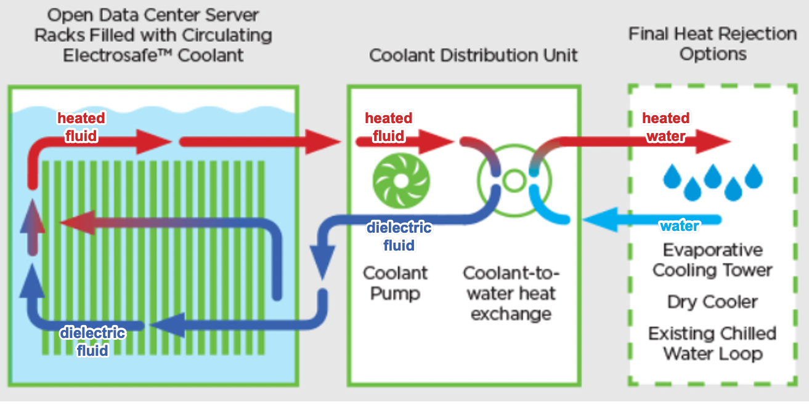
Immersion cooling flow

Slide 6
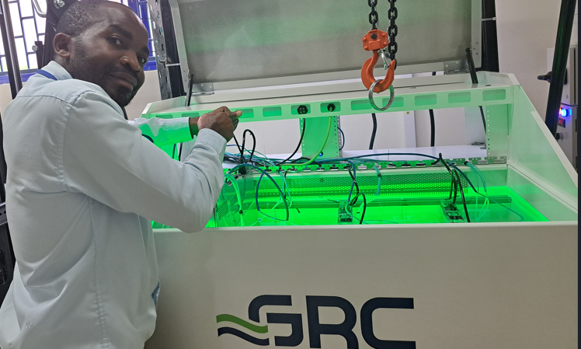
Server immersion cooling at ICERUganda
Servers are immersed in the GRC tank filled with a dielectric liquid and are fully operational

Slide 7


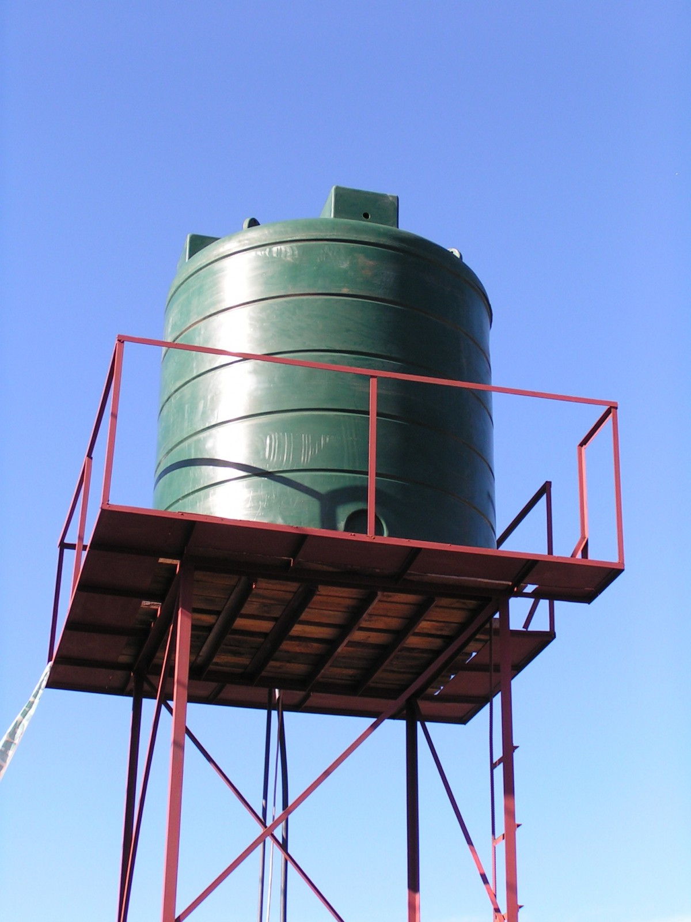
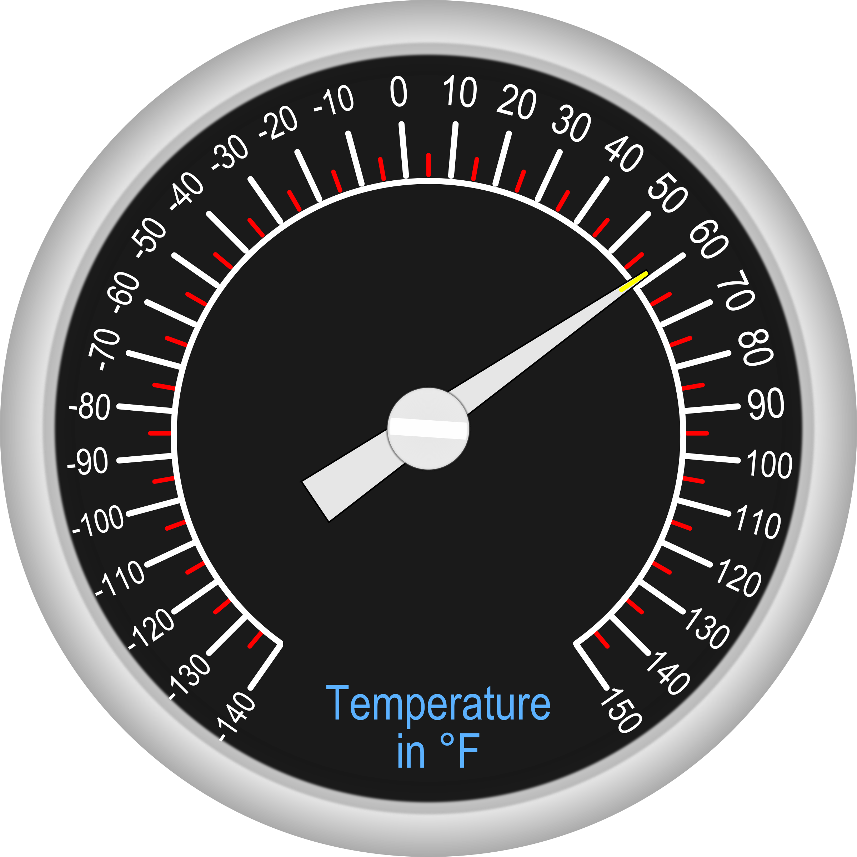


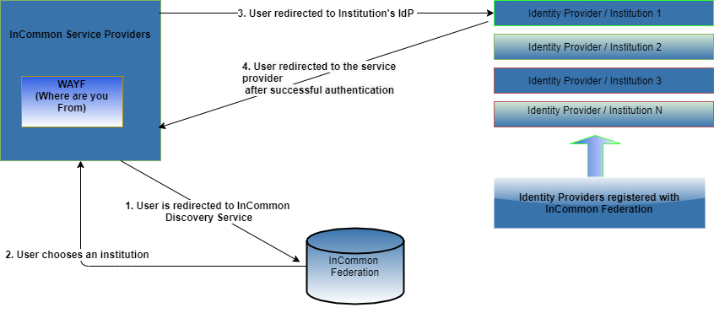
Immersion cooling installation requirements
Immersion cooling tank with dielectric liquid
Heat Exchanger
Chilled water tank / Dry coolers
Thermostat controller
Technical skills: plumbing & electrical
Pully or gantry crane

Slide 8
Immersion cooling challenges
High initial cost for liquid cooling equipment
tanks, dry coolers, water tower etc.
Heavy weight for cooling tanks installed in Uganda and Mali. 24U GRC tank is 507+ Kg & required 16 men to offload
Supplied dry coolers lacked inbuilt thermostats

Slide 9
Lessons learned
Type of the power input for the immersion cooling system:
Single or three-phase power
Need loading and offloading plan as equipment is heavy.
E.g. 24U GRC immersion cooled rack has 507kg
Conventional servers can be reconfigured for immersion cooling.
More effective when the liquid is directly cooling the processors.

Slide 10
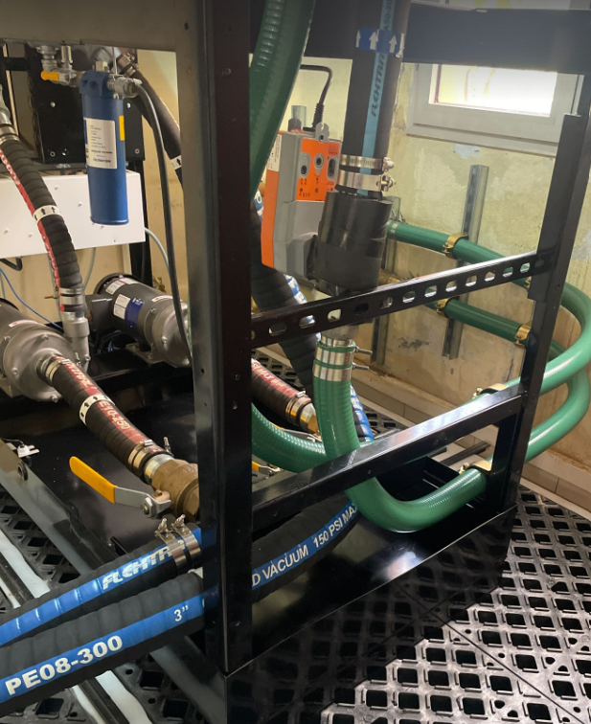
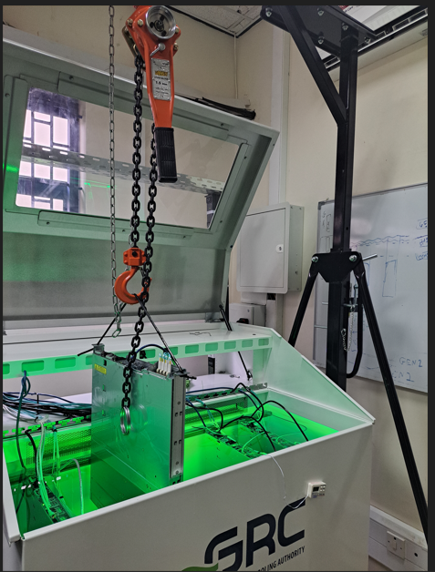
Lessons learned continued
Proper liquid piping & fittings
Pulley plan for server maintenance

Slide 11
Statistics
Liquid absorbs and transfers heat 23.5x faster than air
Over 10 degrees C of improved cooling when the liquid is directly absorbing the heat from server processors.
Electricity saving for the cooling cost can reach 90%
Space efficiency exceeds 50% for high density server install.

Slide 12


Acknowledgements
Michael Tartakovsky, CIO NIAID/NIH, Director OCICB
Christopher J Whalen, RDCT
Matthew Eisenberg, NIAID Business Process & IM Branch
Daniel Holliday, RDCT
Steven J Reynolds, NIH ICER Uganda
Lloyd Ssentongo, RDCT
GSA Contract #47QTCA22D008/140D0424F0200 for the National Institute of Allergy and Infectious Diseases, NIH

Slide 13
Thank you
Ben Kakeeto
Systems Engineer
Research Data and Communication Technologies (RDCT)
NIH-ICER Uganda
bkakeeto@reseachdata.us
+256 701 165311
Questions?

