Slide 1
Building a Highly Available Mobile Broadband Last Mile
  By
  Walid Kyazze
  wkyazze@renu.ac.ug

Slide 2

Outline
Mobile Broadband last mile?
RENU’s Implementation
Old setup
Design Optimizations
New Setup
Achievements
Future Works
Overview

Slide 3
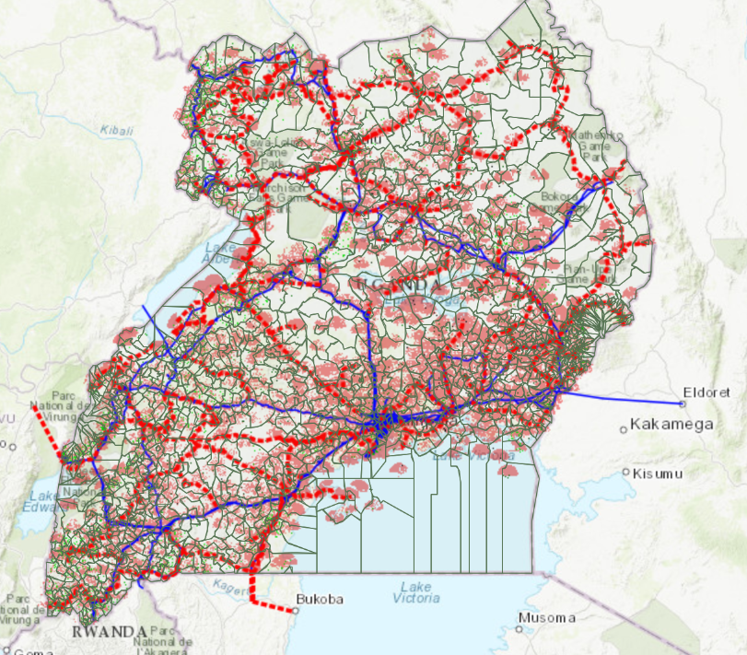
Why Mobile Broadband?
Uneconomical costs for remote fiber lines
Rugged terrain and thick vegetation
LEO satellite connectivity ???
Rapid expansion of cellular networks i.e., in UG LTE coverage stands at 86.37%, and 60%-70% on the entire African continent.

Slide 4
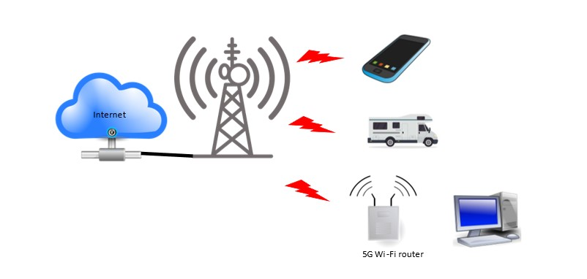
What is Mobile Broadband ?
Wireless Internet access through cellular networks.
Leverages advanced mobile technologies like 3G, LTE, and 5G.

Slide 5

RENU’s Implementation of Mobile Broadband Last Mile Connectivity

Slide 6
RENU’s Implementation
Private APN with a Ugandan MNO – up to 20Mbps
Dedicated bandwidth for each APN – Not data based
Network access requires authentication of the LTE UE, handled by RENU – Based on RADIUS
IP allocation is managed by RENU – 1:1 Static allocation by the RADIUS server

Slide 7
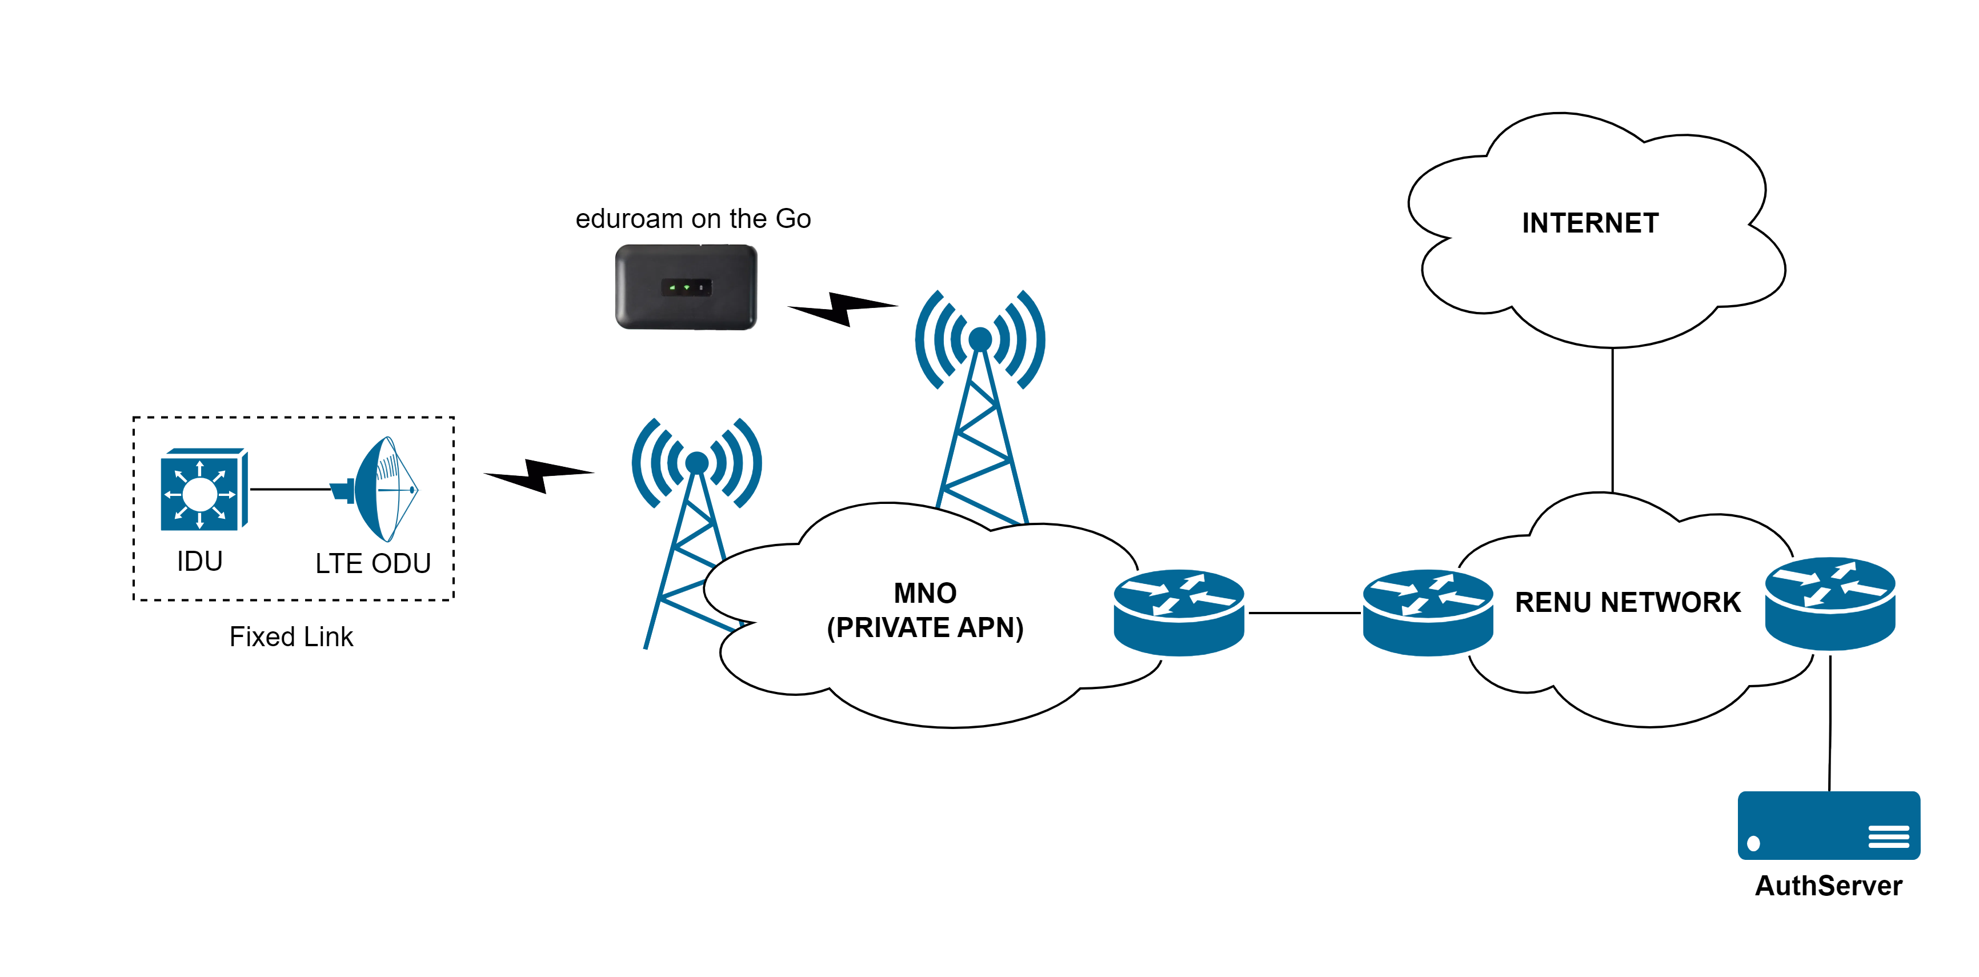
Mobile Broadband Last Mile Architecture – Old Setup

Slide 8
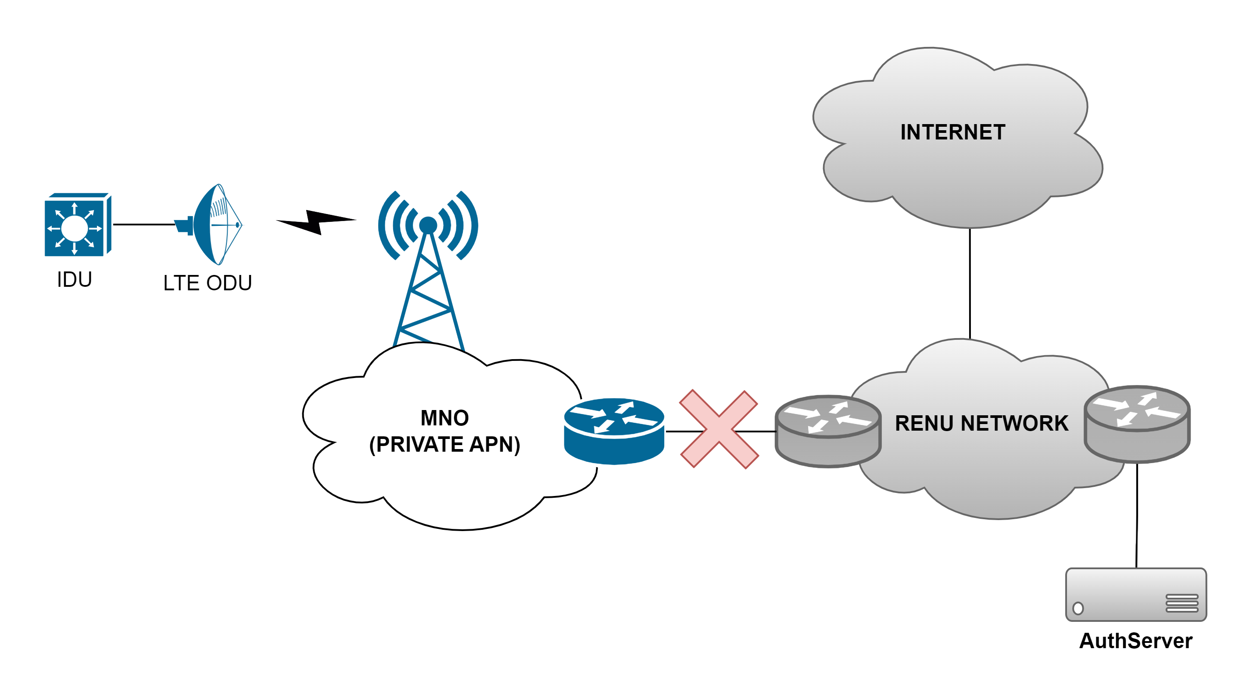
Challenges with the old setup
Single point of failure – Link Failure

Slide 9

Challenges with the old setup – Cont’d
Single point of failure – Authentication Server

Slide 10
Design Optimizations for High Availability
Physical link redundancy – Dual links to the MNO
Authentication server redundancy – Requirements
  At least two running authentication nodes
  Active - Active operation of the nodes
  A single authentication server IP address known to the MNO
  User and session data replication across all nodes
  Automatic failover

Slide 11
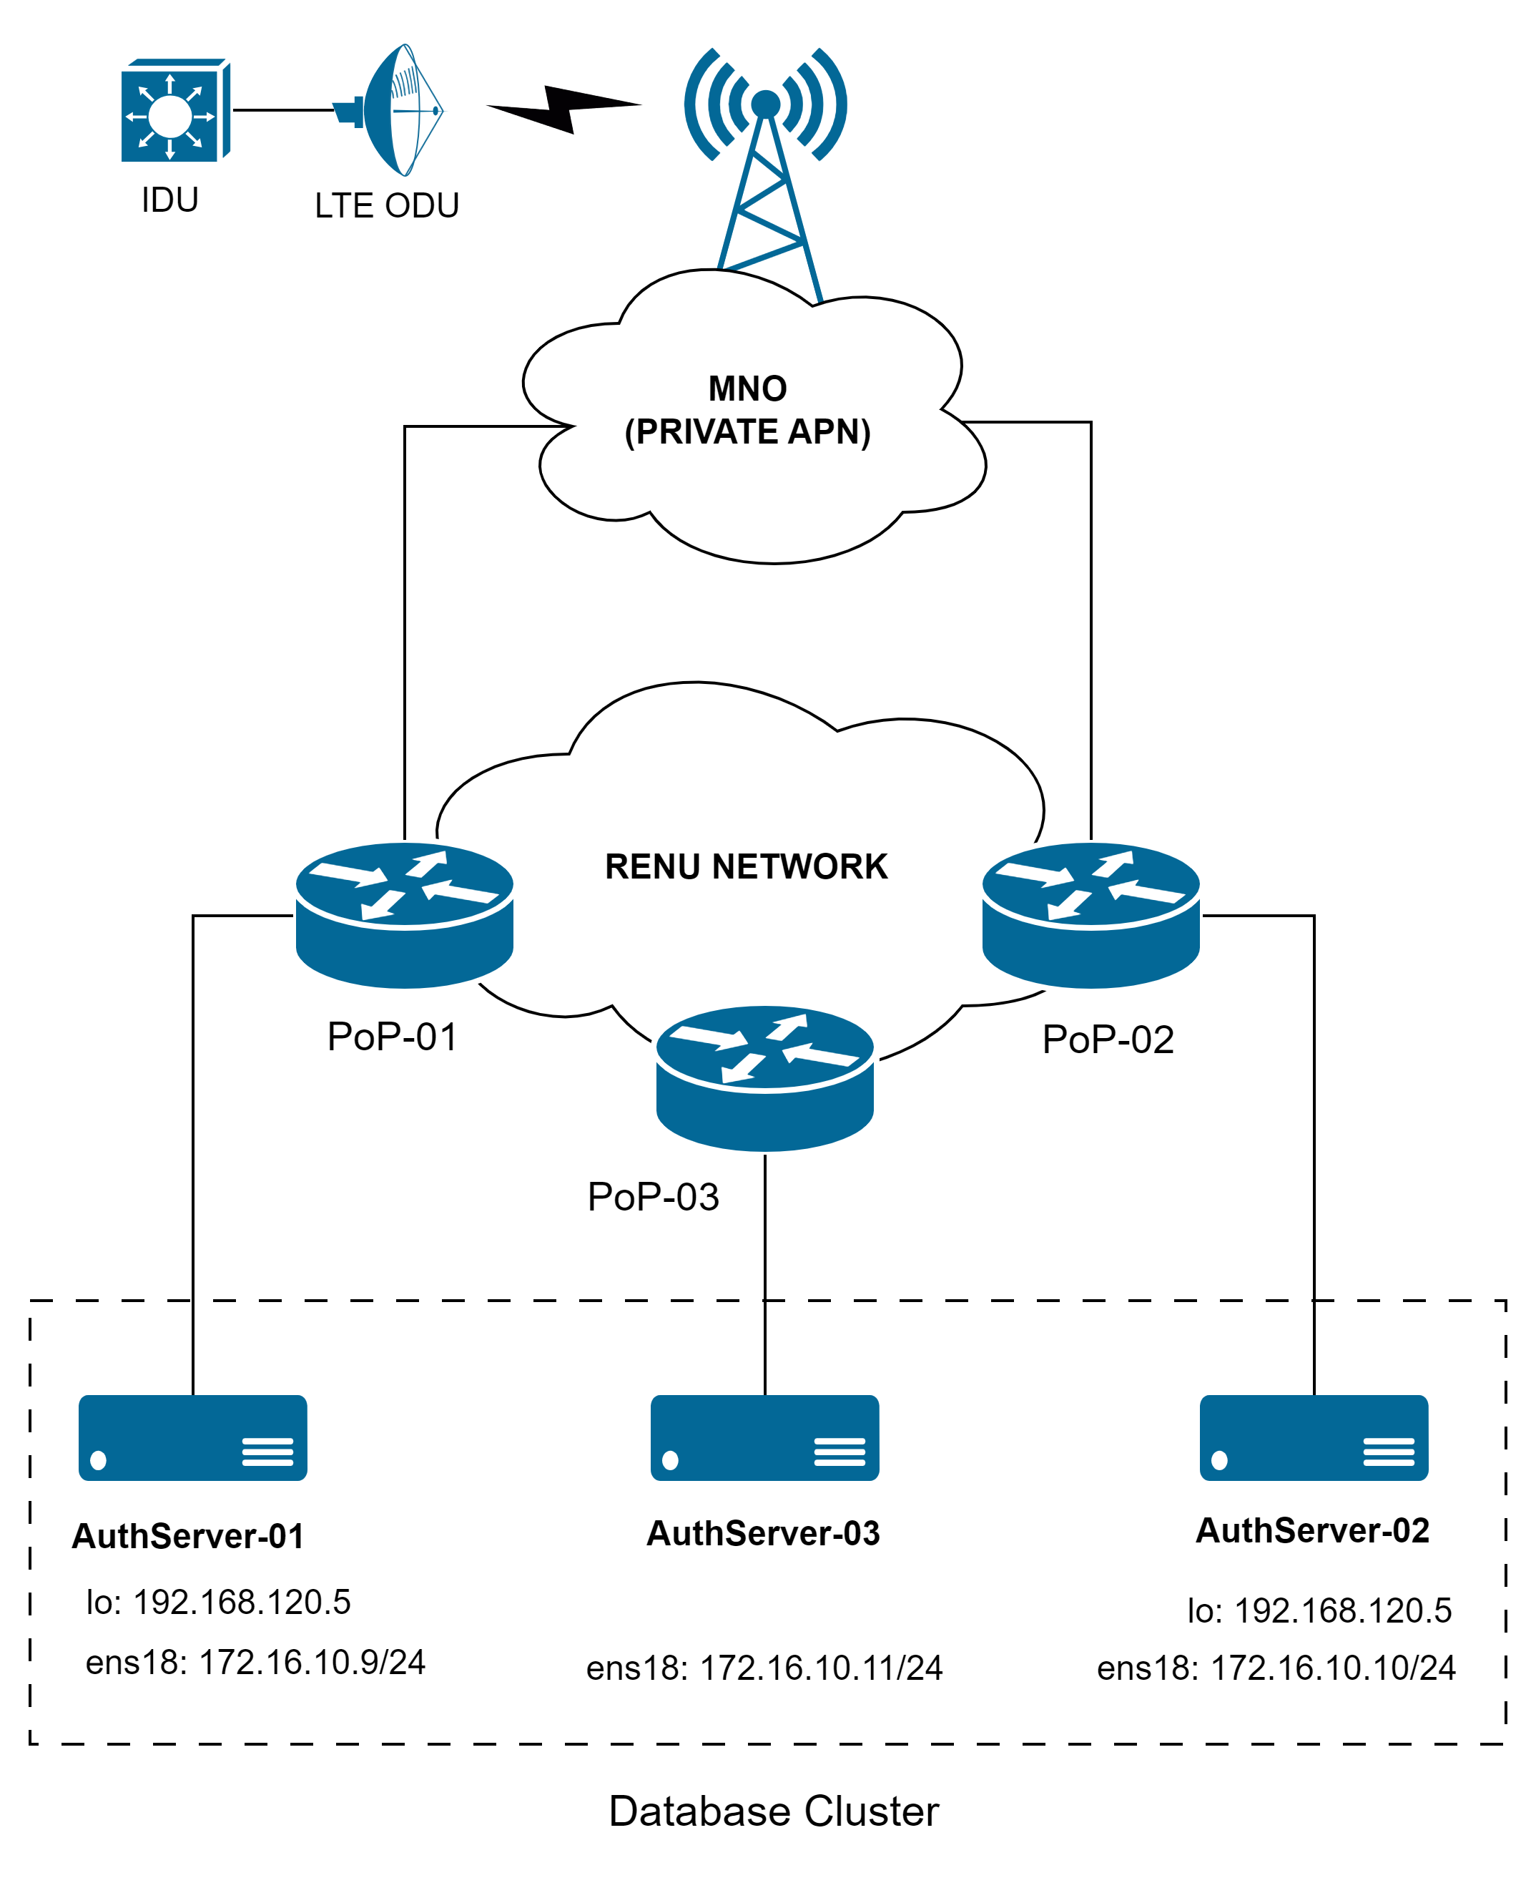
New Design
Second link to MNO: L3 failover
Anycast: Active-Active operation
Galera Database Cluster: Node synchronization
Route Tracking: Failover mechanism
  ICMP reachability checks on the server unicast IP address

Slide 12
Achievements
Deployed as fixed links for Health Facilities, Schools, and other remote sites.
Deployed as mobile links for eduroam on the Go
Over 1000 active links with approximately 1Gbps of traffic.

Slide 13
Future Works
Application level monitoring for failover – RADIUS service health.
Exploring private LTE and 5G networks for intra-campus connectivity.

Slide 14


Slide 15
Asante Sana!

