Slide 1


Digital Tools and Bioinformatics in Academic Libraries: Transforming Research Support at Makerere University
Onan Mulumba
(Makerere University)
31st October 2024

Slide 2

Bioinformatics: The use of computational tools to analyze biological data.
Biopython
Computational/ Digital tools
RStudio (Bioconductor)
BLAST
Galaxy

Slide 3
Bioinformatics: The use of computational tools to analyze biological data.
Genomic
Biological data
Transcriptomic
Proteomic
Metabolomic

Slide 4

Why bioinformatics in Libraries?
5. Need for customized Library services e.g IL programmes
4. Libraries serve as gateways to these essential resources
3. Researchers depend on these tools for gene sequencing, protein structure analysis, etc
2. Bioinformatics aids in processing complex biological data
Traditional library services not effective in supporting practical research

Slide 5

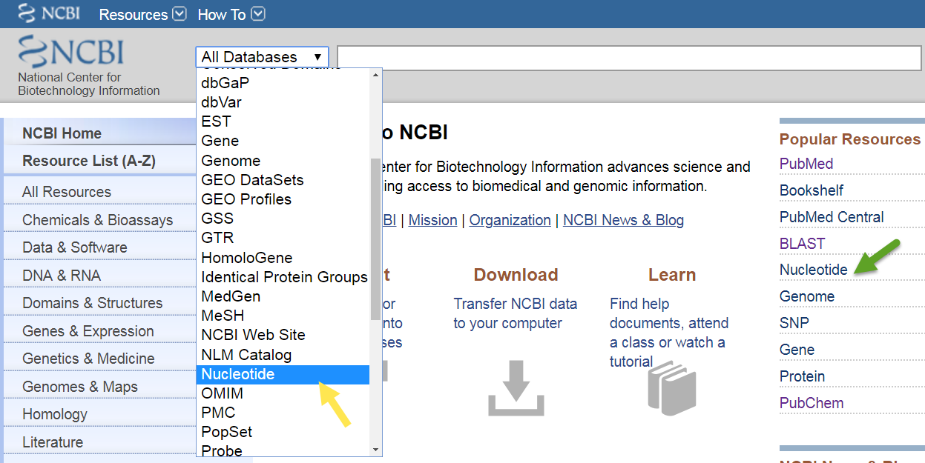
Essential Bioinformatics Databases
NCBI (GenBank, BLAST)

Slide 6
Essential Bioinformatics Databases
Ensembl (vertebrate genomes)
KEGG (Metabolic pathways)
PDB (Protein 3D structures)
UniProt (protein sequence)
RefSeq (NCBI Reference DNA & RNA Sequence Database)

Slide 7

Tools supporting data analysis and visualization
Cytoscape: Molecular interaction visualization
MATLAB: Bioinformatics and systems biology analysis
MATLAB: Bioinformatics and systems biology analysis
Google Cloud, AWS: For computational bioinformatics
Cloud platforms and collaborative tools
GitHub/GitLab: Sharing code workflows & pipelines
Slack/Teams: Real-time communication and collaboration

Slide 8

What academic libraries should do?
Document & provide information to aid accessing research support tools eg: Pipelines, and other data analysis & visualization tools
Organize IL trainings customized to specific user needs
Teach Bioinformatics & Mol. Bio students & researchers to access Biological sequence/omics databases
Provide access to HPCs and cloud services

Slide 9
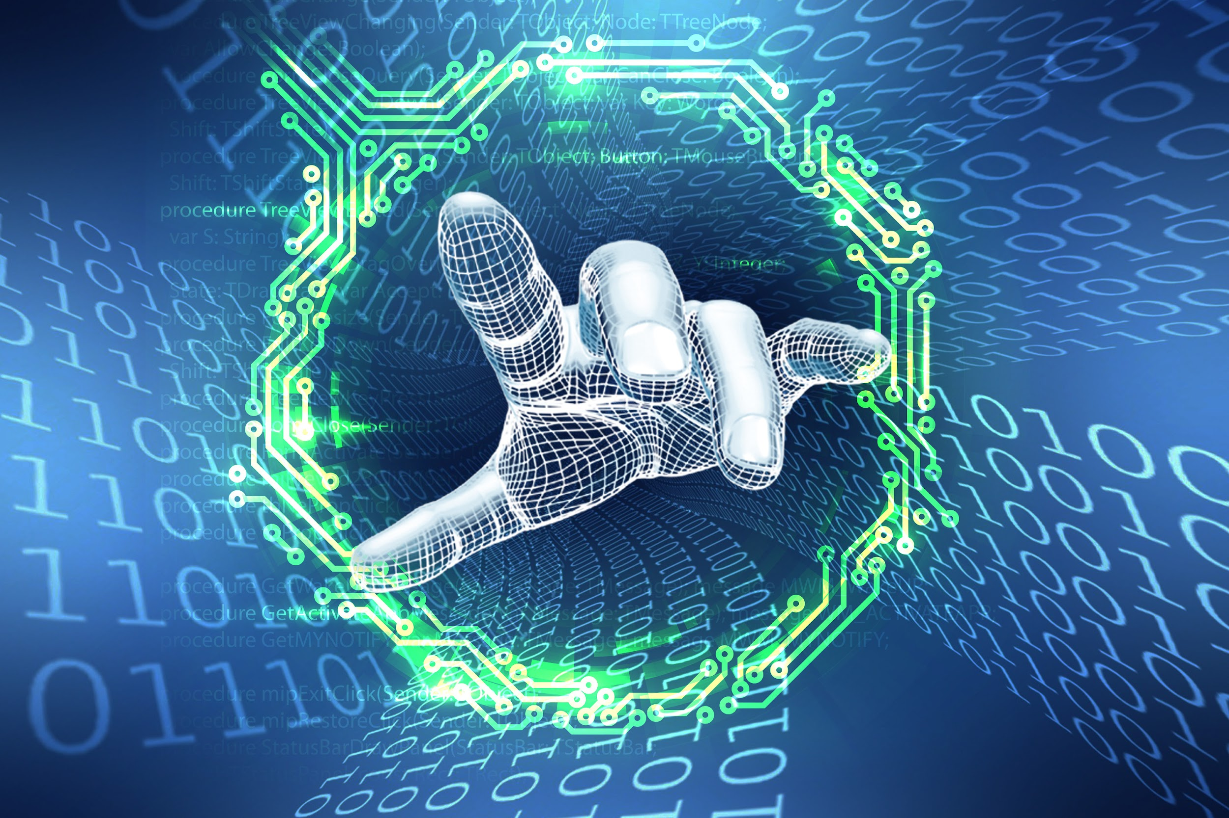
What Makerere has done
Employ a subject specialist
Design & implement customized IL training curricula

Slide 10
What the patrons have said.
This is an excellent programme! Please invite us for more trainings like this.
I never knew the library has all this to offer.
So far the best training I have had at the university.
Please also teach us how to analyse data using R.
I like this. You’re the best.
Do you offer Bioinformatics analysis services? I could pay.

Slide 11


1
Lack of skilled personnel - Hire & train staff
2
Low bandwidth for downloading data - Optimize
3
Budget constraints - Loby

Slide 12


