Slide 1
An efficient application of the equal cost multipath on software defined network to address transmission failures.
Siyabonga Peter
Supervisors: Prof V.M. Srivastava and Dr H.I. Kobo

Slide 2
Presentation outline
NICIS and SANReN
Problem statement
Response to the problem
High level description of SDN, IS-IS and ECMP
Methodology
Experimental design
Results
Recommendation
Future work
Acknowledgement

Slide 3




Background of NICIS
National Integrated Cyberinfrastructure System (NICIS)
Structure
South African National Research Network (SANReN)
Centre for High Performance Computing (CHPC)
Data Intensive Research Initiative of South African (DIRISA)
SANReN
High-bandwidth Network
CHPC
High
Performance Computing
DIRISA
Data Intensive Research
A national initiative of the DSI
Hosted at the CSIR by the NGEI cluster, Smart Society Division
National Integrated Cyberinfrastructure System (NICIS)
SANReN, https://www.sanren.ac.za/ | CHPC, https://www.chpc.ac.za/ | DIRISA, https://www.dirisa.ac.za/

Slide 4
Problem statement
Load shedding/reduction
Third party infrastructure vandalism
Demand for internet access
The impact on SANReN community

Slide 5
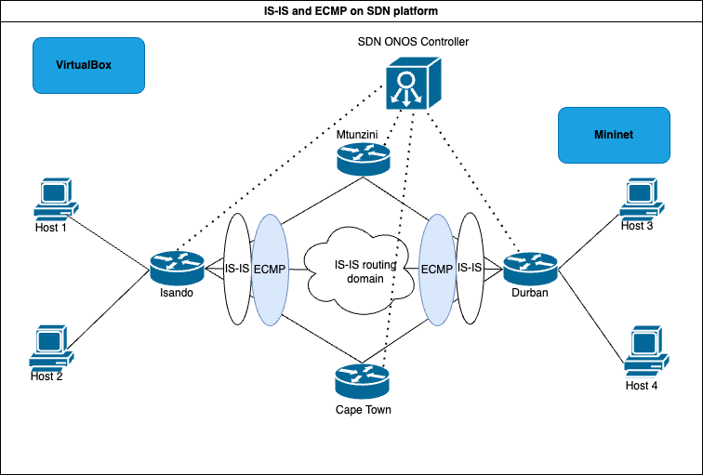
Response to the problem

Slide 6
HLD of SDN, IS-IS and ECMP
SDN refers to a software-controlled approach to networking by API’s.
IS-IS is a link state routing protocol that provides fast convergence and scalability.
ECMP refers to the routing technique of forwarding packets to multi best paths of the same cost.

Slide 7
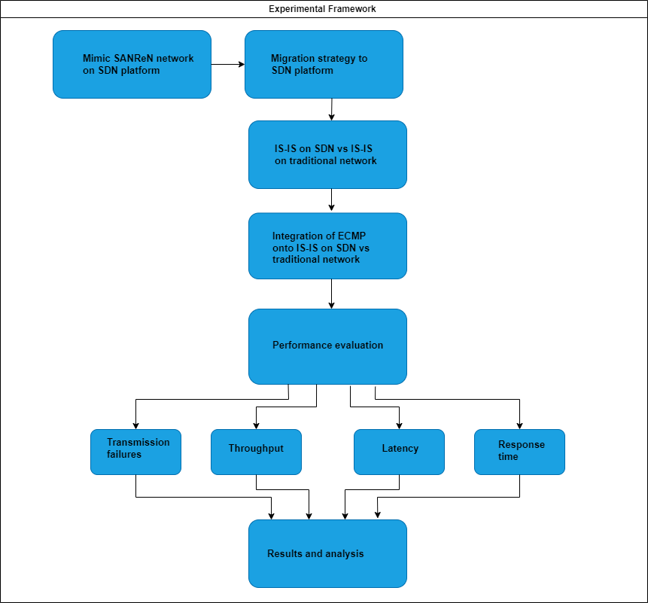
Methodology

Slide 8
Experimental design
Hardware
Software
Hardware | Specification
Laptop | Intel(R) CoreTM i7-10850H CPU@ 2.70GHz a clock speed of 2.71 GHz
RAM | 32 GB
HDD | 800GB
Operating Systems | Windows and Linux Kernel
Software | Specification
VirtualBox | Version 6.1.32
VM Mininet | Ubuntu 22:04:02 LTS
Mininet | Version 2.3.0
MobaXterm | Version 22.0
OpenFlow | Version 1.3
ONOS | Version 3.0.0
Wireshark | Version 2.6.10
Iperf3 | Version 3.9
D-ITG | Version 2.8.1

Slide 9
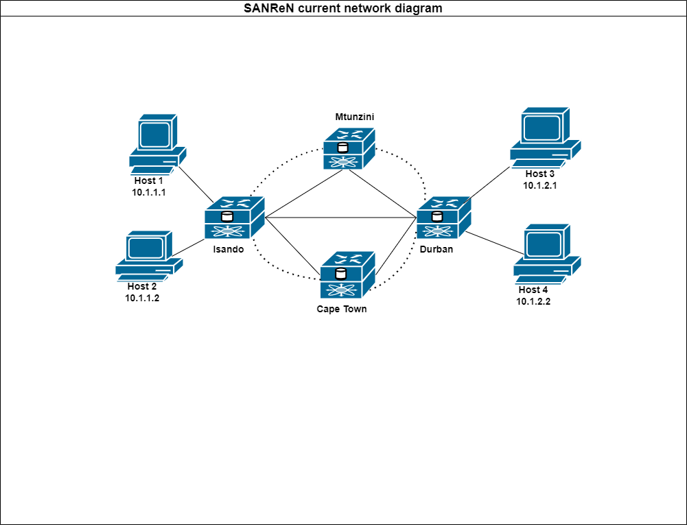
Experimental design cont…

Slide 10
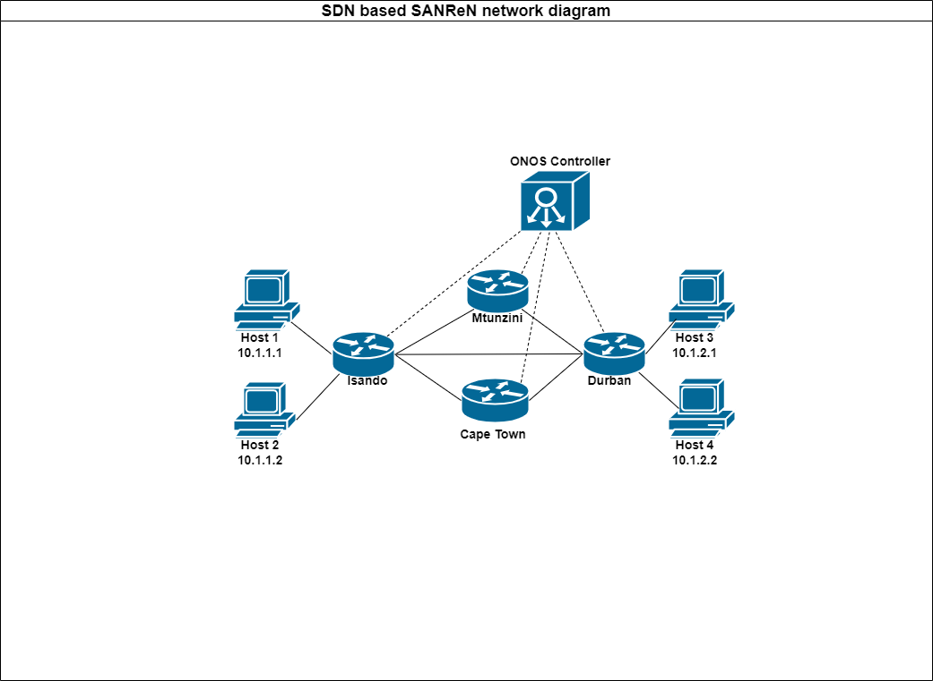
Experimental design cont…

Slide 11
Results
Transmission failures at 500Mbps
Transmission failures at 1Gbps

Slide 12
Results
Throughput at 500Mbps
Throughput at 1Gbps

Slide 13
Results
Latency at 500Mbps
Latency at 1Gbps

Slide 14
Results
Response time at 500Mbps
Response time at 1Gbps

Slide 15
Recommendations
Service providers and network operators should migrate to SDN ecosystem.
A proper framework must be developed that includes re-skilling of technical staff.
A hybrid method to be considered instead of a blanket approach.

Slide 16
Future work
Mobile transmission networks
Other routing protocols
Incorporate other transmission performance metrics
Energy efficient devices

Slide 17



Acknowledgements

Slide 18
Any questions?
speter@csir.co.za
siya@sanren.ac.za

