Slide 1
AmLight ExP- Network Connectivity for Open Science between South Africa, the US, and South America
Vasilka CHERGAROVA - Florida International University, Miami, FL, USA, Emails: vchergar@fiu.edu
Notes:
[italics in reference to USC]

Slide 2
Outline
What is AmLight-ExP?
SC23 & BEAA Collaboration
Open Science Grid
Astronomy
Cryogenic Electron Microscopy
Other Science Drivers
Conclusion
60 Miles backhaul
Notes:
Need to define GNA

Slide 3











Americas-Africa Lightpaths Express and Protect (ExP)
AmLight ExP is a hybrid network that uses Optical spectrum (Express) and Leased capacity (Protect) to build a reliable cutting-edge network infrastructure for research and education
AmLight ExP Network currently consists of:
  600G of upstream bandwidth between the U.S., Latin America, Caribbean, and 100G to South Africa in Cape Town.
  Open Exchange Points (OXPs) with Points of Presence (PoPs) in: Florida (3), Brazil(2), Chile, Puerto Rico, Panama, and South Africa, New: Georgia (Atlanta), Argentina (Buenos Aires)
  Production Software-defined networking (SDN) Infrastructure since 2014
  Deeply Programmable R&E Network Infrastructure
  Highly instrumented: PerfSONAR, sFlow, Juniper Telemetry Interface (JTI), In-band Network Telemetry (INT)
(AmLight ExP project is supported by NSF Award #1451018 and #2029283. )
3
Notes:
The AmLight international network topology consists of two rings. The AmLight Express spectrum ring is the primary route to bring large astronomical scientific datasets from Chile to South Florida. Activation is currently in progress. We have accepted the spectrum on Monet from Fortaleza Brazil to Boca Raton Fl. The terrestrial cable has been acquired to connect MI3 where Monet terminates to the AMPATH International Exchange Point at MI1 NAP of the Americas in Miami.
The AmLight protected 100G ring is already in operation and carries multiple types of research and education data. It will be the backup for astronomy data. Recently, a 100G connection between Panama and Miami was completed.

Slide 4
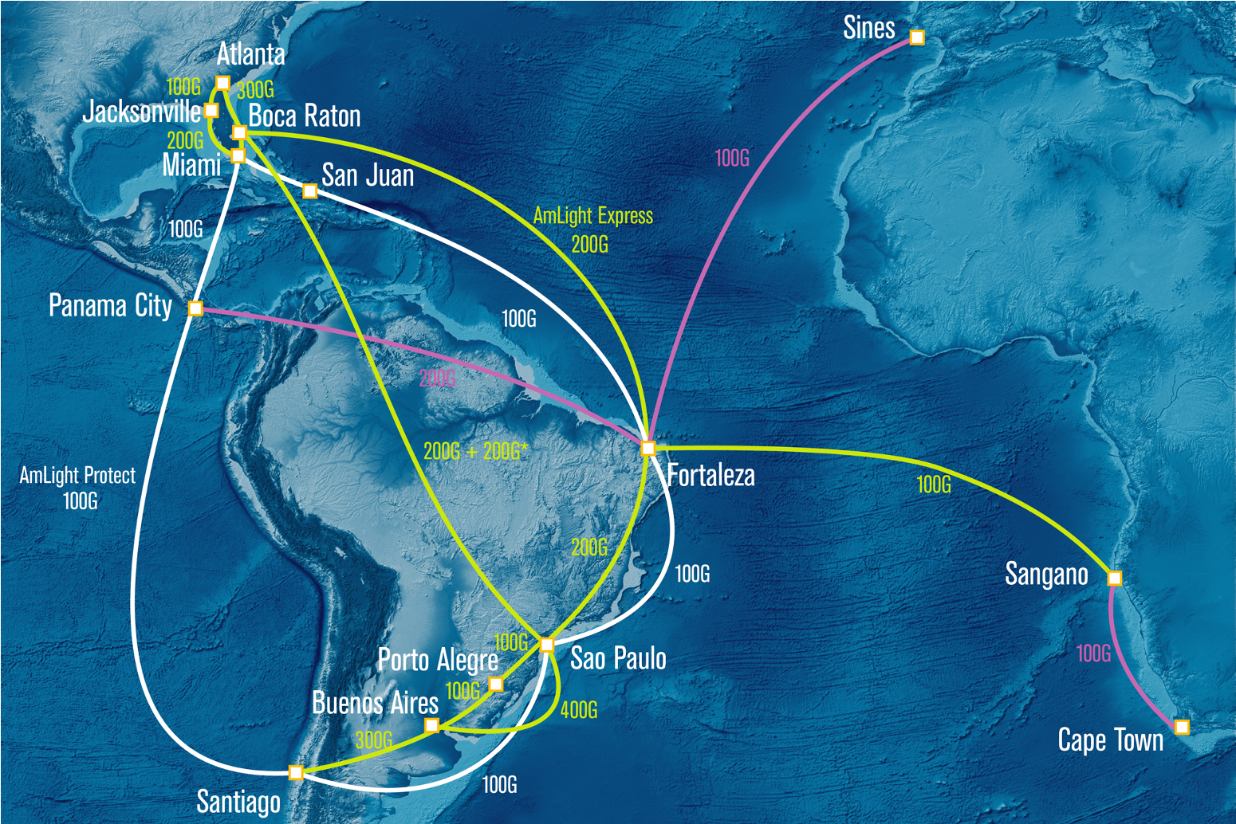






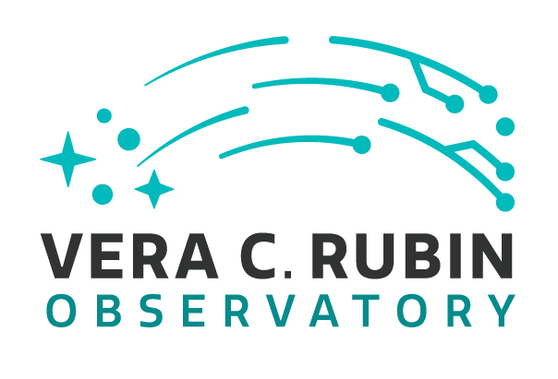


Americas-Africa Lightpaths Express and Protect (ExP)
(NSF Award # OAC-2029283)
4
Notes:
This graphic shows the AmLight network and how it interconnects now to Africa through US networks to New York and then on the Advanced North Atlantic or ANA link and GEANT.
The AARCLight Link is shown on the new Angola Cables South Atlantic Cable System connecting Luanda, Angola to Fortaleza, Brazil and AmLight. This link is not yet in service for the research and education network community. Discussion is underway to light the service in early 2019.

Slide 5
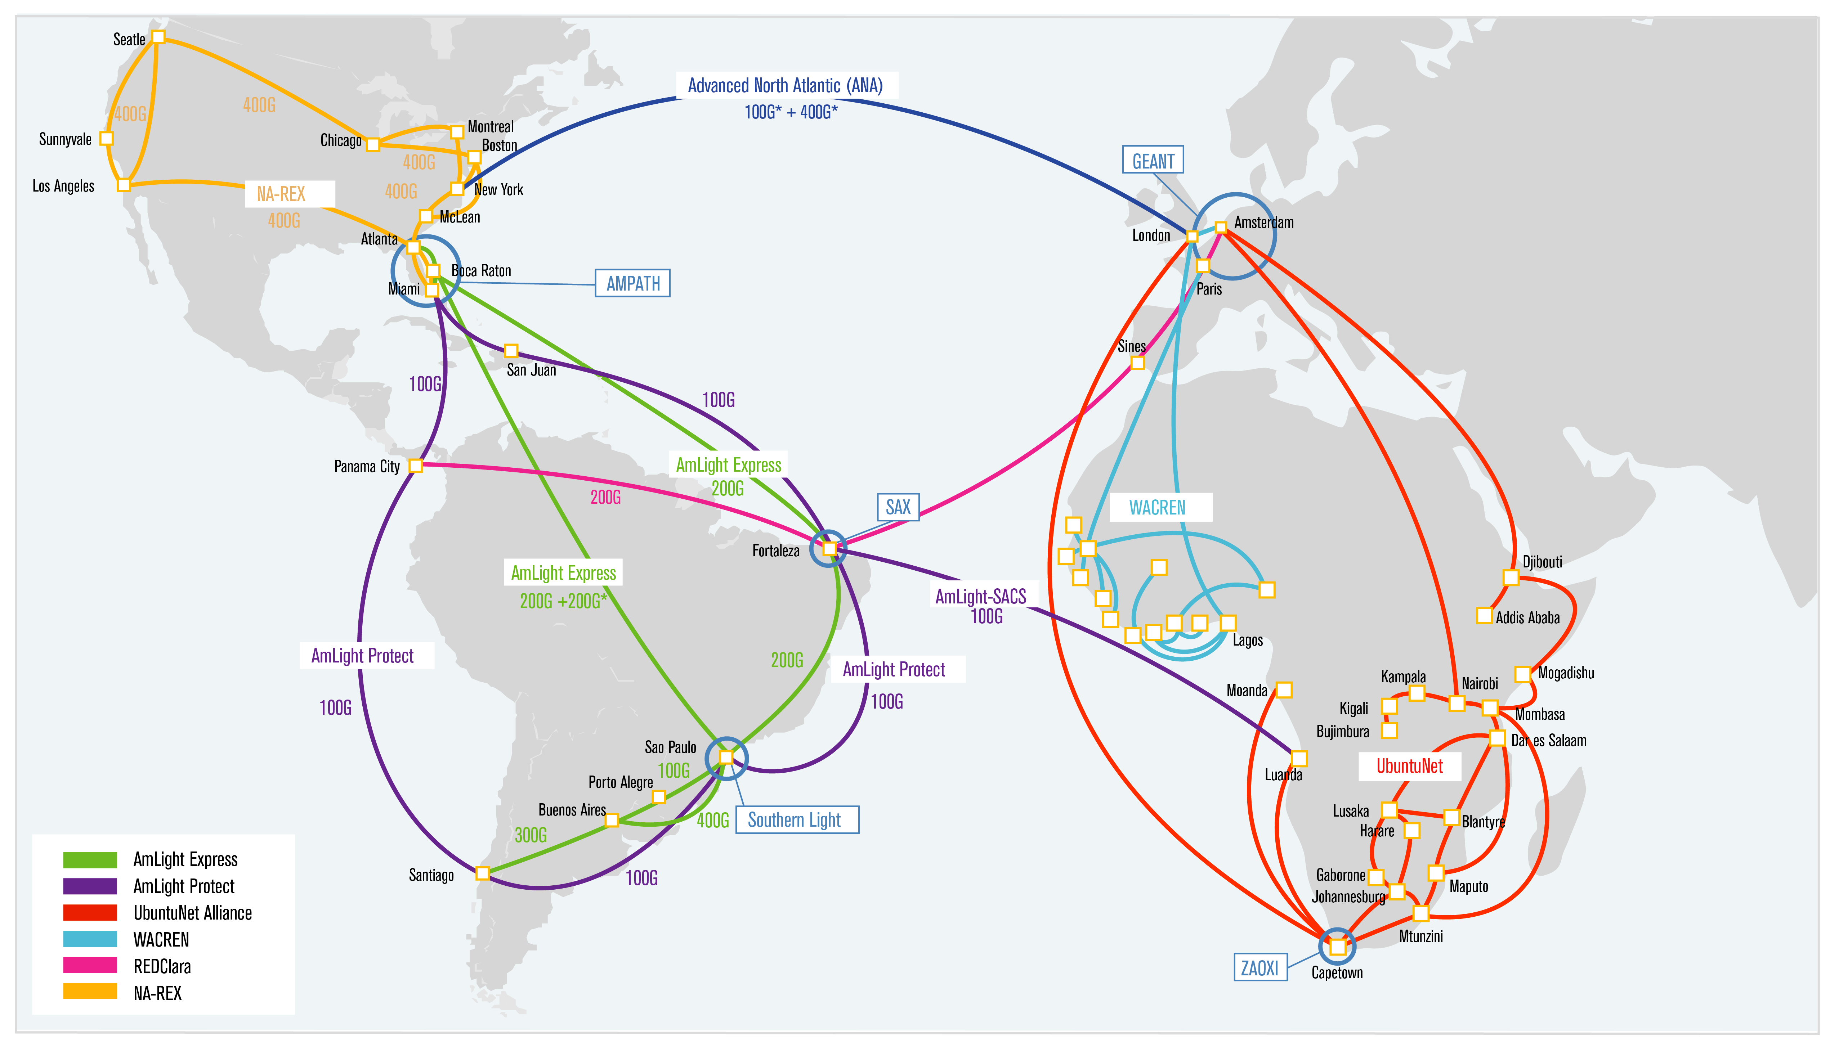

Slide 6
The South Africa NREN = TENET & SANReN
TENET
Created in 2000 as a non-profit company. Membership is primarily universities (all 26) and research institutions, but serves a much wider constituency
Funded through cost recovery from beneficiaries
Operates network deployed by SANReN, but also deploys some network components
Delivers services
SANReN
Created in 2006 as a business unit in the Council for Scientific and Industrial Research
Funded through a State grant (Department of Science and Technology)
Designs, acquires and implements networks and network components, from metro to international level
Develops and incubates services
6

Slide 7
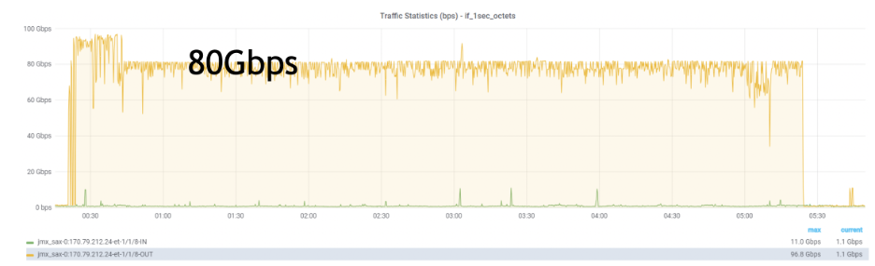
Network performance during Supercomputing (SC23)
Leveraged AmLight-ExP's 100Gbps infrastructure via South Atlantic Cable System (SACS)
Demonstrated SANReN Data Transfer Nodes (DTNs)
Achieved 2.5 Tbps data transmission across the US, Brazil, and South Africa
Test Path: Miami to Cape Town
Used 100Gbps SACS link (Miami - Fortaleza - Cape Town) - filled to +/- 98%.
Achieved 70Gbps throughput using iperf3, running 4 parallel 20Gbps streams with a 400MB TCP window
Collaboration Impact
Highlighted African NREN involvement in global data transfer experiments
Strengthened partnership between AmLight-ExP and SANReN
7

Slide 8
Bridging Europe, Africa, and the Americas (BEAA) – New Collaboration for shared transoceanic R&E networking resilience
Partnership between seven regional/national R&E networks across Europe, Africa, and Latin America
Aimed at enhancing network resilience via shared transoceanic links
Memorandum of Understanding (MoU)
Signed by AmLight/FIU, GÉANT, RedCLARA, RNP, CSIR, TENET, and the UbuntuNet Alliance
Initial 3-year agreement for mutual backup and high-capacity resource sharing
Ensures back-up connectivity for uninterrupted R&E collaborations
Impact
Critical during outages, e.g., March 2024 cable disruptions off West Africa
Enabled traffic migration to backup systems like Google's Equiano and AmLight SACS academic link
8

Slide 9
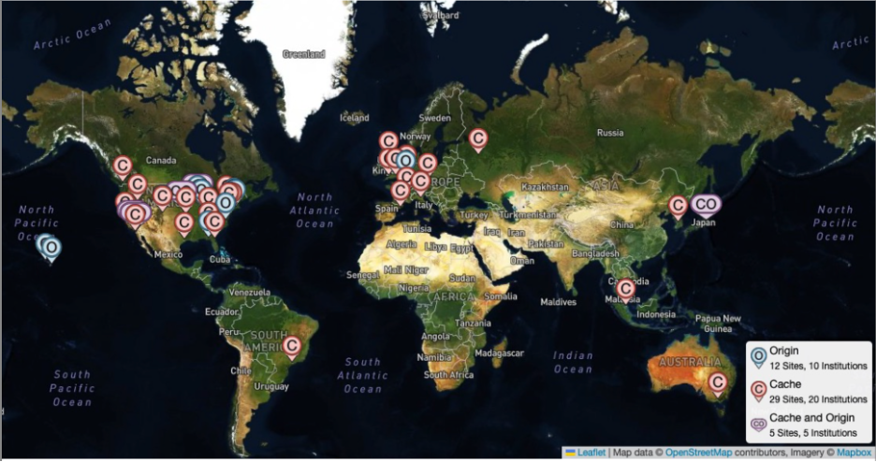
Open Science Grid (OSG)
OSG's Role
Provides software and services to enable opportunistic usage of distributed computational resources
Supports 35 institutions across five continents through the Open Science Data Federation (OSDF)
Infrastructure
17 Origins and 34 caches globally contributing to the resource-sharing network
Challenges
Cache population delays due to lack of data on latency and geographical distance between Caches and Origins
Requires better insights into round-trip time (RTT) to improve efficiency
9

Slide 10
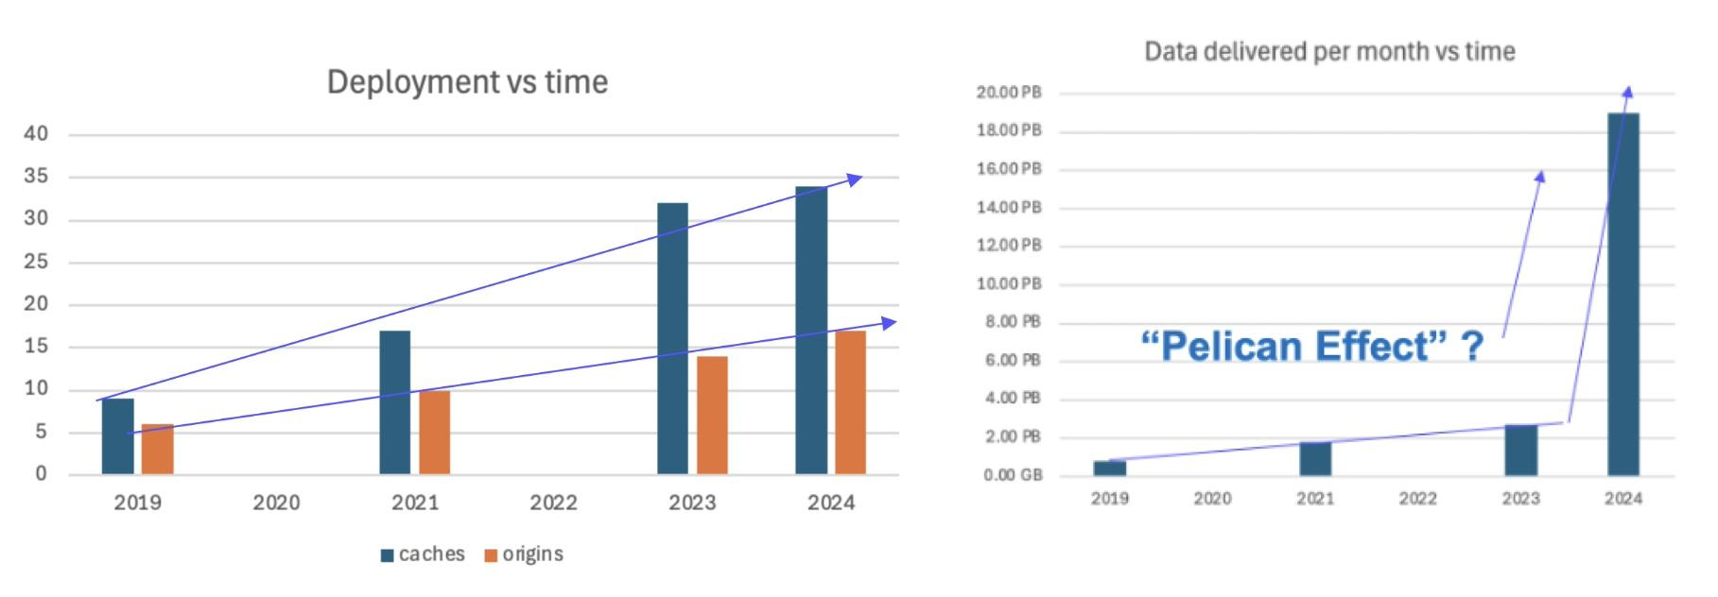
Open Science Data Federation (OSDF): Expanding Impact and Global Collaboration
7x Increase in OSDF Usage
Caching system saves 75% of 100G transnational network capacity
Now utilized by one-third of OSPool users, accounting for 10% of total reads
Top Fields Using OSDF
Biology, Physics, Math, Chemistry, Geological & Earth Sciences
Global Expansion
Discussions underway to deploy OSG caches in South America and Africa
SPRACE data center (Sao Paulo) already serves over 1.2PB of jobs from major projects like Ligo, Fermilab, and OSPool
Enhanced Flexibility
OXP Orchestrators and telemetry provide better service definition, network visualization, and utilization reports
10

Slide 11

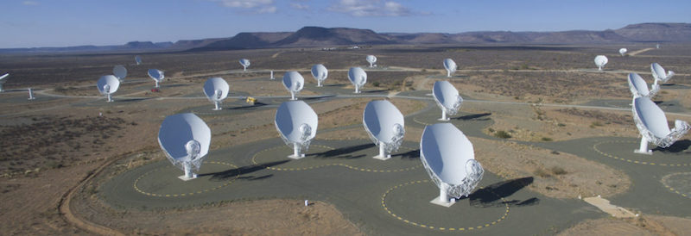
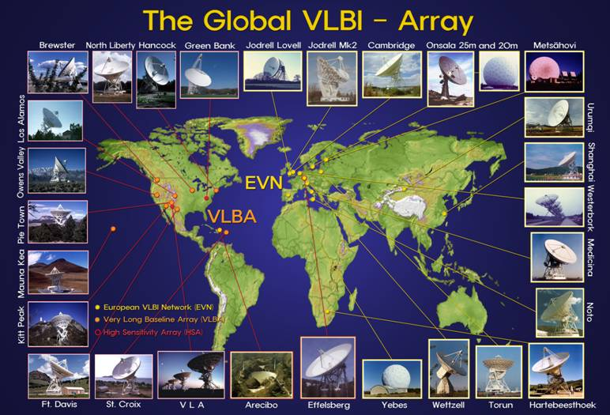
Astronomy Initiatives: South Africa's Role in Global Research
South African Astronomical Observatory (SAAO)
Manages the Southern African Large Telescope (SALT) – the largest optical telescope in the Southern Hemisphere
Hosts multiple international research telescopes connected via the SANReN network
MeerKAT & Square Kilometre Array (SKA)
MeerKAT: 64-antenna radio telescope incorporated into SKA
SKA to include 197 dishes in South Africa & 131,000 antennas in Australia
First observations in 2024, construction complete by 2030
Very-long-baseline Interferometry (VLBI)
HartRAO in South Africa part of global collaboration for radio astronomy
Connected to European VLBI Network (EVN) for data processing via SANReN network
Collaboration with AmLight & TENET to facilitate data transfers to US collaborators at the NRAO VLBA
https://www.ska.ac.za/science-engineering/meerkat/about-meerkat/
https://www.skatelescope.org
https://geodesy.hartrao.ac.za/site/en/geodesy-equipment/radio-telescope-vlbi.html (©T. Krichbaum, MPIfR)
11
Notes:
The SKA array will produce upwards of a hundred gigabits per second of compressed data.
SKA anticipates generating close to an Exabyte of raw data per day when fully operational.
Many African countries will be part of SKA in phase-2 further provoking the need for higher performance R&E Network capacity.
Other Notes:
http://theconversation.com/ghana-is-boosting-africas-ascent-to-astronomical-heights-82849
HERA network connection for example use “mailing disks” and 200Mbps to NRAO (page 3): https://www.dropbox.com/s/tjune963k0cfk45/Technical%20Design%20%E2%80%93%20reionizationHERA.pdf?dl=0

Slide 12
Cryogenic Electron Microscopy (cryo-EM): Opportunities for Global Collaboration
Cryo-EM in Biomolecular Research
Revolutionizing studies on viruses (HIV, Tuberculosis), cancer, and bacteria
Generates 1-10 TB of data per session, enabling high-resolution movies of specimens
US Involvement in cryo-EM
Over 100 cryo-EM instruments located in the US
Significant potential for remote collaboration
Untapped Potential in Africa
No cryo-EMs in Africa, but African researchers are learning to use them
AmLight ExP, SANReN, and TENET can facilitate collaboration with University of Cape Town (UCT) and US researchers
Future Collaboration
Opportunity to pilot remote observation programs with US NIH/NSF-supported researchers
Expanding access to cutting-edge research tools for African scientists
12
Notes:
The SKA array will produce upwards of a hundred gigabits per second of compressed data.
SKA anticipates generating close to an Exabyte of raw data per day when fully operational.
Many African countries will be part of SKA in phase-2 further provoking the need for higher performance R&E Network capacity.
Other Notes:
http://theconversation.com/ghana-is-boosting-africas-ascent-to-astronomical-heights-82849
HERA network connection for example use “mailing disks” and 200Mbps to NRAO (page 3): https://www.dropbox.com/s/tjune963k0cfk45/Technical%20Design%20%E2%80%93%20reionizationHERA.pdf?dl=0

Slide 13
Collaborative Research Driving Science Across the South Atlantic
Medical & Agricultural Collaborations
Army worm pest control: Brazil, US, South Africa & 9 African countries collaborating on maize/sorghum pest control
Clinical research: FIOCRUZ (Brazil) & Mozambique focusing on infectious diseases (Malaria, AIDS, TB)
Atlantic International Research Centre (AIR-Centre)
A platform for global collaboration on space, oceans, climate change, and more
EU-BR-ZA agreements promote South Atlantic & Southern Ocean research
National Institutes of Health (NIH) in Africa
$74.5M invested in DS-I Africa to catalyze data science, AI, and health discoveries
Projects addressing pandemic preparedness, AI for pregnancy outcomes, antimicrobial resistance, and more
13
Notes:
The SKA array will produce upwards of a hundred gigabits per second of compressed data.
SKA anticipates generating close to an Exabyte of raw data per day when fully operational.
Many African countries will be part of SKA in phase-2 further provoking the need for higher performance R&E Network capacity.
Other Notes:
http://theconversation.com/ghana-is-boosting-africas-ascent-to-astronomical-heights-82849
HERA network connection for example use “mailing disks” and 200Mbps to NRAO (page 3): https://www.dropbox.com/s/tjune963k0cfk45/Technical%20Design%20%E2%80%93%20reionizationHERA.pdf?dl=0

Slide 14
Conclusion & Next Steps: Advancing Global Research and Education with AmLight-ExP
AmLight-ExP: A transformative network connecting the US, Latin America, and Africa through advanced optical spectrum and leased capacity.
Successful Demonstrations:
  SC24: 100Gbps throughput tests between US and South Africa
  WACS/SACS/AmLight link boosted during SC23
  Support for data-intensive research in fields like astronomy, medical research, agriculture, and genomics.
BEAA Collaboration:
    Enhances network resilience for continuous connectivity across continents
    Regional RENs (WACREN, UbuntuNet Alliance) empower higher education institutions in Africa.
14
Notes:
The SKA array will produce upwards of a hundred gigabits per second of compressed data.
SKA anticipates generating close to an Exabyte of raw data per day when fully operational.
Many African countries will be part of SKA in phase-2 further provoking the need for higher performance R&E Network capacity.
Other Notes:
http://theconversation.com/ghana-is-boosting-africas-ascent-to-astronomical-heights-82849
HERA network connection for example use “mailing disks” and 200Mbps to NRAO (page 3): https://www.dropbox.com/s/tjune963k0cfk45/Technical%20Design%20%E2%80%93%20reionizationHERA.pdf?dl=0

Slide 15
THANK YOU!
Vasilka CHERGAROVA - Florida International University, Miami, FL, USA, Emails: vchergar@fiu.edu
Heidi MORGAN - University of Southern California, Los Angeles, USA, Email: hlmorgan@isi.edu
Julio IBARRA - Florida International University, Miami, FL, USA, Email: julio@fiu.edu
Jeronimo BEZERRA - Florida International University, Miami, FL, USA, Emails: jbezerra@fiu.edu
Luis Fernandez LOPEZ - Florida International University, Miami, FL, USA, Emails: llopez@fiu.edu
Donald A. “Chip” COX III - Vanderbilt University, Nashville, USA, Email: chip.cox@vanderbilt.edu
Gabriella E. ALVAREZ - Florida International University, Miami, FL, USA, Emails: gaby.elan@gmail.com
Aluizio HAZIN - Rede Nacional de Ensino e Pesquisa (RNP), Brazil, Email: aluizio.hazin@rnp.br
Kasandra PILLAY - Council for Scientific and Industrial Research (CSIR), South African National Research Network (SANReN), South Africa, Emails: kpillay@csir.co.za
Ajay MAKAN - Council for Scientific and Industrial Research (CSIR), South African National Research Network (SANReN), South Africa, Emails: ajay@sanren.ac.za
Duncan GREAVES - Tertiary Education and Research Network of South Africa (TENET), South Africa, Email: ceo@tenet.ac.za
Abdullah SHARIFF - Tertiary Education and Research Network of South Africa (TENET), South Africa, Email: abdullah@tenet.ac.za
Paul SULLIVAN - Tertiary Education and Research Network of South Africa (TENET), South Africa, Email: paul@tenet.ac.z
The authors would also like to thank SANReN, TENET, UbuntuNet Alliance, WACREN, Academic Network of São Paulo (ANSP), and Rede Nacional de Ensino e Pesquisa (RNP).
15

