Slide 1


INTERNATIONAL CONFERENCE
Design and implemention of an AI-enabled IoT-based smart aquaculture system for water quality management in Kalumbila Mine's surface plant areas (PhD continuous research)
(A Case of Chisola and Musanghezi Dams)
Chimanga Kashale¹, Professor Santhi Kumaran², Professor Josephat Kalezhi³
Copperbelt University
School of Information and Communication Technology (SICT)

Slide 2
OUTLINE
Introduction
Literature Review
Methodology
Results
Conclusions
Recommendations
References

Slide 3
INTRODUCTION & BACKGROUND
Kalumbila District, located in Zambia's North-Western Province, was established on August 28, 2015, by President Edgar Chagwa Lungu.
The district shares borders with Solwezi to the east, the Democratic Republic of Congo to the north, Mwinilunga to the west, and Kasempa and Mufumbwe to the south.
According to the 2010 census, the population was 85,505, with 42,548 males and 42,957 females. However, the 2018 National Demographic Survey reported a population of 142,444 (ZAMSTART, 2018).
Kalumbila District has 12 wards with 4 chiefdoms and the major economic activity is mining considering the fact that the district has got two giant mines (Barrick mine- former Lumwana and First Quantum Minerals(FQM) Trident Foundation mine- former Kalumbila Mine).
The surge in population in Kalumbila District, driven by the mining industry, has led to a significant increase in demand for agricultural products.
However, the local farming community, comprising mainly small-scale farmers (80%), has struggled to meet this demand because of the environmental degradation of mine Effluents (pollutants) that are emitted due to mining activities being conducted in the area (ZAMSTAT, 2020).
According to World Bank Report (2020), Kalumbila mine is one of the biggest copper producing mines in Africa. The open-pit mine also holds one of the biggest copper reserves in the world.

Slide 4
INTRODUCTION & BACKGROUND
The current mining plan involves the staged development of a large open-pit measuring 5.4km- long, 1.5km-wide and 375m-deep.
The extracted ore is crushed in-pit and sent to a crushed ore stockpile overland, from where it is further conveyed to a nearby processing plant.
The fine ore material undergoes a conventional sulphide ore flotation circuit for the production of copper concentrate(FQM, 2016).
However during this process, high presence of heavy metals is emitted to the atmosphere and water bodies thereby affecting the natural abitats and surrounding as illustrated in the figure below:

Slide 5
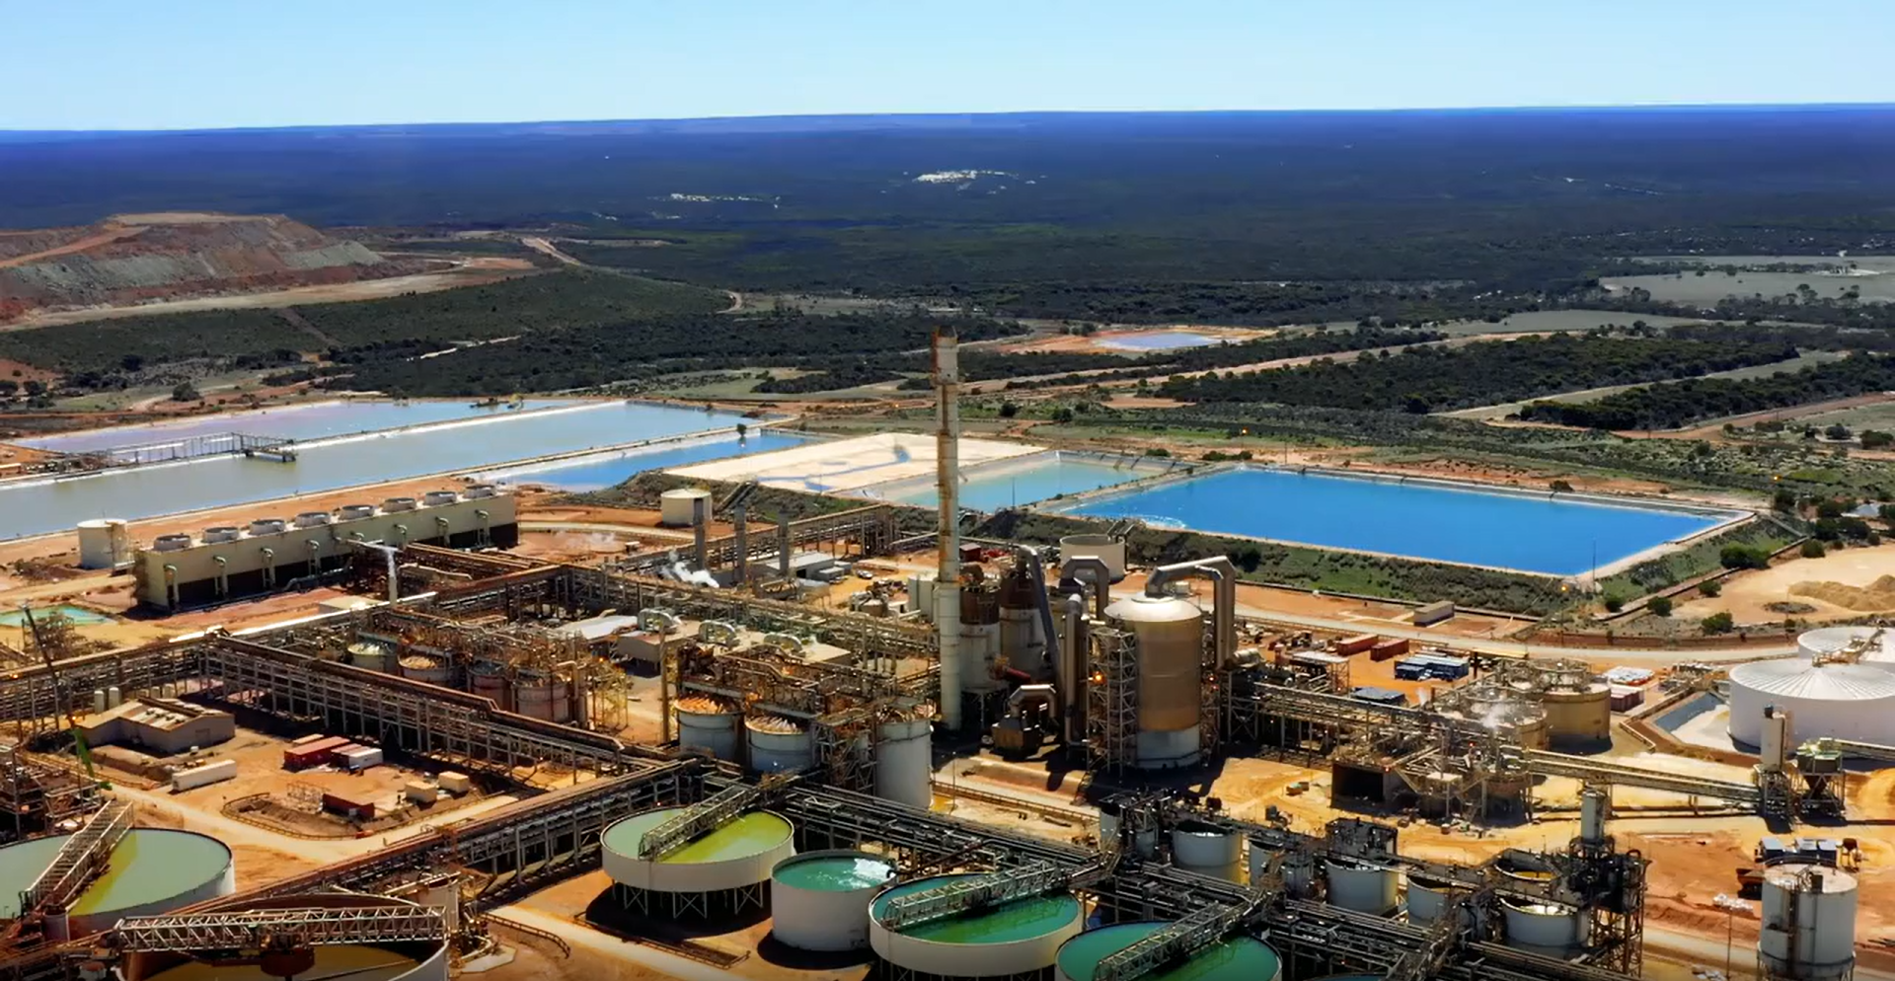
INTRODUCTION & BACKGROUND
Source: First Quantum Minerals limited, 2016
Caritas Zambia,2022

Slide 6
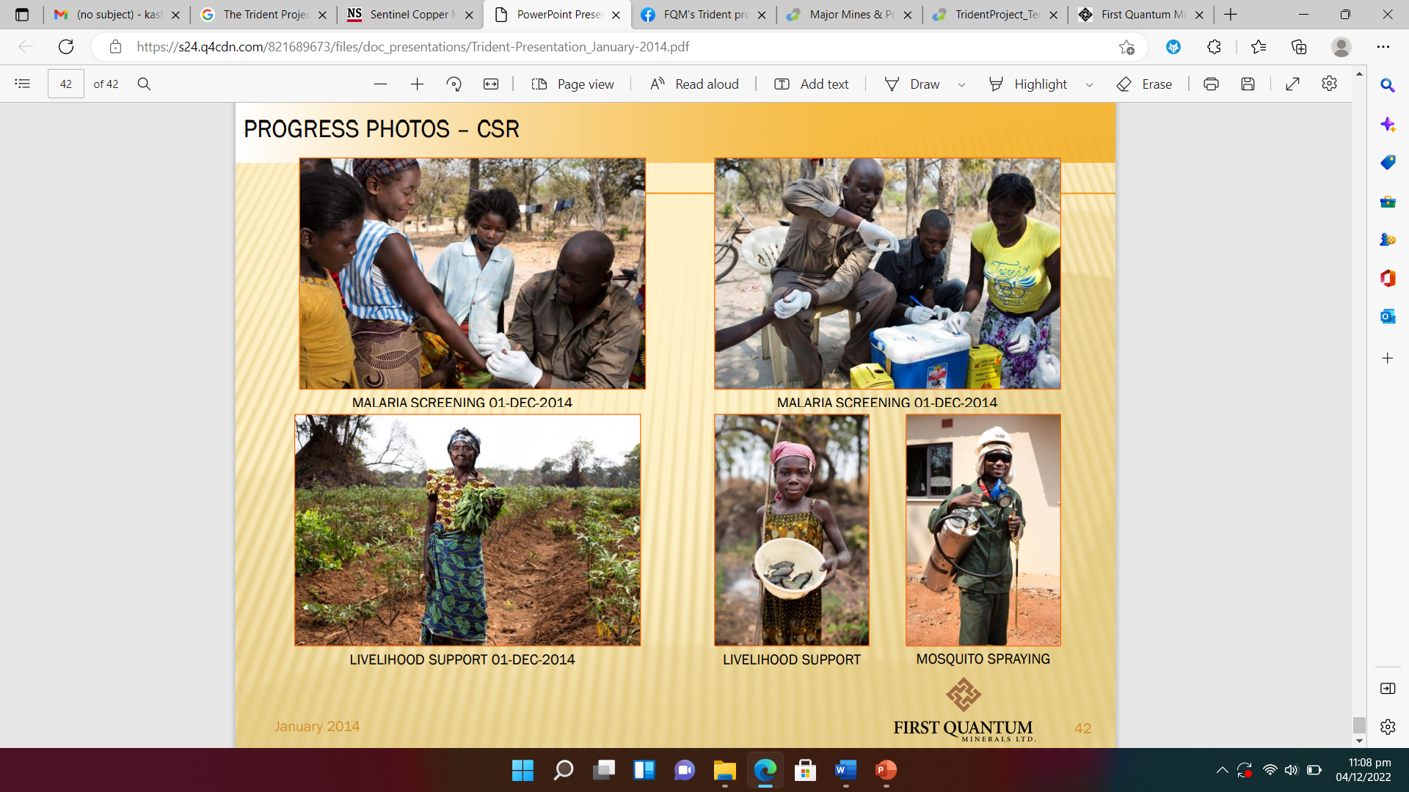
INTRODUCTION & BACKGROUND
According to Caritas Zambia (2020), the activities of FQM has negatively affected fishing and agricultural activities for which the surrounding communities depends on.
Caritas, 2016

Slide 7
Statement of the Problem
The problem of the study emerges that, the mining activities being conducted in Kalumbila district of North Western province has negatively affected the human beings and the environment in which they live (ZEMA, 2020).
According to the ZEMA report on mining activities being conducted in the district, substantial environmental and social harm is caused to the communities around as the activities depletes water supplies, pollutes the air, soil and water, and destroys ecological systems (ZEMA, 2021) .
Reports by independent environmentalist have continued to uncover that mine waste containing sulfide minerals is a common phenominon in mine surface plant areas and a potential source for acid mine drainage (AMD) if they are exposed to oxygen and water ((Independent Environmental Reports, 2024).).
However, despite the measures put in place by the mining firms to mitigate the challenges, heavy metals, acid mine drainage and land degradation issues has continued to be the topic of the debate (Samatepa, 2020).
The motivation of this study was to design and implement a Machine learning prediction model to assess the effect of these mine pollutants on fish production in Mine Surface Plant Areas.
The model uses IoTs sensors powered by energy harvesting technologies to provide real-time monitoring of the mine pollutants before and after they are emitted to the environment.

Slide 8
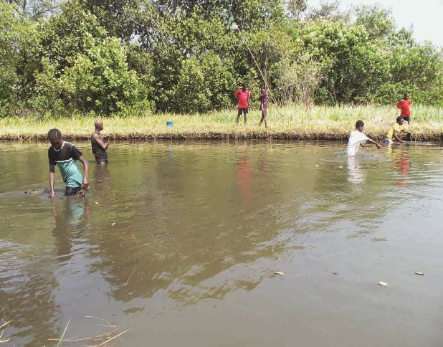

Aim of the study
The aim of this study was to design and implement a Machine learning prediction model to assess the effect of mine pollutants on fish production in Mine Surface Plant Areas, with a focus on Musanghezhi and Chisola Dam
Source: Accurate photos, 2021

Slide 9
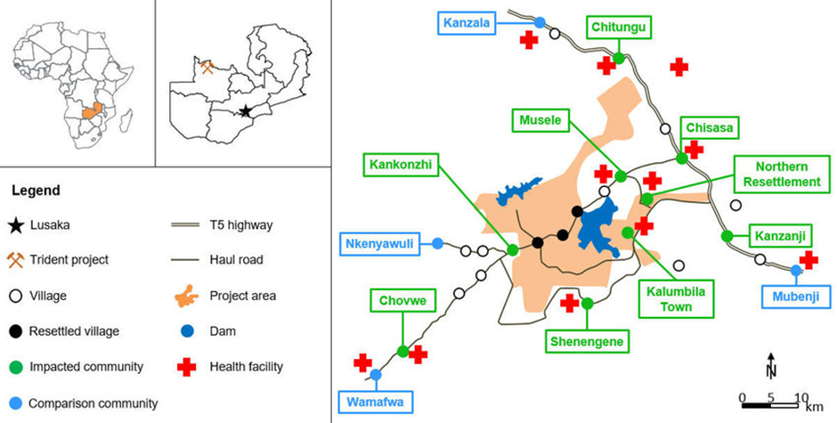
Study Area
Source: Astrid M. Knoblauch et al, 2022

Slide 10
RESEARCH OBJECTIVES
The main objective of the study was to design and implement a Machine learning prediction model that assess the effect of mine pollutants on fish production in Mine Surface Plant Areas.
Specific objectives:
To assess the impact of heavy metal contamination on water quality in the Mine's surface plant areas.
To design and implement an AI-enabled IoT-based smart aquaculture system for water quality management in Mine's surface plant.
To develop a Machine Learning Model that utilizes data on mine influents (Cu, Fe, Co and pH) to predict potential future changes in heavy metal contamination levels

Slide 11

Literature review
Journal | Year | Author(s) | Methods | Findings | Gap
Environmental Science & Technology | 2020 | Lu, J. et al. | Review of machine learning techniques | Machine learning offers various methods for assessing pollutant impact on aquatic ecosystems | No specific focus on fish production
Ecotoxicology and Environmental Safety | 2021 | Zhu, Y. et al. | Machine learning models | Predicts heavy metal contamination and its effects on fish populations | Focuses on heavy metals, did not consider mine surface plant areas
Water Research | 2019 | Wang, X. et al. | Machine learning for water quality prediction | Predicts water quality parameters in mine-impacted areas | Water quality, not directly fish production, but provides insights
Journal of Hazardous Materials | 2022 | Chen, L. et al. | Integrated machine learning models | Assesses impact of mining pollutants on fish | Uses multiple models, and was computationally expensive
Ecological Indicators | 2020 | Huang, B. et al. | Machine learning for aquatic toxicity of mining effluents | Predicts aquatic toxicity of mining effluents | Focuses on effluent toxicity, not specific fish production impact
Academia Journal | 2011 | Not Available | Investigated effects of mine effluents on fish physiology and histology | Mine effluents negatively impact fish health (reduced growth, reproductive impairment, organ damage) | Lacks focus on prediction modeling for fish production assessment
Aquatic Ecosystem Health & Management | 2018 | Not Available | Reviewed effects of metal contamination on aquatic systems and fish | Metals impair fish physiology and behavior | Does not quantify the impact on fish production
US Environmental Protection Agency (EPA) | 2003 | Not Available | Assessed environmental impact of abandoned mine drainage (AMD) on fish communities | AMD significantly reduces fish diversity, abundance, and biomass | Doesn't use machine learning for prediction

Slide 12
Gaps In Literature
Despite extensive research on the impact of environmental pollutants on aquatic ecosystems, there is a notable gap in studies specifically addressing the effects of mine pollutants on fish production within mine surface plant areas.
Most of the existing literature just generalized the impact of various pollutants on fish populations without accounting for the unique conditions and pollutant types prevalent in mine surface plant areas.
The majority of studies focus on individual pollutants rather than the combined and potentially synergistic effects of multiple pollutants commonly found in these regions.
While previous research have employed basic machine learning models, this study made use of hybrid models, which can offer more precise and actionable insights.

Slide 13
METHODOLOGY
Data collection focused on gathering environmental data on pollutants (e.g., heavy metals (Copper, Cobalt, Iron), pH levels) and aquaculture data on fish production metrics (e.g., growth rates, mortality rates) from local sources.
Preparation of Dataset: The dataset consisted of 252 samples (observations) of surface water taken from Chisola Dam for the period 2015 to 2022. The dataset was systematically arranged based on the recommendation from ZEMA and how the pollutants are determined.
Physical and Chemical Measurements of Properties of Water: The contaminated water possessed a particular pH value and contained Copper (Cu), Iron (Fe), and Cobalt (Co) as heavy metal contaminants.
The assessment of these levels in the initial sample set was carried out on 10 Sites (S1-S10) using the WTW pH330i multi-parameter instrument (Wissenschaftlich–Technische Germany). Calibration of the pH probe was accomplished using buffer solutions having a pH of 7.00.
Selection of Inputs: In this study four dependent variables were measured and predicted based on how their levels determines the levels of heavy metals in water. The four dependent variables were pH, Copper (Cu), Iron (Fe) and Cobalt (Co). The dataset distribution was as follows: 70% of the data samples, selected randomly from the entire dataset, for the training phase of a forecast model of the dependent variable.
The remaining 30% of the samples was used to verify network performance while training the network and to avoid over-learning. The aim was to test the predictive validity and effectiveness of these models which ranged from 15% for the test and 15% for the validation respectively.
Hyperparameter tuning optimized the model performance, evaluated using metrics like Mean Squared Error (MSE) and R² for regression models. Feature importance analysis will help interpret the impact of each pollutant on fish production.

Slide 14
RESULTS
The results of this research are presented according to the research objectives presented in section 1.2 above:
Objective one: To assess the impact of heavy metal contamination on water quality in the
Mine's surface plant areas.
The study thought to assess impact of heavy metal contamination on water quality in the Mine's surface plant areas (Chisola and Musanghezi Dams) in Kalumbila.
To this effect the Physical and chemical variables such as pH, dissolved oxygen, and temperature were evaluated for contamination based different sites (S1-10) according to the Overall Index of Pollution (OIP) on their impact on aquatic life.
According to the results obtained and as depicted in Table 1, pH values were between 8.53 and 8.10, indicating an alkaline nature at selected sites (S1–S10).
Dissolved oxygen (DO) showed fluctuations within the range of 0.6 to 9.3 mg/l while other chemical just slightly diverted from the recommended limits but optimum for aquatic life survival.

Slide 15
RESULTS cont..
Table 1: Summary of Overall Index of Pollution (OIP) values of Chisola and Musanghezi Dams
Sampling Sight | Chisola Dam |  |  | Musanghezhi Dam
 | OIP Range | Current | Pollution Level | Sampling Sight | OIP Range | Current | Pollution Level
Site 1 | < 3.9 | 2.5 | Low | Site 1 | < 3.9 | 1.8 | Low
Site 2 | < 3.9 | 4.2 | High | Site 2 | < 3.9 | 2.1 | Low
Site 3 | < 3.9 | 5.8 | High | Site 3 | < 3.9 | 2.7 | Low
Site 4 | < 3.9 | 6.1 | High | Site 4 | < 3.9 | 3.2 | Slightly high
Site 5 | < 3.9 | 7.0 | High | Site 5 | < 3.9 | 6.5 | High

Slide 16
RESULTS cont..
The Overall Index of Pollution (OIP) values for the 10 sites indicate varying levels of pollution across Chisola Dam and Musanghezhi Dam.
In Chisola Dam, Sites 2 to 5 show high pollution levels, with OIP values exceeding the < 3.9 range, reaching as high as 7.0 at Site 5, which suggests severe water contamination.
Site 1, however, remains within acceptable pollution levels with an OIP of 2.5 (low pollution). In Musanghezhi Dam, most sites, except for Site 5 (OIP 6.5, high pollution) and Site 4 (OIP 3.2, slightly high), exhibit low pollution levels.
This suggests that Chisola Dam is generally more polluted than Musanghezhi Dam, with critical contamination in the former.
The graph below shows presents the OIP levels and current pollution levels in Chisola and Musanghezhi Dams respectively.

Slide 17
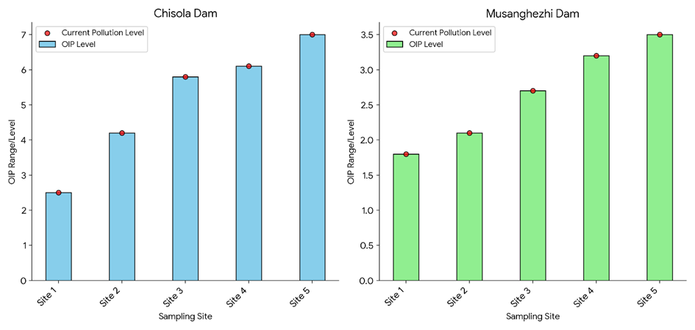
RESULTS cont..
Figure 1: Comparison of OIP Levels between Musangezhi and Chisola Dams

Slide 18

RESULTS
Objective two: To design and implement an AI-enabled IoT-based smart aquaculture system for water quality management in Mine's surface plant
An AI-enabled IoT-based system for real-time monitoring and prediction of water quality metrics that affect fish production was developed as shown in figure1 below:

Slide 19
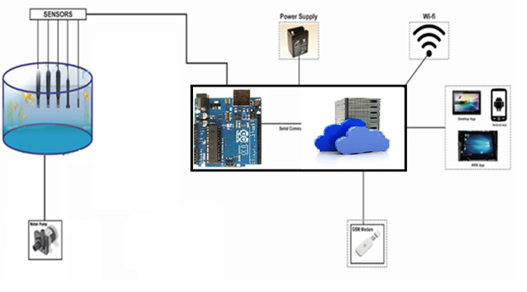
RESULTS
Objective Two: To design and implement an AI-enabled IoT-based smart aquaculture system for water quality management in Mine's surface plant
.

Slide 20
RESULTS cont..
The diagram above illustrates an IoT-based system for real-time monitoring and prediction of water quality in the mine surface plant areas of Kalumbila District that was developed.
The system features sensors that are placed in water to measure critical parameters (pH, dissolved oxygen, temperature, and other water quality metrics) necessary for fish growth.
The data was being collected and transmitted via a microcontroller (Arduino Uno Rev3) and powered by a stable supply and communicates through GSM modem to a cloud server for data storage and analysis.
The cloud server is then able to process the data collected in real-time, and then run AI models to predict potential water quality issues and trigger alerts on the system users.
The fish farmer is then able to monitor these metrics on platforms such as mobile, web, or desktop.

Slide 21

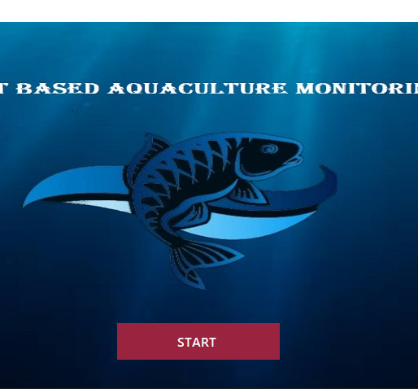
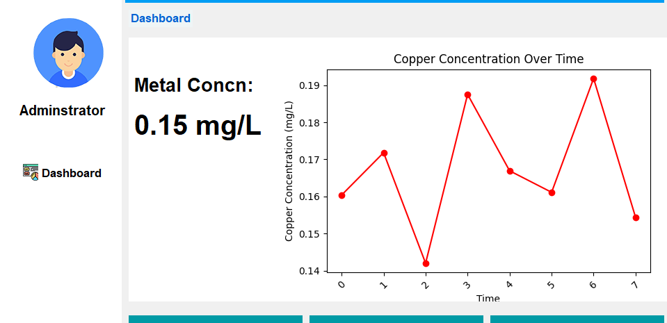
RESULTS cont..
The implementation

Slide 22
RESULTS cont…
Objective three: To develop a Machine Learning Model that utilizes data on mine influents (Cu, Fe, Co and pH) to predict potential future changes in heavy metal contamination levels
To measure the third objective, the study investigated three prediction models (RF, MLR and ANN) and applied three statistical tools (Mean Absolute Error (MAE), Root Mean Squared Error (RMSE) the coefficient of determination (R² score) to assess their performance.
The three-prediction model were chosen because they offer complementary strengths. RF handles non-linear relationships and ranks feature importance, while MLR was simple, interpretable, and serves as a good baseline model.
ANN was found to excel at capturing complex, non-linear dependencies.
Collectively the models allowed for a more comprehensive and accurate analysis of environmental data The results are shown below in table 2 and Figure 8 respectively:

Slide 23
RESULTS cont…
Table 2: Performance of ML Models
Model | MAE | RMSE | R²
MLR | 0.40 | 0.45 | 0.78
ANN | 0.35 | 0.38 | 0.82
RF | 0.25 | 0.22 | 0.94
According to the results depicted in the table above, the Mean Absolute Error (MAE) were estimated as 40% for MLR, 35% for ANN, 30% for KNN and 25% for RF.
The Mean Absolute Error (MAE) was used because it helps calculates the average absolute difference between the actual and predicted values, giving thereby giving an idea of how wrong the predictions were.
In a MAE, a lower MAE signifies a better performance of the model as it indicates smaller deviations from the actual value. Therefore, in our study the RF model yielded the lowest MAE (25%), indicating that on average, the RF model’s predictions deviated least from the actual water-quality indices.
:

Slide 24
RESULTS cont…
Figure 3: Performance of ML Models
According to the results obtained and as depicted in the diagram above, Random Forest exhibited better performance in terms of both predicting accuracy and its ability to capture relationship among the variables involved than other algorithms.

Slide 25
CONCLUSION
This research successfully met its objectives by assessing water quality, designing a smart monitoring system, and developing predictive models for heavy metal contamination in Kalumbila Mine's surface plant areas.
The water quality assessment identified significant contamination, particularly in Chisola Dam, with higher Overall Index of Pollution (OIP) values than Musanghezhi Dam.
An AI-enabled IoT-based real-time water quality monitoring system was developed to track critical parameters and provide timely alerts to fish farmers.
Finally, the study evaluated three predictive models; Random Forest (RF), Artificial Neural Networks (ANN), and Multiple Linear Regression (MLR) with RF outperforming the others, showing the highest accuracy and reliability in predicting future contamination levels.
:

Slide 26
RECOMMENDATIONS
There is need to expand the use of the AI-enabled IoT-based smart aquaculture system across more water bodies in mine surface plant areas across the country to continuously provide real-time monitoring and early detection of water quality issues and ensure immediate intervention to prevent severe contamination.
Implementation of stricter controls on mining discharge and waste management to significantly reduce the pollution load in affected areas.
There is need to utilize the Random Forest (RF) model, which demonstrated superior accuracy, to predict future trends in water quality based on historical data obtained from these sites.
There is need for collaborations between the local communities, the mines and government authorities to enforce strict environmental regulations on mine discharge limits, especially for areas showing critical contamination levels.

Slide 27
IMPLICATION OF THE STUDY
There is need to expand the use of the AI-enabled IoT-based smart aquaculture system across more water bodies in mine surface plant areas across the country to continuously provide real-time monitoring and early detection of water quality issues and ensure immediate intervention to prevent severe contamination.
Implementation of stricter controls on mining discharge and waste management to significantly reduce the pollution load in affected areas.
There is need to utilize the Random Forest (RF) model, which demonstrated superior accuracy, to predict future trends in water quality based on historical data obtained from these sites.
There is need for collaborations between the local communities, the mines and government authorities to enforce strict environmental regulations on mine discharge limits, especially for areas showing critical contamination levels.

Slide 28
Main References
Zambia Ministry of Lands and Natural Resources. (2019). Kalumbila District Profile.
Kalumbila Town Council. (2020). Town Profile.
First Quantum Minerals Limited. (2022). Kalumbila Mine.
Mining Weekly. (2020). Trident mine, Zambia.
Zambia Water Resources Management Authority. (2019). Kalumbila River Basin Profile.
Environmental Council of Zambia. (2018). Environmental Impact Assessment Report for Kalumbila Mine.
World Health Organization. (2019). Environmental Health Risks in Mining Areas.
International Journal of Environmental Science and Technology. (2020). IoT-based Systems for Sustainable Aquaculture.

