Slide 1



Slide 2

Scholarly Publishing in Africa
Overcoming Barriers and Creating Opportunities
Dr. Baraka Manjale Ngussa
Chief Editor
Gitoya Centre for Academic Research Dissemination
Crossref Ambassador, Tanzania
Johanssen Obanda
Community Engagement Manager
Crossref

Slide 3

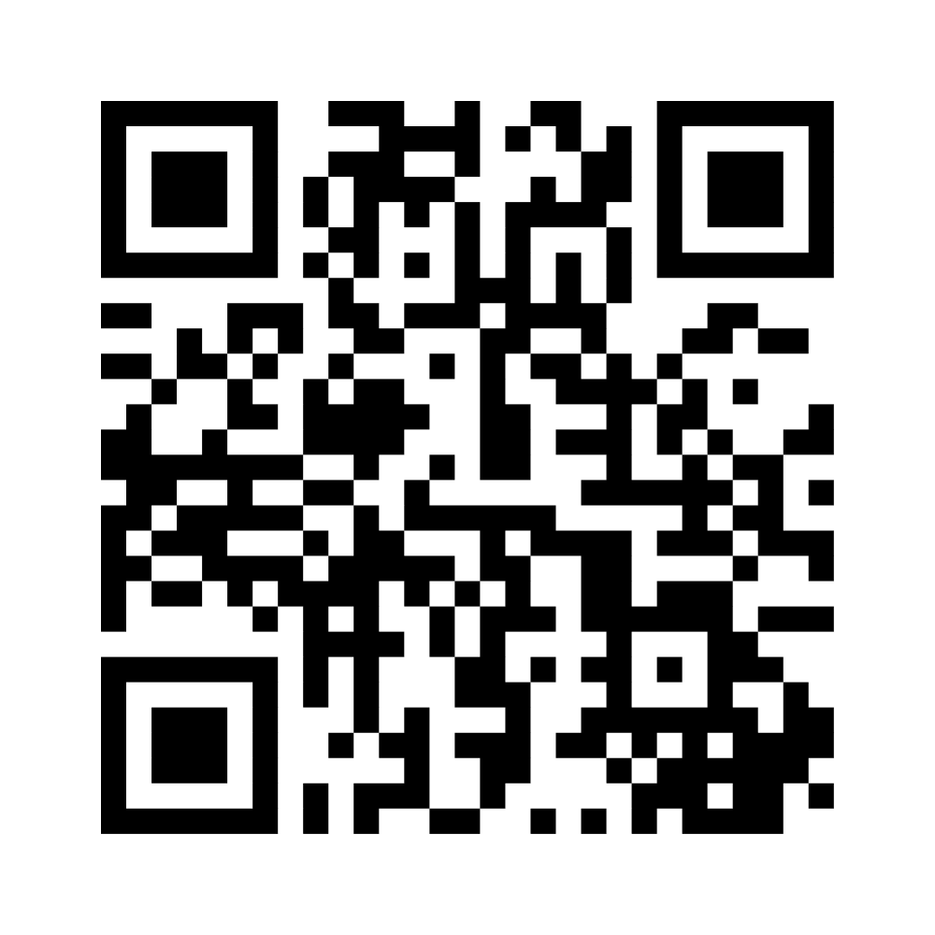
Who is in the room?
www.mentimeter.com
Code: 1441 9638

Slide 4
AGENDA
About Crossref
Research Nexus and the Integrity of the Scholarly Record (ISR)
GEM Program

Slide 5
ABOUT CROSSREF

Slide 6

ABOUT CROSSREF
Open scholarly infrastructure
Metadata registry to enable services
Crossref DOIs are citation identifiers
grants, preprints, articles, chapters, proceedings, standards, reports, protocols, dissertations, reviews
20 K
members
160
countries
1.2 billion
DOI resolutions each month
2 billion
Queries each month
160 million
Open metadata records
120 sponsor orgs
50 Ambassadors
Notes:
Crossref is an open foundational scholarly infrastructure. It was incorporated in 2000 by a group of 15 society and commercial publishers - who wanted to work collaboratively to enable reference linking- which at the time meant assigning DOIs and collecting minimal amount of metadata to enable reference matching.
Things have scaled up considerably in the last 24 years. Today, Crossref has a metadata registry of research objects, persistent identifiers and relationships that is open for all and can be built on by us and others.
We have 20,000 members from 160 countries. These members create metadata records for a range of research objects, such as journal articles, conference papers, datasets and so on, and they create a digital object identifier or DOI to tie all of this information together. The DOI serves as a persistent link and it is always traceable on the internet.
These DOIs are resolved, which means that they are are clicked on or followed over a billion times every month and the metadata is retrieved by thousands of systems 2 billion times each month
There are currently over 160 million metadata records and Importantly, this metadata is made available via open public APIs for anyone to use and build on.
With this data, Crossref powers the underlying metadata behind systems like Scopus, OpenAlex, Dimensions, and Web of Science, and many others.
All this is made possible with the help of many partners including over 100 sponsoring organisations which help with technical and financial support for more than half of our members, several Ambassadors, and just under 50 staff members who are spread across 11 countries.

Slide 7
VISION
We envision a rich and reusable open network of relationships connecting research organizations, people, things, and actions; a scholarly record that the global community can build on forever, for the benefit of society.
Notes:
Our vision is a shared idea of the future environment that we wish to see. We articulate this as “a rich and reusable open network of relationships connecting research organizations, people, things, and actions; a scholarly record that the global community can build on forever, for the benefit of society."

Slide 8
MISSION
Crossref makes research objects easy to find, cite, link, assess, and reuse. We’re a not-for-profit membership organisation that exists to make scholarly communications better. We rally the community; tag and share metadata; run an open infrastructure; play with technology; and make tools and services—all to help put research in context.
Notes:
As to Crossref’s part in achieving that vision - Our role is to make all kinds of research objects easy to find, cite, link, assess, and reuse. We’re a not-for-profit membership organisation that exists to make scholarly communications better. We rally the community; tag and share metadata; run an open infrastructure; play with technology; and make tools and services. All this is to try to help put research in context for everyone in the scholarly community.

Slide 9



BENEFITS OF MEMBERSHIP
Persistent, open, community-governed infrastructure
Community responsibility = collective benefit
Open metadata distribution & retrieval
Become part of a globally connected network of scholarly research
Tell people your content exists. Register persistent identifiers.
Other Crossref members are obliged to link references to you (and you to them) in a persistent way.
Thousands of tools and services rely on open metadata via Crossref. We provide the infrastructure so you don’t have to make thousands of separate agreements with numerous parties.
Notes:
And why do organizations decide to join Crossref?
A primary reason is to become part of a globally connected network of scholarly research.
This allows them to show people where their content is located and update that information with persistent identifiers when the content moves.
By creating a persistent identifier for each object it enhances the discoverability of their publications through robust metadata, making their content more likely to be found.
Crossref membership also offers benefits such as the ability to determine who is using their content and the opportunity to participate in collaborative services.
Furthermore, the metadata provided by our members powers a variety of additional services that we have developed at Crossref, benefiting both our members and the wider academic community.
So there are numerous compelling reasons to join and become a part of our community.

Slide 10



OBLIGATIONS OF MEMBERSHIP
Take responsibility for your metadata
Use Crossref DOIs everywhere
Understand your fees
Your participation doesn’t end with getting the DOI registered. As a member, you are making a commitment to updating and maintaining the metadata record for the long-term. That means updating URLs when they change, adding references and abstracts.
Crossref DOIs are different from other DOIs. An obligation of membership is to use and display DOIs in all links on your site, for example in your reference lists, in the ‘how to cite this’ advice, and in communicating with authors/vendors.
We charge fees so we can keep the infrastructure sustainable and invest in new and growing services to support our mission. Annual membership and per-DOI deposit fees apply; please check before joining.
Notes:
As a Crossref members, you need to:
Register only what you have the legal rights to
Deposit metadata and create DOI links
Maintain and update your metadata and landing page URLs over the long term
Make sure you have a unique landing page for each metadata record/DOI and follow our DOI display guidelines
Link references
And pay your fees

Slide 11
BECOME A MEMBER
Membership in Crossref is open to organisations that produce professional and scholarly materials and content.
Independent member:
www.crossref.org/membership
Sponsored member:
www.crossref.org/membership/about-sponsors
GEM Program:
https://www.crossref.org/gem/
Notes:
Some of you here today may be Crossref members, but for anyone wanting to join here is how to get started:
Crossref is a membership organization and you need to make an application to become a member.
Independent member
Visit our page at the link you see here to submit an application.
The form will ask for information such as:
Name of your Organization
Organization website (URL), your mailing address
Various contacts, primary contact, technical / metadata quality contact (we need three different people)
Part of the application contains a confirmation that you have read a summary of your obligations as a member.
Sponsored member
To join through a Sponsor, you need to find one on the sponsors program page that covers your country and request to join through them. If you agree to work together, your Sponsor will send you a dedicated link to apply for Crossref membership under their sponsorship. Please don’t use the standard link to apply for membership that you can find on this website.
GEM Program
Mr. Obanda will talk more about the GEM program. You can join either directly or through a sponsor under the GEM program if your organization is eligible.

Slide 12
RESEARCH NEXUS
AND INTEGRITY OF THE SCHOLARLY RECORD (ISR)

Slide 13
THE “SCHOLARLY RECORD”
The outputs of the research and publishing process create a “scholarly record”
Journal article
Dataset
Conference
Preprint
Notes:
As you have heard already, Crossref members include any organisations that produce research objects so think of publishers, societies, universities, funders, and research institutions, among many others. These members are able to create a persistent identifier or DOI for their work, and also a persistent metadata record about this work. In this way, outputs of the research and publishing process create a scholarly record.
In the past, this would mostly refer to journal articles or book chapters as they were traditional outcomes of the process. however, in recent times the diversity and complexity of research outputs has increased vastly. Additionally, its not just the outcomes but also the “process” stage of the research process that is being included as part of the scholarly record. For example you can imagine that a journal article resulted from a dataset that was collected and curated by a researcher, it was initially a preprint that was subsequently published in a journal, it also resulted in a conference poster.
Therefore, its not just the journal article but also all of these components that are a part of the scholarly record.

Slide 14
THE “SCHOLARLY RECORD”
The outputs of the research and publishing process create a “scholarly record”
Each output has associated metadata
evidence and context to help assess the integrity of the scientific and publishing process.
funding info
references
title
correction
author names
Journal article
data from
is preprint of
date
citation
list
number
title
Dataset
Conference
authors
location
doi
title
authors
Preprint
posted_date
Notes:
What else is in the scholarly record? Each of these outputs have metadata associated with them . This metadata tells us a lot about each of these items: it tells us who were the authors, when was this published, which organizations were the authors affiliated with, and so much more.
By doing so, This metadata serves as evidence and context to help assess the integrity of the scientific and publishing process.
As you can begin to see, thinking of these items in individual terms is not enough anymore. In addition to the associated metadata, there are many different relationships between these items or works which are of interest. For example, the relationship between the dataset and the paper which denotes that this paper was a result of this dataset, or the relationship between preprint and the paper, which shows how the work evolved over time, the relationship between this paper and other papers that this work cites which shows how this work contributes to this field of research. there are other interesting relationships as well, for example with funding organizations or with authors who contributed to the research etc.
The scholarly record is about more than just published outputs - it’s also a network of inputs, relationships, and contexts.
An arrow back to the artice (any example of an opposite relationship)

Slide 15
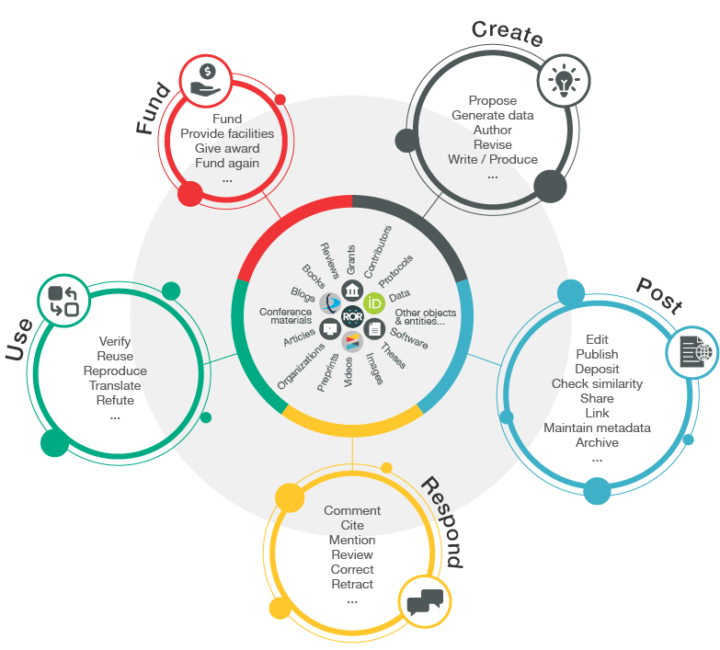
THE RESEARCH NEXUS
Notes:
We call this network of entities and relationships as the research nexus.
This slide shows a schematic representation of this same concept that I have been speaking about. At the centre of this are all the research objects and the actors of the scholarly ecosystem, and the circles around them represent how these objects related to each other and how they act on each other. Together they form
A rich and reusable open network of relationships connecting research organizations, people, things, and actions; a scholarly record that the global community can build on forever, for the benefit of society.
The foundation of the research nexus is metadata , the richer and more comprehensive the metadata in Crossref records, the more value there is for our members and the community. This metadata powers several systems like Scopus, OpenAlex, Dimensions, and Web of Science, and many others.

Slide 16
INTEGRITY OF THE SCHOLARLY RECORD (ISR)
Different from but supports research integrity
Preserving the integrity of the scholarly record (ISR) is essential
Complete, Comprehensive, Correct metadata= ISR
Crossref provides infrastructure which enables those who produce scholarly outputs to provide metadata (effectively evidence) about how they ensure the quality of content and how the outputs fit into the scholarly record.
Notes:
Every initiative and service that we’ve launched since our founding has been focused on documenting and clarifying the scholarly record in an open, machine-actionable and scalable form so as to preserve the integrity of this scholarly record.
This is a concept that is different from research integrity, but it supports the overall endeavour to protect research integrity.
Research integrity is affected by unethical research and publishing practices such as data falsification, fabrication, and plagiarism. while integrity of the scholarly record is affected by unavailability of metadata, outdated metadata, incomplete metadata records, and incorrect metadata
Crossref provides infrastructure which enables those who produce scholarly outputs to provide metadata (effectively evidence) about how they ensure the quality of content and how the outputs fit into the scholarly record.

Slide 17
INTEGRITY OF THE SCHOLARLY RECORD (ISR)
Crossref does not assess the quality of content or the integrity of the research process
  DOI record is not a signal of quality- just a signal that an item exists
Associated metadata tells us
  Who authored the work
  Who funded the work
  What is the relationship between work A and dataset B
Notes:
It is important to note that Crossref itself does not assess the quality or the integrity of the research process,
Just having a DOI is not a signal of quality- a DOI only signals that an item exists.
But rather it is the metadata provided by the members that allows the community to assess the work. the more

Slide 18
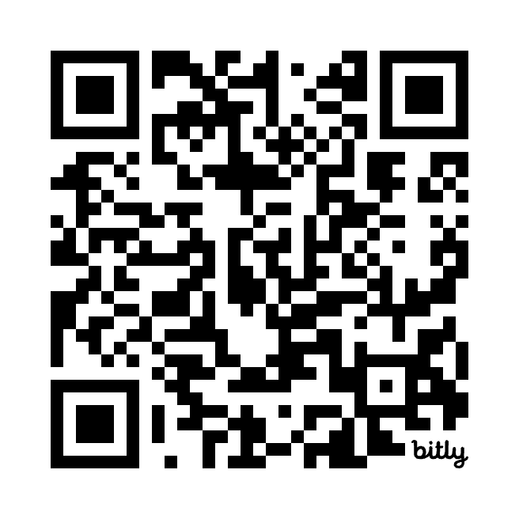
INTEGRITY OF THE SCHOLARLY RECORD (ISR)
Crossref is focused on enriching metadata to provide more and better trust signals while keeping barriers to membership and participation as low as possible to enable an inclusive scholarly record.
Crossref can play a role in assessing legitimacy (activities of the actors) but not in quality (calibre of the content itself).
Read more
Notes:
Add a QR code to the blogs.

Slide 19
GLOBAL EQUITABLE MEMBERSHIP (GEM) PROGRAM
Notes:
With this background, I am going to outline a few ways in which Crossref infrastructure can support the preservation of the integrity of the scholarly record, by making use of the metadata contributed by our community.

Slide 20
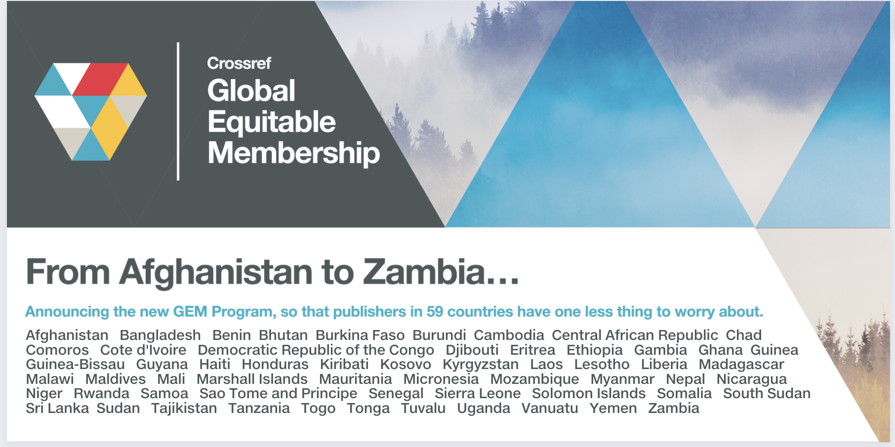
GLOBAL EQUITABLE MEMBERSHIP (GEM) PROGRAM
Notes:
Over the years we have heard from various communities about the challenges they face when looking to join Crossref. The reasons may differ by region but these are generally a combo of financial, language, and technical challenges.
We know that for some cost can be the largest barrier to joining. Our GEM program was created to help lower this barrier for orgs in certain regions
In the past, we had a limited ‘fee assistance’ program to waive the content registration fees for members working under specific partner arrangements. But these programs were limited in scope. Learning from the experiences of these partnerships, we expanded this program to provide greater membership equitability and accessibility to organizations located in the least economically-advantaged countries. This new program now encompasses the annual fee as well as the content registration fees.
Eligibility for the program is based on a member’s country. Our list of countries is predominantly based on the International Development Association (IDA) list, which uses the World Bank income classifications. We have discussed this with the World Bank (which is also a Crossref member), and they also prioritize the IDA countries in their own strategies for access and other support.
The list will undergo an annual review, countries may be added or removed over time as economic situations change. Starting in January 2023, organizations based in countries listed in our GEM program will be eligible to join Crossref and contribute with their metadata to the scholarly record at no cost.

Slide 21
GEM ELIGIBLE COUNTRIES IN AFRICA
Benin (4)
Burkina Faso (4)
Burundi (2)
Central African Republic (1)
Chad
Comoros
Cote d'Ivoire
Democratic Republic of the Congo (15)
Djibouti
Eritrea
Ethiopia (13)
Gambia
Ghana (27)
Guinea
Guinea-Bissau
Madagascar (3)
Malawi (2)
Mali (3))
Mauritania (1)
Mozambique (1)
Niger
Rwanda (5)
Niger
Rwanda (5)
Sao Tome and Principe
Senegal (7)
Sierra Leone (1)
Somalia (8)
South Sudan
Sudan (13)
Tanzania (21)
Togo (1)
Uganda (15)
Zambia (5)
Notes:
Overview of membership in Africa from GEM eligible countries. I’ve listed the number of organizations in each country. Still many without any participation
Over time, more widely know, more orgs can join under the program

Slide 22
WHAT DOES GEM COVER?
Yes
Annual member fee
Content registration fees
No
Similarity Check fees
Metadata plus fee
Notes:
GEM covers the annual member fee and the content reg fees for all content types. It does not cover SimCheck or Metadata plus.
GEM eligible members are able to add these additional services to their accounts, however there is a fee associated with them.
Similarity Check is a service we run in partnership with Turnitin. Members pay an annual administrative fee ($55) as well as document checking fees. For all members we waive the fee for the first 100 documents checked, after that the fee is $0.75 per document.
All of our metadata is freely available with our search tools and API, but there is a fee for our premium Metadata Plus service, which offers combined machine access to all available metadata in XML and JSON formats with some additional features. For most people, the free search tools are sufficient.
I will now invite MAdhura to take you through setting up as an independent member and explore other Crossref services.

Slide 23
LOOKING AHEAD
Become a sponsor in your country to support publishers, librarians.
Be the champions for metadata in your community as a Crossref Ambassador.
Publishers
Deposit post-publication updates (retractions, corrections)
Editors
Streamline journal policies, encourage and collect key metadata
Authors
Include important metadata (ORCID iDs, ROR IDs) along with your submissions

Slide 24
Thank you
Asante Sana!
ngussathe5th@gmail.com
jobanda@crossref.org

