Slide 1

Development of National AI Strategy for Kenya
Ubuntunet Connect Conference 2025
Rainbow Tower Hotel, Harare, Zimbabwe

Slide 2
Background
Africa rushes to develop national AI strategies
  Early movers, 2018 - 2022 - Mauritius, Egypt, Rwanda, Tunisia and Ethiopia
  Followers in next 2-3 years - Zambia, South Africa, Kenya, Lesotho and Ghana
Why the rush?
  AU's Continental AI Strategy (2024)
  AU’s Data Policy Framework (2022)
  The ‘promise’ of AI
The result?
  Many countries have developed National AI Strategy and increasingly many are developing National Data Strategy
  Few have developed National AI Policy or National Data Policy
  Implementation challenges, including:
    Low digital and data literacy among the general population
    Expensive compute and storage infrastruture
    Inadequate AI talents and skills
    Gaps in policy and governance frameworks (data, AI, EmTech…)
    Limited investments in AI R&D and innovation
    Limited public financial resources allocated to AI
    The dangers of ‘tech colonialism’ with AI

Slide 3
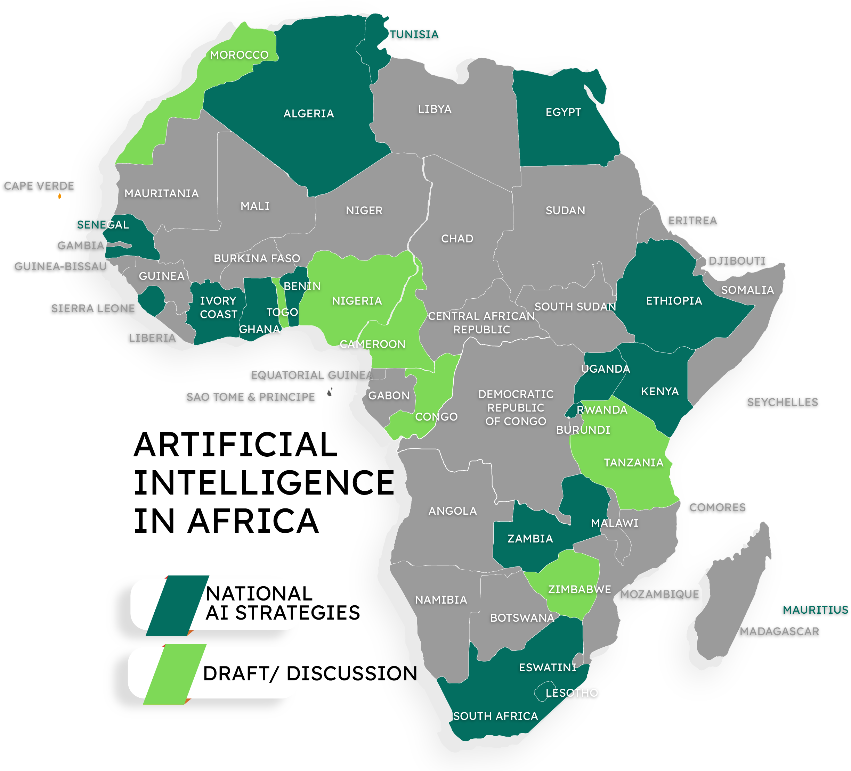
AI Strategy in Africa @ Mar 2025

Slide 4
Why develop a national AI strategy?
Positive impact on economic growth, e.g.
  Improve efficiencies in key sectors
  Enhance productivity in selected priority sectors
  Make Kenyan products more competitive, e.g. adding features
  Create jobs
Improve public sector efficiency, e.g.
  Improve government service delivery
  Enhance decision-making
  More effective management of operating costs
Enhance local AI innovation and international competitiveness
  Promote local development of AI solutions and enterprises using local data and talent
  Attract international investments and collaborations on AI and emerging technologies
Protect Kenyans against negative impacts of externally developed AI solutions
  Address job displacement concerns
  Ensure responsible AI development and deployment
  Ensure ethical use of AI
Increase AI talent pool
  Opportunities to develop local AI talent pool

Slide 5
Methodology Summary
1
Documents Review
Benchmarking with Relevant Countries
2
Online
Surveys
Key Informant Interviews
3
4
Focus Group Discussions
Townhall Talks in County Innovation Hubs
5
6
Stakeholder Engagements
Strategy Co-development with Technical WG
7
8

Slide 6
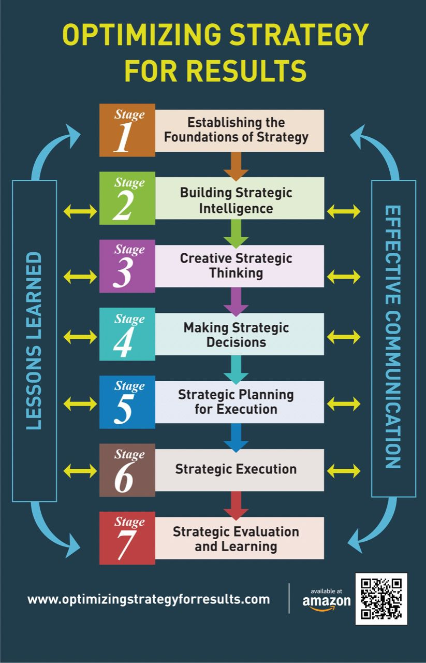
Strategy Development Framework

Slide 7
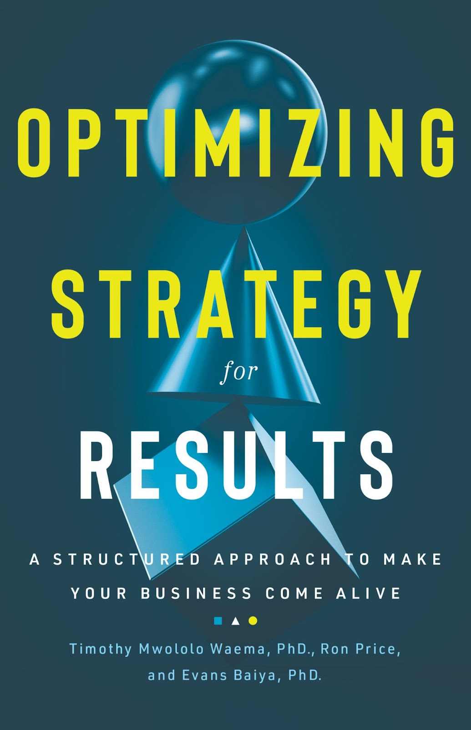
Amazon: https://amzn.to/3taryq8

Slide 8
High
  Tech infrastructure providers
  Customers
  AI researchers
  AI developers
  AI investors
  Tech associations
Strategy:
Keep involved periodically/as necessary
Strategy:
Actively engage, inform & collaborate
Kenya AI Strategy Stakeholder Mapping
INTEREST - Right to expect their needs and wants to be addressed by the AI Strategy
Strategy:
Inform periodically and monitor
Strategy:
Keep satisfied and informed
  Media & advertising agencies
  Communities
  Regulatory agencies
INFLUENCE - Ability to sanction or reward the AI Strategy based on the stakeholder’s satisfaction
High
Low

Slide 9
Summary of Primary Data Collection
Approach
  Stakeholders: Government, Industry, Academia, Civil Society, and the Public
Key insights from KIIs
  Kenya’s AI Ecosystem strengths
    Vibrant startup ecosystem and youthful AI talent (~40,000 trained)
    Access to renewable energy (e.g., geothermal power)
    Successful technology applications in crisis response
  Kenya’s AI Ecosystem challenges
    Limited digitised, quality data and infrastructure gaps
    Ethical concerns: data privacy, misinformation, bias
    Public mistrust and lack of policy clarity
    Power imbalances in donor landscape and limited SME funding
  Recommendations
    Build local data repositories
    Establish governance frameworks for ethical AI deployment
    Create transparent financing models and foster interdisciplinary collaboration

Slide 10
Focus group discussion insights
  Embedding Local Contexts in AI Development
    Incorporate Afrocentric values and local languages
    Embed indigenous knowledge into AI systems
    Promote data sovereignty and reduce reliance on foreign data centers
  Opportunities
    Agriculture: Boosting crop yields
    Health: Enhanced diagnostics
    Education: Tailored learning solutions
  Challenges & Recommendations
    Address AI skills gaps and curriculum alignment
    Invest in infrastructure (data centers, cloud computing)
    Encourage public-private partnerships and innovation hubs

Slide 11
Town hall meeting takeaways
  Opportunities
    AI for public service efficiency and inclusion
    Personalisation to improve citizen engagement
    Solutions for societal challenges (poverty, health disparities)
  Concerns
    Digital divide and AI’s impact on job displacement
    Ethical risks: creativity, misinformation, and well-being
    Limited access to AI technologies
  Recommendations
    Develop unified legal and ethical AI frameworks
    Increase smartphone access and digitization efforts
    Implement public awareness campaigns and welfare systems for displaced workers

Slide 12
Summary: Internal Environmental Analysis
Strengths | Limitations
Existing diverse and vibrant local innovation ecosystem | AI-skills gap
Young digital-ready AI workforce | Regulatory gaps and regulatory conflicts
Foundational legal framework for ethical AI development and use | Data quality, availability and accessibility concerns
Existing digital infrastructure | Primary and supporting infrastructure constraints
Political will and strong government support for the adoption of AI | Limited investments in local AI, research and development
Kenya is a regional hub/gateway to the East & Central Africa region | Ensuring equity and inclusion in AI development and gaps in public AI/digital literacy
 | Fragmented/uncoordinated prioritisation of development and application of AI

Slide 13
Summary: External Environmental Analysis
Opportunities | Challenges
Job creation and economic growth potential | Data governance and data sovereignty
AI role in enhancing public sector efficiency | Labour market disruption and job displacement
Strengthening existing policy and regulations | Global regulatory pressure
AI-specific education programs | Cap on competitiveness in AI technology (global supply chain)
Investments into the local AI innovation ecosystem | Cybersecurity and misinformation/disinformation
Leadership in AI development (models, responsible AI, policy)

Slide 14
Vision
Draft AU AI strategy vision
Africa-centric, Responsible and Ethical AI that Empowers People and Contributes to the Continent Inclusive Growth, Resilience and Socio-economic Development
Kenya AI strategy vision
A regional leader in AI R&D and innovation for inclusive socio-economic development

Slide 15
Value Proposition
Economic growth through contribution to GDP growth, including new digital jobs, enhanced productivity, revenue generation, cost management, and improved government service delivery
Competitiveness by positioning Kenya as a leader in AI R&D, active AI startup ecosystem, and a net exporter of quality AI technology and services
Data governance framework that facilitates ethical AI use and data accessibility
Agile AI governance framework that responds quickly to technological change
Social impact by improving access to essential services, alleviating poverty, and empowering local communities and individuals

Slide 16
Guiding Principles
AU AI Guiding Principles | Kenya’s AI Guiding Principles
Local first People-centred Human rights and human dignity Peace and prosperity Inclusion and diversity Ethics Cooperation and integration Cooperation between African institutions and international organisations Skills Development, Public Awareness and Education | Inclusivity and non-discrimination Participation and co-creation Transparency and accountability Ethical and responsible AI Cultural preservation and contextualization Environmental sustainability Economic benefit and self-sufficiency Local first approach

Slide 17
Strategic Themes and Sub-themes

Slide 18
Strategic Themes | Strategic Sub-themes
AI Digital Infrastructure | AI-ready national digital infrastructure Compute infrastructure (data centres) Green energy sources to power AI infrastructure Domestic manufacturing facilities for AI-specific hardware Cybersecurity infrastructure Partnerships and collaborations
Data | Data governance framework Secure data sharing Quality AI training datasets
AI R&D and Innovation | AI R&D capabilities AI innovation Scaling local AI enterprises Market for local AI solutions

Slide 19
Strategic Themes | Strategic Sub-themes
Talent Development | Foundational AI skills in schools Specialised AI skills in tertiary institutions and industry Partnerships for AI talent development and placement Acquisition of quality foreign AI talent
Governance | Policy framework for AI & emerging technologies Agile AI legal and regulatory frameworks AI risk and safety frameworks Stakeholder collaborations
Investments | Private sector investments in AI Public sector investments in AI Kenya as an investment destination for AI
Ethics, Equity and Inclusion | Ethical, responsible and inclusive AI development and deployment Inclusivity and national values in AI development and deployment Public AI literacy

Slide 20
Summary of AI Strategy
Vision: A regional leader in AI R&D, innovation and commercialization for inclusive socio-economic development
Ultimate Outcomes
High-capacity digital infrastructure for AI access and development
Enhanced dataset quality, useability, shareability and sovereignty
Increased contribution of AI to GDP in priority sectors
Robust pipeline of competent and agile AI workforce
Agile governance and adaptable legal framework for AI
Increased investments in AI
Enhanced ethicalness, equity and inclusiveness of AI solutions
Priority Sector Use Cases (Agriculture, Healthcare, Education, Security, MSME, Public Service Delivery, Creative Industry, Sustainability)
AI Digital Infrastructure: Modernise the national digital infrastructure for AI access and development
Data: Establish a robust and sustainable data ecosystem for AI and innovation
AI R&D and Innovation: Drive the development of cutting-edge localised AI models and solutions through a thriving local R&D and innovation
Pillars
Talent Development: Build a robust pipeline of competent and agile AI workforce for Kenya
Enablers
Governance: Establish an agile governance and adaptable legal framework for AI
Investments: Strategically accelerate public and private investments in AI
Ethics, Equity and Inclusion: Foster a culture of ethical, equitable, and inclusive AI development and deployment

Slide 21
Implementation Mechanisms
Developed the following implementation mechanisms:
  Implementation plan
  Implementation roadmap
  Detailed budgets at the level of flagship projects
  Financing strategy
  Monitoring and evaluation (M&E) framework
  Institutional framework to implement the strategy
  Key risks and their mitigation strategies
Development of these frameworks excluded stakeholders who were deemed to be pursuing interersts that could differ from the national interests, including the big techs
Recommended a coordinated, inclusive and accountable partnership between the public sector, private industry, academia and civil society in the implementation of the strategy
  Multi-Stakeholder Digital Transformation Advisory Council
  AI and Emerging Technologies Technical Working Committee to provide hands-on and coordinated expert assistance and strategic direction in the execution of the national AI strategy

Slide 22
Role of NRENs
Key roles of NRENs in the AI ecosystem
  Allow transfer of massive datasets and access to international computational resources through high-speed connectivity locally, regionally (eg UA) and globally (eg GEANT)
  Provide High-Performance Computing (HPC) resources and cloud infrastructure for researchers and students
  Can host national data repositories or provide the high-speed links to access them, ensuring data sovereignty and security
  Can be involved in the development of the AI talent pool
NREN involvement in national AI strategy?
  Limited involvement in my view. Any contrary opinion?
Recommendation?
  NRENs need to influence relevant national policies strategies, e.g. IT, research and education through:
    Being involved in policy/strategy development and implementation
    Piloting project concepts to de-risks larger public investments
    Providing evidence-based input in policy processes
    Training a pool of experts in AI and emerging technologies, working with universities
    Demonstrating aggregating demand top lower costs is a contribution to sustainable digital transformation

Slide 23
Reflections for Other Countries
Extensive stakeholder involvement for buy-in
  Many stakeholder workshops
  Townhalls in local communities
  Use of technical working group members drawn from global private sector, local private sector, academia, civil society and public sector to co-develop strategy
Use of a sound strategy development methodology
  Ensures that the process is thorough
  Ensures that the resulting strategy is grounded in situational analysis evidence
Exclude stakeholders deemed to be pursuing interersts that could be divergent to the national interests when developing the strategy implementation
Develop a financing strategy so that there is clarity over the sources of the funds to finance strategy execution
Governments should establish a mechanisms for private sector, academia and civil society to play strategic advisory and M&E roles in the implementation of national AI strategy

Slide 24
Note:
The Kenya AI Strategy is in
the reading list for Masters students
studying Public Policy in
the University of Bath, UK

Slide 25
Asanteni sana kwa kunisikiliza
Thank you for your attention
Prof. Timothy Mwololo Waema
waema@uonbi.ac.ke

