Slide 1
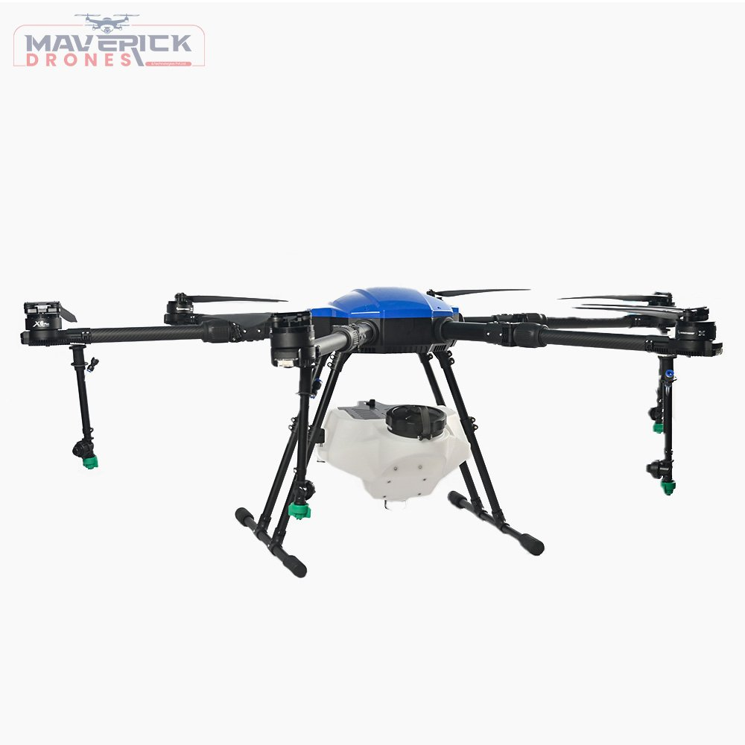
Drones for data collection in remote areas: Challenges and opportunities
Presented by
Khemis Ben Samuel
Makerere University

Slide 2
Background
The UAV i.e. mobile nodes, drone or flying vehicle
Majorly use wireless communication technologies & deployed in an ad hoc settings
The drone usually finds applications in agriculture, entertainment, environment, health & fire safety
Need to adapt to the changing topology.
We plan to use drones to collect data from beehives
Fig.1: Pictorial View of a drone collecting data from ground nodes

Slide 3
Problem
The dynamic network topology causes
  Intermittent links
  Complicates Data scheduling
Environmental changes
  vegetation cover and weather pattern
The need for efficient algorithms to enable the drones to quickly learn and adapt changes
Seeks to Maximize data collection & minimize energy consumption
The dynamic topology based on planned movements and algorithms will deployed on those nodes for data collection.

Slide 4
Typical Use Cases scenario
Drone to fly over a space
Establish connection with ground nodes
Measure signal strength
Collect data
  Images, Text, video etc.
Store data
Aggregate
Transmit (Optional)

Slide 5
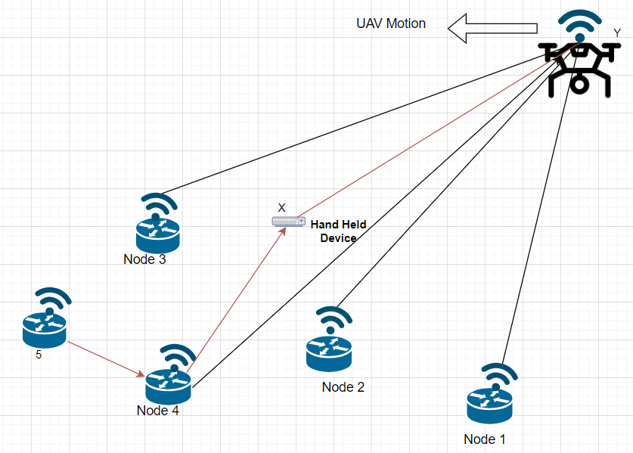
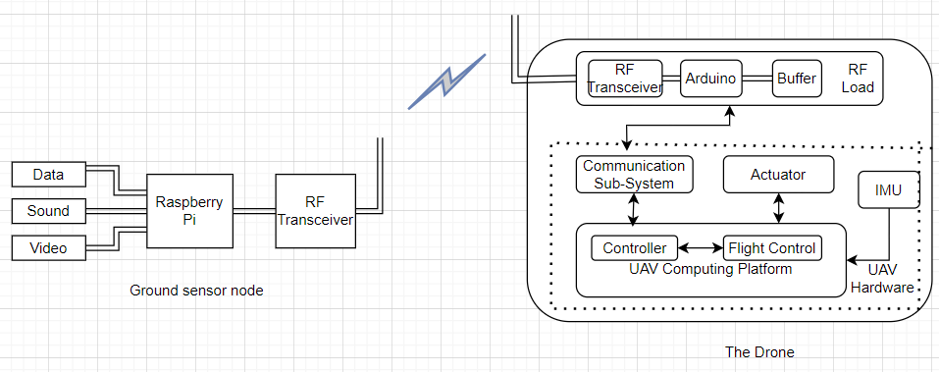
Network architecture
Fig.3: Hardware Network Architecture
RF Transceiver can be IEEE 802.11 operating at 2.4/5.0 GHz with up to of 867 Mbps or it can be an HPD13A for Lora module.
The algorithms will be deployed on the RF Transceivers
Figure 2: UAV Network Architecture

Slide 6

Challenges
Energy constraints
Large size of farms
Drone technology skills
Cost of drones Vs agricultural inputs
Intermittent network & effects on connectivity by vegetation
Funding for research activities
Use of drones cause security threats
Government regulations

Slide 7

Opportunities
Researchers available at Universities
Efficient Path planning algorithms to minimize power consumption
Development of data Scheduling and resource allocation algorithms
Collaborations with other researchers and firms
Rescue missions
Funding from development partners

Slide 8


Support Technologies
Hardware
Mobile Gateway for drone
Robust & small scale storage technologies
Energy harvesting
Lora gateways for data scheduling and transmissions
Software
Software defined radios
Communication technologies
Edge Processing algorithms and machine learning models

Slide 9
Open space is available for Ubuntunet alliance?
Training
Hardware acquisition
Connectivity e.g.
  Lora WAN gateways
  Design of mobile gateways
Provision of Skilled staff for operating drones
Use of drones for emergency connectivity

Slide 10


Slide 11
References
[1] Akram Kout, Bilal Bouaita, Abdesselem Beghriche, Said Labed, Salim Chikhi, El-Bay Bourennane, “A Hybrid Optimization Solution for UAV Network Routing,” Engineering, Technology and Applied Sciences 2023. https://doi.org/10.48084/etasr.5661
http://ademnea.net/
[2] Mahdi Ben Ghorbel, David Rodr´ıguez-Duarte, Hakim Ghazzai, Md. Jahangir Hossain, and Hamid Menouar, “Energy Efficient Data Collection for Wireless Sensors using Drones” IEEE Xplore 2018. https://doi.org/10.1109/VTCSpring.2018.8417798
[3] Lav Gupta, Raj Jain and Gabor Vaszkum ‘’Survey of Important Issues in UAV Communication Networks’ 2015 IEEE. DOI: 10.1109/COMST.2015.2495297
[4] Jingbang Wu, Huimei Lu, Yong Xiang, Bingying Cai, Weitao Wang, Ruilin Liu, “Improving Bandwidth Utilization of Intermittent Links in Highly Dynamic Ad Hoc Network,” Springer 2017. https://doi.org/10.1007/s11277-017-4797-8
[5] Ali H. Wheeb, Rosdiadee Nordin, Asma’ Abu Samah, Mohammed H. Alsharif and Muhammad Asghar Khan, “Topology-Based Routing Protocols and Mobility Models for Flying Ad Hoc Networks: A Contemporary Review and Future Research Directions,” Drones 2022. https://doi.org/10.3390/drones6010009

