Slide 1
The Role of eduroam Awareness Campaigns
  Presenter:
  Joel Omiat
  jomiat@renu.ac.ug
31st October 2024

Slide 2
Outline
Introduction to eduroam
Our eduroam Journey
Why Awareness Campaigns?
RENU eduroam Awareness Campaigns
Impact of the Awareness Campaigns
Testimonials
Challenges
Conclusion
Overview

Slide 3

eduroam (education roaming)
Is a secure, worldwide roaming Wi-Fi Internet access service developed for the research and education community.

Slide 4
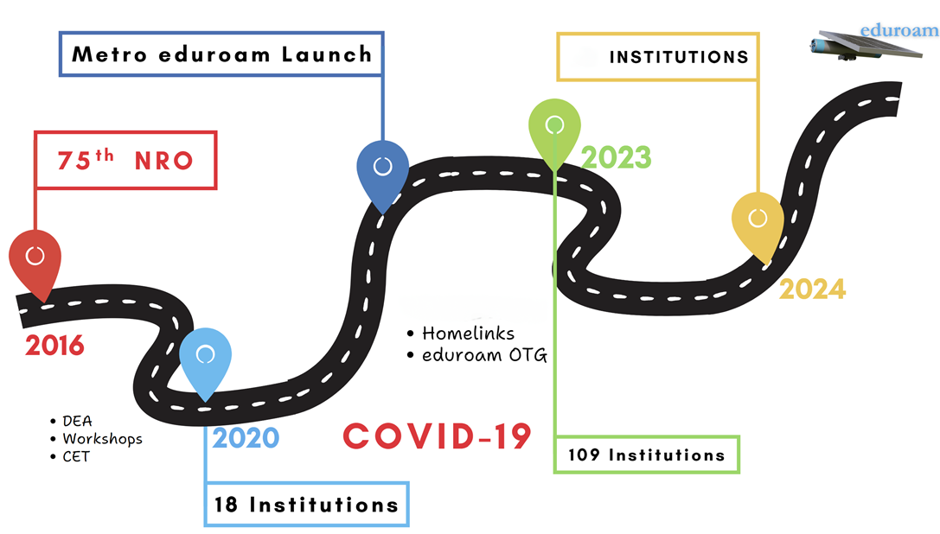

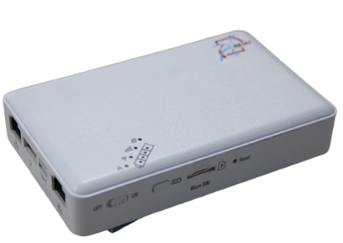
Our eduroam Journey
236
Notes:
For the expansion of eduroam coverage, the future is Mesh!
Core Engineering Team

Slide 5



Why Awareness Campaigns?
The missing link: Sensitization & Awareness
Adoption and effective use
Lack of awareness
A Powerful Tool

Slide 6

2
2
2

Slide 7
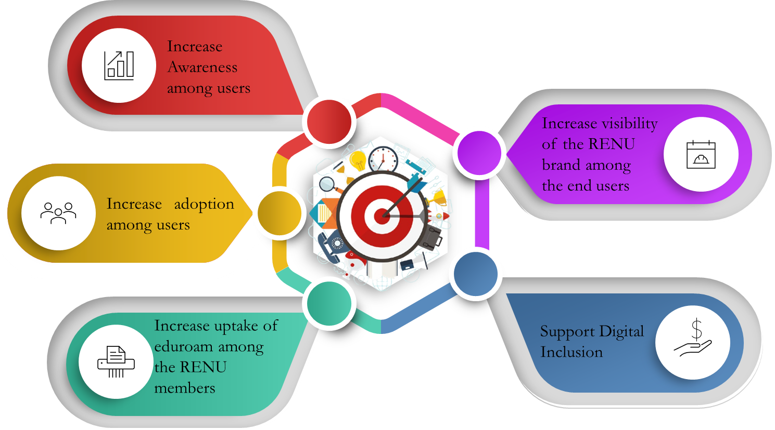
RENU eduroam Awareness Campaigns
Objectives

Slide 8






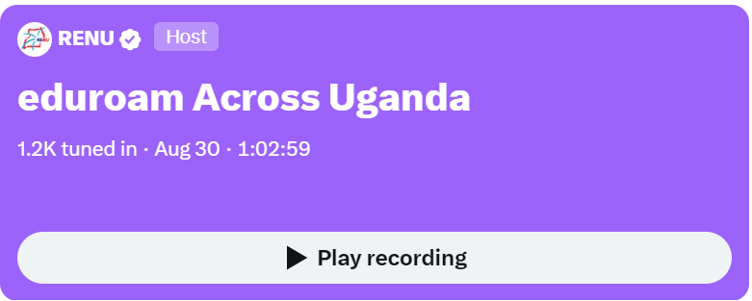
Campaign Strategies

Slide 9




Online Strategies
01
02
03
04
05
06
X, Instagram, Linkedin, YouTube
Press Release (Social media)
Fliers & Banners
Motion Graphics & Reels
X (Twitter) Space
Social Media Influencers
Shout Outs

Slide 10
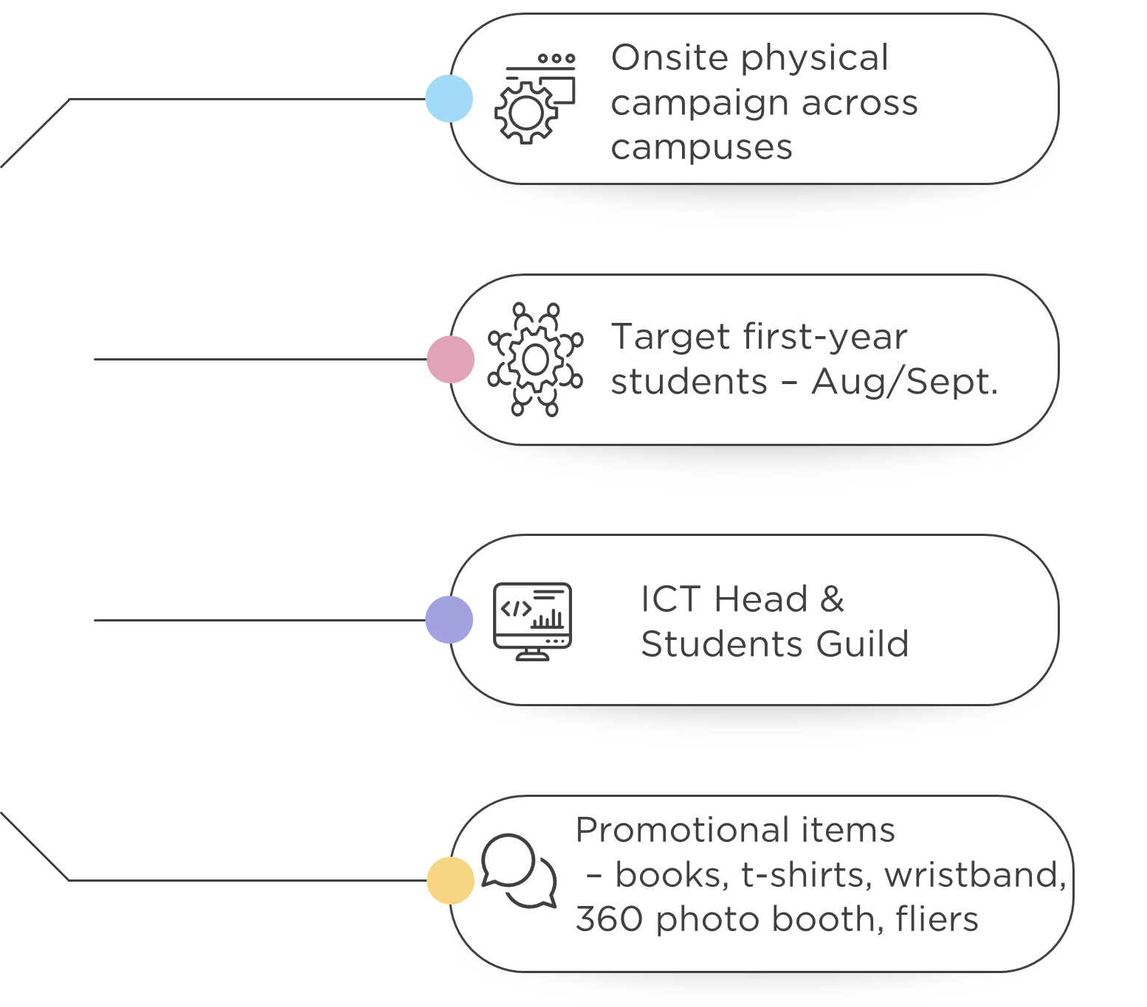

Physical Strategies
Notes:
Target was also the first semester, preferably in the first week of the sem. – ICT Dept. through the ICT Head,
Promotional materials and many more

Slide 11
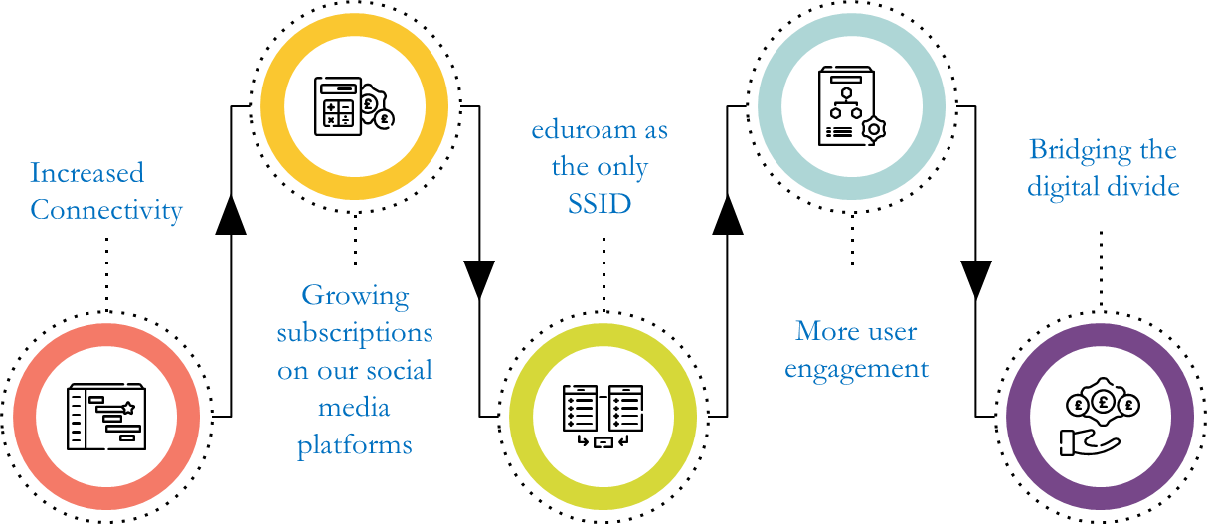
Impact of the Awareness Campaigns

Slide 12

Impact of the Awareness Campaigns
Akamwesi Hostel
Infectious Diseases Institute
Soroti University
Makerere University Business School
2022
Kyambogo University
Makerere University
2024
University of Kisubi
Makerere University Business School
Gulu University
Lira University
2023

Slide 13
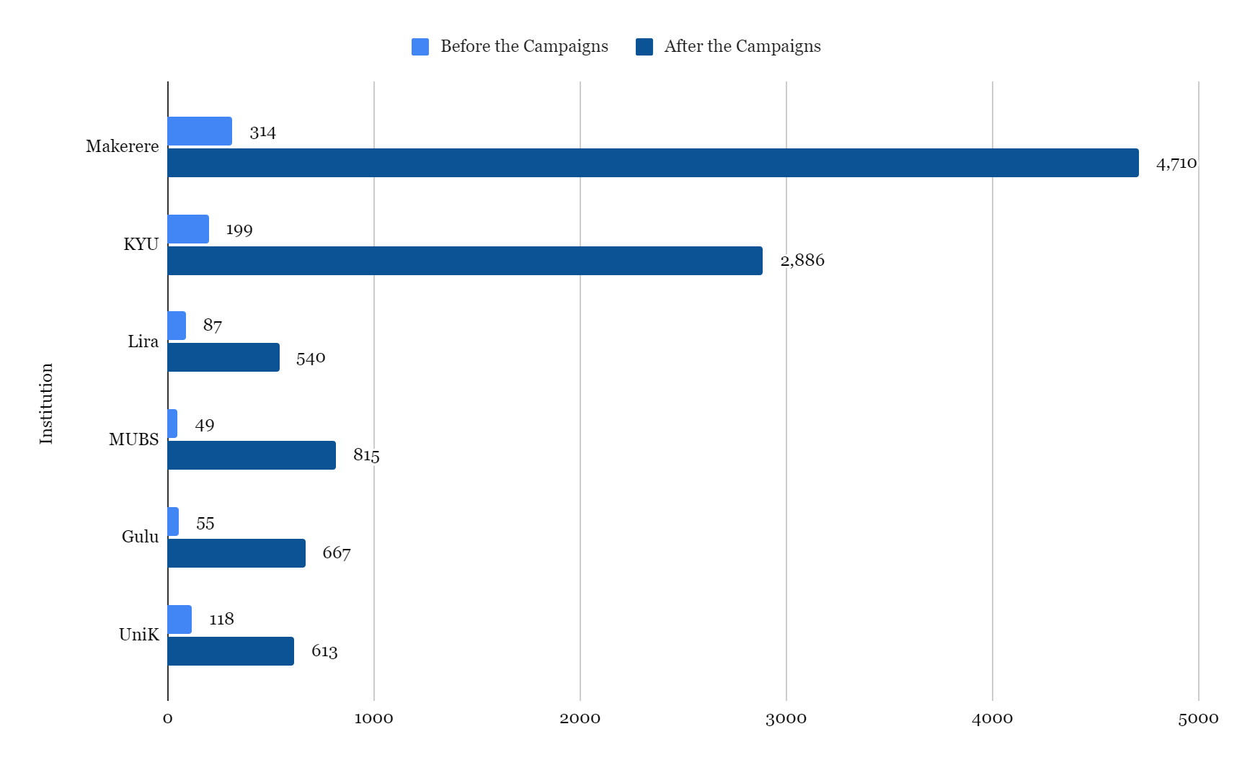
eduroam Statistics

Slide 14
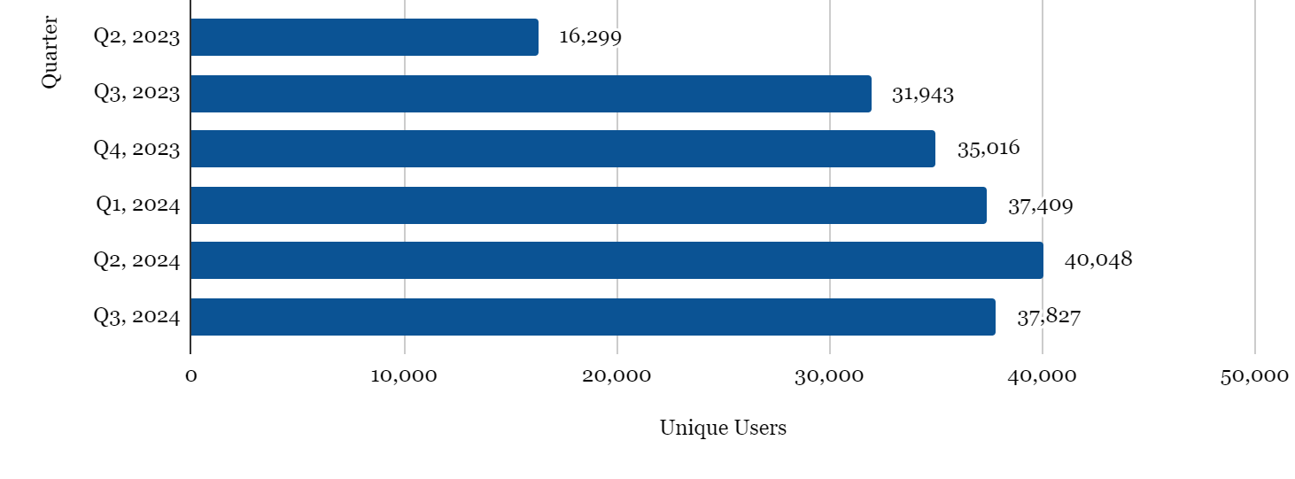
eduroam Statistics
Total number of unique logins since 2022 – 333,411

Slide 15
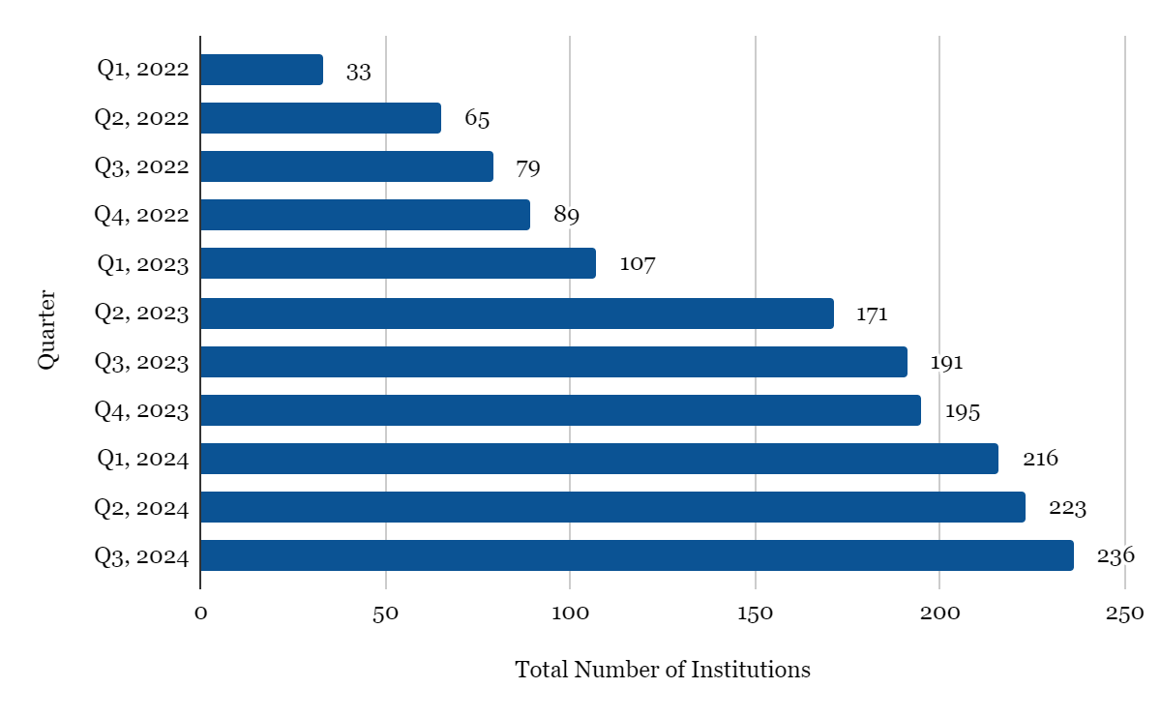
eduroam Statistics
Total number of Institutions Overtime - 236

Slide 16



eduroam Testimonials

Slide 17
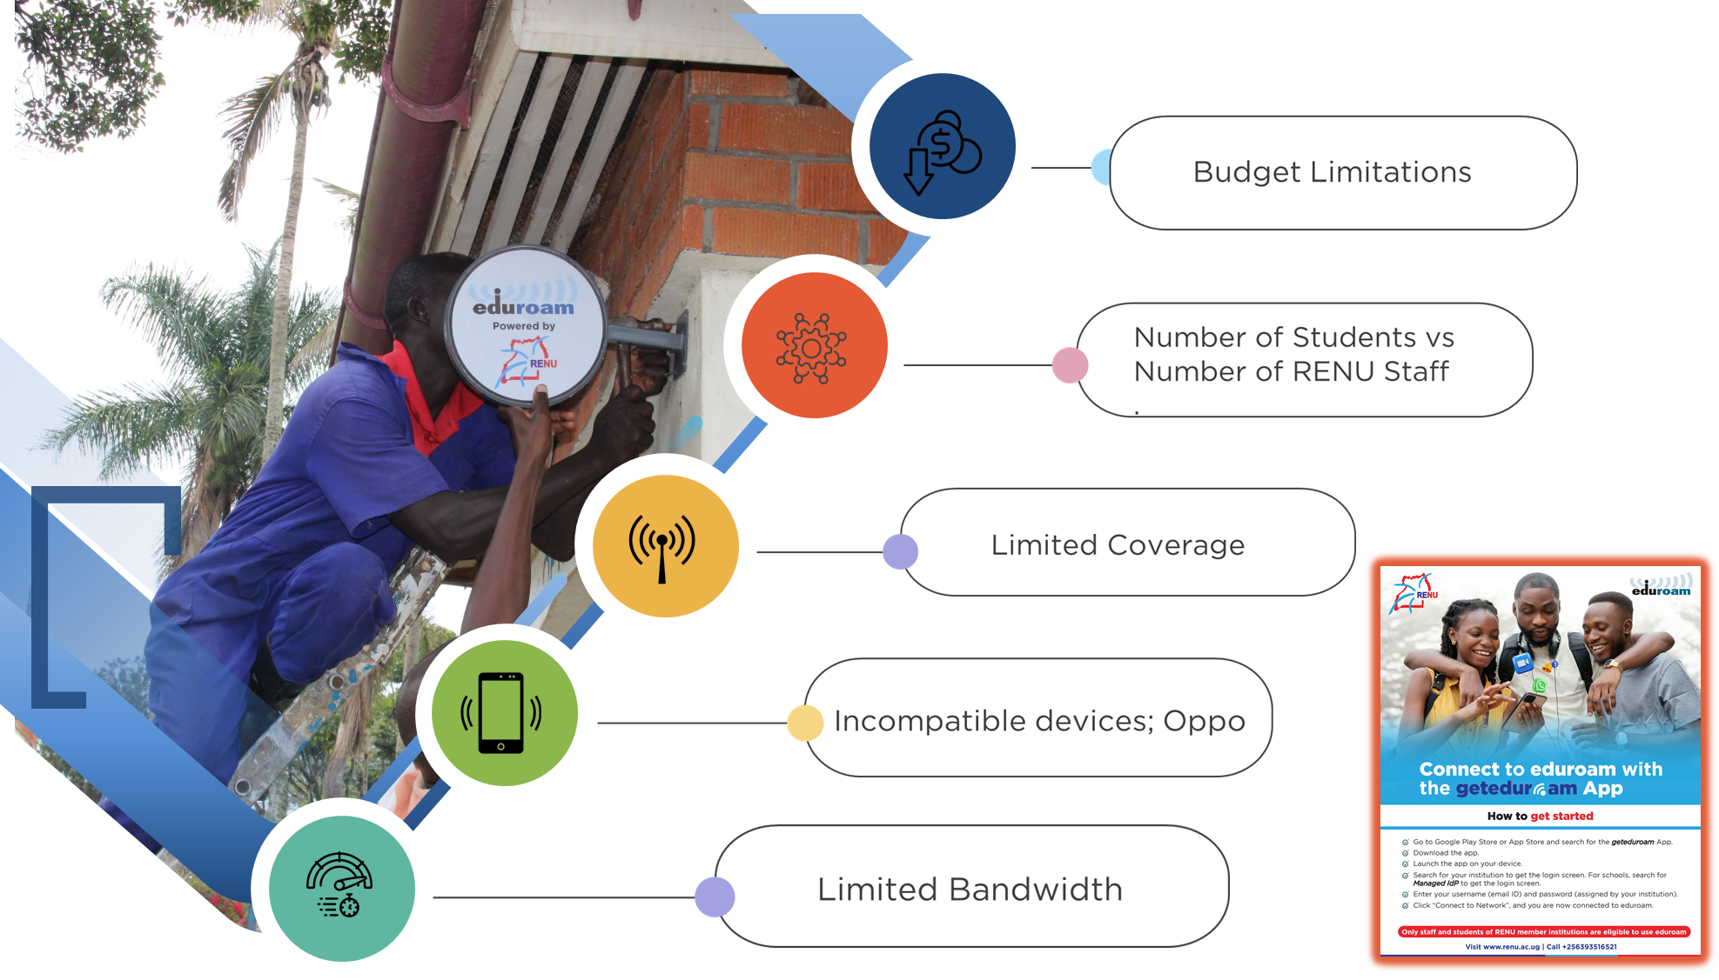
Challenges

Slide 18
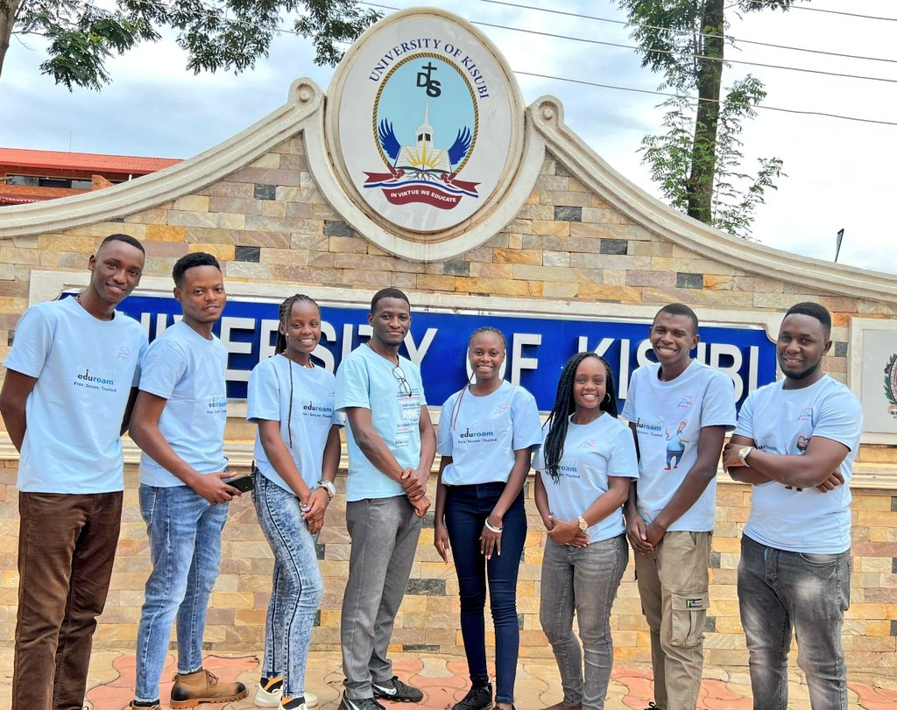





Pictorials

Slide 19
Thank You!
https://renu.ac.ug

