Slide 1


NREN-Government Synergies: A Key to Advancing Research and Education in East Africa
Prof. Idris A. Rai
Deputy Executive Secretary
Inter-University Council of East Africa

Slide 2





Inter University Council for East Africa (IUCEA)
An institution of East African Community (EAC)
Multi-governmental organization
Member based institution
Advises Partner States on all matters on higher
  education in the EAC
Eb@le
RwedNet
BERNET

Slide 3
Functions of IUCEA
IUCEA Act 2009 Article (6a)
Ensure the development of comprehensive electronic network for teaching and learning, information dissemination between member universities and research partners

Slide 4
Missions of NRENs in the EAC
cost-effective, fast and reliable Internet connectivity and related services to enhance education and research
high-speed Internet and a wide range of affordable ICT solutions information
and knowledge sharing
network infrastructure and associated services for enabling sharing of education and research resources
develop and implement e-infrastructures for research and education purposes
interconnecting the country’s universities and providing affordable bandwidth to the universities
Members
RwedNet

Slide 5
Overlapping Missions and Stakeholders
Digital transformation in higher education
Member-based
Except :
IUCEA isn’t an NREN
How can IUCEA Ensure its members are (inter-)connected ?

Slide 6
How ?
Advisory and Policy Advocacy
Partnership with Regional and National RENs
Building a bridge (synergies) between NRENs and EAC Governments
  A Key to Advancing Research and Education in East Africa
IUCEA Strategic Plan: Strategic Objective 4
Advocate for a digital learning infrastructure that focuses on enhancing quality and innovation of teaching and learning in higher learning institutions in EAC

Slide 7
Governments’ Roles
Promotion of ICT Adoption
  Promote the adoption of ICTs in teaching, learning, and research
  Provide institutional budgets on ICTs to utilize for NREN resources
Funding
  Startup funding for NREN establishment
  Leverage additional resources from development partners

Slide 8
Governments’ Roles
Market Stimulation and Regulatory Policy
  Creating enabling regulatory policies, e.g., ensuring that parts of telecom infrastructure, similar to roads and bridges, are used for public goods like education and health
Encouraging Regional Connectivity
  Promote interconnectivity between national NRENs and regional RENs to increase affordability and reach
  Expanding access, and enabling negotiating power for better bandwidth rates.

Slide 9
Bridging NRENs to Governments
IUCEA’s role
Advocacy and Policy Support
  Advocate for enabling and supporting policies for NRENs
  Engage with EAC governments on the benefits of investing/supporting on NRENs
Awareness Campaigns
  Promote the benefits NREN services to government stakeholders and the public
  Highlight success stories and case studies showcasing to EAC partner states the impact of NREN on education and research

Slide 10
Building Partnerships with NRENs
Areas of Collaboration
Technical Support and Expertise
Joint Capacity Building Programs
Infrastructure Development and Support
Regional Networking Events
Collaborative Research Initiatives
Joint Funding Applications

Slide 11
Progress so far …
Partnerships: MoU with UbuntuNet Alliance
Gateway to NRENs in the EAC and beyond
Partner and support UbuntuConnect Conference

Slide 12
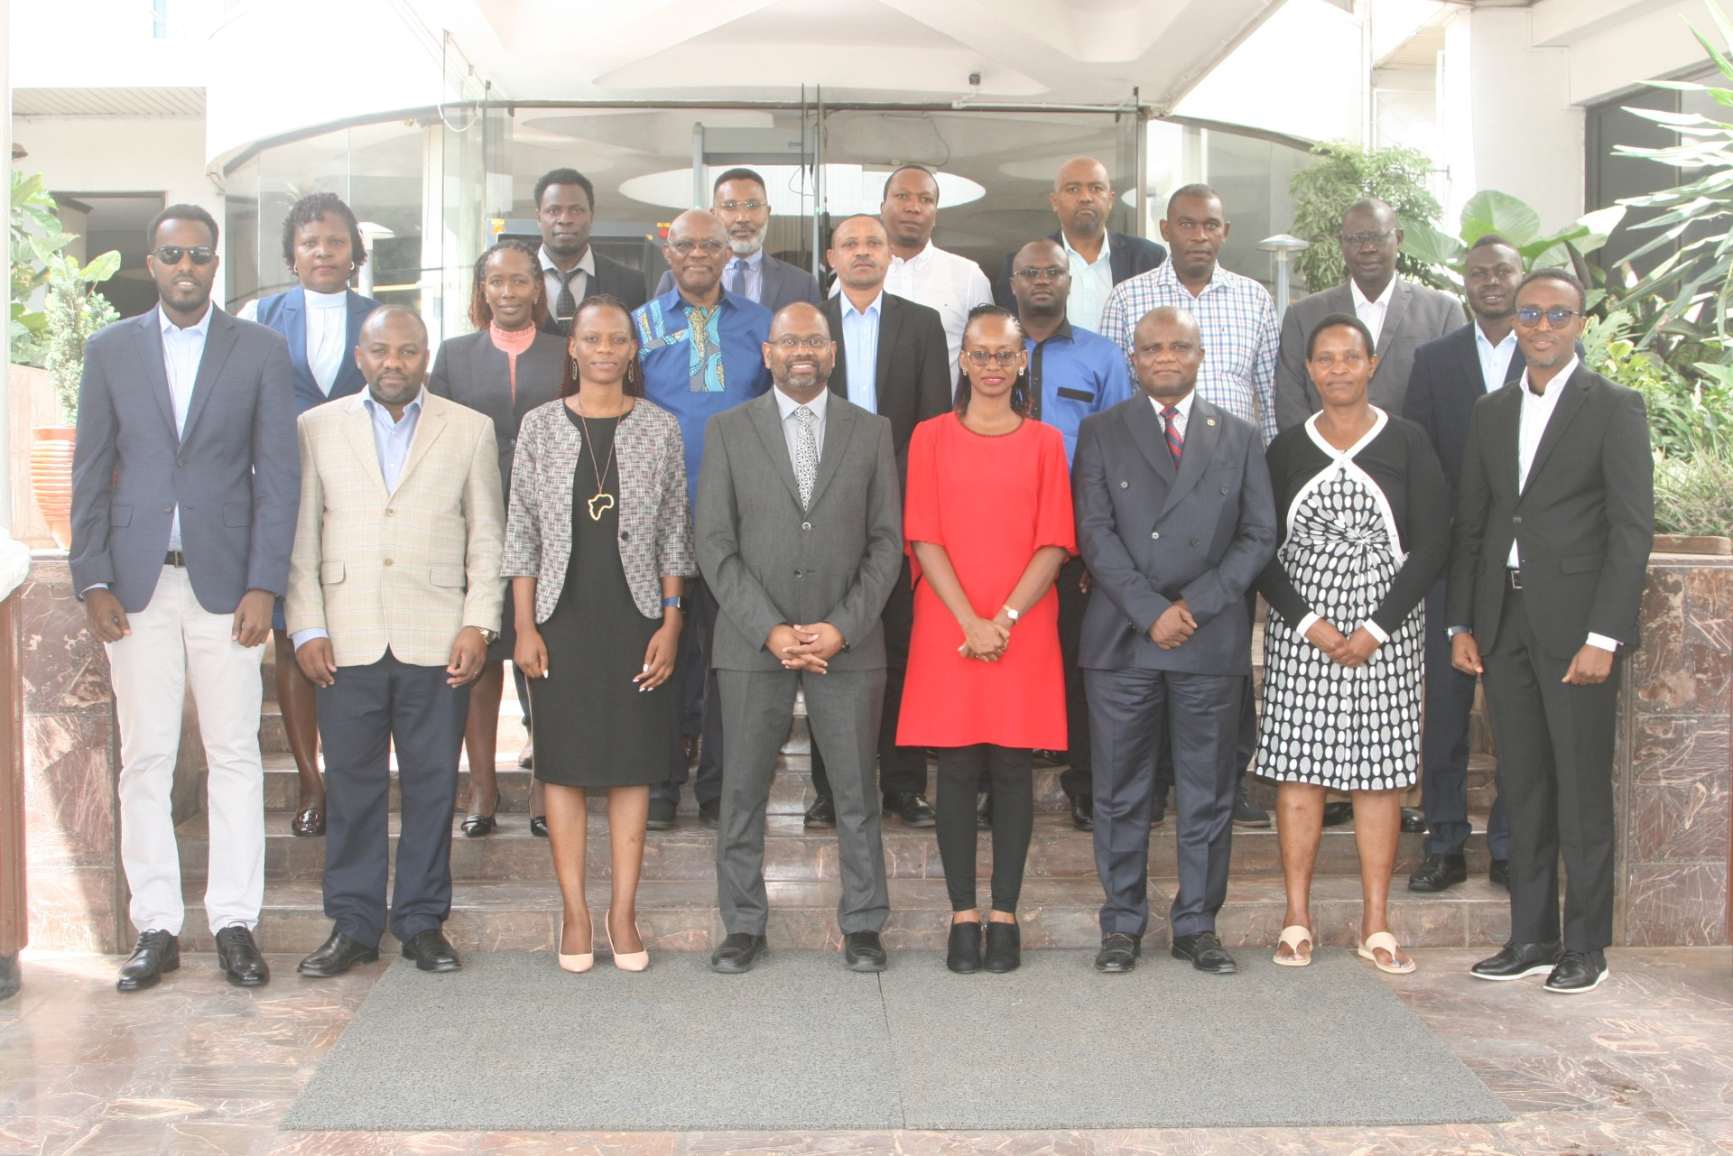
Progress so far …
Technical Support and Expertise/ Joint Capacity Building
A joint baseline study with UA, TERNET, KENET, RENU on Digital Readiness of EAC Universities (pilot 18 member universities) - 2023
Training with UA on Computer Security and Incident Response Team (CSIRT) - 2022
Online Training for University IT Teams on network optimization, FIM, System Administration (with UA, KENET, TERNET) - 2024
Development of a regional ICT Policy framework for higher education - 2024

Slide 13
Progress so far …
Awareness Campaigns
A Directive of Sectoral Council of EAC on Education, Culture, Sports, Science and Technology to present a white paper on the Roles of NRENs in Higher Education Development - on going!
Call for participation: submit your input via menti.com 3642 7402

Slide 14

Call for participation
Submit your inputs on the menti.com
code 3642 7402
What are the challenges that your NRENs faces/faced that hinder its development/advancement
What are different ways could governments help address these challenges
Are there any support/services currently your NREN receives from government
What support/services do you wish NRENs could get from respective governments
Any other comment that will help the advocacy

Slide 15

Call for participation
What are the challenges that NRENs faces (faced) that hinder its development/advancement
What are different ways can governments help address these challenges
Are there any support/services currently your NREN receive from government
What support/services do you wish NRENs get from respective governments
Any other comment that will help the advocacy
https://www.iucea.org/b4uc

Slide 16
Progress so far …
Regional Networking and Joint Activities
Establishment of East African Forum for Research and Education Networks (EAFREN) - ongoing
  Joint policy advocacy and awareness campaigns
  Organizing joint events – capacity building activities for members
  Collaborative research Initiatives
  Joint funding from the EAC governments
Call for Engagement !!

Slide 17
Progress so far …
Policy Briefs
Neutralizing the Demand and Costs of Bandiwidth Connectivity in the EA Universities
Phasing out Islands of Knowledge Cyberspace Enables University to share Learning Resources
Unleashing Potential of E-resources
Retooling East African Community Staff for the Digital Age

Slide 18
Concluding!
IUCEA and NRENs have common goals/stakeholders
IUCEA is a friend in the NREN community / not a foe
IUCEA can play a bridging role to governments
let’s join hands to strengthen the efforts

