Slide 1
WiFiMon: Experiences from Users
Elisantila Gaci, RASH, WiFiMon Service Manager
UbuntuNet Connect 2024, Dar es Salaam, Tanzania
October 31th, 2024

Slide 2


Slide 3
Introduction
Monitoring Wi-Fi performance as experienced by end users
Combination of crowdsourced & hardware probe measurements
Contribution:
Detection of Wi-Fi throughput degradation
Determination of underperforming areas within a Wi-Fi network
→ Admins may enhance performance, e.g. by installing more APs

Slide 4

WiFiMon vs Related Monitoring Tools
Monitoring from the end-user perspective (end-user experience)
No requirements for app installation or end-user intervention
Centralized view of Wi-Fi performance available to the administrator

Slide 5
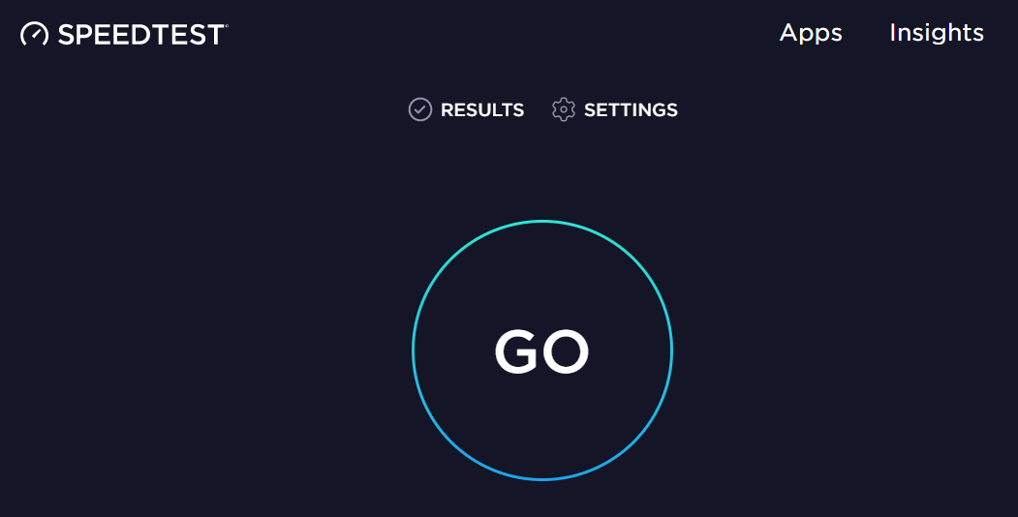
Example: WiFiMon vs Ookla Speedtest
WiFiMon | Ookla Speedtest
Automatically by visiting a site | By pressing “GO”
Wi-Fi administrator | End users
Measurements are triggered:
Results collected by:

Slide 6
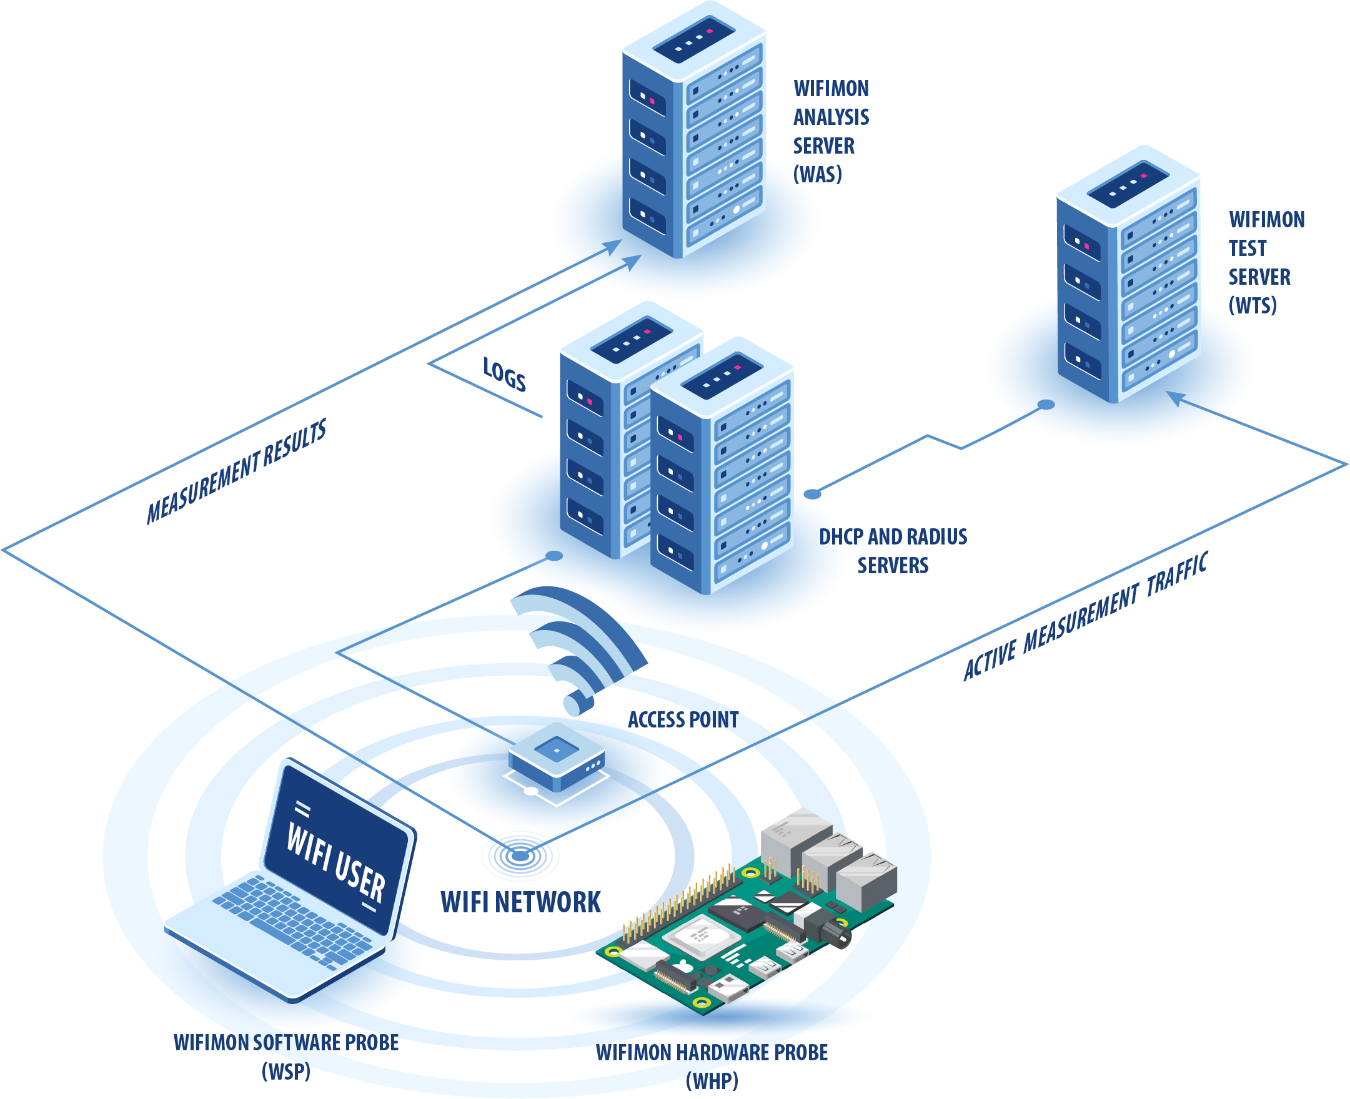
WiFiMon Operation
WiFiMon Components:
WiFiMon Software Probes (WSPs)
WiFiMon Hardware Probes (WHPs)
WiFiMon Analysis Server (WAS)
WiFiMon Test Server (WTS)

Slide 7
WiFiMon Users

Slide 8
Main WiFiMon Users
ASNET-AM, Armenia
CERN, Switzerland
RENU, Uganda
Currently being tested in Brazil

Slide 9
ASNET-AM (Armenia)
Experiences from a conference pilot

Slide 10
ASNET-AM Pilot Details (1/2)
Monitoring eduroam at the Institute for Informatics and Automation
Problems (IIAP) - National Academy of Sciences of Armenia
Monitoring between September 21st - October 3rd 2023
Monitoring about 50-100 people (researchers, professors, engineers, students)
Measurements from 1 WHP (Raspberry Pi 4 Model B) – placed on the floor
WAS/WTS installed in a single VM with 4 vCPU’s, 8 GB RAM (WiFiMon v. 2.1.0)
Pilot Goal:
Experiment with newly introduced WiFiMon features
Help ASNET-AM Wi-Fi administrators identify interesting points requiring further inspection

Slide 11
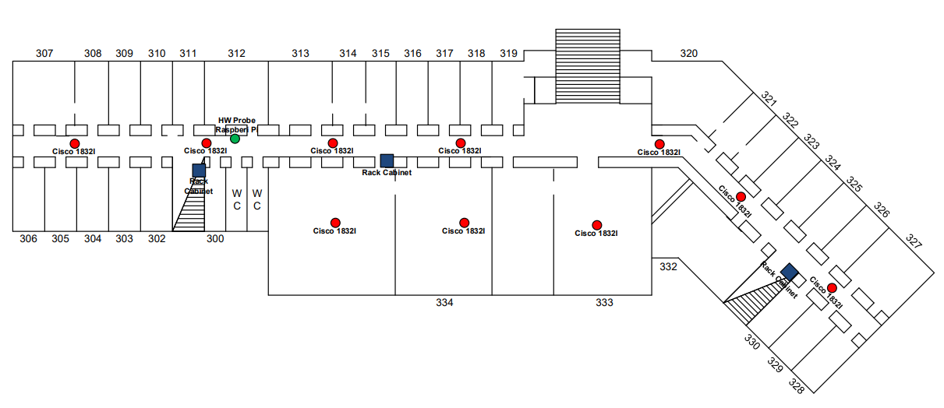
ASNET-AM Pilot Details (2/2)
Monitored area blueprints: WHP is placed at the green bullet

Slide 12
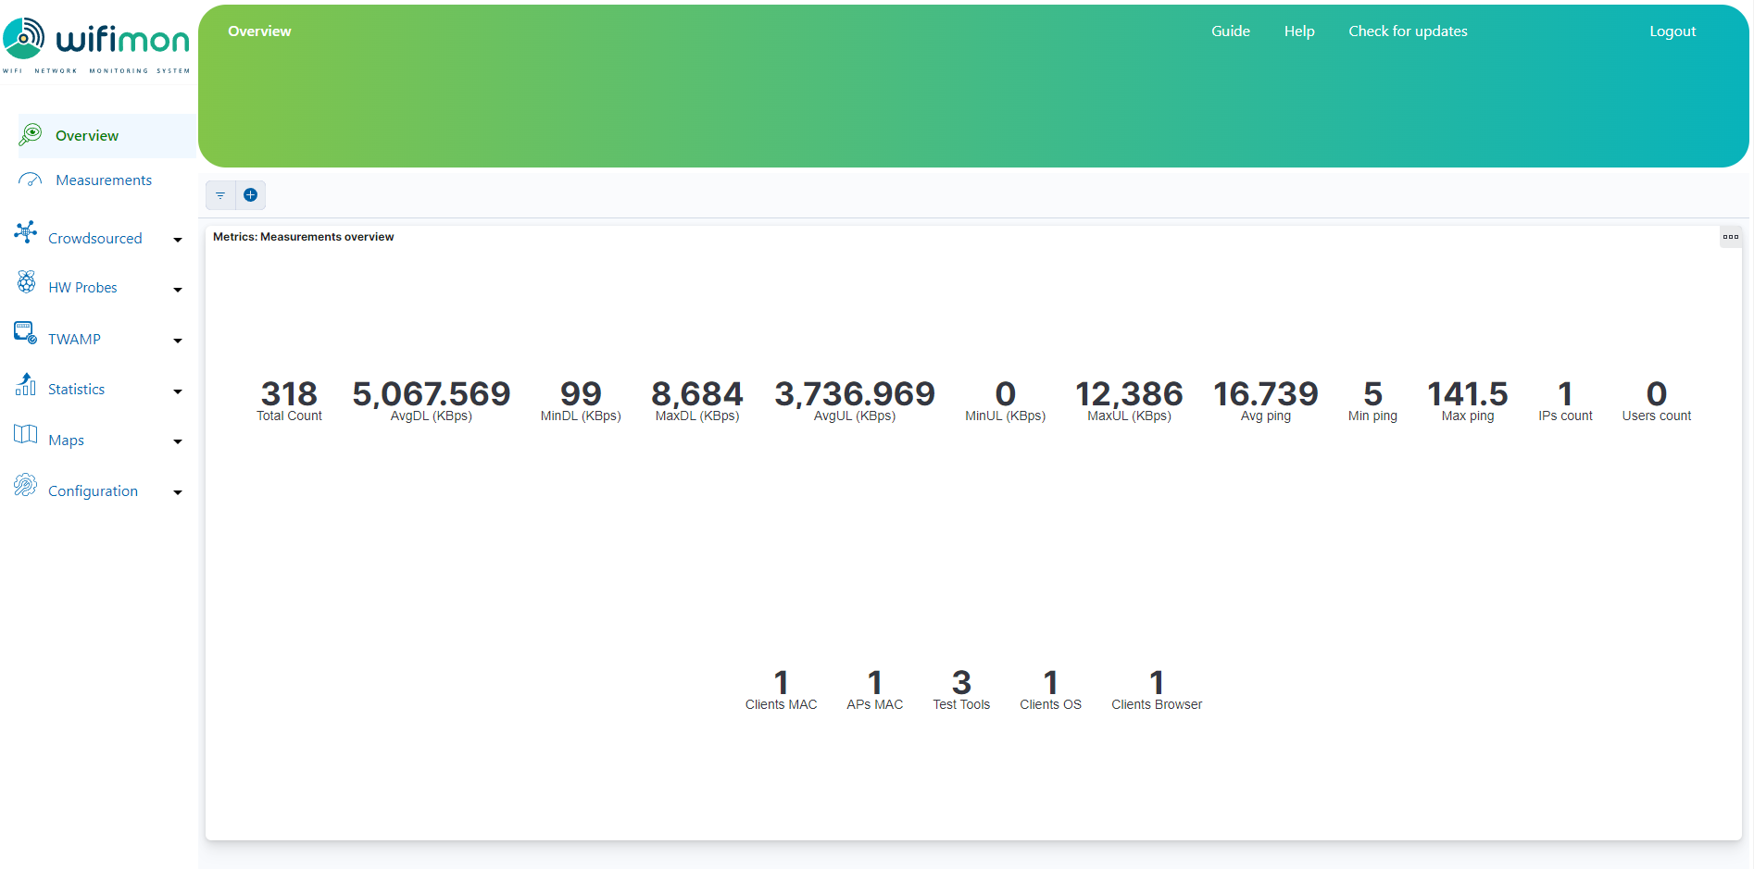
Overview of WiFiMon Measurements (1/8)
The Overview tab summarizes received measurements on a daily basis

Slide 13
Overview of WiFiMon Measurements (2/8)
Total number of received measurements (since midnight)
The Overview tab summarizes received measurements on a daily basis

Slide 14
Overview of WiFiMon Measurements (3/8)
Average download throughput reported
The Overview tab summarizes received measurements on a daily basis

Slide 15
Overview of WiFiMon Measurements (4/8)
Minimum download throughput reported
The Overview tab summarizes received measurements on a daily basis

Slide 16
Overview of WiFiMon Measurements (5/8)
Maximum download throughput reported
The Overview tab summarizes received measurements on a daily basis

Slide 17
Overview of WiFiMon Measurements (6/8)
Metrics for
Upload Throughput
The Overview tab summarizes received measurements on a daily basis

Slide 18
Overview of WiFiMon Measurements (7/8)
HTTP ping metrics
The Overview tab summarizes received measurements on a daily basis

Slide 19
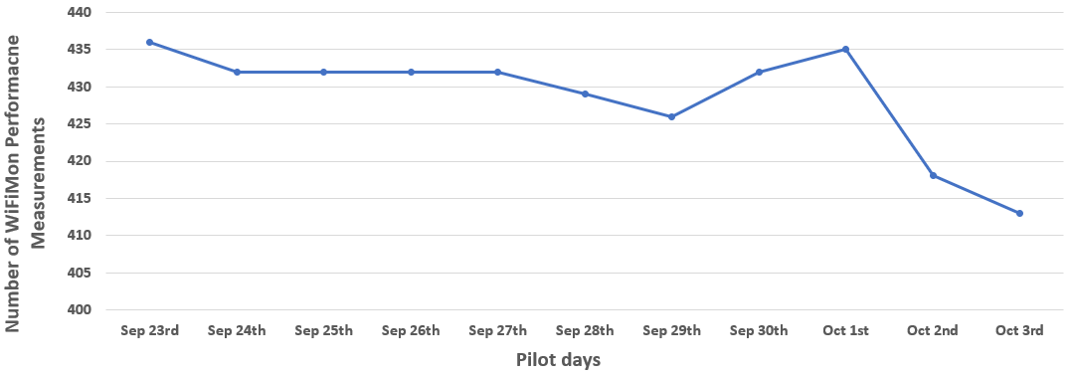
Overview of WiFiMon Measurements (8/8)
Total number of WiFiMon performance measurements received daily between Sep 23rd and Oct 3rd
The WiFiMon Analysis Server (WAS) received 4717 total measurements on 11
days and 429 measurements per day on average
Loss of measurements is evident in various days (e.g. maximum loss on Oct 3rd)

Slide 20
WiFiMon Performance Measurements
WiFiMon may report various types of performance measurements (against the WiFiMon Test Server – WTS)
The most important are:
Download Throughput
Upload Throughput
HTTP Ping Round-Trip Time (RTT)
Jitter

Slide 21
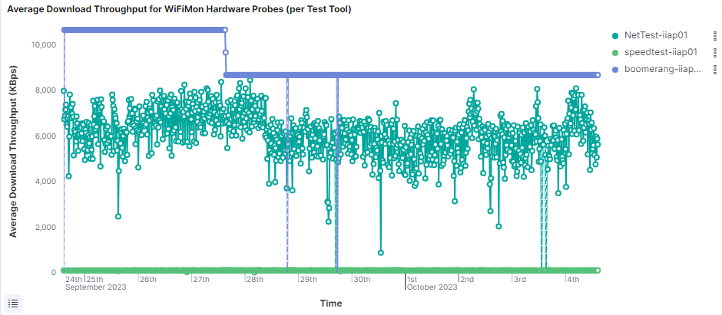
Average Download Throughput – Per Test-Tool
Average download throughput during the last 10 days:
3 different test-tools were used (NetTest, Akamai Boomerang & LibreSpeed Speedtest)
NetTest reports interesting performance drops
LibreSpeed Speedtest reports rather stable performance
Akamai Boomerang detects a very interesting performance drop during the 27th of September; performance suddenly drops and almost stabilizes on a lower value

Slide 22
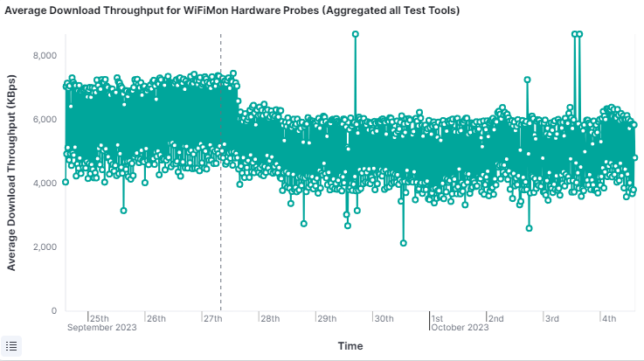
Average Download Throughput – Aggregated
Average download throughput during the last 10 days:
The results of all test-tools are aggregated
Interesting points (blue circles) can be seen in the diagram
Wi-Fi administrators may further inspect what happened at these points

Slide 23
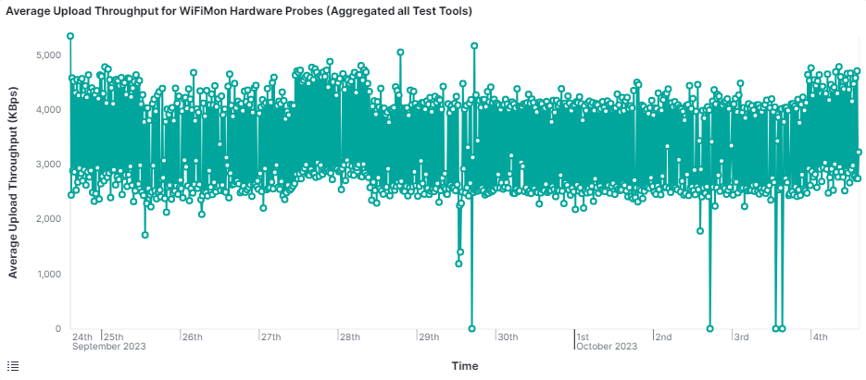
Average Upload Throughput – Aggregated
Average upload throughput during the last 10 days:
The results of all test-tools are aggregated
Significant drops (blue circles) are also visible in the chart

Slide 24
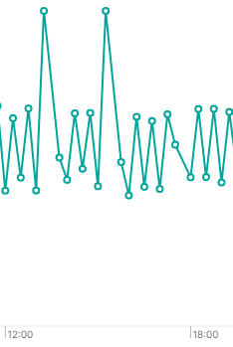
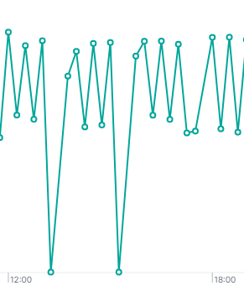
A Closer look on October 3rd Measurements
Average download throughput
Average upload throughput
Download throughput presumably dropped because of data uploads

Slide 25
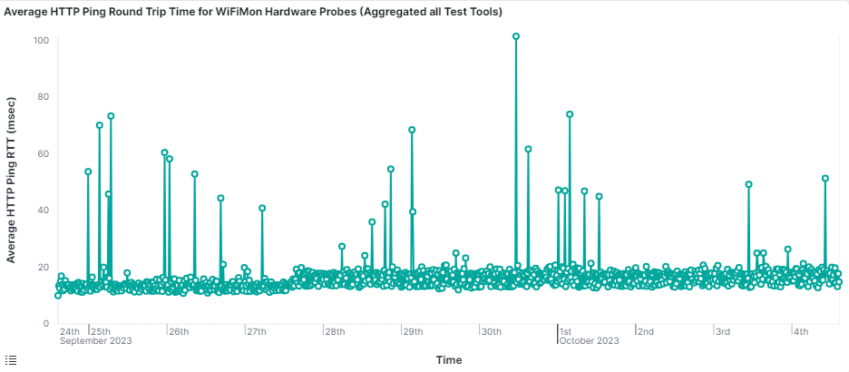
Average HTTP Ping RTT - Aggregated
Average HTTP Ping RTT during the last 10 days:
The results of all test-tools are aggregated
Higher RTT’s are visible (blue circles) in the chart

Slide 26
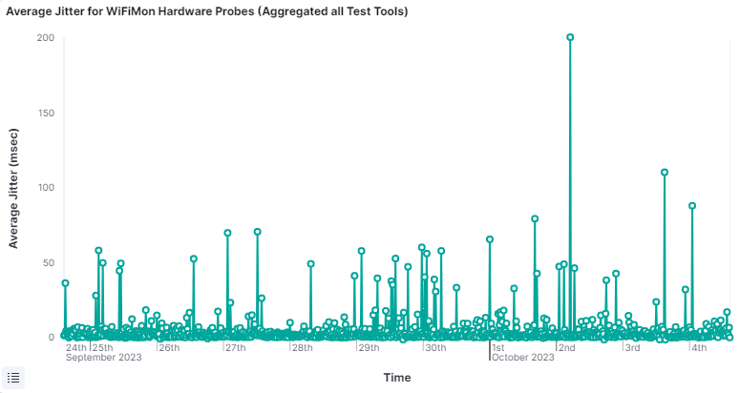
Average Jitter
Average Jitter during the last 10 days:
A very high jitter measurement (blue circle) is visible on October 2nd

Slide 27
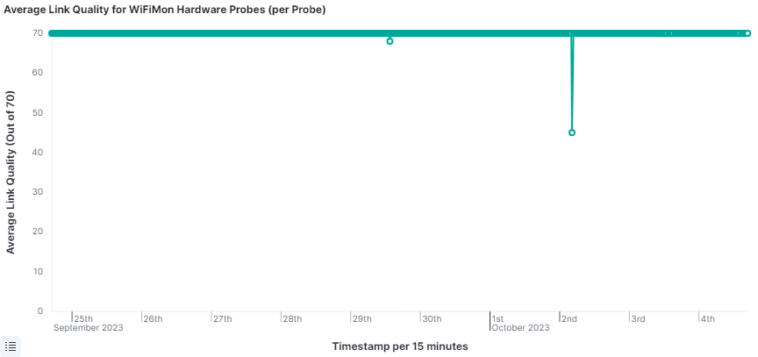
Average Link Quality
Average link quality during the last 10 days reported from the WLAN NIC of the probe:
Link quality (WLAN NIC) does not capture the drops reported by WiFiMon
A major drop on October 2nd matches the jitter increase (previous slide)

Slide 28
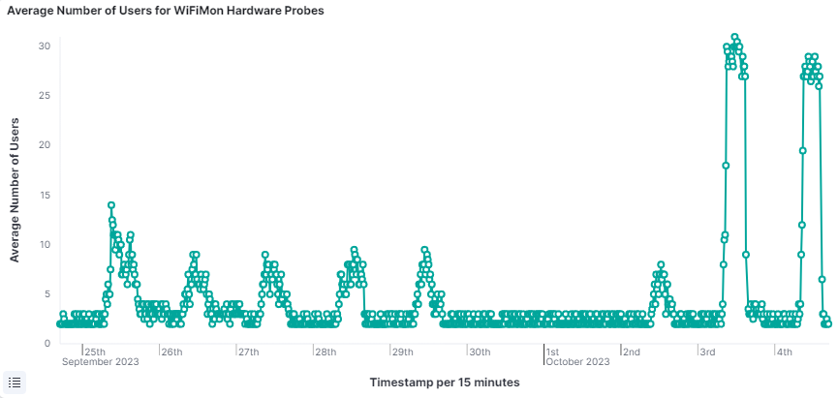
Average Number of Users
Average number of Wi-Fi users during the last 10 days (reported by arp-scan):
Almost no users during the weekend (blue rectangle)
Higher number of users during the conference days (green rectangle)

Slide 29
WiFiMon Performance Measurements
Apart from average measurements, WiFiMon may also report:
Median values
Maximum values
Minimum values
95th percentile values

Slide 30
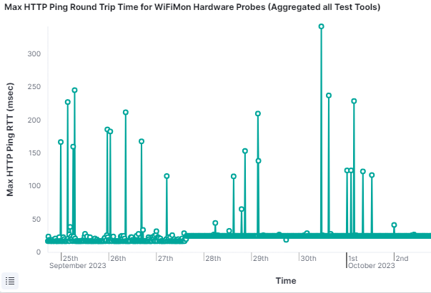
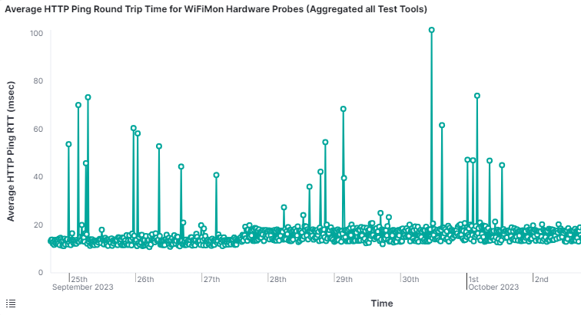
Average vs Max HTTP Ping RTT
Comparison between the average and the maximum HTTP Ping RTT:
Maximum values of RTT are much higher than the reported average

Slide 31
CERN (Switzerland)
Experiences reported in a published article
(article)

Slide 32
CERN Setup Details
Thousands of users (researchers, visitors, students, etc.)
Roughly 5000 Access Points
Both WiFiMon Hardware Probes (WHP’s) and WiFiMon Software Probes
(WSP’s) are used

Slide 33
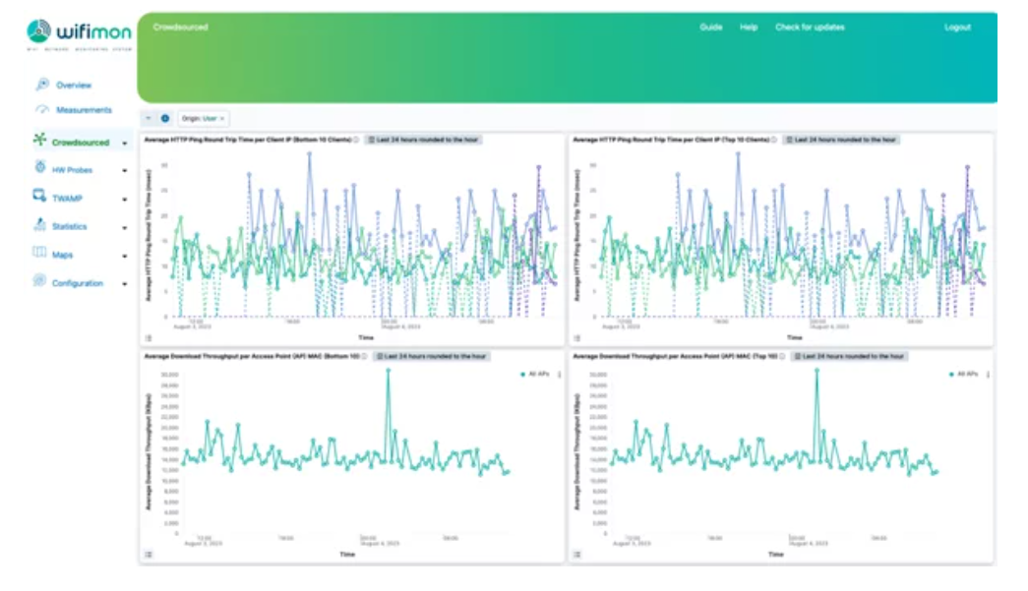
CERN Crowdsourced Measurements
WSP measurements collected from 4 clients within the CERN’s Wi-Fi network

Slide 34
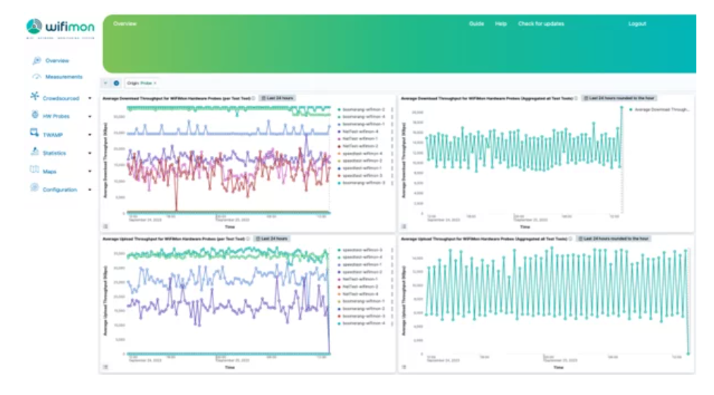
CERN Hardware Probe Measurements
WHP measurements collected from 4 locations within the CERN’s Wi-Fi network

Slide 35
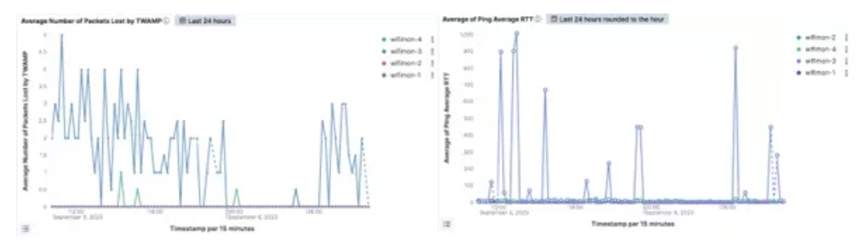
WiFiMon Helped CERN Resolve Wi-Fi Issues
The reported Round Trip Time (RTT) and packet loss helped CERN identify an issue in the Wi-Fi configuration

Slide 36
RENU (Uganda)
Experiences reported during an infoshare
(article)

Slide 37
RENU Setup Details
Thousands of users
Both WHP and WSP measurements are considered

Slide 38
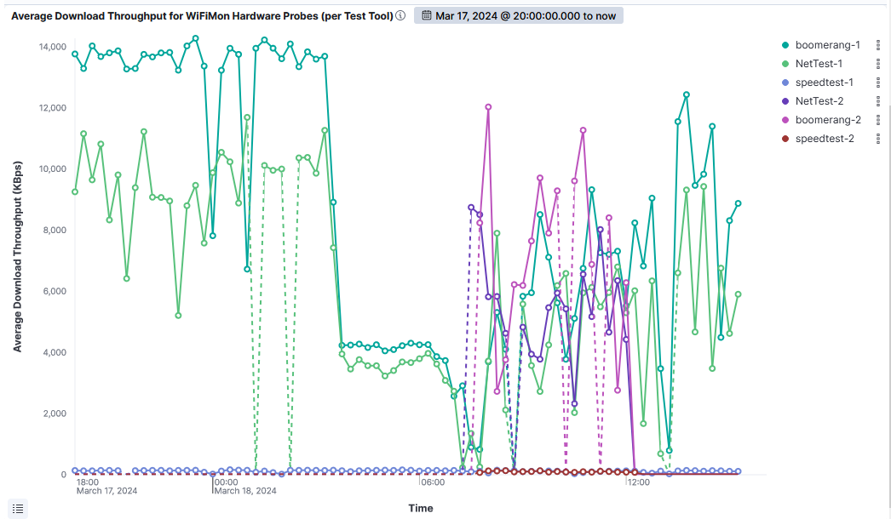
WiFiMon Helped RENU Resolve Wi-Fi Issues
Results reported by two WiFiMon Hardware Probes (WHP’s) using multiple WiFiMon test tools

Slide 39
Thank You

