Slide 1



Maximizing Technological Advancements in Surgical Research: The Impact of the mHealth App, Recovery@Home, on Postoperative Care in Rural Uganda
Nuwahereza Ambrose
Ambrose.Nuwahereza@kyabirwasc.org
Global Surgical Initiatives, Inc -Uganda

Slide 2
Overview
5 billion have no access to essential and emergency surgical care
Annually 61M deaths
Access to surgical services avert 18.3m
Surgeries done 320M per year, 6% in LMICs
Impact of surgery, 450M surgeries performed annually, deficit 130M(140m surgeries).

Slide 3
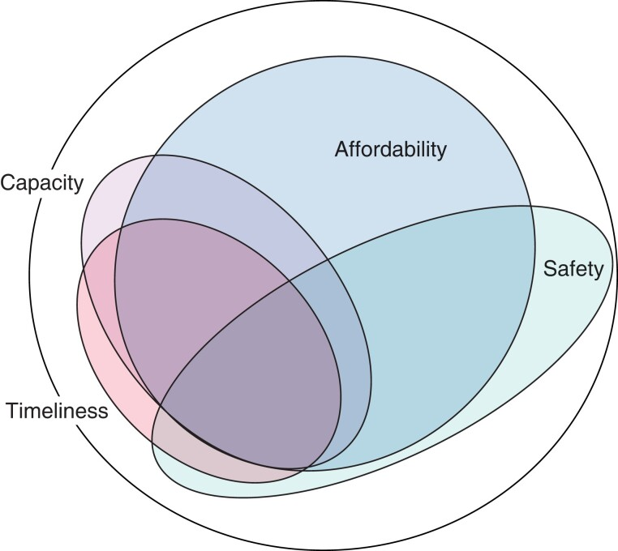
Source: Rudolfson et al 2023

Slide 4

KYABIRWASC
Rural Uganda
Established in 2019 by Mount Sinai Health
Provide safe, affordable surgical care.
Stand alone ambulatory surgical center
Performs 1820 surgeries/year

Slide 5
Recovery@home App.
Android based mobile App
Nurse managed
Capture post operative patients’ recovery data periodically
Monitor post surgery, research purposes, decongest the OPD clinic
Increased access to surgical services, minimal cost, affordable, early detection and prevention of complications.

Slide 6
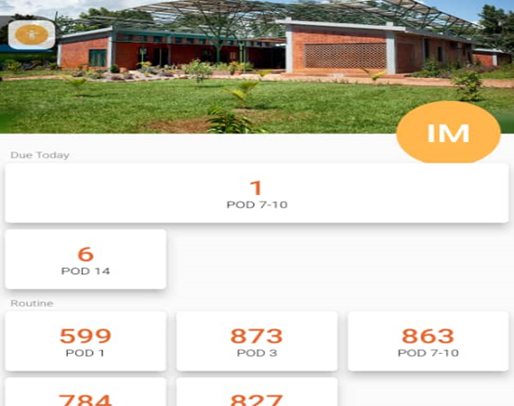
Features of the App
Symptom tracking.
Wound monitoring,
Medication reminders,
Direct communication with healthcare providers.
Designed for Low/No Internet Connectivity

Slide 7
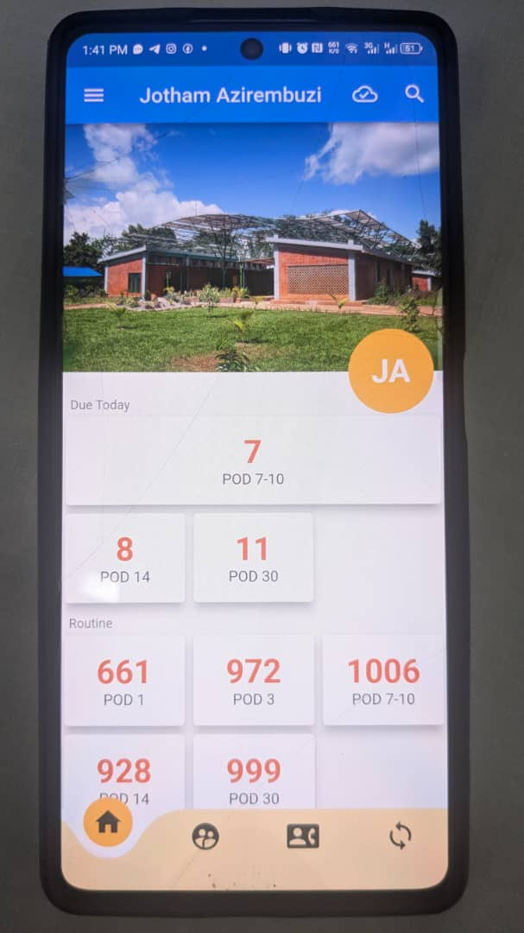
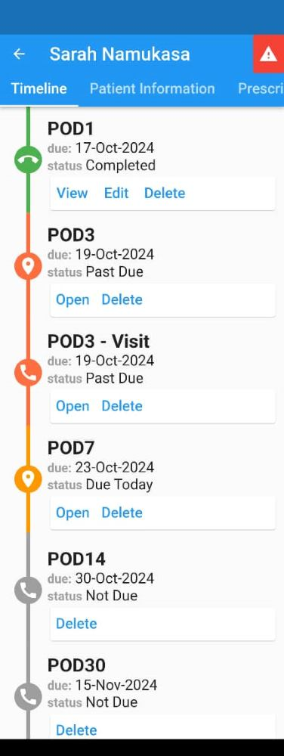
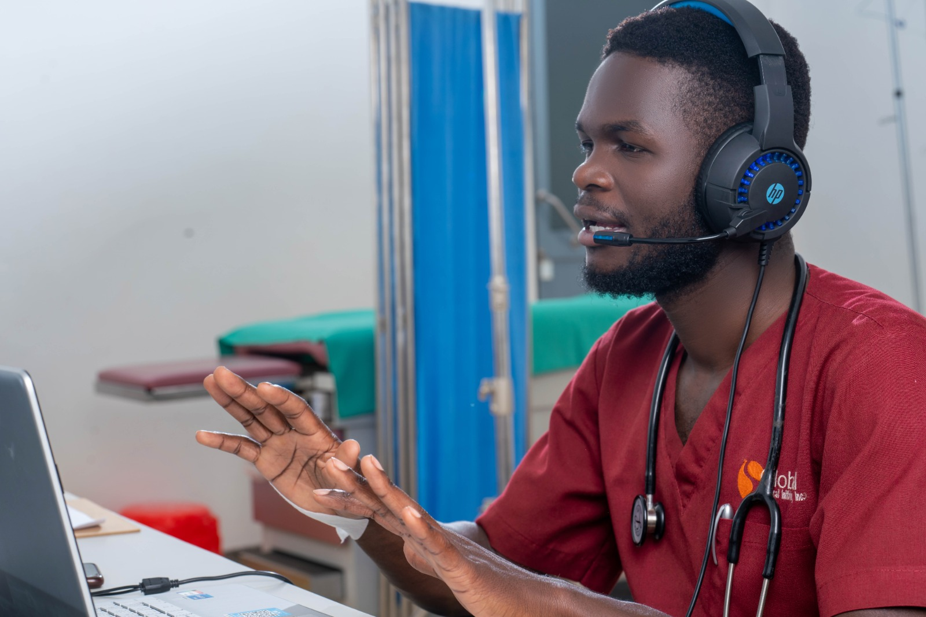
App interface

Slide 8
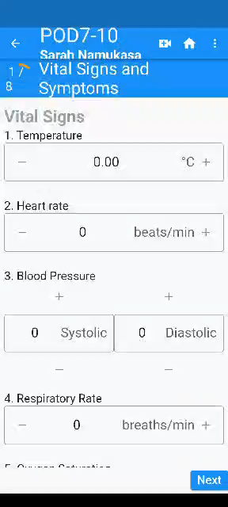
Metrics monitored

Slide 9
How Recovery@Home Works
Post surgery Snycing: Picks all post op patients from EMR.
Periodic: Nurses log symptoms and upload photos of the surgical site (PRN).
Nurse Follow-Up: Nurses review data daily and provide feedback via the app or direct phone calls.
Emergency Alerts: Automatic alerts for critical symptoms (e.g., high fever, excessive bleeding) trigger immediate interventions.

Slide 10
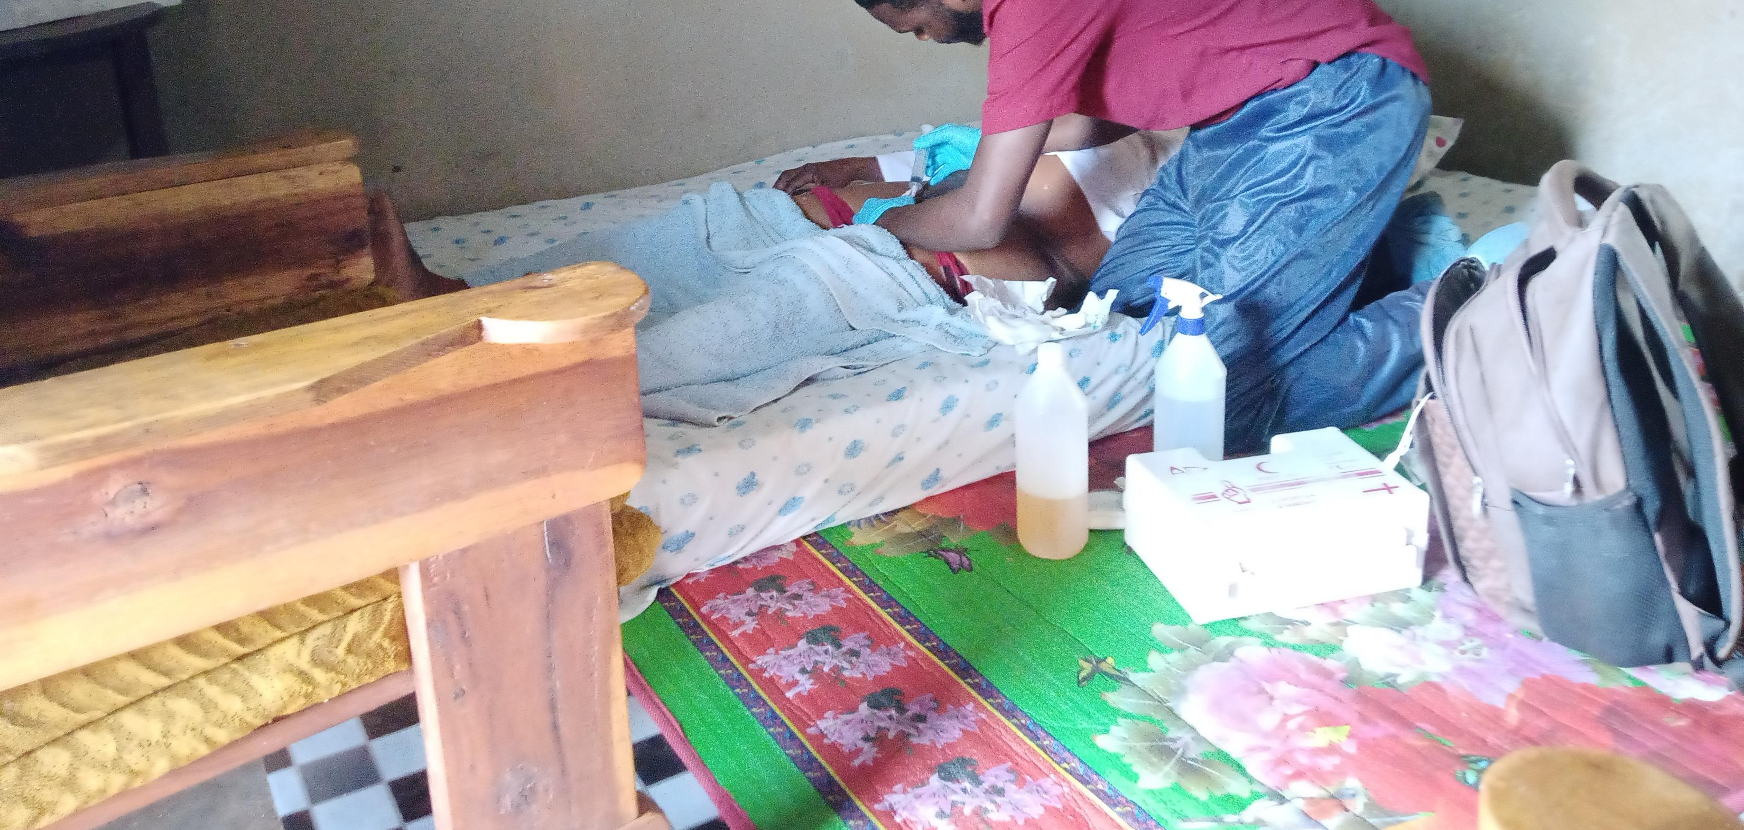
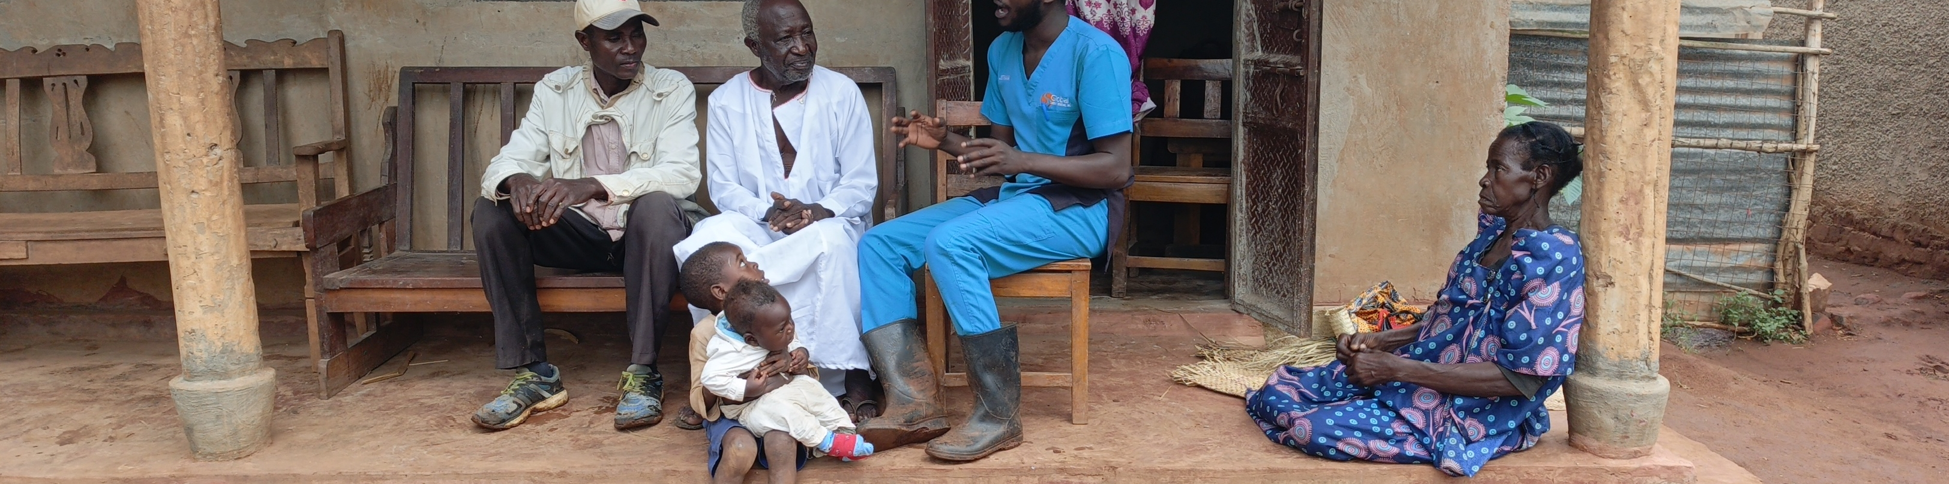
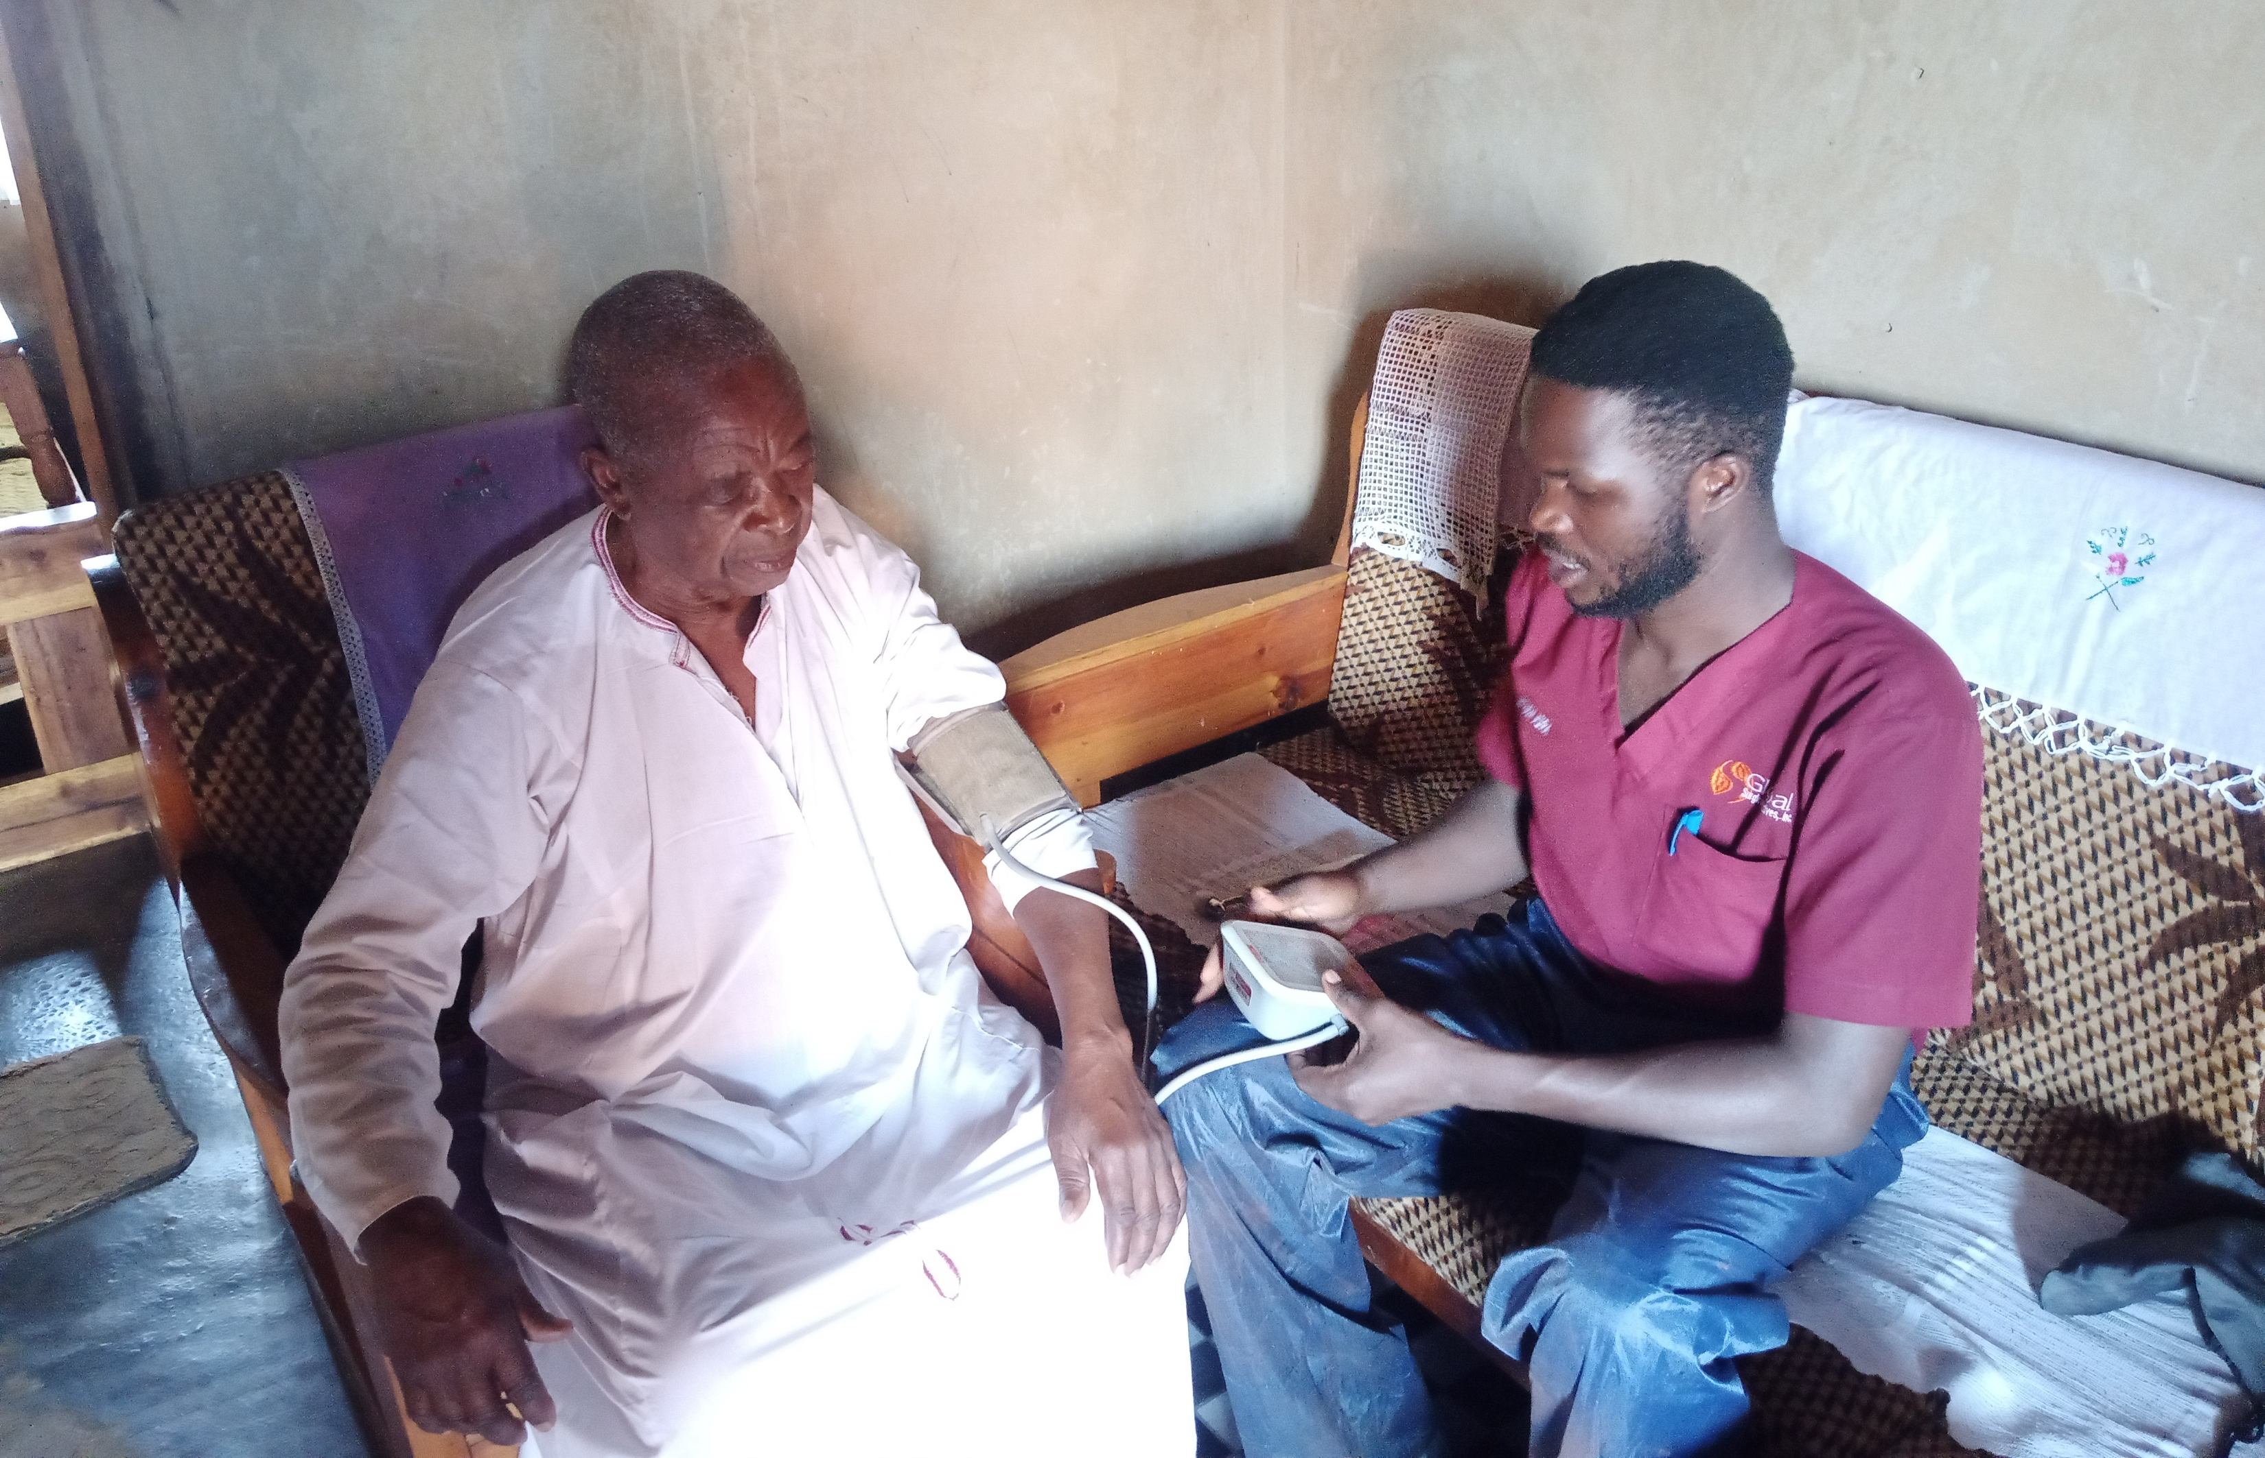
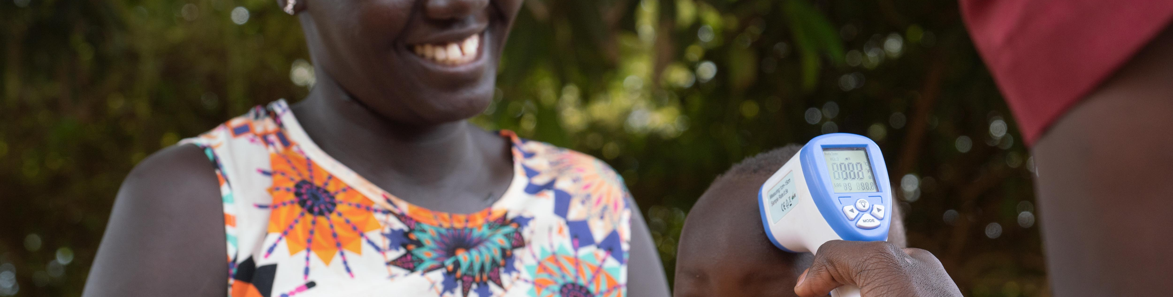

Patient engagement

Slide 11
The Potential of Recovery@Home in Surgical Recovery
Accessibility: Reaching patients through mobile technology, even in remote areas.
Cost-Effectiveness: Reducing the need for travel and hospital visits.
Patient Engagement: Enabling patients to take part in their own health with support from healthcare workers.
Real-Time Monitoring: Providing timely interventions for post-surgical complications.

Slide 12
Data-Driven Insights from Recovery@Home
Improved Data Collection
Early Detection of Complications
Research Outcomes: Patient recovery times, infection rates, and overall health outcomes can inform future surgical protocols.
Contributing to Global Health Knowledge

Slide 13
Challenges and Lessons Learned
Technical Limitations: Phone access, battery life, and internet connectivity.
Cultural Adoption: Ensuring patient and community buy-in for using technology in healthcare.
Knowledge Gaps: Educating healthcare workers and patients.
Sustainability: Ensuring long-term use and funding for the app in low-resource settings.

Slide 14
Scaling Up Recovery@Home Solutions for Global Impact
Scalability: Plans to expand Recovery@Home to the region in EAC and other low-resource settings.
Cross-Application: Potential to adapt the app for other health disciplines.
Global Collaborations: Partnering with global health organizations to improve healthcare access.
Sustainable Models: Exploring partnerships with telecom providers, government health programs, and NGOs.

Slide 15
The Future of Postoperative Care in Low-Resource Settings
AI-Driven Healthcare: Using AI to predict postoperative complications based on patient data.
Telemedicine Integration: Combining mobile apps with telemedicine for more comprehensive remote care.
Wearable Devices: Adding wearables to track patient vitals in real time.
Mobile Health Ecosystem: Building a holistic system of apps, devices, and care providers for full-spectrum health management.

Slide 16
Conclusion
Recovery@Home is a powerful tool for improving postoperative care in rural Uganda.
Maximizing Potential: Expanding the use of mHealth technology can bridge healthcare gaps in low-resource settings.
Call to Action: Continued research and partnerships are needed to scale up these innovations globally- focus on Africa.

Slide 17


