Slide 1
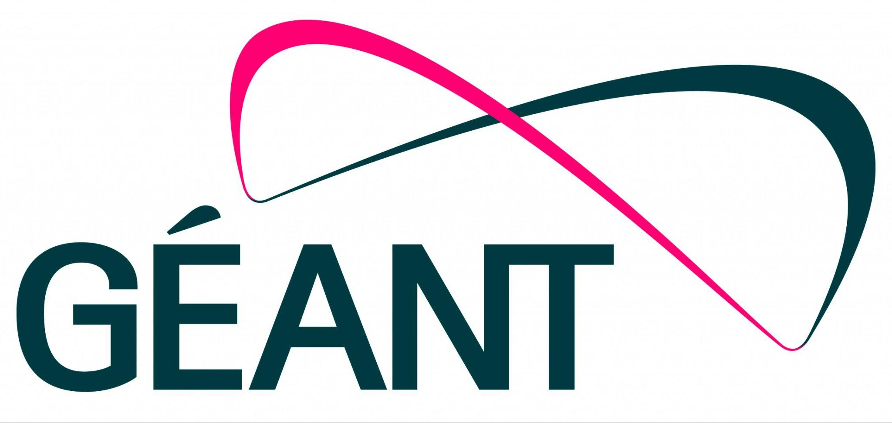
EUMETCast Terrestrial over GÈANT and NRENs using AMT
1/11/2024
Mario Reale / GÈANT
Oriol Espanyol / EUMETSAT

Slide 2

Agenda
GÈANT
EUMETSAT
Automatic Multicast Tunnelling
  AMT Technology
  AMT implementation and deployment
  AMT performance
  AMT security aspects
Q&A

Slide 3


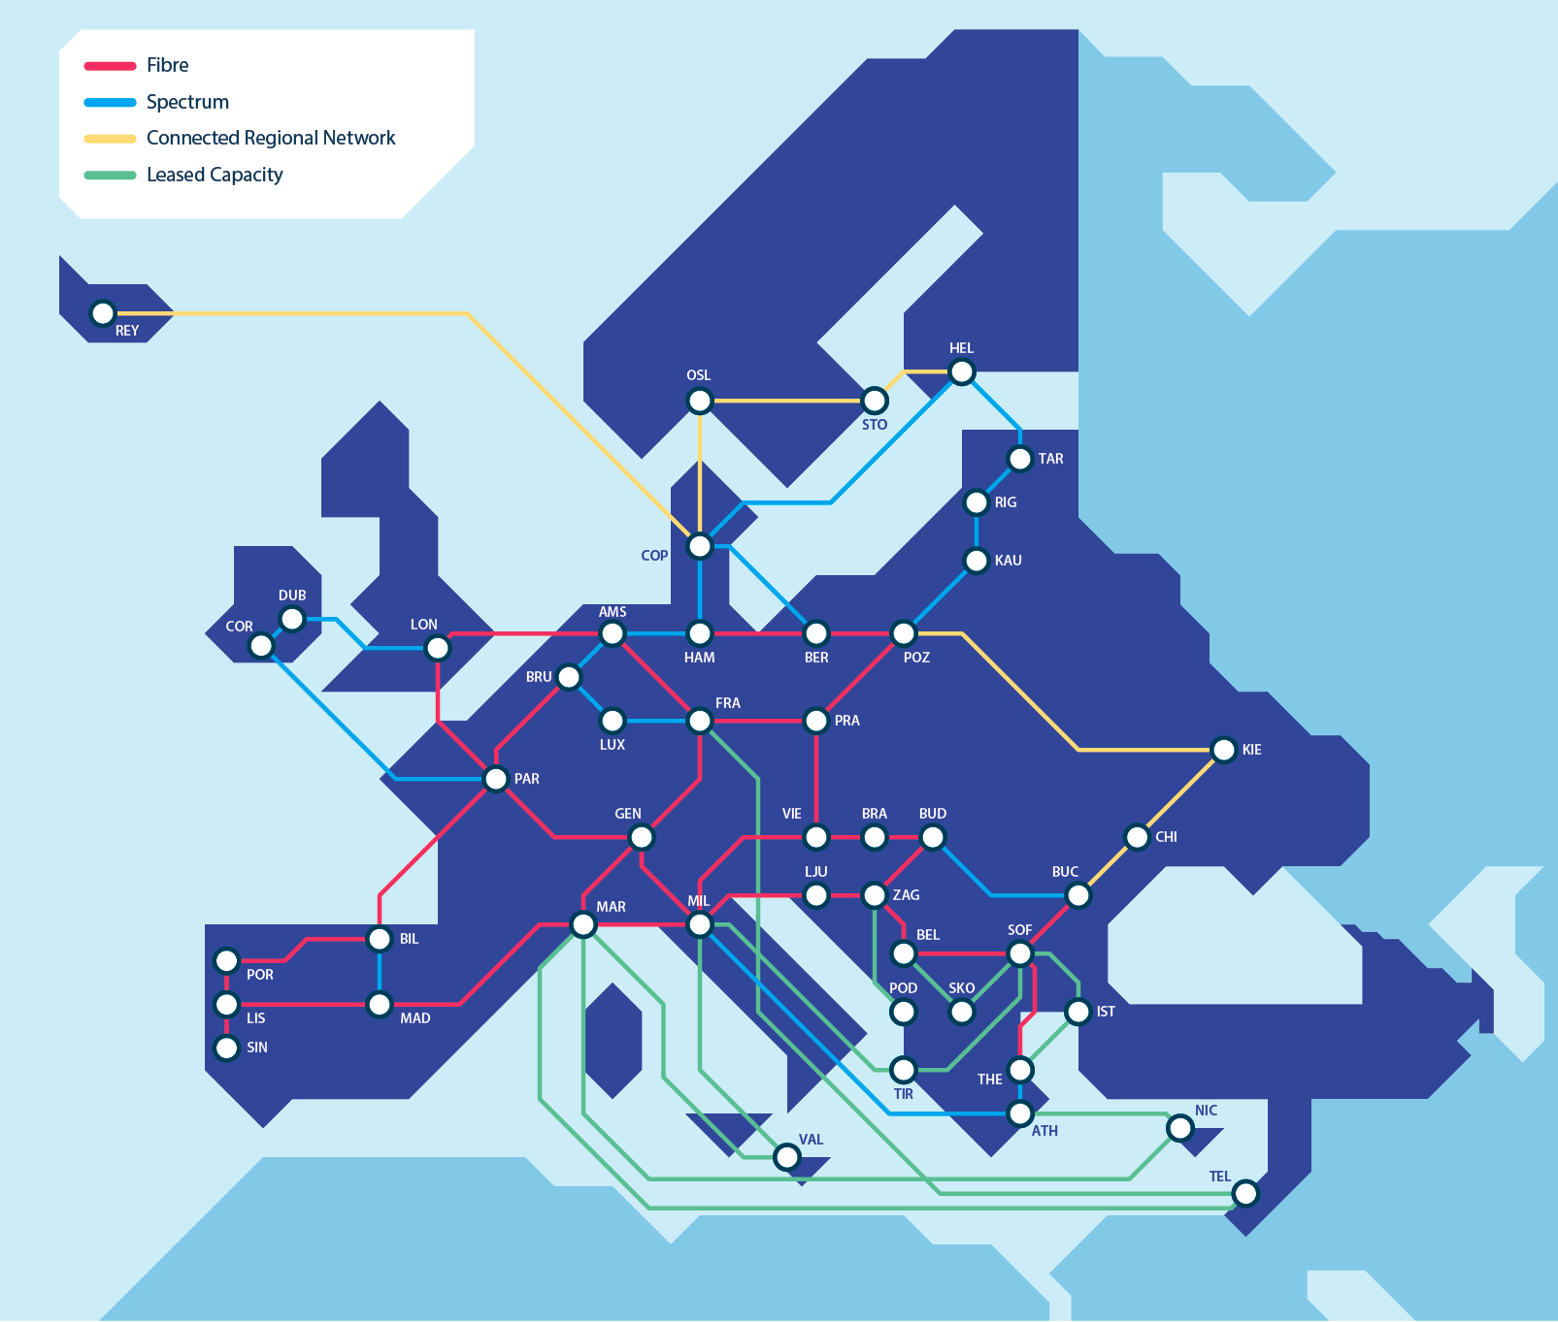
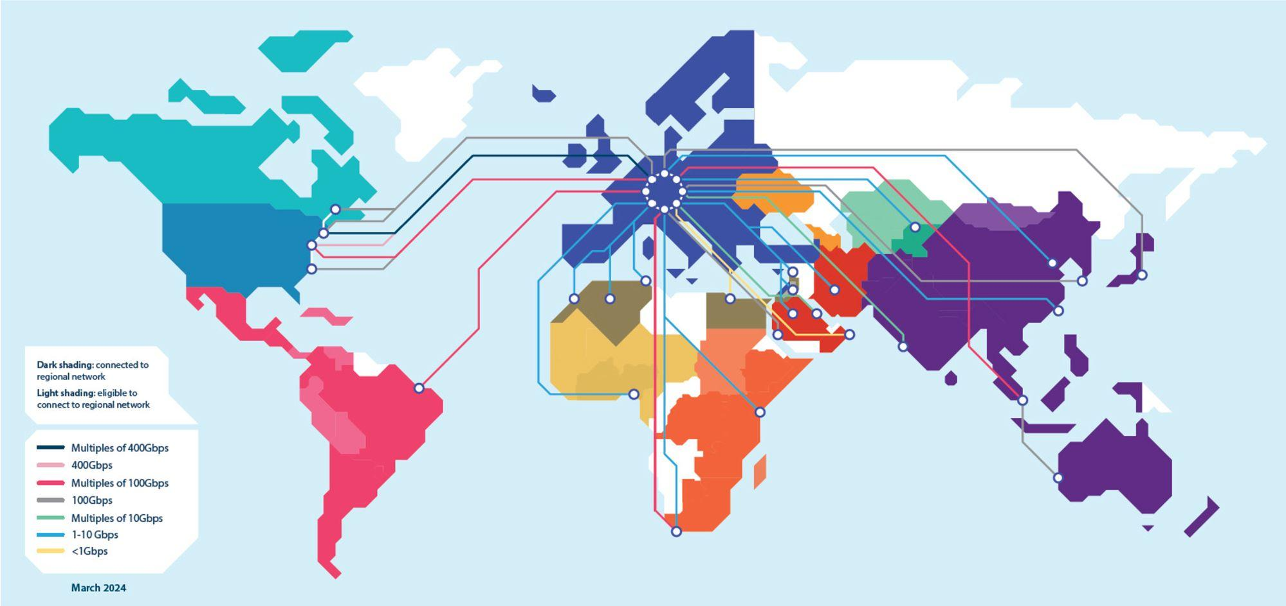




GÉANT
The GÉANT Association is the collaboration of
European National Research and Education Networks (NRENs)
Together, we deliver an information ecosystem of infrastructure and services
to advance research, education, and innovation on a global scale
Network
Services
Security
Trust & Identity
Cloud
Supporting and representing
38 NRENs + NORDUnet across Europe
Interconnecting R&E
communities worldwide
Managing a portfolio of advanced R&E services

Slide 4
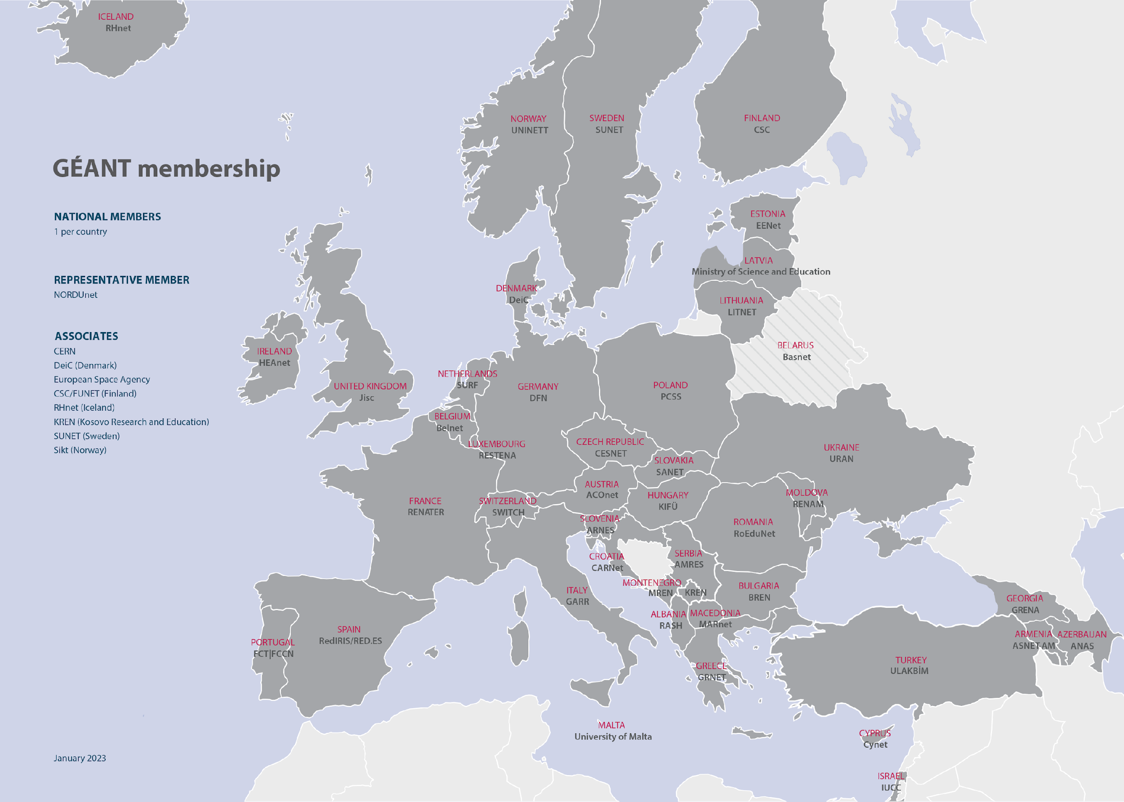


The GÉANT Community
‹#› |
Notes:
as you can see – GEANT is ubiquitous and fully pan-European.
The GÉANT Association is the collaboration of European National Research and Education Networks (NRENs), supporting the advancement of research, education, and innovation on a global scale.
Together we deliver an information ecosystem of infrastructures and services used for communication, collaboration, exchange of data, and access to repositories, services and facilities.
GÉANT Association supports and represents over 38 NRENs + NORDUnet.
Together they support over 10,000 institutions and 50 million academic users.

Slide 5
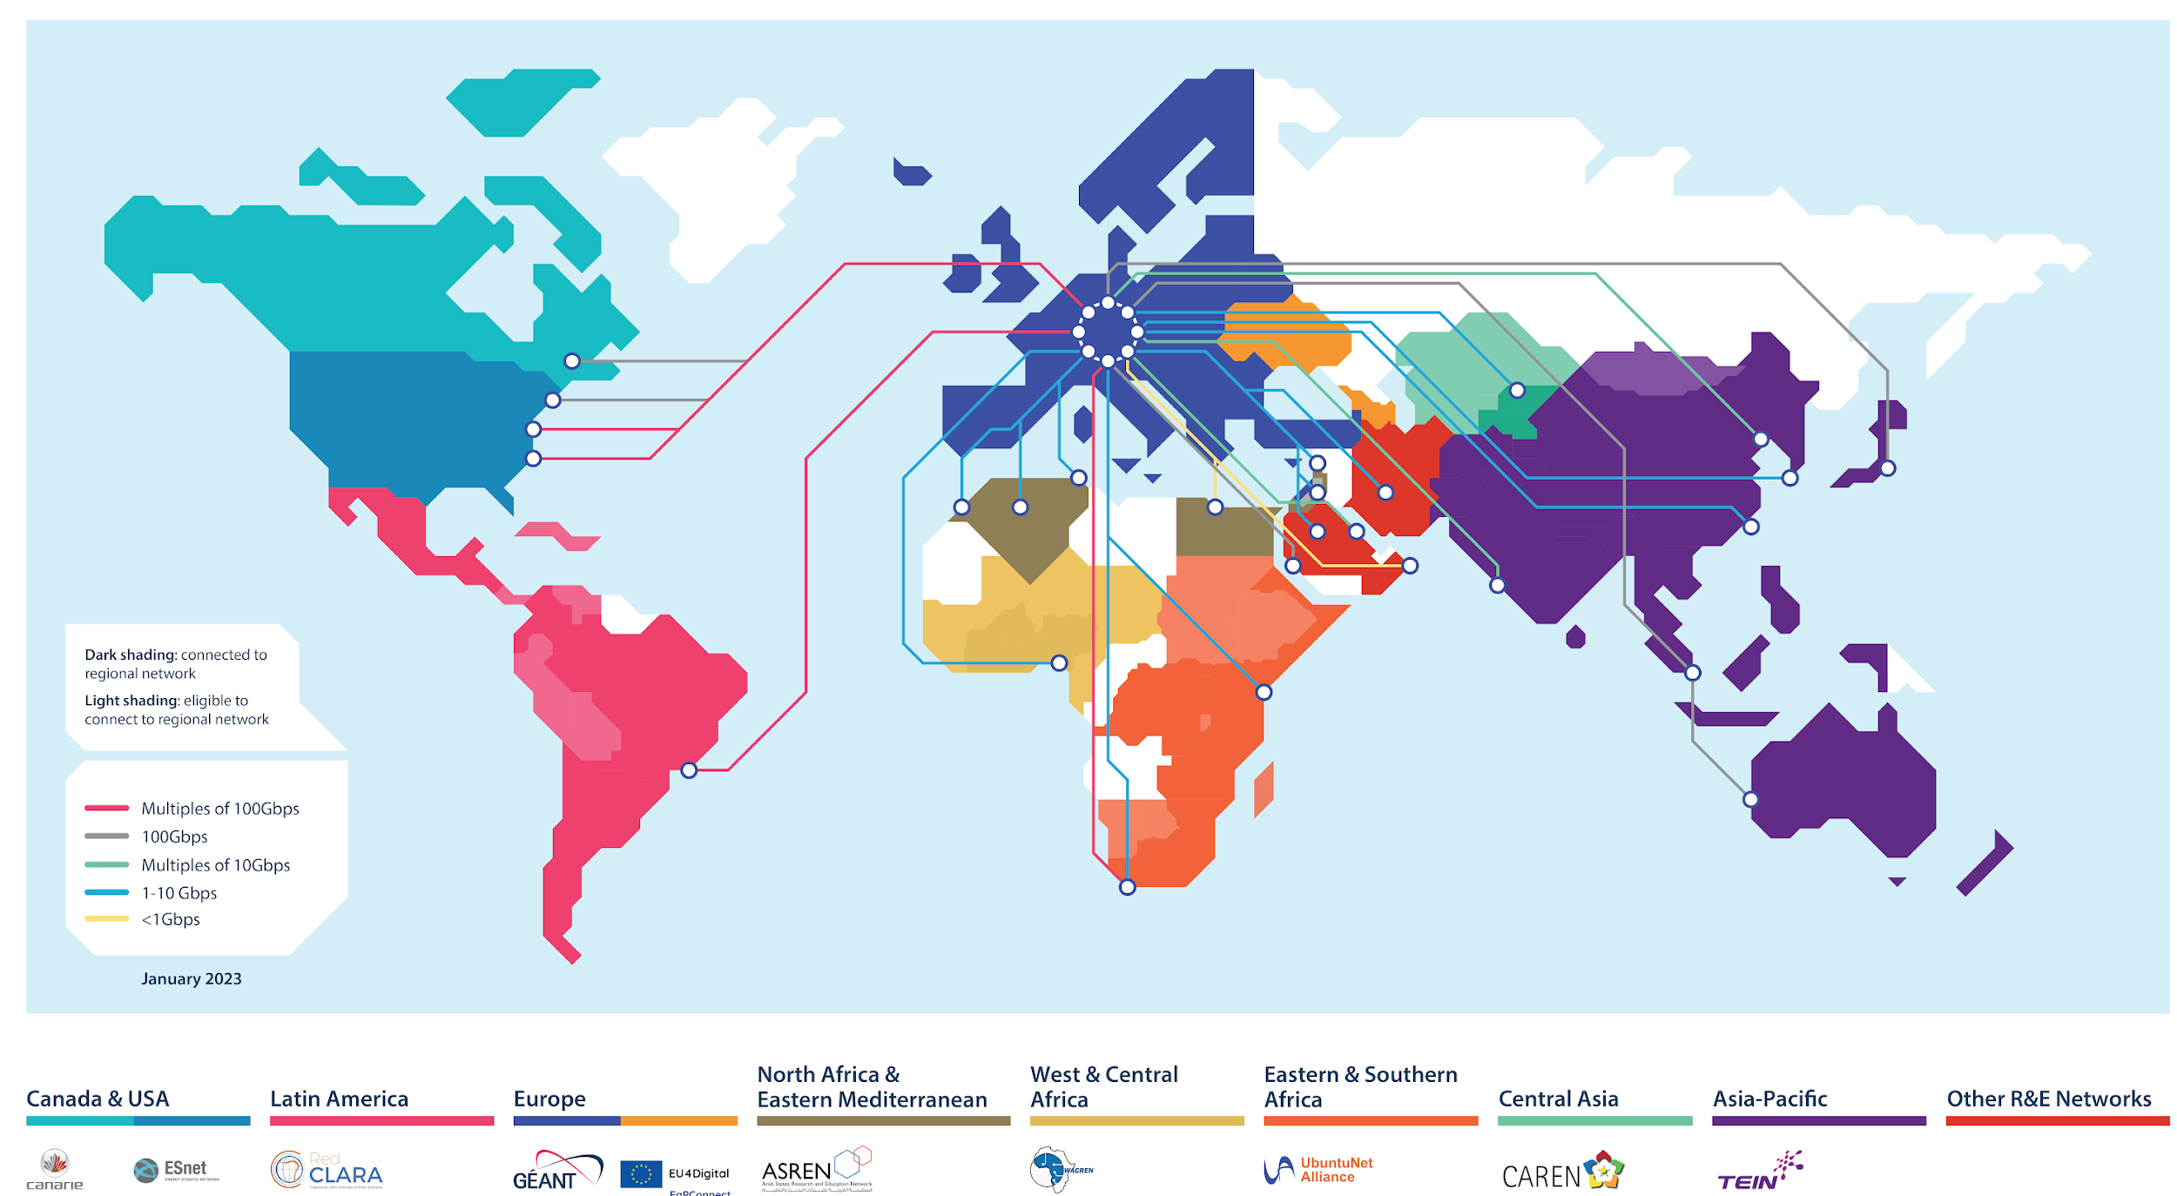

Notes:
NRENs in over 100 countries connected internationally
GÉANT connects to all regions, and via RRENs to countries in those regions.

Slide 6

VISION
Collaborate to deliver the infrastructures and services that enable the R&E community to excel
MISSION
To empower research and education with an open, innovative and trusted information ecosystem

Slide 7




GÉANT Services
Portfolio of in production services tailored to R&E
Network
Network Support
Security
Trust & Identity
Cloud & RTC
GÉANT IP
GÉANT Plus
10G Guaranteed Bandwidth
L3VPN
MD-VPN
Managed Wavelength
GÉANT Open
GWS
Commercial Peering
MS ExpressRoutes
Oracle FastConnect
perfSONAR
perfSONAR PMP
NMaaS
WifiMon (software)
GEANT Operations Centre
Software Tools e.g., BRIAN
Timemap
Argus
NSHaRP:
FoD
RTBH (Remote
Trigger to Black Hole)
DDoS C&A
eduVPN (software)
Trusted Introducer
TCS
eduroam:
Managed IdP
Managed SP
CAT
geteduroam
eduGAIN
eduTEAMS
InAcademia
Campus IdP Toolkit (software)
Filesender Demo
IaaS+ Framework
eduMEET (software)
Bold Type = Not in core package
Notes:
Please note that it is not possible to represent everything a member receives as part of their annual fees on just two slides
A complete list can be found in the Service Listing document that was shared with the General Assembly at the November 2022 meeting
This includes things like:
Procurement support e.g., the Dynamic Purchasing System and frameworks (OTE, Kentik, SDN-WAN Ethernet Switches…)
Training e.g., TRANSITS, eAcademy (OAV, CNaaS, Data Plane Programming etc), subject specific training
Support for Task Forces and Special Interest Groups etc

Slide 8
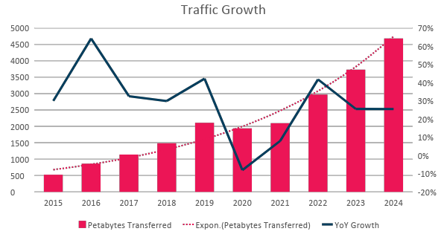
Traffic growth on GEANT Backbone
Long-term Backbone Traffic Growth
(on GÉANT network driven by scientific instruments)
Total: 2010 –2022 growth of over 30% YoY
2015–2019: Traffic growth of 40% YoY
2015–2022: Traffic growth of 27% YoY
10x in 10 Year
Petabytes
Total Backbone Trunk Capacity
February 2019 2.7 Tbps
Now 2022 9.4 Tbps
YoY change in traffic in %

Slide 9






















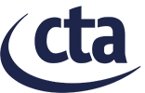
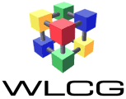

















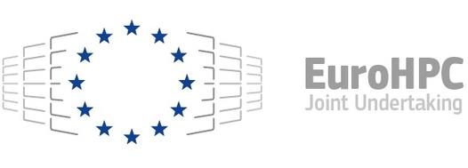




Research Engagement
Astronomy/Physics
Earth Observation
DOMA
eInfras
Life Science
Arts and
Outreach
Humanities
Notes:
Some of the communities we are supporting

Slide 10
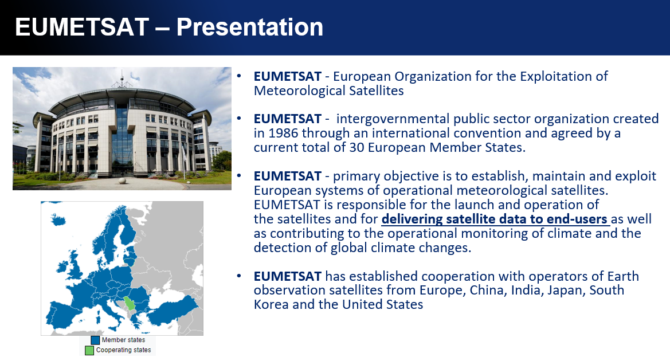

Slide 11
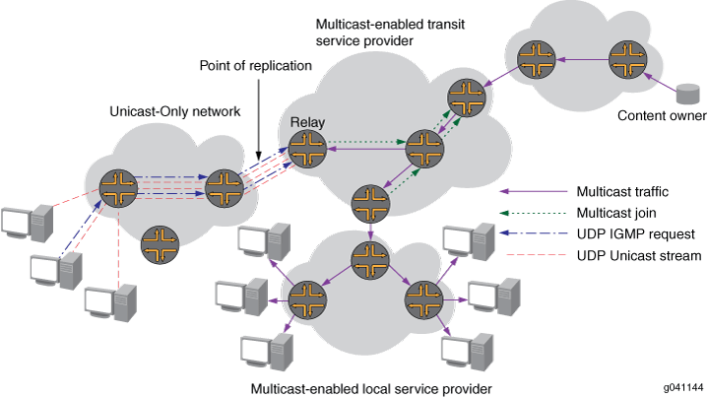
Automatic Multicast Tunnelling - Technology
Challenge: The internet is not multicast capable
Technology: Tunneling of multicast protocol over a unicast network using UDP encapsulation.
Purpose: Facilitates dynamic multicast connectivity between multicast-enabled networks across islands of unicast-only networks

Slide 12
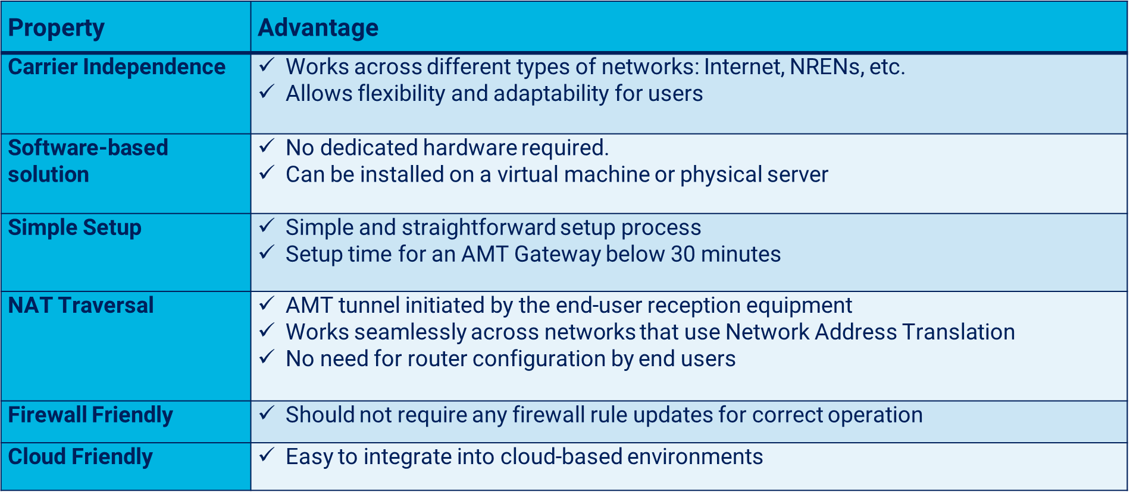
Automatic Multicast Tunnelling - Advantages

Slide 13
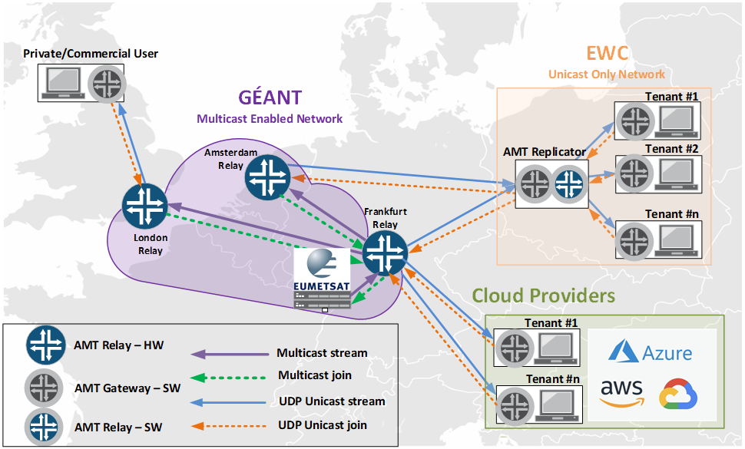
EUMETCast Terrestrial over AMT- Implementation

Slide 14
EUMETCast Terrestrial over AMT – Deployment
Simple and straightforward setup, with ansible scripts available for quick installation
Steps:
Registration: Users follow the standard EUMETCast Terrestrial registration process via EO Portal
Credentials: EUMETSAT Helpdesk provides TelliCast credentials once registration is finalised
Station setup: Users create a EUMETCast Terrestrial over AMT station using a pre-prepared ansible script
SW Installation: Software is installed and activated automatically allowing the user to start receiving data according to EO Portal subscription

Slide 15
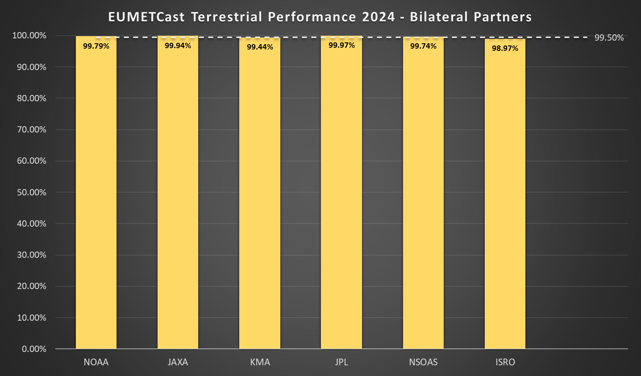
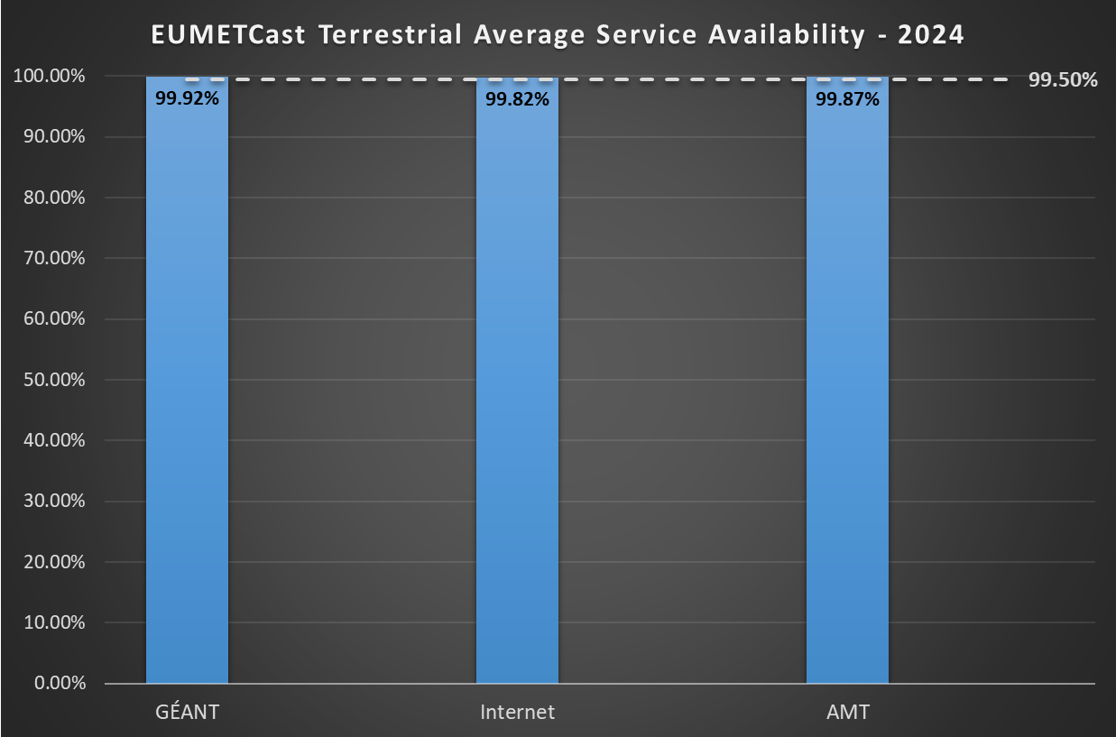
EUMETCast Terrestrial over AMT - Performance
Average file-based availability EUMETCast Terrestrial for Bilateral partners from January to April 2024 shows ~99.6% (dependent on user’s last mile connectivity)
Overall availability for users of the EUMETCast Terrestrial services from January to April 2024 (including GRE, AMT, Internet and native multicast services) is 99.87%, with files arriving at end-user Reception station shortly after they are made available in EUMETSAT.
EUMETCast Terrestrial + EFRS delivers a file-based availability of 100%!

Slide 16

Security Aspects
User access is strictly controlled to ensure that only authorised users have access to the data.
AMT implementation builds on top of EUMETCast Terrestrial security features, which uses authentication and encryption to ensure EUMETSAT’s data is securely transferred through non-secure networks
Security audit carried out on AMT software to ensure it meets security requirements in EUMETSAT and is available on our public repository - https://gitlab.eumetsat.int/open-source/amt
EUMETSAT remains vigilant in monitoring the security of the system and regularly implements updates to maintain the highest standards of protection

Slide 17

Q&A
mario.reale@geant.org
oriol.espanyol@eumetsat.int

