Slide 1
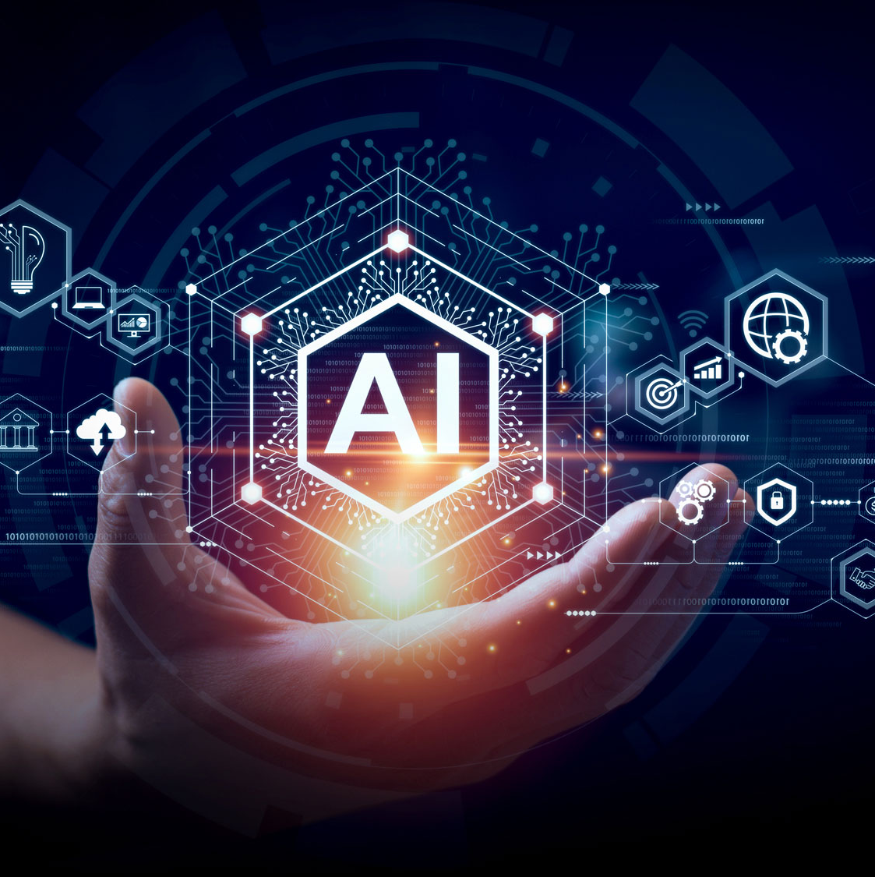
An investigation of student's and academic knowledge and use of artificial intelligence in Higher education institutions: A case study of selected universities in Namibia
Anna Leonard aleonard@unam.na; Senior Librarian, University of Namibia
Melba Mabuku m.mabuku@yahoo.com; Librarian: International University of Management
Daniel Mbangula dmbangula@unam.na; Lecturer, University of Namibia
Paper presented for the UbuntuNet-Connect2024 on Maximizing Technological Advancements in Research and Education on October 31-November 1, 2024 at Dar es Salaam, Tanzania

Slide 2
Presentation outline
Introduction and background of the study
Objectives of the study
Methods of data collection and analysis
Demographic data
Findings
Discussion and conclusion

Slide 3
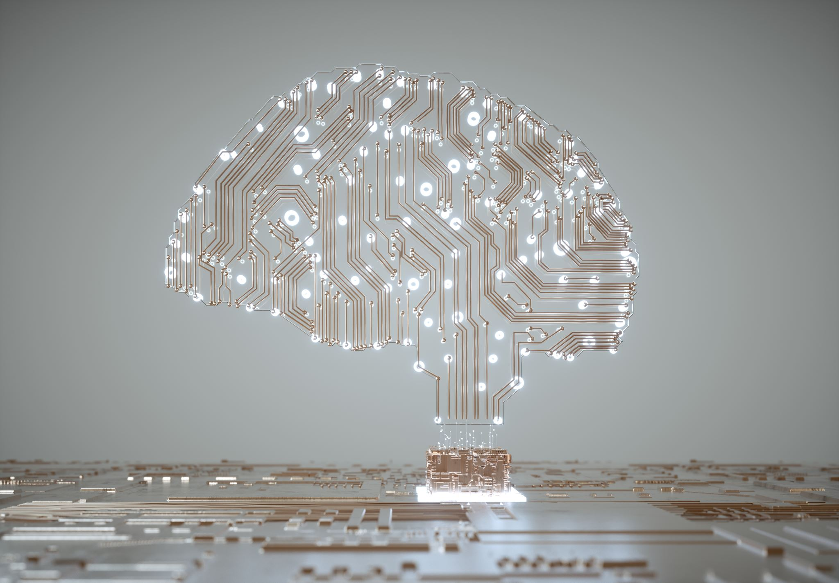
Introduction and background of the study
Undoubtedly, the swift progress of artificial intelligence (AI) is transforming many industries worldwide, and higher education is no exception.
The definition of AI is highly contested, and little consensus has been drawn across the range of fields in which the terminology is used.
Kaplan and Haenlein, (2019, p. 15) have defined AI as “a system’s ability to correctly interpret external data, to learn from such data, and to use those learnings to achieve specific goals and tasks through flexible adaptation.”
“smart” technologies are referred to as AI in the same vein as autonomous cars (Ghorayeb et al., 2021
Huang et al. (2019) and Lee et al. (2021) categorise AI into two categories: Weak and strong AI.
  weak AI could solve specific problems, such as evaluating a song’s performance on a music website.
  Strong AI is currently used in areas that demand high intelligence (e.g., self-driving cars;

Slide 4

Introduction and background continues
Besides the lack of universal agreements on the concept, AI agents are predicted to infiltrate most industries within the next decade, creating a personal, industrial, and social shift towards the new technology (Kelly, Kaye and Oviedo-Trespalacios, 2023).
As AI may benefit society through advances in industries such as transportation (Xia et al., 2020), mental health care (Doraiswamy et al., 2019), and education (Ramu et al., 2022)
Saidakhror (2024) has confirmed that AI has the potential to revolutionise the way universities deliver education.
Choi (2020) and Bisen et al. (2021) have claimed that artificial intelligence is still essential to improving the caliber of higher education in several ways, including grading assignments, monitoring attendance, and giving students feedback.
Grájeda et al. (2024) found that AI tools significantly enhance students' academic experiences, improving comprehension, creativity, and productivity and aiding in institutional diagnostics tools for identifying areas with high and low AI integration.

Slide 5
Introduction and background continue
Cabrera-Sanchez et al. (2021) stated that AI can pioneer discoveries in general, scientific, academic, creative, and social fields, potentially leading to human redundancy.
However, Karan and Angadi (2023) identified six (6) potential risks privacy and autonomy risks, AI biases, accuracy and functional risks, deepfakes and fate risks, social knowledge and skill-building risks, and risks in shifting teacher's role) in the use of AI in teaching, learning and research activities.
Mathew and Mweenakumari (2023) observed unfair evaluation of student reliability, accuracy, and potential ethical implications.
Various factors such as the perceptions of students and lecturers towards artificial intelligence, availability and access to technological devices and AI tools and institutional readiness to integrate AI in education (Kim, et al., 2020, Jebreen, et al., 2024).
Understanding students and lecturers applications of artificial intelligence in teaching and learning and their perceptions towards integration of artificial intelligence in public universities in Namibia in critical, considering the uniqueness of Namibian educational systems, technological, economic situation and cultural context.

Slide 6

Objectives of the study
To establish the extent to which students and lecturers in Namibian higher education institutions are aware and apply AI technologies for teaching, learning and research activities.
To discover students and lecturers’ perceptions regarding the significance and relevance of AI technologies in Namibian education.
To explore the perceived benefits of using AI tools in teaching and learning activities at Namibian higher education institutions.
To identify the possible challenges of integrating AI technologies in teaching, leaning and research activities in Namibian higher education institutions.

Slide 7
Methods of data collection and analysis
The study adopted a quantitative survey design, using an online questionnaire among students from the three largest universities in Namibia: the University of Namibia, the Namibia University of Science and Technology, and the International University of Management.
The study used random sampling to select 200 students. Of these, 174 responded to the survey, reflecting a 70% response rate. RedCAP was used to administer the survey.
Convenience sampling was used to select ten lecturers who participated in interviews.
The study applied descriptive analysis of quantitative data and presented using tables, charts.

Slide 8
Demographic data

Slide 9
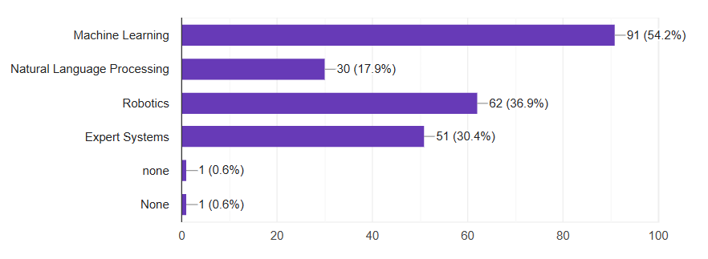
Findings

Slide 10
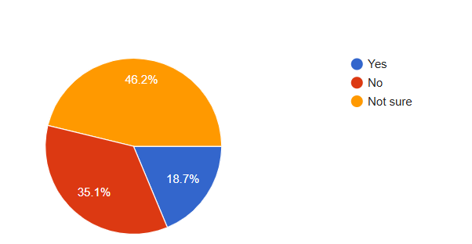
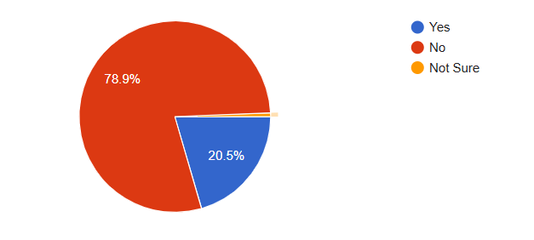
Course on AI
Universities’ provision of AI tools

Slide 11
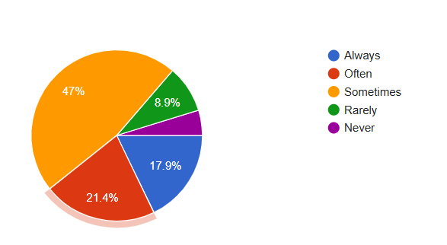
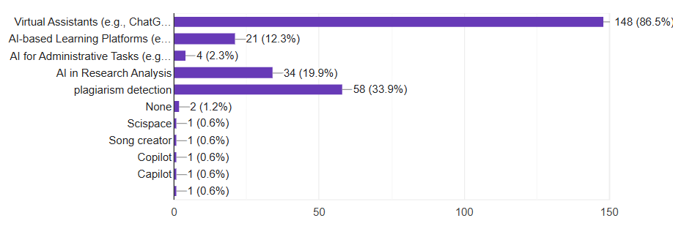
Use of AI
Have you used AI

Slide 12
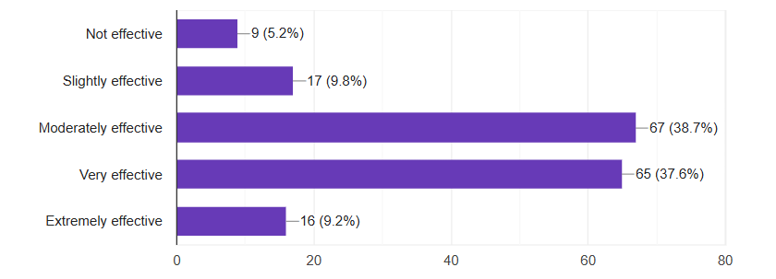
Purposes and effectiveness of AI

Slide 13
Level of knowledge and perception of AI
level of knowledge of AI
 | SD | D | N | A | SA
Have limitations in their ability to handle complex tasks | 16 | 17 | 23 | 67 | 51
Can generate factually inaccurate output | 9 | 23 | 40 | 70 | 32
Can exhibit biases and unfairness in their output. | 14 | 32 | 54 | 49 | 25
Rely too heavily on statistics, which can limit their usefulness | 14 | 39 | 54 | 43 | 24
Have limited emotional intelligence and empathy, which can lead to output that is insensitive or inappropriate | 12 | 25 | 48 | 71 | 18
perception towards the use of AI
 | SD | D | N | A | SA
AI will replace face to face teaching | 36 | 42 | 35 | 48 | 14
traditional assessment will become obsulute | 16 | 42 | 32 | 67 | 17
AI will write students assays as much as a human can | 5 | 16 | 23 | 75 | 55
improve teaching and learning | 7 | 19 | 32 | 77 | 36

Slide 14
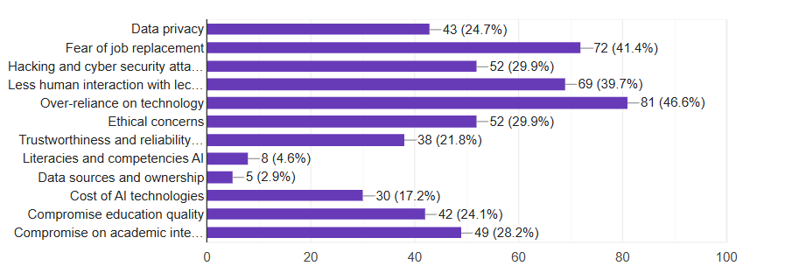
General concerns about integrating AI in teaching and learning

Slide 15
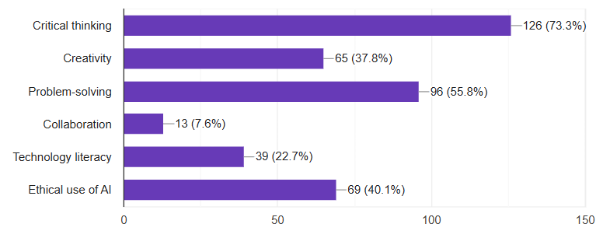
Competencies for effective use of AI
“AI can tailor educational experiences in individual students needs, which will help the students understand more than what the lecturers explained in class”
“I think AI should be taught as a subject at universities; we need to be part of its development and not just end users.”
“Students are becoming dependent on AI, and lecturers with big classes find it difficult to detect AI-generated content”
“There should be policies to aid the integration of AI in different spheres of education. The university should provide AI technological infrastructure and courses on AI”

Slide 16
More Verbatim Quotes from participants
“AI can be integrated for language translations and accessibility; students can be training AI to translate in local Indigenous languages” P5
“Students' use of AI tools must be limited, as it might result in them graduating without the required knowledge”P8.
“poor connectivity and accessibility to devices prevent effective use of AI” P4
“AI has the potential to improve education access and equity, but the benefits must be distributed fairly, and disadvantaged students have the necessary resources to take advantage of AI tools”.
“AI continues to evolve, it can offer more interactive and immersive learning experiences through augmented and virtual reality, allowing students to explore complex concepts.”

Slide 17
Discussion and conclusion
While there is a growing awareness of AI among students and lecturers, the depth of understanding and practical application vary significantly.
Many participants recognise the potential of AI to enhance educational practices and streamline administrative processes, yet a notable number still lack comprehensive training on its practical use.
The findings also indicate that institutional support is critical in fostering an environment conducive to AI integration. Therefore, universities must actively promote AI literacy through training sessions.
Moreover, challenges such as limited access to technology, insufficient infrastructure, and concerns about ethical implications were highlighted.
These barriers must be addressed to fully leverage AI's benefits in education.
In conclusion, for AI to be effectively utilised in higher education in Namibia, a concerted effort is required from all stakeholders. This includes developing targeted training programs, improving technological infrastructure, and fostering an open dialogue about the ethical dimensions of AI. By doing so, universities can empower students and academics to harness the transformative potential of AI, ultimately enhancing educational outcomes and preparing graduates for a rapidly evolving job market.

Slide 18

THANK YOU

