Slide 1







Technologies for Intelligent pollinator and Fruit Fly Monitoring
by
Mary Nsabagwa, Makerere University
Julianne Sansa-Otim, Makerere University
Agatha Turyagyenda, Makerere University
Florence Lello, The Nelson Mandela African Institution of Science and Technology
Ephrance Namugenyi, Makerere University
Khemis Ben Samuel, Makerere University & University of Juba
Safari Yonasi, Makerere University

Slide 2
Contributors
Mary Nsabagwa, Makerere University
Julianne Sansa-Otim, Makerere University
Agatha Turyagyenda, Makerere University
Florence Lello, The Nelson Mandela African Institution of Science and Technology
Ephrance Namugenyi, Makerere University
Khemis Ben Samuel, Makerere University & University of Juba
Safari Yonasi, Makerere University

Slide 3


Background on Pollinators
Pollination is vital in
  Food production and the general plant ecosystem
  Improves the quality and quantity of crops, especially fruits
Bees, contribute 1/3 of the total human dietary supply
Without pollinators, we would face
  flowering plant species would produce no seeds

Slide 4
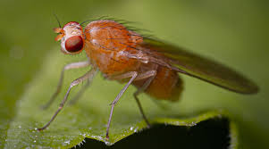
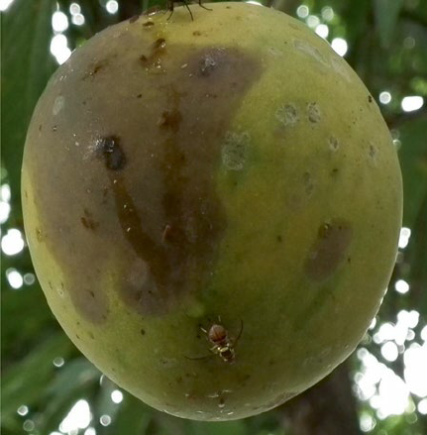
Background of Fruit Flies
Climate change has caused increase in the number of fruit flies
Fruit flies
  lay eggs under the skin of the fruit
  Hatching into larvae that feed on the fruits
They cause
  Disruption of trade
  Trigger huge financial losses
Need for intelligent real time monitoring of fruit flies
  To establish the dynamics
  For timely implementation of appropriate control measures

Slide 5
Background: The problem
Pollinator loss was estimated at $138.3 billion due to stressors eg.
  climate change, agricultural intensifications, urbanization, pesticide use, management practices,
Crop sector losses were estimated to be $10.5 billion
The total economy-wide losses to be $334.1 billion
Understanding the bees population trends helps in designing conservation measures to protect them, and hence, improve food production

Slide 6
Considerations for fruit fly and Bee monitoring
A Smart IoT Honeybee monitoring in Low Resource Settings
Intelligent Fruit Fly counting for Low Resource settings
Drones for data collection in remote areas
Adaptive network considerations for bee data systems

Slide 7
THANK YOU

