Slide 1
Will we still be doing eduroam in ten years?
Donald Coetzee
Guy Halse

Slide 2



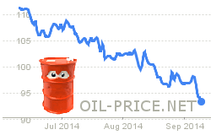
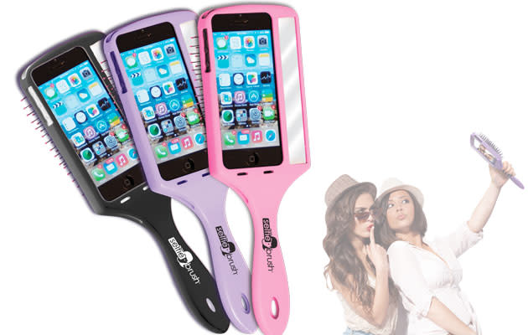

Let’s go back to 2014…
https://www.planeandpilotmag.com/
https://www.marvel.com/movies/guardians-of-the-galaxy
https://www.paramountpictures.com/movies/interstellar
https://www.engadget.com/

Slide 3
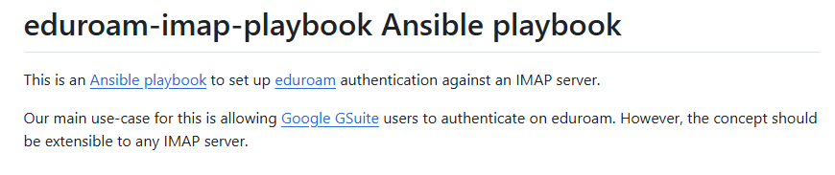
But how were we doing eduroam in 2014?
2 years after South Africa started doing eduroam
Promoting and assisting institutions with on-prem RADIUS
Hacky solutions to try solve problems

Slide 4
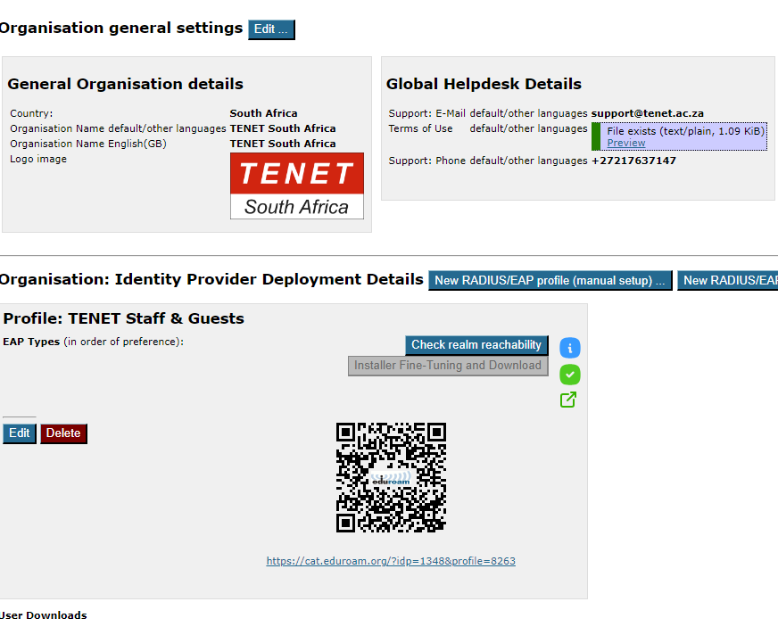
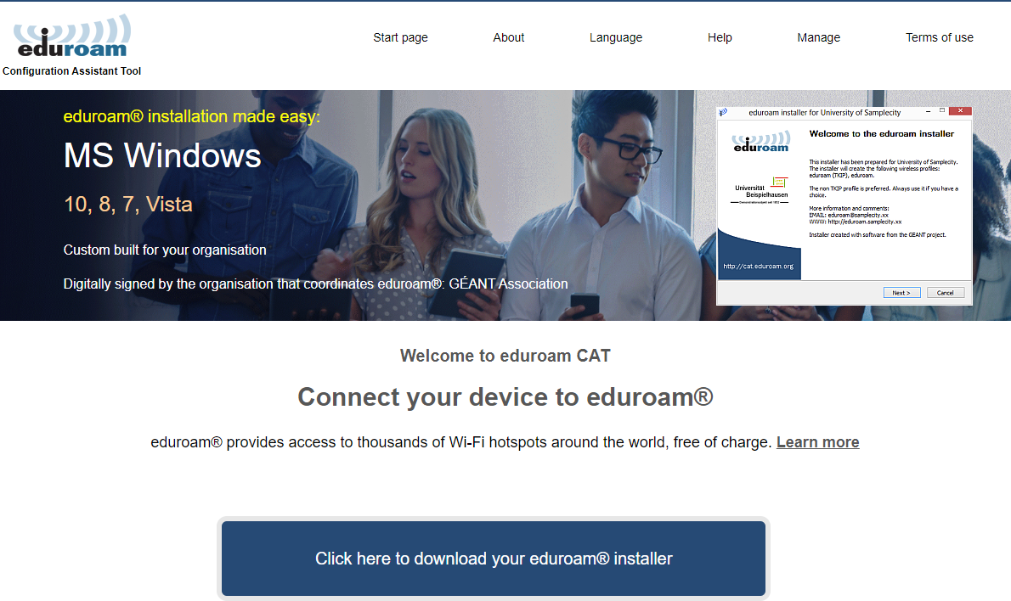
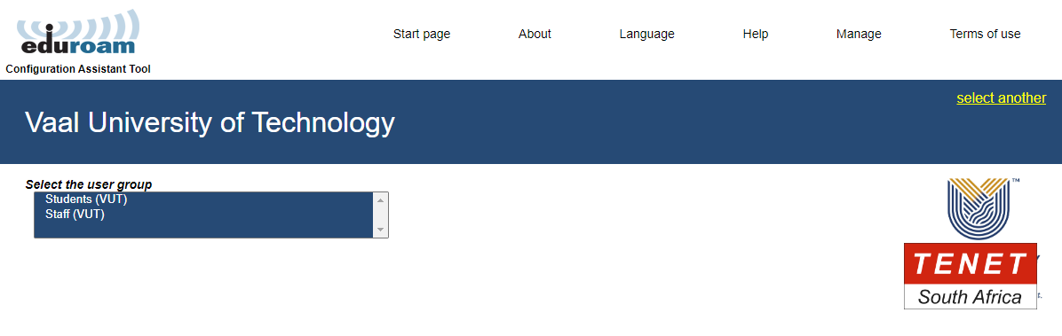
eduroam CAT
https://cat.eduroam.org/
Configuration Assistant tool
Connection profiles

Slide 5
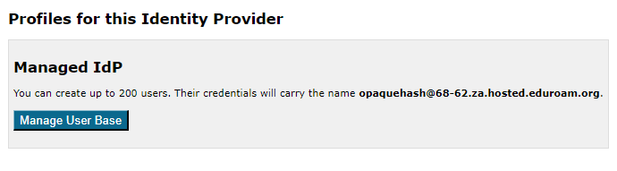
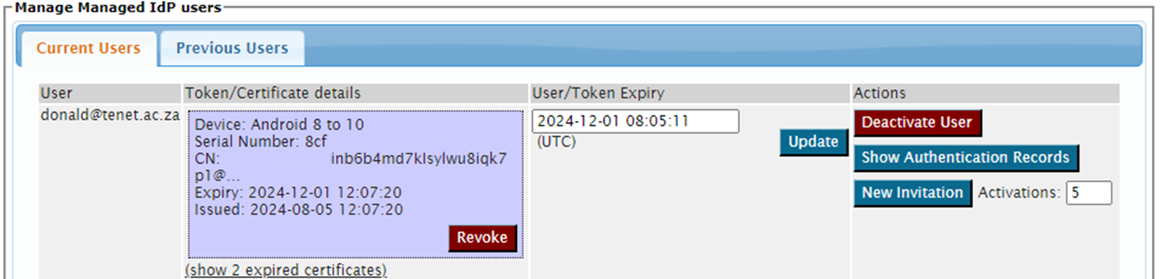
Managed IdP
https://hosted.eduroam.org/
Certificate based tokens
Geared for smaller entities
Minimises on-prem infrastructure
Does it scale?

Slide 6
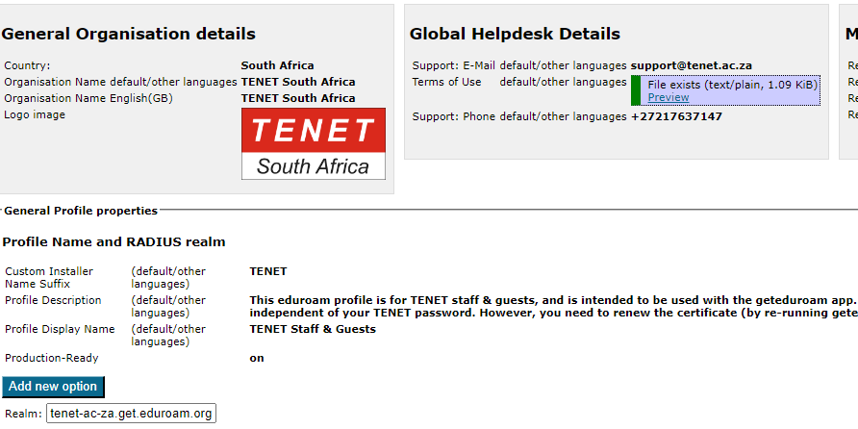
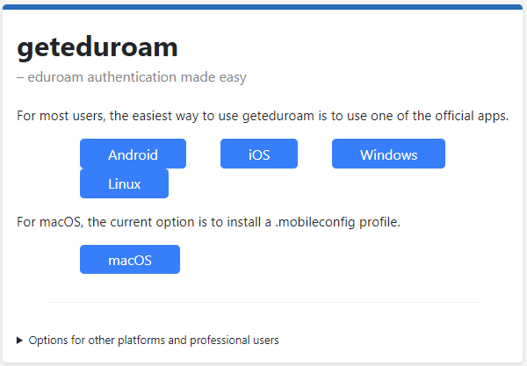
geteduroam
https://www.geteduroam.app/
Scales really well
Commons Conservancy[1]
https://get.eduroam.org
[1] https://commonsconservancy.org/programmes/geteduroam/

Slide 7
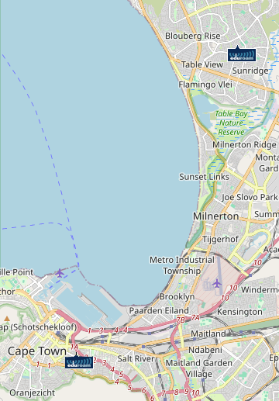

Managed Service Provider
https://msp-pilot.eduroam.org/
“Pilot” you say??
Also helps smaller entities
Minimises on-prem infrastructure

Slide 8
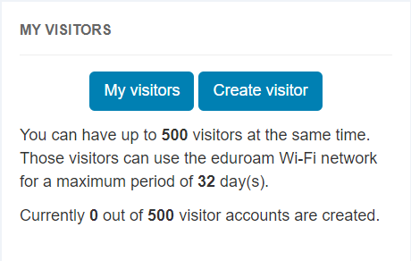
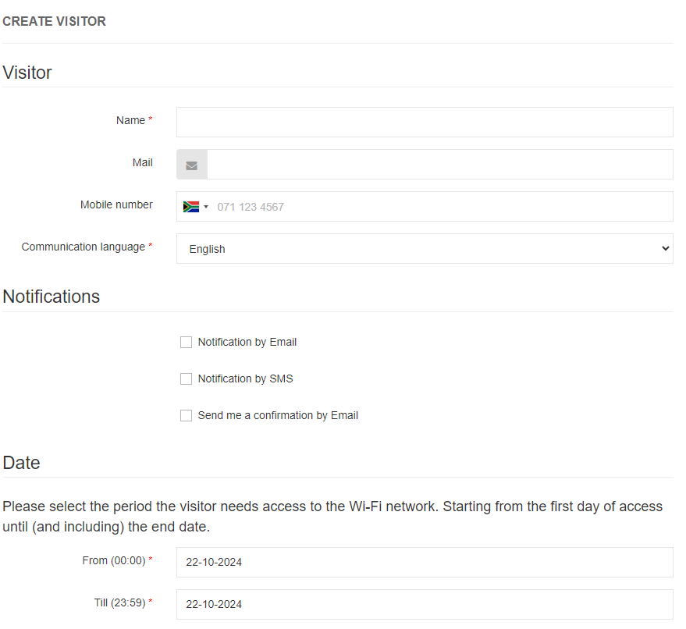

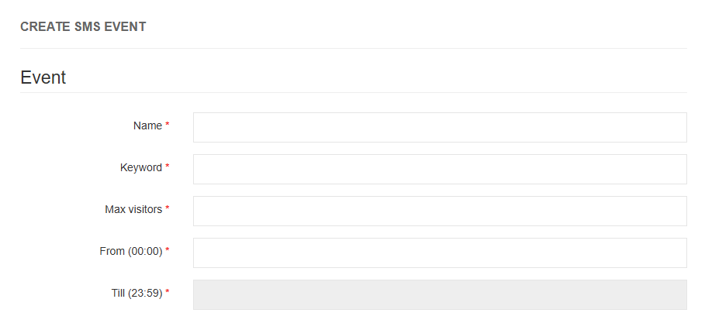
eduroam Visitor Access (eVA)
https://eva.eduroam.ac.za (for e.g.)
Visitor access
Not open source but licenced
Contribute towards it

Slide 9

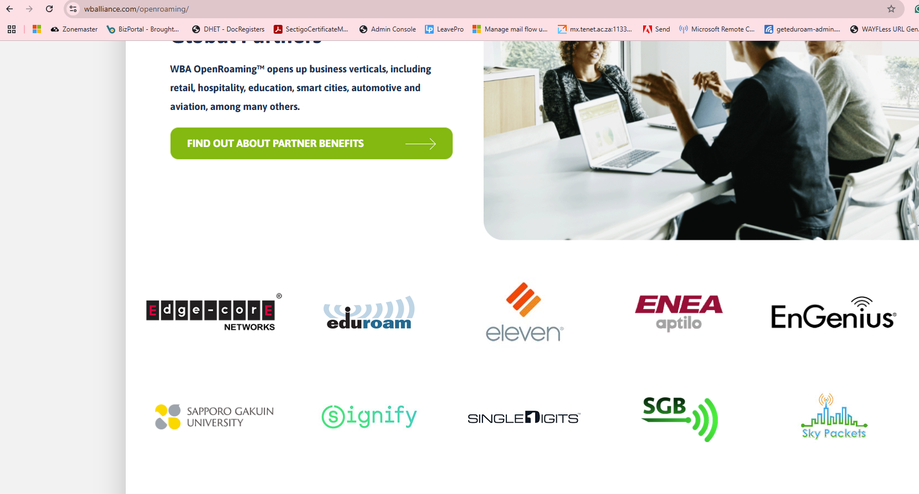



OpenRoaming
https://wballiance.com/openroaming
OpenRoaming and eduroam
https://eduroam.org/eduroam-openroaming-end-user-information/
Be aware of it, pay attention to it, be ready for it
https://www.android.com/
https://www.samsung.com/
https://www.apple.com/

Slide 10
Will we still be doing eduroam in ten years?
Not if we continue to build and do things like we did in 2014

Slide 11
Questions

